Slide 1
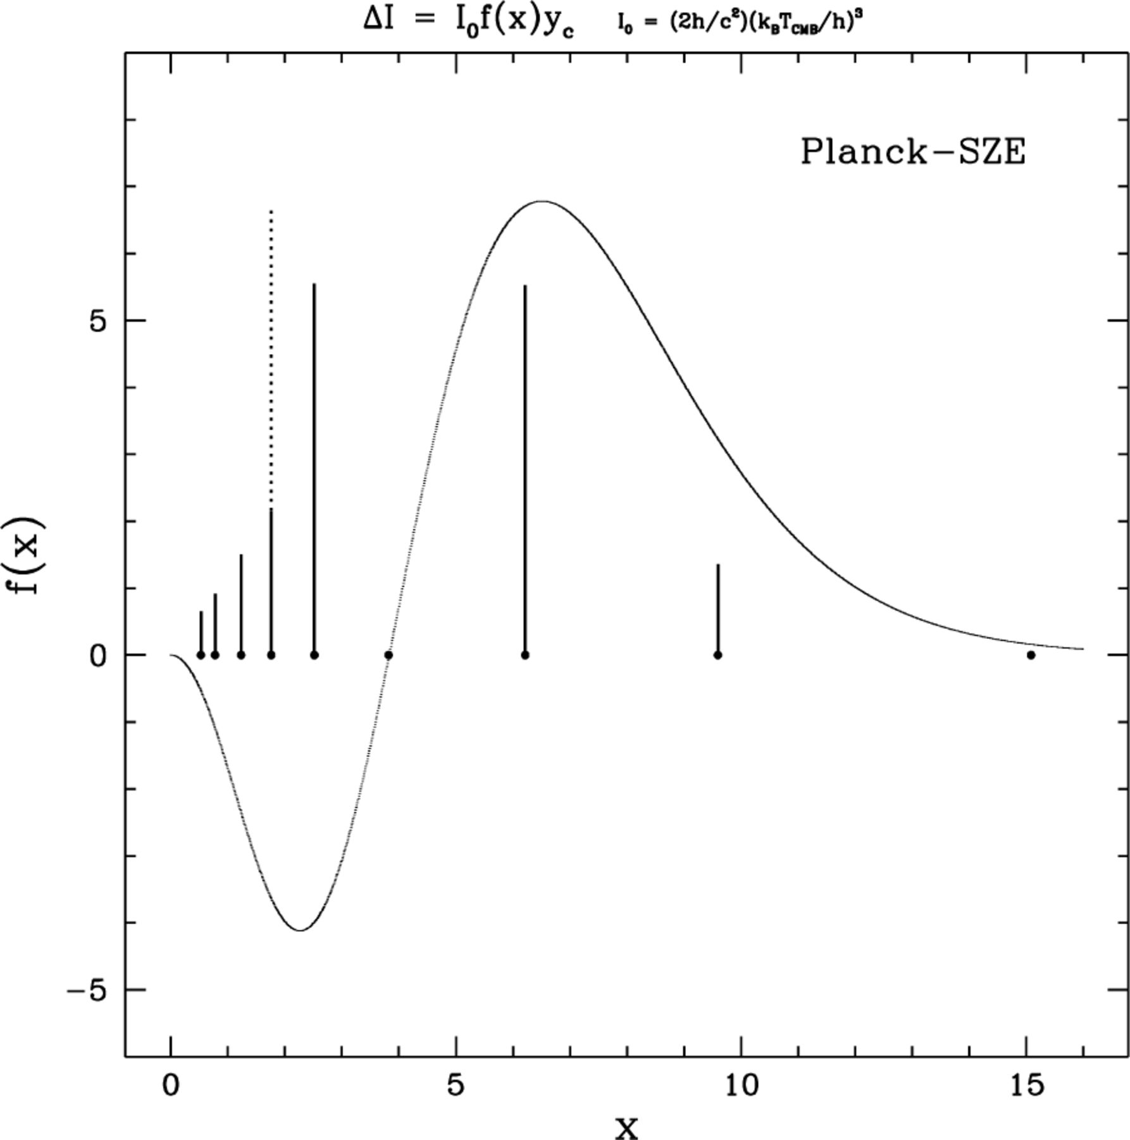
Figure 1. Spectral shape of the thermal SZE. Planck channels (vertical lines) are between 30 and 800 GHz, also ...
Notes:
Figure 1. Spectral shape of the thermal SZE. Planck channels (vertical lines) are between 30 and 800 GHz, also including the 217-GHz channel where the thermal SZE vanishes. The amplitudes of the lines are proportional to the signal-to-noise ratio expected for the SZE in that channel. The S/N ratio depends on the spectral shape factor f(x) since the signal is proportional to f(x) (see equation 5 below) and the noise is proportional to the sensitivity per resolution element (σ); S/N=∝ f(x)/σ. The best channels to detect the SZE decrement/increment will be those of the HFI instrument at 100 GHz (x=1.7), 143 GHz (x=2.5) and 353 GHz (x=6.2), respectively, together with that at 217 GHz (x=3.8). At 100 GHz (x=1.7) there are two channels: the LFI (solid line) and the HFI (dotted line).
Unless provided in the caption above, the following copyright applies to the content of this slide: © 2002 RAS

Slide 2
Table 1. Best LCDM (flat) and OCDM (Λ = 0) models. Both models are indistinguishable in the redshift regime of the ...
Notes:
Table 1. Best LCDM (flat) and OCDM (Λ = 0) models. Both models are indistinguishable in the redshift regime of the data considered in Diego et al. (2001a).
Unless provided in the caption above, the following copyright applies to the content of this slide: © 2002 RAS

Slide 3
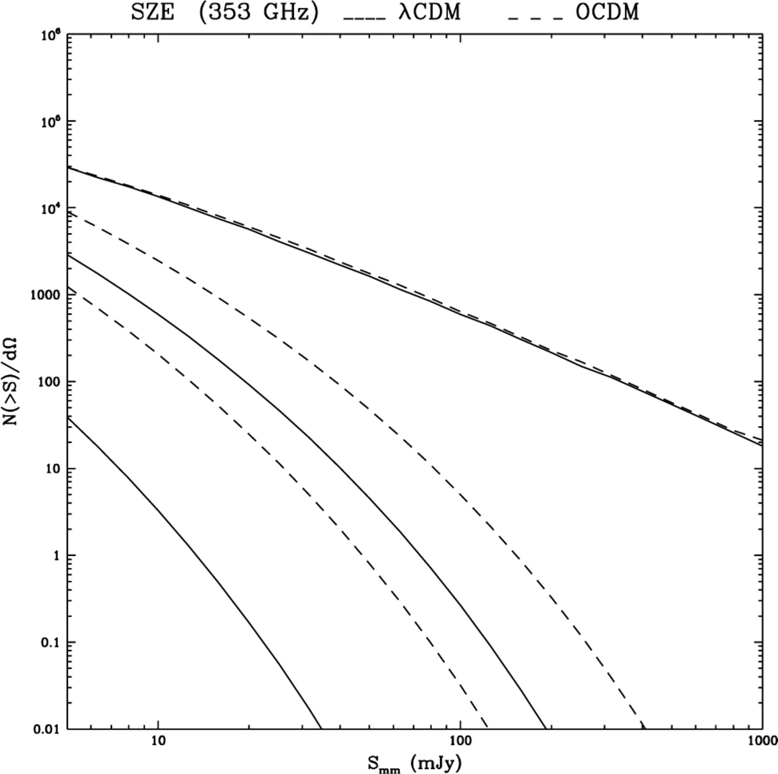
Figure 2. The SZE integrated number counts of the cluster population predicted at millimetre wavelengths (353 GHz) for ...
Notes:
Figure 2. The SZE integrated number counts of the cluster population predicted at millimetre wavelengths (353 GHz) for the best flat (solid) and open (dotted) models in Table 1. In the plot three redshift shells are represented: top z>1, middle z∈[1,2] and bottom z<2.
Unless provided in the caption above, the following copyright applies to the content of this slide: © 2002 RAS

Slide 4
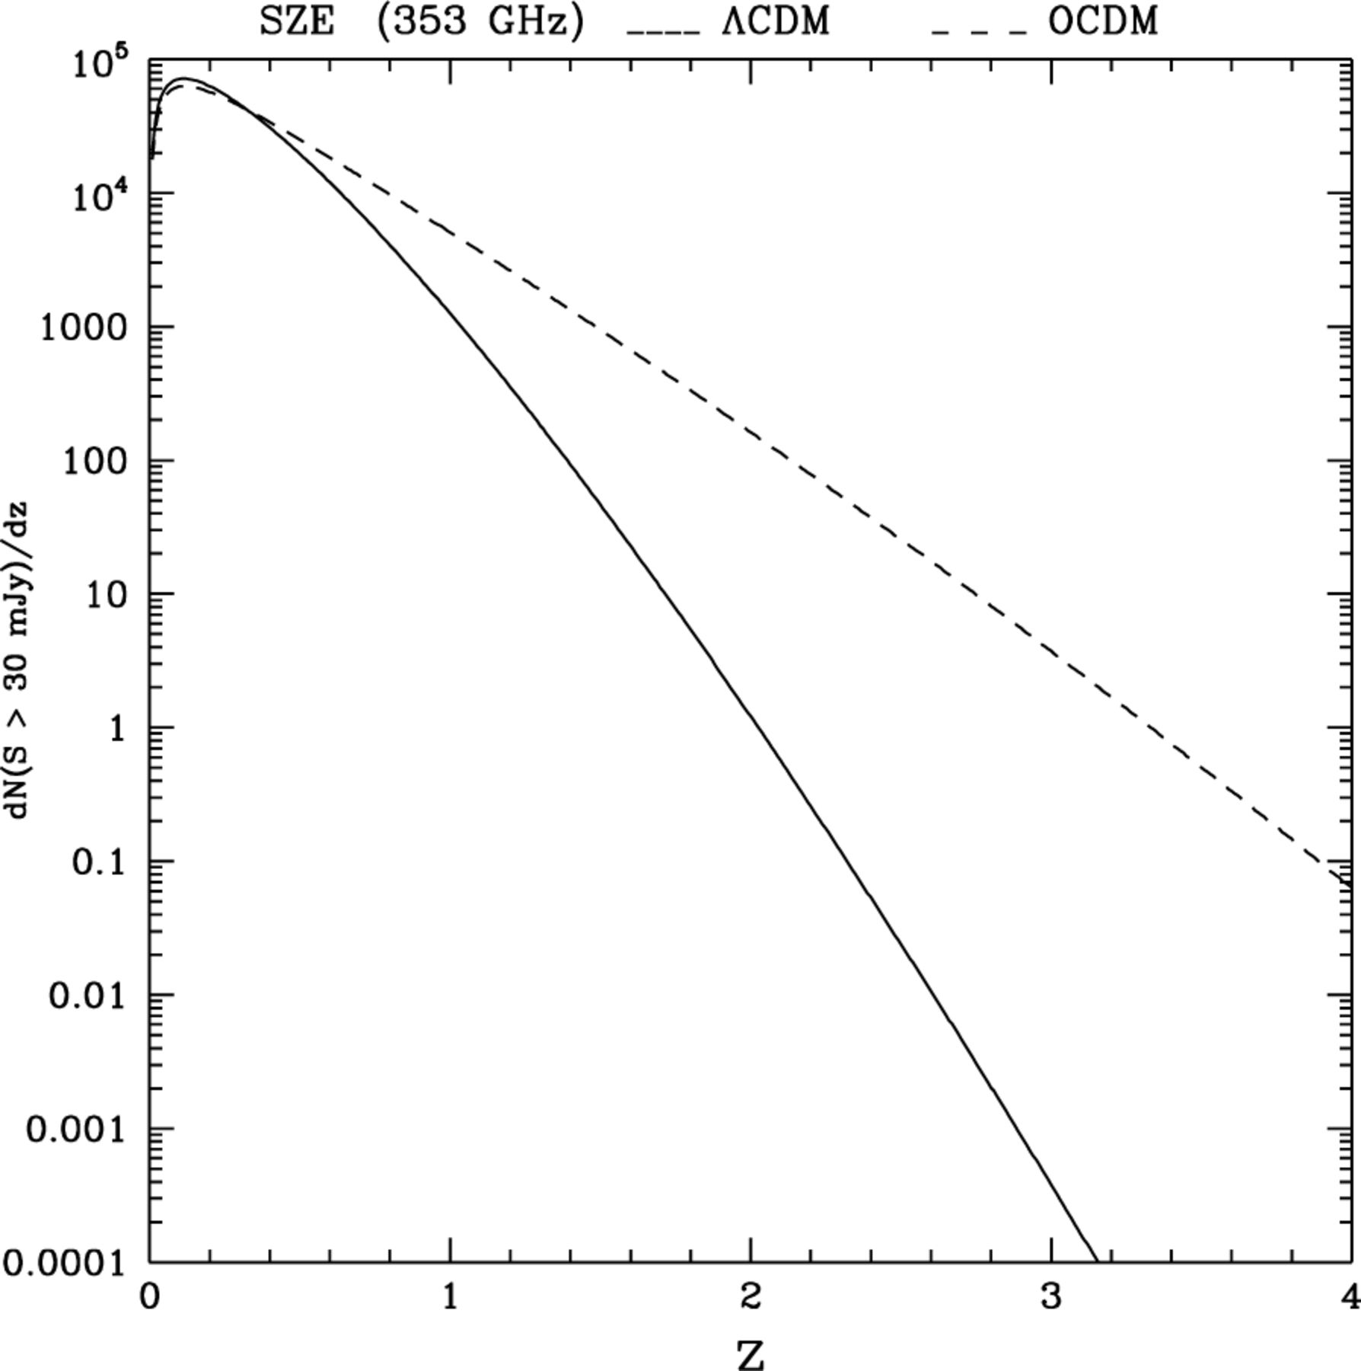
Figure 3. The SZE differential number counts of the cluster population predicted for the Planck mission at millimetre ...
Notes:
Figure 3. The SZE differential number counts of the cluster population predicted for the Planck mission at millimetre wavelengths (353 GHz) for the best flat (solid) and open (dotted) models in Table 1 as a function of redshift.
Unless provided in the caption above, the following copyright applies to the content of this slide: © 2002 RAS

Slide 5
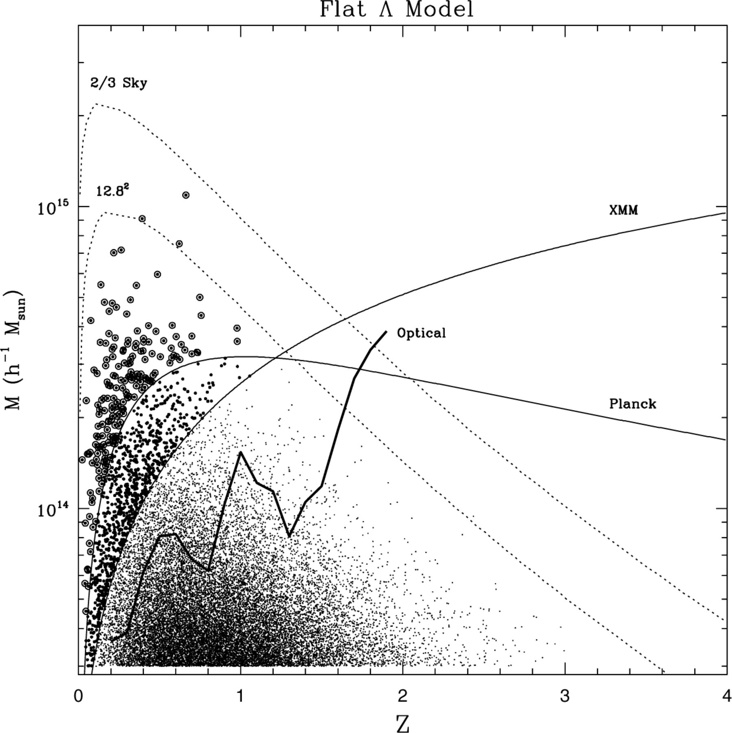
Figure 4. ΛCDM model. Each cluster is represented as a dot in this plot. Clusters marked with a big black dot have ...
Notes:
Figure 4. ΛCDM model. Each cluster is represented as a dot in this plot. Clusters marked with a big black dot have fluxes (in the 0.5–2 keV band) above the limiting flux SX=1.4×10−14 erg s−1 cm−2 and they are the clusters expected to be detected by Newton–XMM in the XCS (Fixsen et al. 1996). Cluster marked with an open circle are those with a SZE flux above 30 mJy at 353 GHz and they are the clusters expected to be detected by Planck. Solid lines represent the masses for which the flux equals the limiting flux of Planck (30 mJy), and the XCS. Dotted lines show the maximum cluster mass expected in a solid angle equal to 2/3 of the sky (top) and (12.8°)2 (bottom). Finally, the heavy solid line indicates the selection function for a hypothetical optical survey made with a 10-m class telescope and 2 h of observation (eight bands and 900 s per band, see Section 4.1).
Unless provided in the caption above, the following copyright applies to the content of this slide: © 2002 RAS

Slide 6
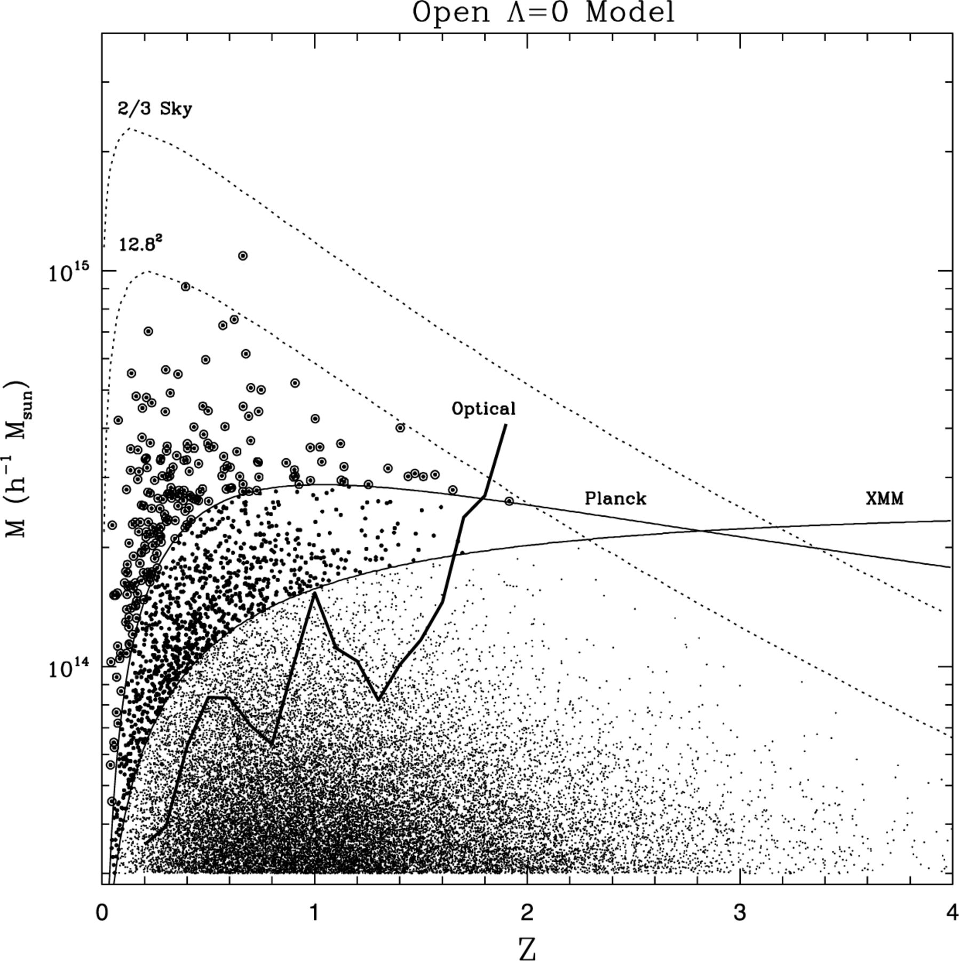
Figure 5. OCDM case. Note the differences in the cluster distribution above the coasting phase redshift ...
Notes:
Figure 5. OCDM case. Note the differences in the cluster distribution above the coasting phase redshift zc≈0.7 (see text).
Unless provided in the caption above, the following copyright applies to the content of this slide: © 2002 RAS

Slide 7
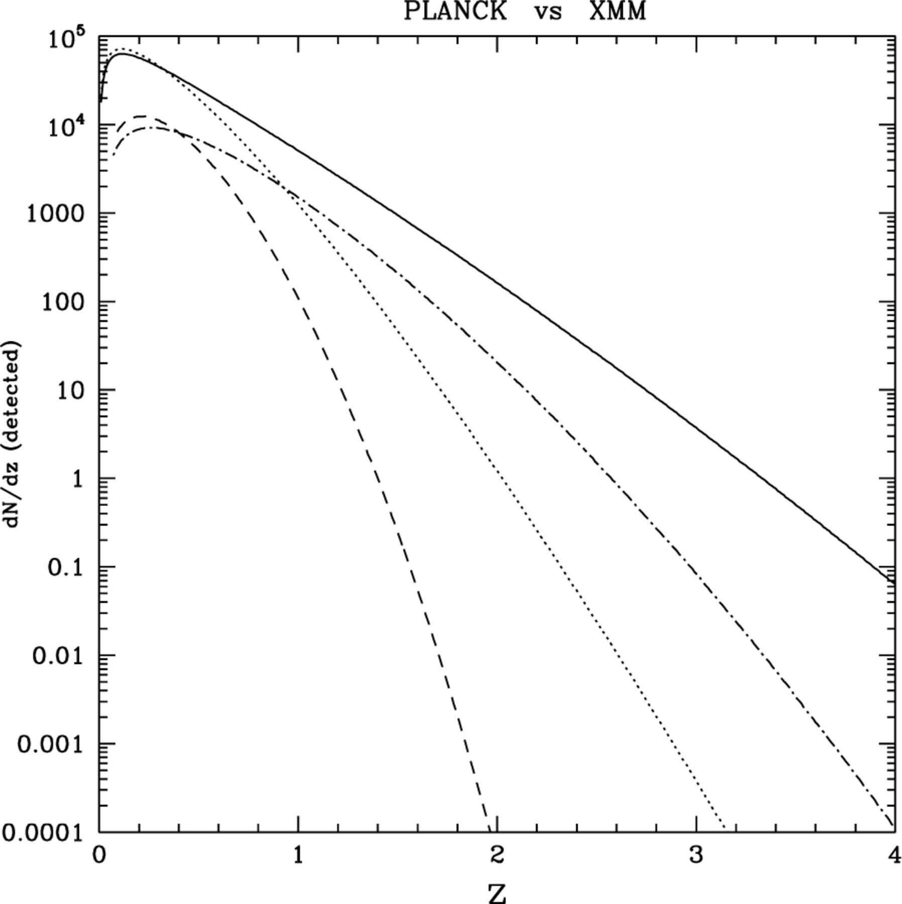
Figure 6. Expectations for Planck (solid line OCDM, dotted line ΛCDM) and the XCS (dot-dashed line OCDM, dashed line ...
Notes:
Figure 6. Expectations for Planck (solid line OCDM, dotted line ΛCDM) and the XCS (dot-dashed line OCDM, dashed line ΛCDM).
Unless provided in the caption above, the following copyright applies to the content of this slide: © 2002 RAS

Slide 8
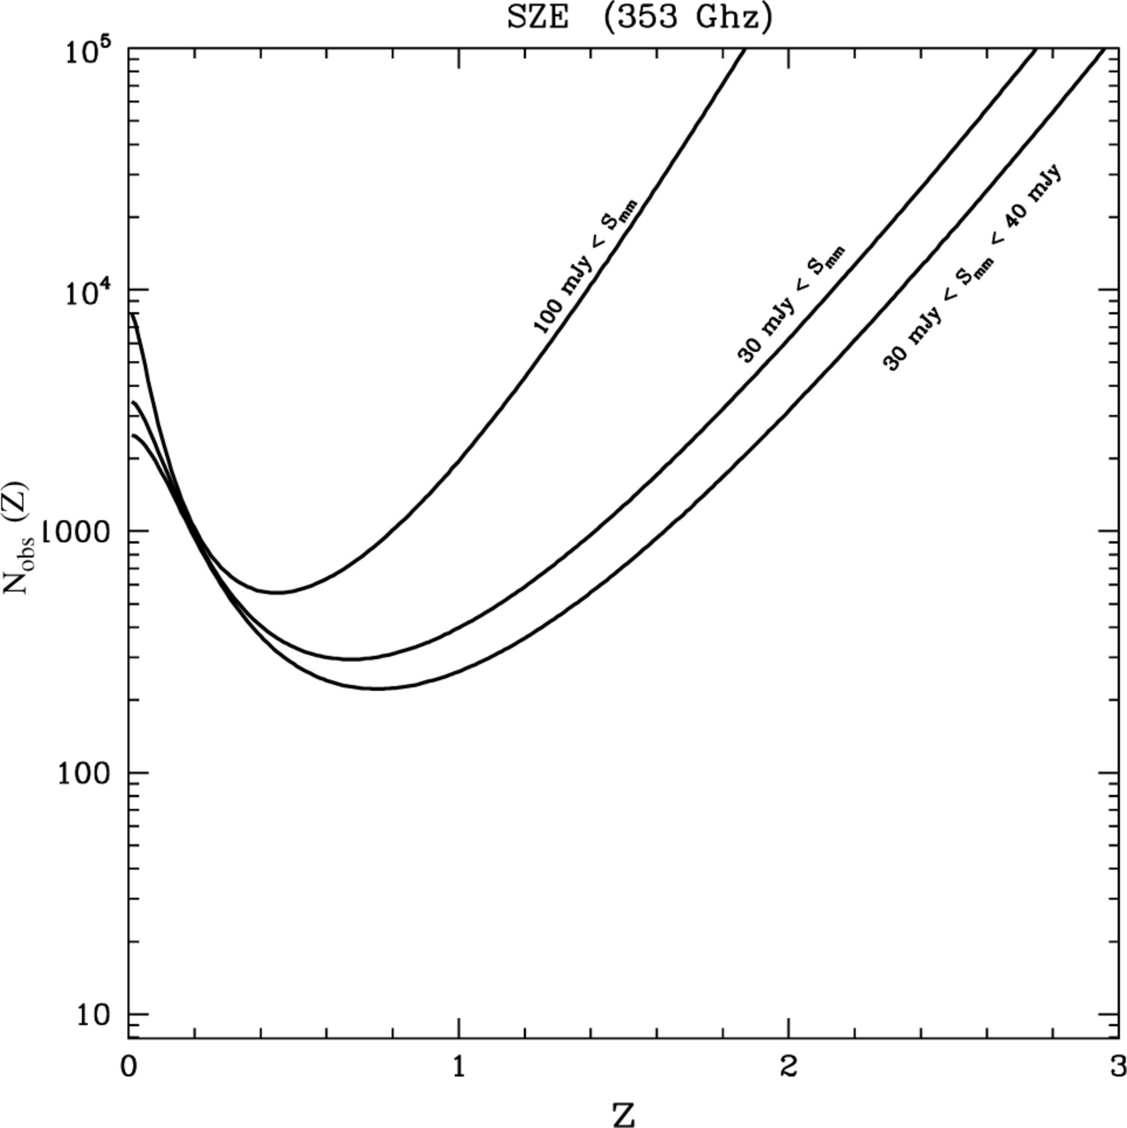
Figure 7. Required number of clusters for which we should determine the redshift in order to distinguish the OCDM and ...
Notes:
Figure 7. Required number of clusters for which we should determine the redshift in order to distinguish the OCDM and ΛCDM models in Table 1. By determining the redshift of ≈300 clusters randomly selected from the Planck catalogue we could distinguish both models. The differences would show up in the small subsample of clusters having z<0.6.
Unless provided in the caption above, the following copyright applies to the content of this slide: © 2002 RAS

Slide 9
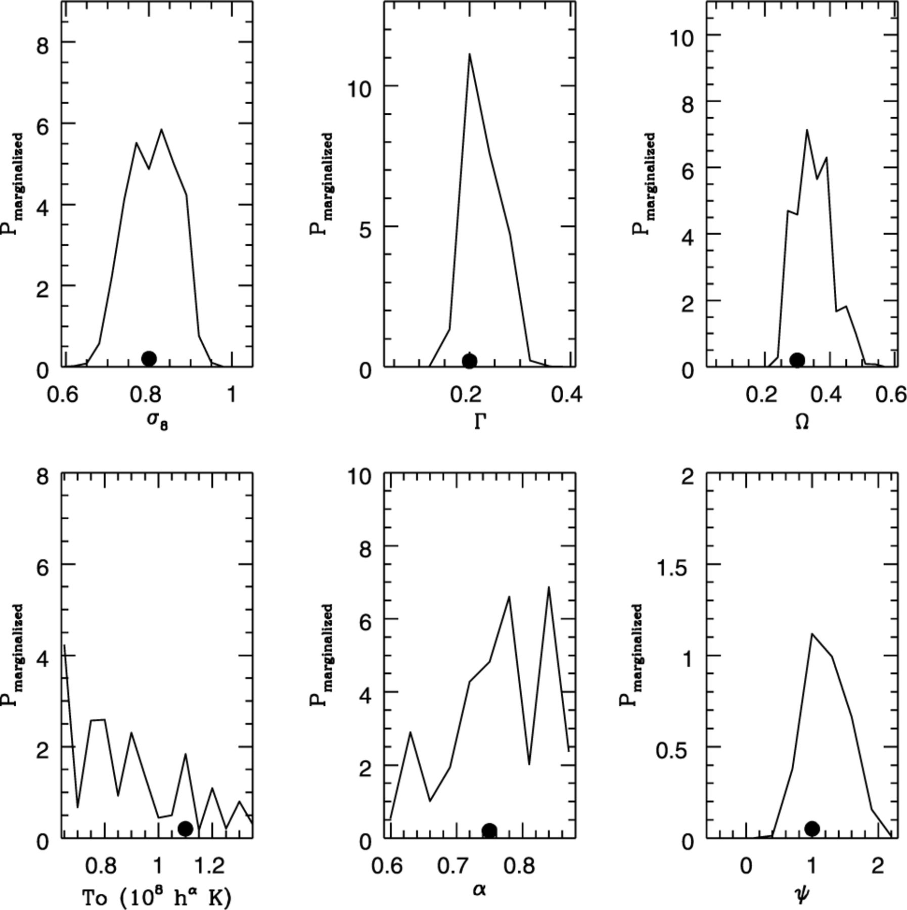
Figure 8. Marginalized probability in each parameter. The black dot represents the input model (ΛCDM model in Table ...
Notes:
Figure 8. Marginalized probability in each parameter. The black dot represents the input model (ΛCDM model in Table 1).
Unless provided in the caption above, the following copyright applies to the content of this slide: © 2002 RAS

Slide 10
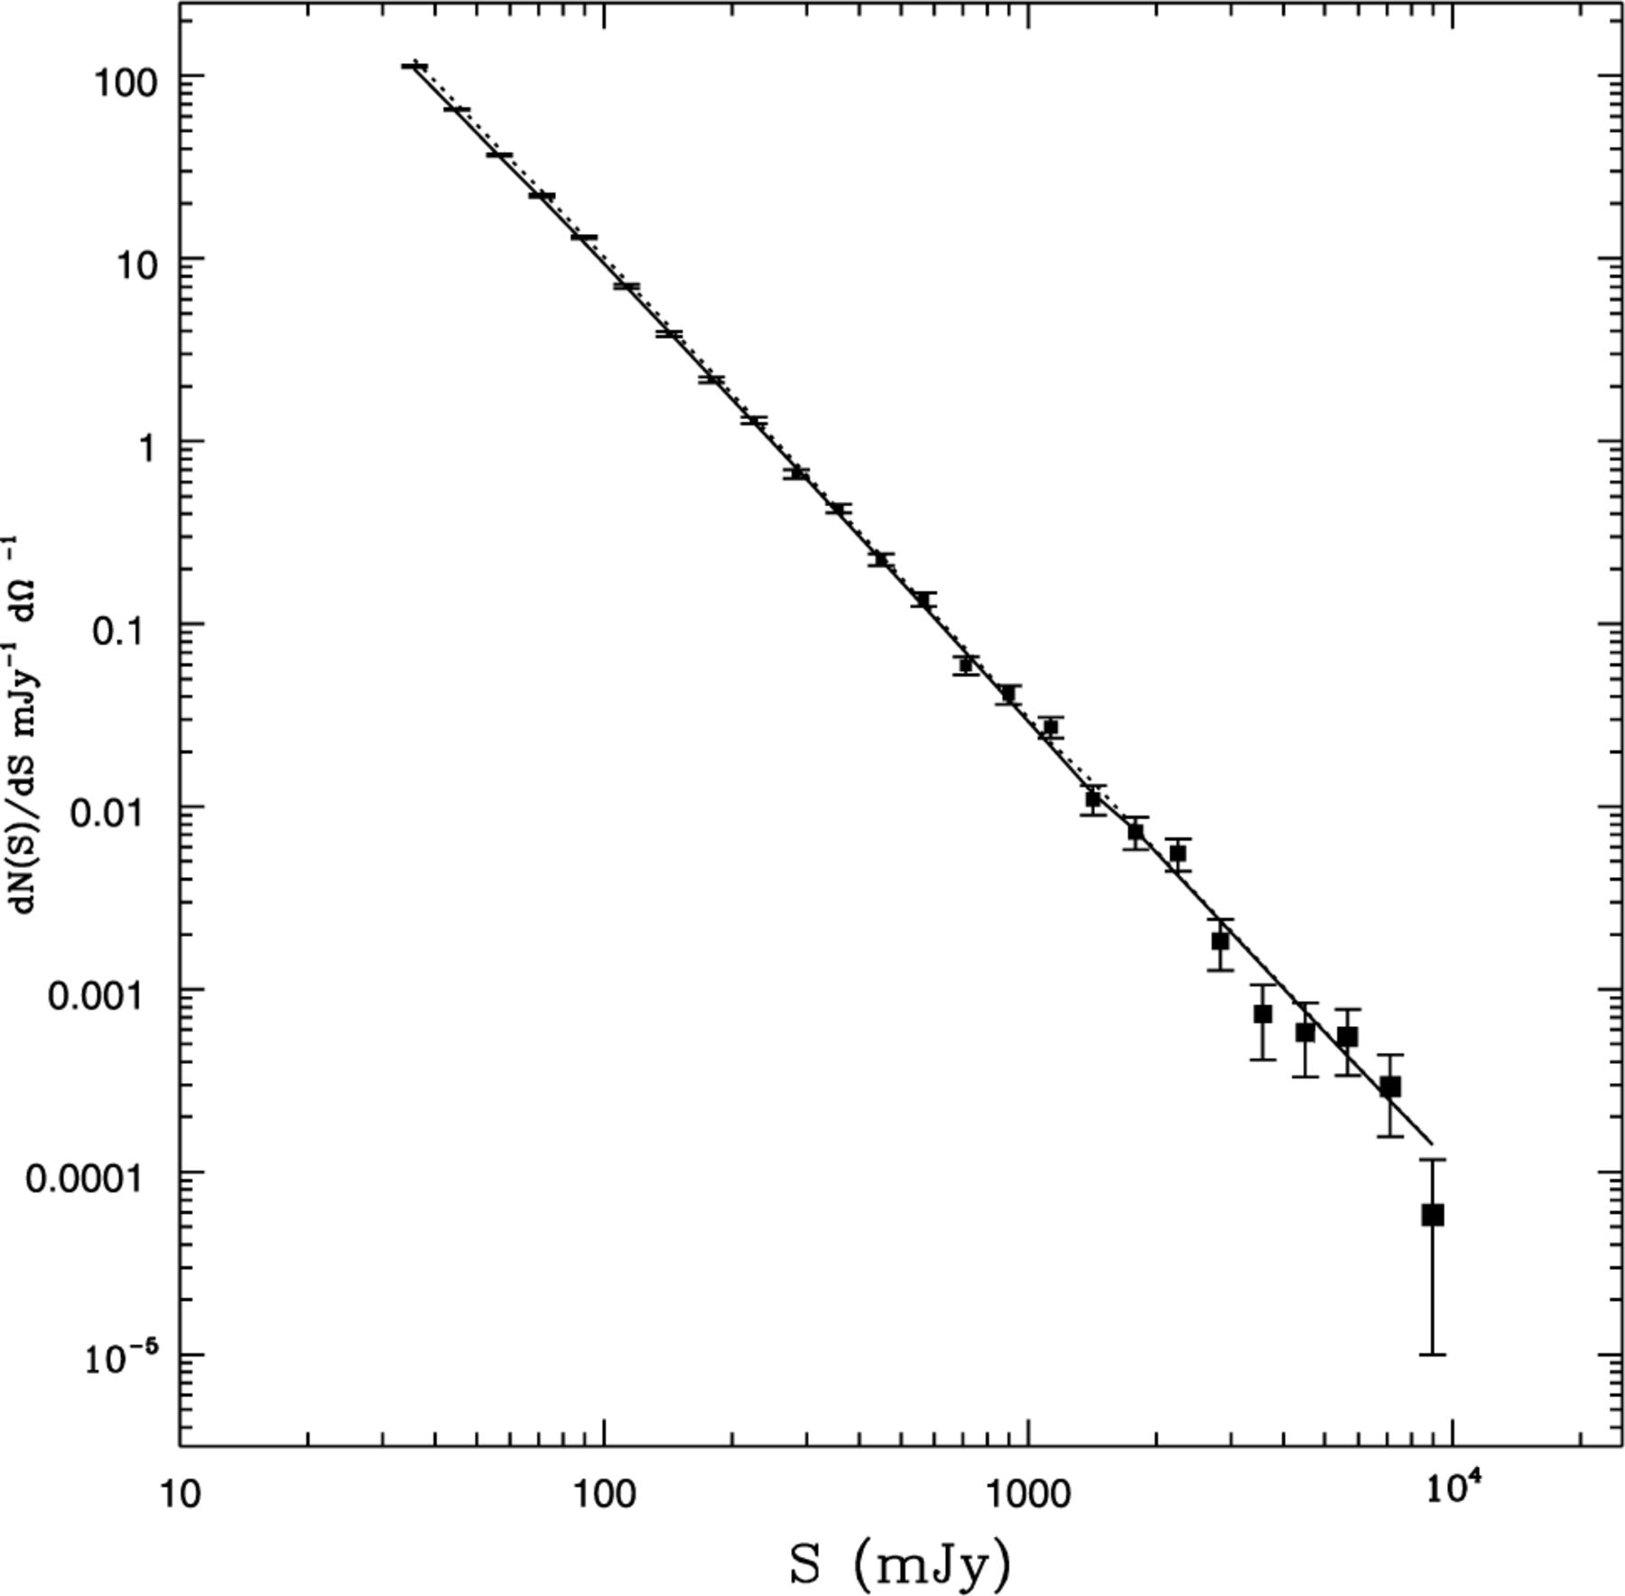
Figure 9. dN/dS curve for the ΛCDM (solid) and OCDM (dotted) models in Table 1. Data points represent a Monte Carlo ...
Notes:
Figure 9. dN/dS curve for the ΛCDM (solid) and OCDM (dotted) models in Table 1. Data points represent a Monte Carlo realization of mock data for the ΛCDM model. This curve includes all the Planck detected clusters (2/3 of the sky).
Unless provided in the caption above, the following copyright applies to the content of this slide: © 2002 RAS

Slide 11
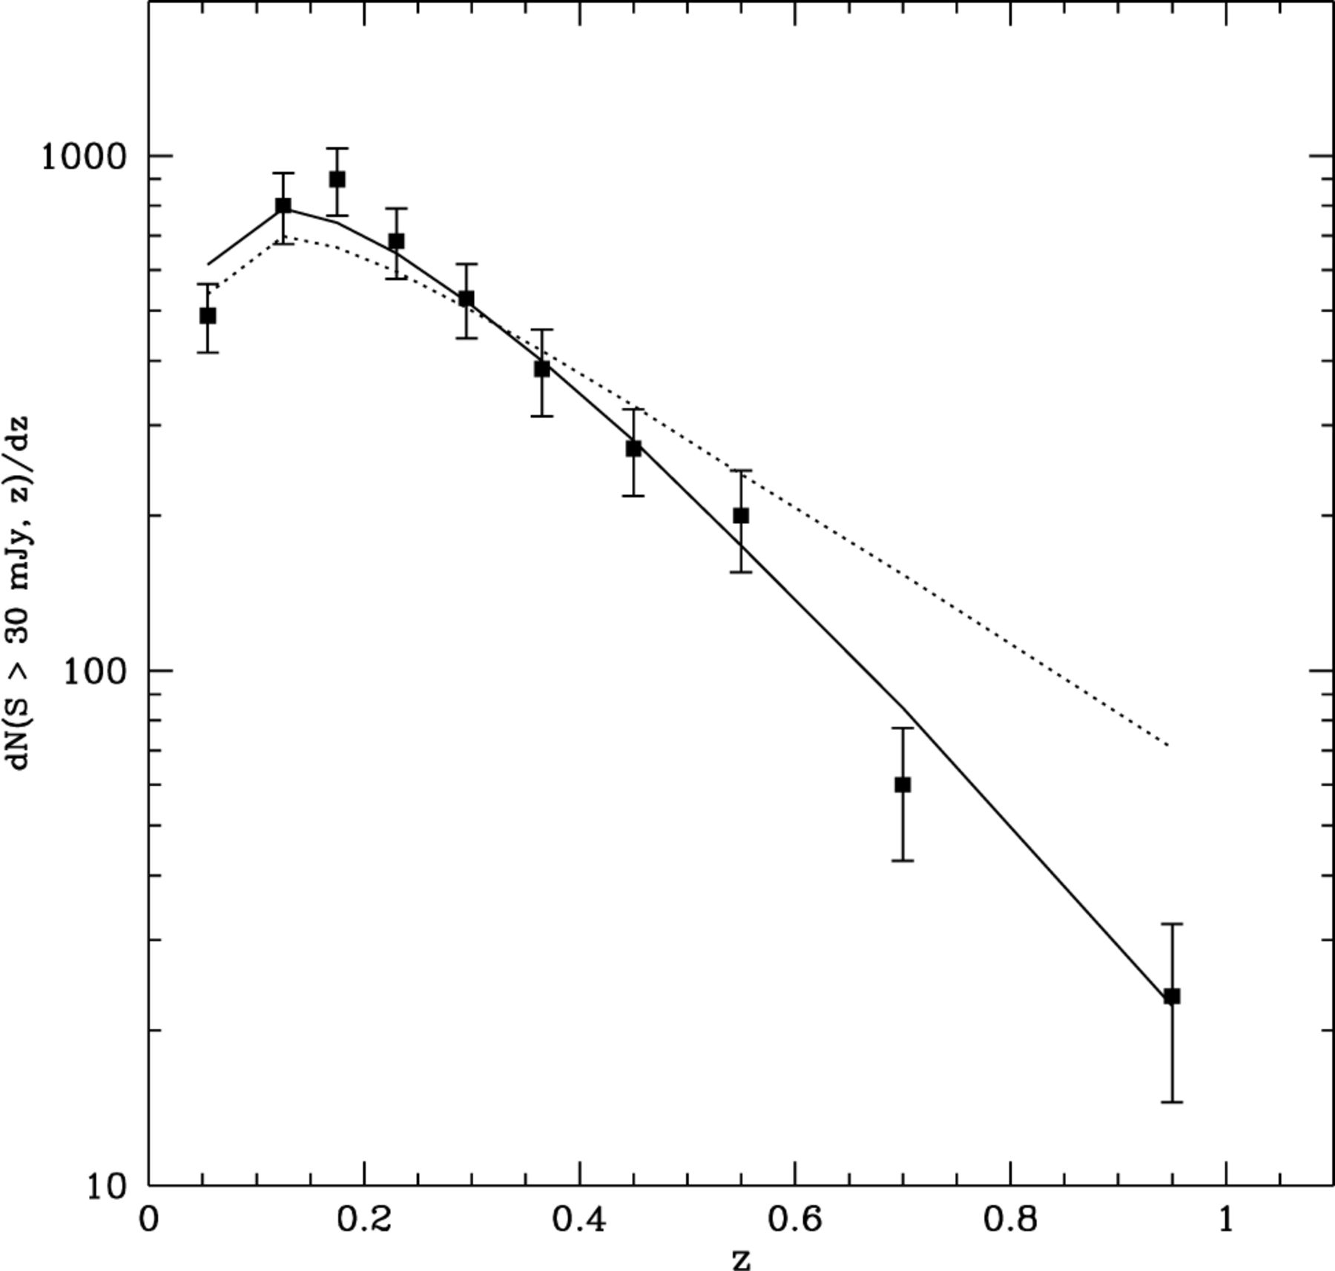
Figure 10. dN(S<30 mJy,z)/dz (353 GHz) curve for the ΛCDM (solid) and OCDM (dotted) models in Table 1. As in Fig. 9 the ...
Notes:
Figure 10. dN(S<30 mJy,z)/dz (353 GHz) curve for the ΛCDM (solid) and OCDM (dotted) models in Table 1. As in Fig. 9 the data were simulated assuming a ΛCDM model. The simulation was over a solid angle dΩ=0.6675 per cent of the sky where a total of ≈300 clusters were found with fluxes greater than 30 mJy.
Unless provided in the caption above, the following copyright applies to the content of this slide: © 2002 RAS

