Slide 1
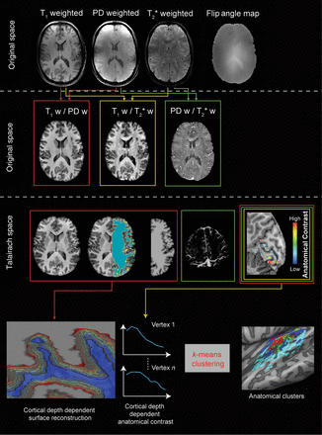
Figure 1. The analysis pipeline for anatomical images. Individual subject data resampled at 0.3 mm isotropic (top row) ...
Notes:
Figure 1. The analysis pipeline for anatomical images. Individual subject data resampled at 0.3 mm isotropic (top row) are combined to obtain 3 different ratio images resampled at 0.5 mm isotropic and corrected for residual inhomogeneities to obtain unbiased anatomical images (second row). The T1w/PD ratio images are segmented to obtain the white/gray matter border and gray matter mask for each individual subject. The T2*w/PDw images are used to obtain individual subject venograms. The gray matter mask, the venograms, and the T1w/T2*w images are used to obtain individual subject intracortical maps related to myelin content (middle row). Advanced segmentation and cortical thickness measures are used to define cortical depth-dependent surfaces. After sampling the anatomical contrast at the different relative cortical depths, this information is submitted to a clustering algorithm in order to obtain a parcellation (bottom row).
Unless provided in the caption above, the following copyright applies to the content of this slide: © The Author 2014. Published by Oxford University Press. All rights reserved. For Permissions, please e-mail: journals.permissions@oup.com

Slide 2
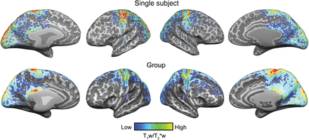
Figure 2. Single-subject (S6) and group (N = 6) (after cortex-based alignment) intracortical (myelin-related) maps. ...
Notes:
Figure 2. Single-subject (S6) and group (N = 6) (after cortex-based alignment) intracortical (myelin-related) maps. Anatomical contrast is projected on the individual reconstructed surfaces of both hemispheres (top row) and on the average (after cortex-based alignment) cortical surfaces (bottom row).
Unless provided in the caption above, the following copyright applies to the content of this slide: © The Author 2014. Published by Oxford University Press. All rights reserved. For Permissions, please e-mail: journals.permissions@oup.com

Slide 3
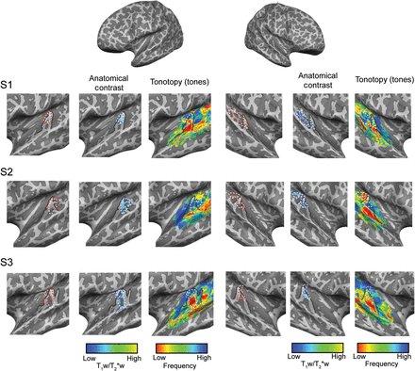
Figure 3. Single-subject (S1, S2, and S3) intracortical (myelin related) and tonotopic maps as obtained in experiment 1 ...
Notes:
Figure 3. Single-subject (S1, S2, and S3) intracortical (myelin related) and tonotopic maps as obtained in experiment 1 (“tones”). Anatomical contrast and tonotopic maps are projected on the individual reconstructed surfaces of both hemispheres. Macroanatomical features (HG) and the highly myelinated region in the auditory cortex are outlined on all maps (solid black and dotted white line, respectively). The cluster resulting in the highest myelin-related content throughout the cortical depth is outlined in red.
Unless provided in the caption above, the following copyright applies to the content of this slide: © The Author 2014. Published by Oxford University Press. All rights reserved. For Permissions, please e-mail: journals.permissions@oup.com

Slide 4
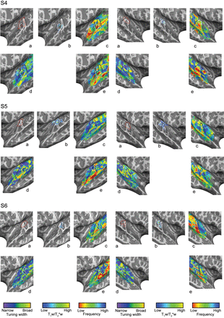
Figure 4. Single-subject (S4, S5, and S6) intracortical (b) (myelin-related), tonotopic (c and e), and tuning width (e) ...
Notes:
Figure 4. Single-subject (S4, S5, and S6) intracortical (b) (myelin-related), tonotopic (c and e), and tuning width (e) maps as obtained in session 1 (“tones”; c) and session 2 (“natural sounds”; d and e). Anatomical contrast and functional maps are projected on the individual reconstructed surfaces of both hemispheres. Macroanatomical features (HG) and the highly myelinated region in the auditory cortex are outlined on all maps (solid black and dotted white line, respectively). The cluster resulting in the highest myelin-related content throughout the cortical depth is outlined in red and is reported in (a).
Unless provided in the caption above, the following copyright applies to the content of this slide: © The Author 2014. Published by Oxford University Press. All rights reserved. For Permissions, please e-mail: journals.permissions@oup.com

Slide 5
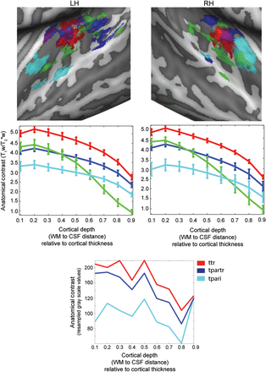
Figure 5. Cortex-based realigned group clusters (top) as identified by the parcellation procedure (k-means clustering). ...
Notes:
Figure 5. Cortex-based realigned group clusters (top) as identified by the parcellation procedure (k-means clustering). Individual maps are thresholded in order to show only vertices consistently assigned to the same cluster in at least 4 of the 6 subjects. Cortical depth-dependent profiles (middle) of anatomical contrast related to the centroid of each cluster (standard error computed across subjects) are reported together with the anatomical maps and color-coded accordingly. The bottom panel represents the cortical depth profiles for the regions ttr, tpartr, and tpari as digitized from Nieuwenhuys (2013).
Unless provided in the caption above, the following copyright applies to the content of this slide: © The Author 2014. Published by Oxford University Press. All rights reserved. For Permissions, please e-mail: journals.permissions@oup.com

Slide 6
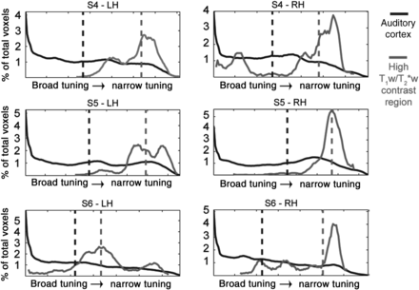
Figure 6. Distribution of tuning width values within the auditory cortex (black line) and the region with the highest ...
Notes:
Figure 6. Distribution of tuning width values within the auditory cortex (black line) and the region with the highest T1w/T2*w signal (gray line) for each individual subject and hemisphere. Vertical dotted lines represent the median of the distribution. The shift of tuning width toward narrow values (high values of tuning width) can be noted in each individual hemisphere.
Unless provided in the caption above, the following copyright applies to the content of this slide: © The Author 2014. Published by Oxford University Press. All rights reserved. For Permissions, please e-mail: journals.permissions@oup.com

