Slide 1
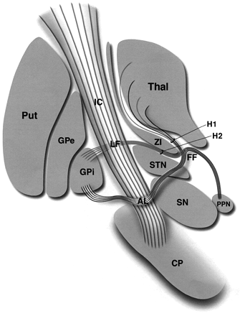
Fig. 1 Representation of the major anatomical structures and fibre tracts associated with the subthalamic ...
Notes:
Fig. 1 Representation of the major anatomical structures and fibre tracts associated with the subthalamic nucleus. AL = ansa lenticularis; CP = cerebral peduncle; FF = Fields of Forel; GPe = globus pallidus externus; GPi = globus pallidus internus; H1 = H1 Field of Forel (thalamic fasciculus); IC = internal capsule; LF = lenticular fasciculus (H2); PPN = pedunculopontine nucleus; Put = putamen; SN = substantia nigra; STN = subthalamic nucleus; Thal = thalamus; ZI = zona incerta.
Unless provided in the caption above, the following copyright applies to the content of this slide: The Guarantors of Brain 2003

Slide 2
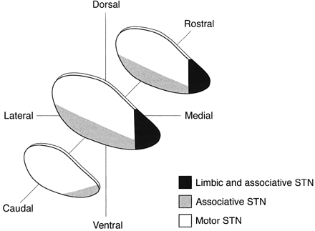
Fig. 2 Schematic representation of the intrinsic organization of the subthalamic nucleus (STN) according to ...
Notes:
Fig. 2 Schematic representation of the intrinsic organization of the subthalamic nucleus (STN) according to the tripartite functional subdivision of the basal ganglia.
Unless provided in the caption above, the following copyright applies to the content of this slide: The Guarantors of Brain 2003

Slide 3
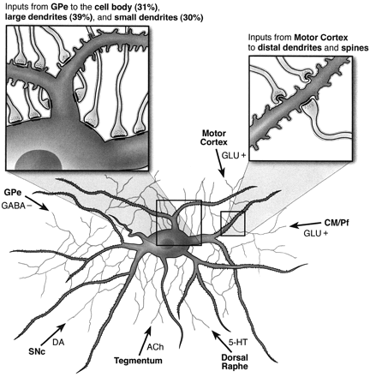
Fig. 3 Schematic representation of the synaptic contacts of the major afferents to the subthalamic nucleus. ...
Notes:
Fig. 3 Schematic representation of the synaptic contacts of the major afferents to the subthalamic nucleus. Fibres from the tegmentum, SNc, motor cortex, CM/Pf of the thalamus, and dorsal raphe, contact principally distal dendrites, whereas pallidal inhibitory fibres innervate mostly proximal dendrites and the cell body. ACh = acetylcholine; CM/Pf = centromedian/parafascicular complex of the thalamus; DA = dopamine; GABA = γ‐aminobutyric acid; GLU+ = glutamate; GPe = globus pallidus externus; 5HT = serotonin; SNc = substantia nigra compacta.
Unless provided in the caption above, the following copyright applies to the content of this slide: The Guarantors of Brain 2003

