Slide 1
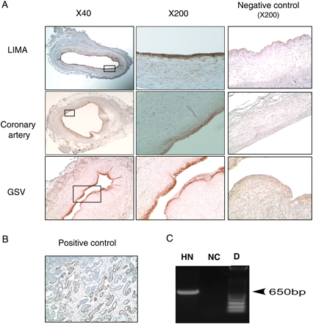
Figure 1 HN expression in endothelial cells of human arteries and veins. (A) Immunostaining of HN (brown) at low and ...
Notes:
Figure 1 HN expression in endothelial cells of human arteries and veins. (A) Immunostaining of HN (brown) at low and high magnification in normal LIMA, atherosclerotic coronary artery, and saphenous vein (GSV). Negative controls: LIMA, coronary artery, and GSV were incubated with rabbit serum instead of HN antibody. (B) HN is expressed in Leydig cells of young male testis (positive control). HN-positive cells are indicated by the brown staining at the site of the endothelium. (C) HN mRNA is expressed in HAECs. HN, RT–PCR performed on mRNA isolated from HAECs showed that HN mRNA is expressed in cultured endothelial cells. NC, negative control was performed whole reaction without DNA. D, DNA ladder.
Unless provided in the caption above, the following copyright applies to the content of this slide: Published on behalf of the European Society of Cardiology. All rights reserved. © The Author 2010. For permissions please email: journals.permissions@oxfordjournals.org.

Slide 2
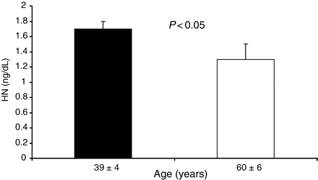
Figure 2 Plasma HN level of healthy volunteers according to age. The older group showed significantly lower plasma HN ...
Notes:
Figure 2 Plasma HN level of healthy volunteers according to age. The older group showed significantly lower plasma HN level than the younger group.
Unless provided in the caption above, the following copyright applies to the content of this slide: Published on behalf of the European Society of Cardiology. All rights reserved. © The Author 2010. For permissions please email: journals.permissions@oxfordjournals.org.

Slide 3
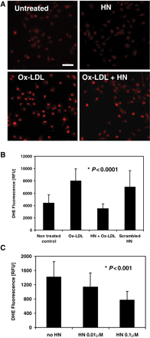
Figure 3 HN inhibits Ox-LDL-induced ROS formation in HAECs. HAECs were incubated overnight in the absence or presence ...
Notes:
Figure 3 HN inhibits Ox-LDL-induced ROS formation in HAECs. HAECs were incubated overnight in the absence or presence of 0.1 µM HN, treated with DHE for 30 min, and exposed to 100 µg/mL Ox-LDL for another 30 min. Fluorescence images of 10–12 non-overlapping fields were taken at low magnification (×15). Bar, 100 µm. (B) Quantification of DHE fluorescence in individual HAECs photographed at high magnification (×90). Data are shown for non-treated control cells, or cells treated with 100 µg/mL Ox-LDL, 0.1 µM HN, or 0.1 µM scrambled HN peptide. (C) HAECs were pre-incubated overnight with 0.01 or 0.1 µM HN, treated with DHE and Ox-LDL as described in (B) and fluorescence was quantified. In (C), DHE fluorescence is expressed as average RFU (n ≥ 100 cells per experimental condition in two independent experiments).
Unless provided in the caption above, the following copyright applies to the content of this slide: Published on behalf of the European Society of Cardiology. All rights reserved. © The Author 2010. For permissions please email: journals.permissions@oxfordjournals.org.

Slide 4
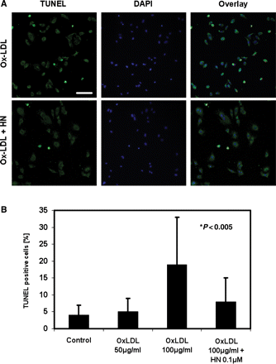
Figure 4 HN inhibits Ox-LDL-induced apoptosis in HAECs. Cells were incubated overnight with 0.1 µM HN followed by ...
Notes:
Figure 4 HN inhibits Ox-LDL-induced apoptosis in HAECs. Cells were incubated overnight with 0.1 µM HN followed by Ox-LDL treatment for 6 h, fixed, and subjected to TUNEL staining. Nuclei were visualized by DAPI staining and cells were imaged by epifluorescence microscopy. TUNEL-positive cells are shown in green and nuclei in blue. (A) Upper panels: HAECs were treated with Ox-LDL without HN pre-incubation; (lower row) cells pre-treated overnight with HN followed by Ox-LDL incubation. Bar, 100 µm. (B) Quantification of TUNEL staining in cells that were left untreated (Control), or incubated with 50 or 100 µg/mL Ox-LDL, or with 100 µg/mL Ox-LDL after an overnight pre-incubation with HN. All incubations with Ox-LDL were for 6 h.
Unless provided in the caption above, the following copyright applies to the content of this slide: Published on behalf of the European Society of Cardiology. All rights reserved. © The Author 2010. For permissions please email: journals.permissions@oxfordjournals.org.

Slide 5
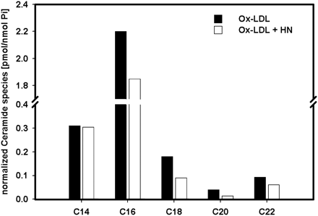
Figure 5 Mass spectrometry analysis of ceramide species in HAECs. HAECs were incubated overnight with or without with ...
Notes:
Figure 5 Mass spectrometry analysis of ceramide species in HAECs. HAECs were incubated overnight with or without with 0.1 µM HN followed by an incubation with 100 µg/mL Ox-LDL for 6 h. Cells were then harvested and ceramide species were analysed by mass spectrometry (HPLC/MS/MS) from lipid extracts of the cells (see Section 2).
Unless provided in the caption above, the following copyright applies to the content of this slide: Published on behalf of the European Society of Cardiology. All rights reserved. © The Author 2010. For permissions please email: journals.permissions@oxfordjournals.org.

