Slide 1
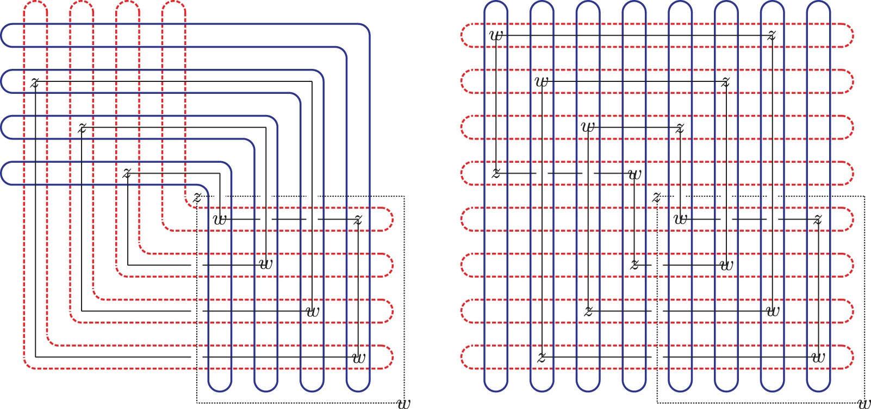
Fig. 1. Desirable diagrams for links. Left: a desirable diagram for $K\cup A$, where $K$ is the unknot. Right: the ...
Notes:
Fig. 1. Desirable diagrams for links. Left: a desirable diagram for $K\cup A$, where $K$ is the unknot. Right: the corresponding 2-periodic diagram for $\widetilde {K}\cup \widetilde {A}$, where $\widetilde {K}$ is the trefoil. $\alpha $s are dashed, $\beta $s are solid, axes thin, dashed and the knots thin, too. We explain the argument in the case of branched double covers; the case of periodic knots is similar. Given a 1-parameter family of complex structures $j$ on $S^2$ there is an induced 1-parameter family of almost complex structures ${\rm Sym}^n(j)$ on ${\rm Sym}^n(S^2)$. Given a generic choice of $j$ the complex structures ${\rm Sym}^n(j)$ achieve transversality for all moduli spaces of holomorphic disks in $({\rm Sym}^n(S^2{\setminus }({\mathbf {z}}\cup {\mathbf {w}})),T_\alpha \cup T_\beta )$ [26, Proposition 13.5]. Furthermore, the pullback $\widetilde {\jmath }$ of $j$ to $\widetilde {\Sigma }$ induces a one-parameter family of almost complex structures ${\rm Sym}^{2n}(\widetilde {\jmath })$ on ${\rm Sym}^{2n}(\widetilde {\Sigma }{\setminus }(\widetilde {{\mathbf {z}}}\cup \widetilde {{\mathbf {w}}}))$. The same argument which yields [26, Proposition 13.5] implies that, for a generic choice of $j$, ${\rm Sym}^{2n}(\widetilde {\jmath })$ achieves transversality for all homotopy classes of Whitney disks $\phi $ in ${\rm Sym}^{2n}(\widetilde {\Sigma }{\setminus }(\widetilde {{\mathbf {z}}}\cup \widetilde {{\mathbf {w}}}))$ which are not $\tau $-invariant, that is, for which $\phi \neq \tau _*(\phi )$. Any $\tau $-invariant homotopy class $\phi $ has Maslov index $\mu (\phi )$ even. Thus, as discussed in Point (ET-2) of Section 4, Hypothesis 4.1 is satisfied. So, by Proposition 4.3, the equivariant complex $\widetilde{{\widetilde{{CF}}}}_{{\mathbb Z}/2} (\widetilde {T}_\alpha ,\widetilde {T}_\beta )$ computed with respect to ${\rm Sym}^{2n}(\widetilde {\jmath })$ agrees with the equivariant complex ${\textit {CF}}_{{\mathbb Z}/2}(\widetilde {T}_\alpha ,\widetilde {T}_\beta )$ computed using non-equivariant almost complex structures. As in the proof of Corollary 1.10, ${\textit {CF}}_{{\mathbb Z}/2}(\widetilde {T}_\alpha ,\widetilde {T}_\beta )$ is isomorphic, in turn, to the equivariant Floer homology as defined by Seidel–Smith. □ Proof of Corollary 1.13For the spectral sequences (1.6) and (1.8), this is immediate from Corollary 1.12, the fact that the double cover of a nice Heegaard diagram branched over the basepoints is nice (obvious), and the fact that curve counts in nice diagrams are combinatorial [49]. For Corollary (1.9), curves are allowed to pass over the $z$ basepoint on the axis, and therefore we need the additional fact that in our desirable diagram for $K\cup A$, the $z$ basepoint for $A$ is contained in a bigon, which ensures that in the diagram for $\widetilde {K}\cup \widetilde {A}$, the $z$ basepoint for $\widetilde {A}$ is contained in a rectangle.□
Unless provided in the caption above, the following copyright applies to the content of this slide: © 2016 London Mathematical Society

Slide 2
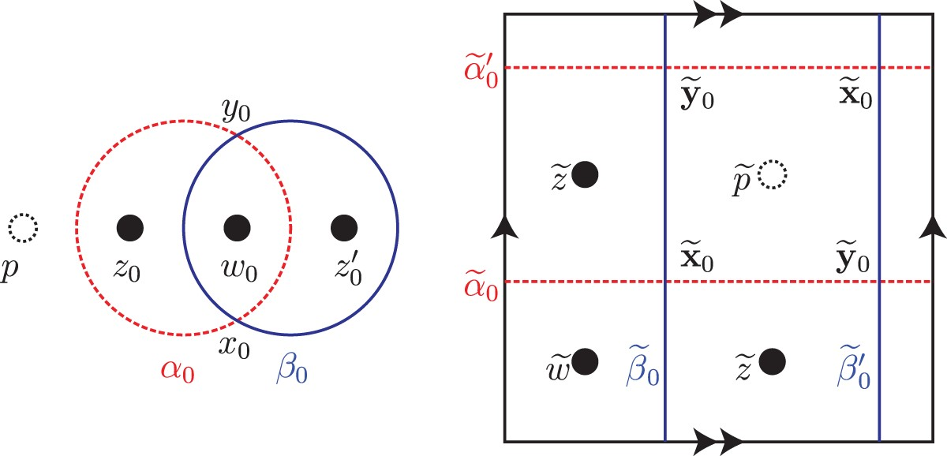
Fig. 2. Stabilizations of type 0–1–2–3. Left: a stabilization replacing a $z$ basepoint by a $(z,w,z)$ triple. Right: ...
Notes:
Fig. 2. Stabilizations of type 0–1–2–3. Left: a stabilization replacing a $z$ basepoint by a $(z,w,z)$ triple. Right: the branched double cover of this stabilization.
Unless provided in the caption above, the following copyright applies to the content of this slide: © 2016 London Mathematical Society

Slide 3
(6.5) Stabilization and a skein sequence for the branched double cover. (A) A piece of a bridge diagram: $A_i$ is ...
Notes:
(6.5) Stabilization and a skein sequence for the branched double cover. (A) A piece of a bridge diagram: $A_i$ is dashed and $B_i$ is solid. The double cover of this diagram is $\mathcal {H}$. (B) A stabilization of the bridge diagram: the double cover of this diagram is $\mathcal {H}_1$. (C) The disjoint union of the bridge diagram with an unknot. The double cover of this diagram is $\mathcal {H}_0$. (D) A Reidemeister I move applied to the stabilization. The double cover of this diagram is $\mathcal {H}'$. Diagrams (B) and (C) are obtained from (D) by unoriented skein moves. Note that: The diagram $\mathcal {H}_0$ represents $\Sigma (L)\#(S^2\times S^1)$; the diagrams $\mathcal {H}$, $\mathcal {H}'$, and $\mathcal {H}_1$ all represent $\Sigma (L)$. There are obvious, ${\mathbb Z}/2$-equivariant isomorphisms \[ \widehat{\textit{CF}}(\mathcal{H}_0)\cong \widehat{\textit{CF}}(\mathcal{H})\otimes\widehat{\textit{CF}}(S^2\times S^1) \cong \widehat{\textit{CF}}(\mathcal{H})\otimes {\mathbb F}_{2}\langle \Theta_{\textit{top}},\Theta_{\textit{bot}}\rangle \] where the $\Theta _{\textit {top}}$ (respectively, $\Theta _{\textit {bot}}$) is the top-graded (respectively, bottom-graded) generator of $\widehat {\textit {HF}}(S^2\times S^1)$. (In particular, the $H_1/\textit {tors}$-action on $\widehat {\textit {HF}}(S^2\times S^1)$ sends $\Theta _{\textit {top}}$ to $\Theta _{\textit {bot}}$ and sends $\Theta _{\textit {bot}}$ to 0.) We already know that the quasi-isomorphism type of $\widehat {\textit {CF}}$ over ${\mathbb F}_{2}$ is an invariant of $\Sigma (L)$; we are trying to prove that these maps respect the ${\mathbb F}_{2}[{\mathbb Z}/2]$-module structure. Non-equivariant invariance implies that the long exact sequence (6.5) splits as \[ 0\longrightarrow \widehat{\textit{HF}}(\mathcal{H}')\longrightarrow\widehat{\textit{HF}}(\mathcal{H}_0)\longrightarrow \widehat{\textit{HF}}(\mathcal{H}_1)\longrightarrow 0. \] The map $g$ sends the kernel of the $H_1(S^2\times S^1)$-action to 0, and $\widehat {\textit {HF}}(\mathcal {H})\otimes {\mathbb F}_{2}\langle \Theta _{\textit {top}}\rangle $ isomorphically to $\widehat {\textit {HF}}(\mathcal {H}_1)$. The map $g$ is given by counting holomorphic triangles, and hence respects the ${\mathbb F}_{2}[{\mathbb Z}/2]$-module structure. Thus, the composition \[\widehat{\textit{CF}}(\mathcal{H})\longrightarrow \widehat{\textit{CF}}(\mathcal{H}_0)\longrightarrow \widehat{\textit{CF}}(\mathcal{H}_1), \] where the first map sends $\widehat {\textit {CF}}(\mathcal {H})$ to $\widehat {\textit {CF}}(\mathcal {H})\otimes {\mathbb F}_{2}\langle \Theta _{\textit {top}}\rangle $, is an ${\mathbb F}_{2}[{\mathbb Z}/2]$-equivariant quasi-isomorphism. □
Unless provided in the caption above, the following copyright applies to the content of this slide: © 2016 London Mathematical Society

Slide 4
Fig. 4. A saddle cobordism. Left: the cobordism itself. Right: the perturbations used in the triple diagram for the ...
Notes:
Fig. 4. A saddle cobordism. Left: the cobordism itself. Right: the perturbations used in the triple diagram for the triangle map.
Unless provided in the caption above, the following copyright applies to the content of this slide: © 2016 London Mathematical Society

Slide 5
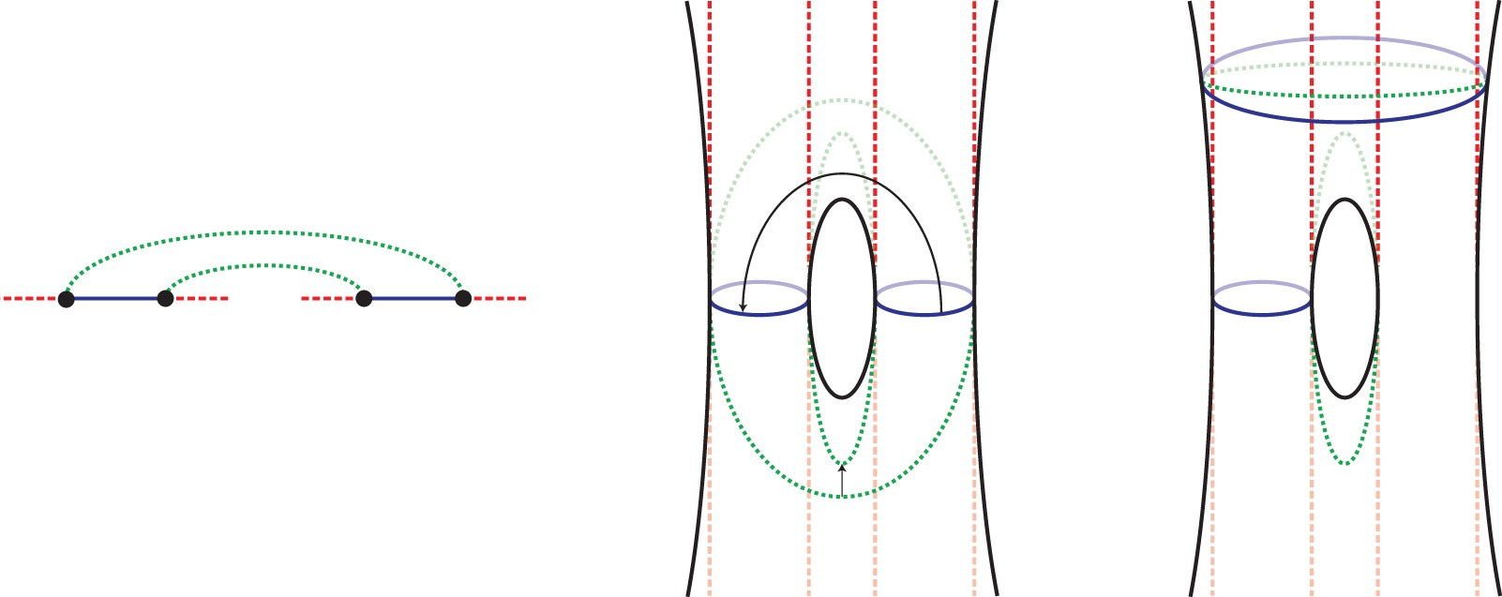
Fig. 5. Strong equivalence to a subordinate diagram. Left: part of the bridge triple diagram where a saddle occurs. ...
Notes:
Fig. 5. Strong equivalence to a subordinate diagram. Left: part of the bridge triple diagram where a saddle occurs. Center: the branched double cover of this diagram. Right: after performing handleslides according to the two small arrows in the center diagram, the resulting diagram is subordinate to a link.
Unless provided in the caption above, the following copyright applies to the content of this slide: © 2016 London Mathematical Society

Slide 6
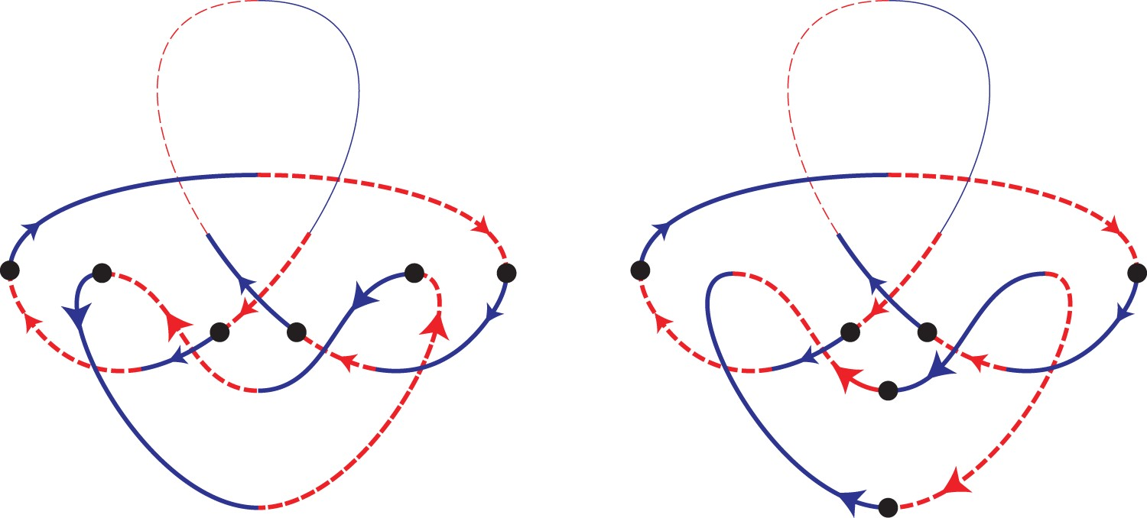
Fig. 6. Fixed generators and orientations. The distinguished arcs on the based component are thin. Both choices of ...
Notes:
Fig. 6. Fixed generators and orientations. The distinguished arcs on the based component are thin. Both choices of generators, corresponding to the two orientations of the unmarked component, are shown.
Unless provided in the caption above, the following copyright applies to the content of this slide: © 2016 London Mathematical Society

Slide 7
Fig. 7. Orientations and cobordisms. Left: a quite twisty diagram for an unknot component. Center: an even more ...
Notes:
Fig. 7. Orientations and cobordisms. Left: a quite twisty diagram for an unknot component. Center: an even more twisty unknot. Right: orientations and generators for an oriented saddle.
Unless provided in the caption above, the following copyright applies to the content of this slide: © 2016 London Mathematical Society

Slide 8
Fig. 8. A bridge diagram for the connected sum.
Notes:
Fig. 8. A bridge diagram for the connected sum.
Unless provided in the caption above, the following copyright applies to the content of this slide: © 2016 London Mathematical Society

Slide 9
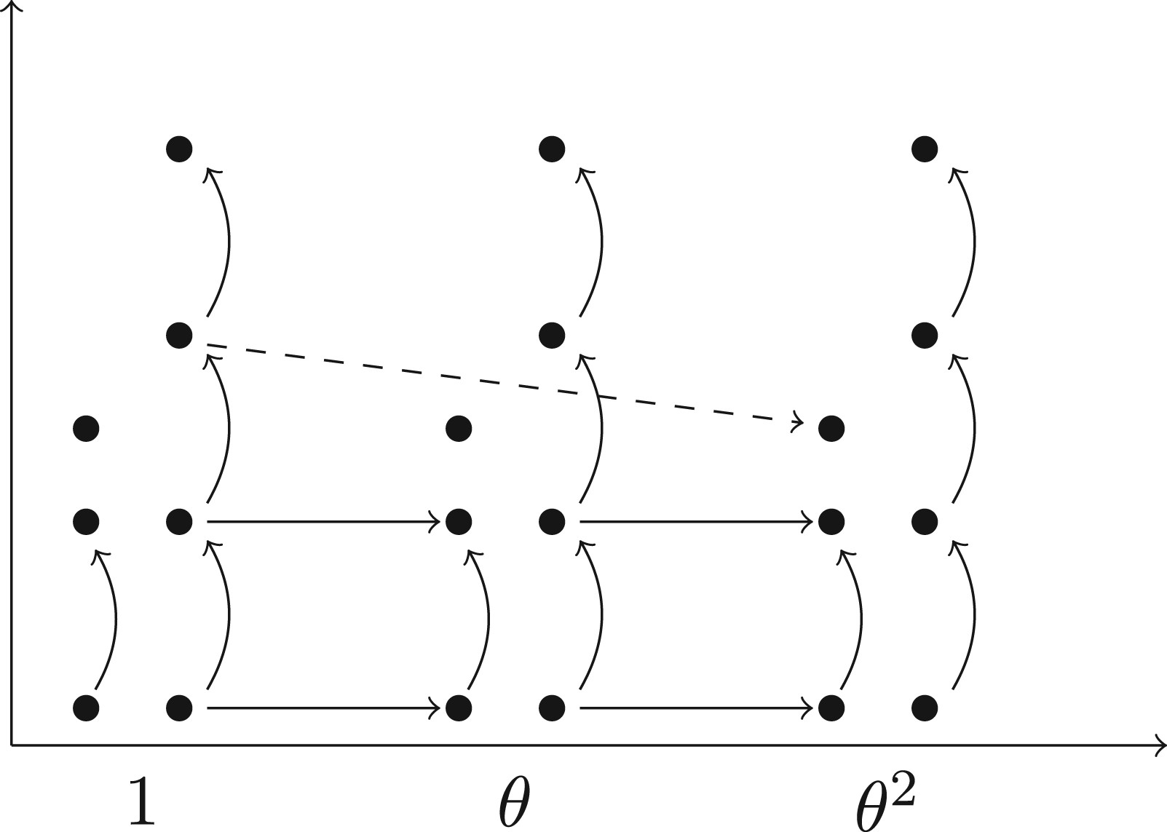
Fig. 9. A model for $HF^-$ spectral sequence. This is a sample $E_1$-page for the spectral sequence associated to the ...
Notes:
Fig. 9. A model for $HF^-$ spectral sequence. This is a sample $E_1$-page for the spectral sequence associated to the filtration of $\textit {HF}_{{\mathbb Z}/2}(\Sigma (K),{\mathfrak s}_0)$ by the $\theta $-power. In each filtration level we have a copy of $\textit {HF}^{-,*}(\Sigma (K), {\mathfrak s}_0)$; the vertical axis is the homological grading in this complex. Curved vertical arrows denote the action of $U$; horizontal arrows show a possible non-trivial $d_1$ differential. The dashed arrow is a possible $d_2$ differential on the next page of the spectral sequence.
Unless provided in the caption above, the following copyright applies to the content of this slide: © 2016 London Mathematical Society

Slide 10
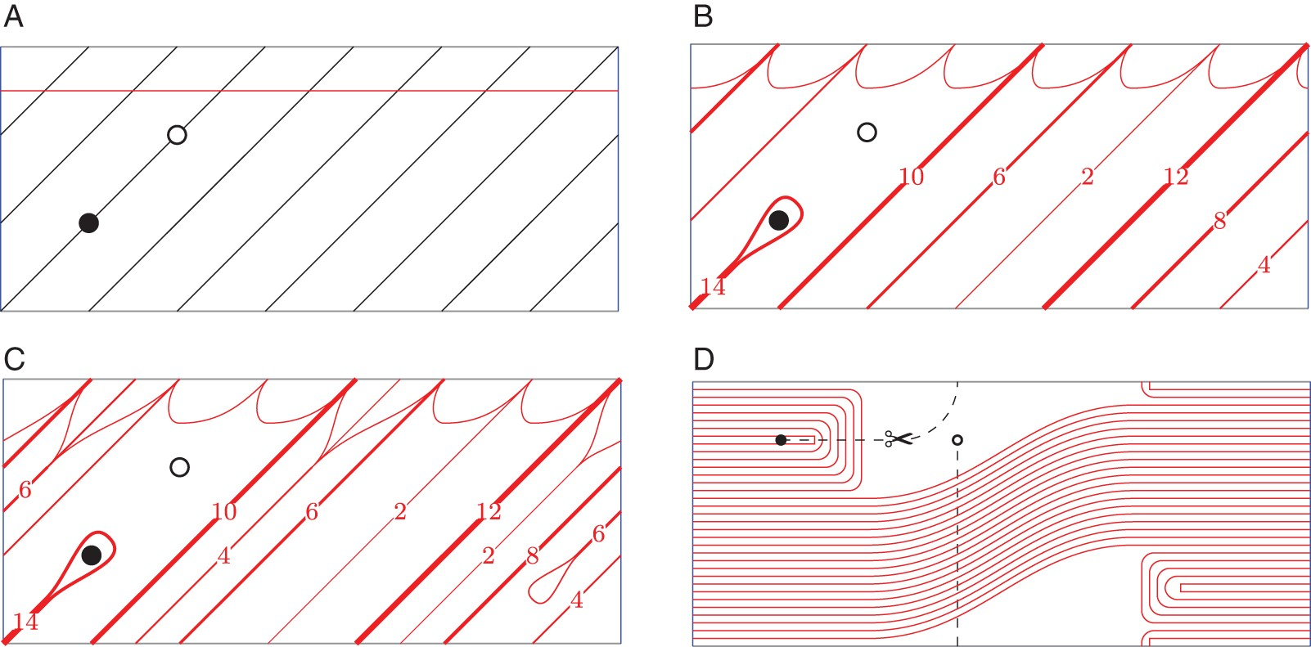
Fig. 10. Nice Heegaard diagrams for the $(3,7)$ torus knot. In each case, the left and right edges of the rectangle ...
Notes:
Fig. 10. Nice Heegaard diagrams for the $(3,7)$ torus knot. In each case, the left and right edges of the rectangle are the $\beta $-circle(s). To construct a nice Heegaard diagram for the double branched cover $\Sigma (2,3,7)$, cut along the dashed line, take two copies, and then join the two copies along the preimages of the dashed line. (A) The knot $T(3,7)$, drawn with two basepoints on the standard genus one Heegaard diagram of $S^3$. (B) A doubly pointed Heegaard diagram for $T(3,7)$ obtained from the previous diagram by doing a finger move along the knot (drawn with train-tracks). (C) Making the previous diagram nice by doing one more finger move. (D) The same Heegaard diagram, straightened out, and drawn without train-tracks.
Unless provided in the caption above, the following copyright applies to the content of this slide: © 2016 London Mathematical Society

Slide 11
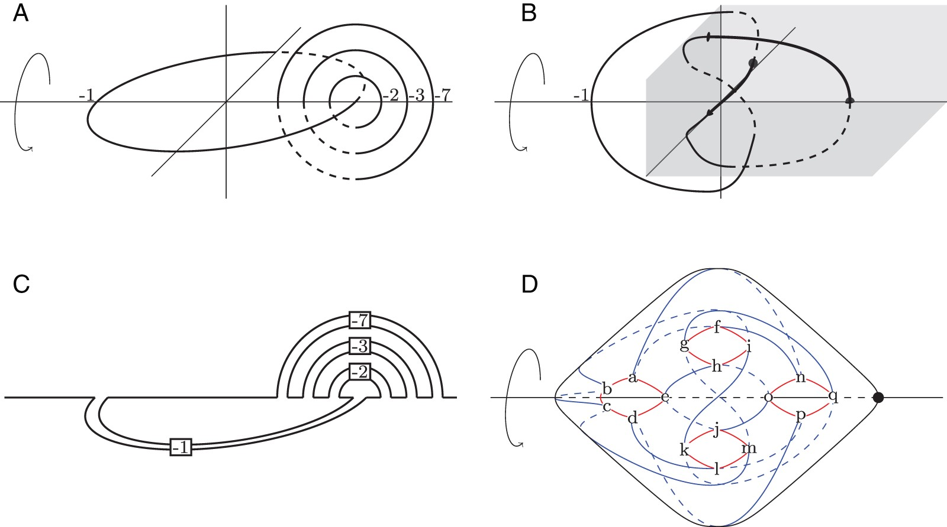
Fig. 11. A Heegaard diagram for $\Sigma (2,3,7)$, viewed as a $(-1)$-surgery of the positive trefoil. The diagram ...
Notes:
Fig. 11. A Heegaard diagram for $\Sigma (2,3,7)$, viewed as a $(-1)$-surgery of the positive trefoil. The diagram reflects the ${\mathbb Z}/2$ symmetry that comes from viewing $\Sigma (2,3,7)$ as the double branched cover of the Montesinos knot $M(-1;(-2,1),(-3,1),(-7,1))$. (A) A surgery presentation of $\Sigma (2,3,7)$ that exhibits a ${\mathbb Z}/2$ symmetry. (B) Using ${\mathbb Z}/2$-equivariant Kirby moves, it is also the $(-1)$-surgery on the positive trefoil (the portion of the trefoil in the positive octant is emphasized.) (C) The fixed set in the quotient $S^3$ is the Montesinos knot $M(-1;(-2,1),(-3,1),(-7,1))$. (D) A Heegaard diagram for the $(-1)$-surgery of the trefoil, along with the ${\mathbb Z}/2$ symmetry. The small, planar, thick circles are $\alpha $, and the large, non-planar, thin ones are $\beta $.
Unless provided in the caption above, the following copyright applies to the content of this slide: © 2016 London Mathematical Society

Slide 12
Fig. 12. Winding a bridge diagram. Perform $N$ Reidemeister I moves near each endpoint, as shown, by winding the ...
Notes:
Fig. 12. Winding a bridge diagram. Perform $N$ Reidemeister I moves near each endpoint, as shown, by winding the $B$-curve clockwise $N$ full turns. The case $N=2$ is shown. Suppose that$C_*$is a chain complex over${\mathbb F}_{2}$, with$C_n={\mathbb F}_{2}\langle X_n\rangle $freely generated by a finite set$X_n$, with$X_n=\varnothing $for$|n|$sufficiently large. Suppose further that${\mathbb Z}/2^m$acts on each$X_n$, and that this action induces an action by chain maps on$C_*$; that the action on each$X_n$is semi-free, so$X_n=X_n^\sigma \amalg X_n^{{\rm free}}$where$\sigma $acts freely on$X_n^{{\rm free}}$and fixes$X_n^\sigma $; and that the$X_n^{{\rm free}}$generate a subcomplex$C_*^{{\rm free}}$of$C_*$. In particular, the dual basis to$X_n^\sigma $generates a subcomplex$C^{\ast }_\sigma $of the dual complex$C^{\ast }={\rm Hom}_{{\mathbb F}_{2}}(C_*,{\mathbb F}_{2})$. Let$H(C^{\ast }_\sigma )$denote the homology of$C^{\ast }_\sigma $. Then the localized equivariant cohomology\[ w_2^{-1}H_{{\mathbb Z}/2^m}(C_*) =w_2^{-1}{\rm Ext}_{{\mathbb F}_{2}[{\mathbb Z}/2^m]}(C_*,{\mathbb F}_{2}) \]is isomorphic to$w_2^{-1}H^{\ast }({\mathbb Z}/2^m)\otimes _{{\mathbb F}_{2}} H(C^{\ast }_\sigma )$. In particular, if$m=1$then\[ \alpha^{-1}H_{{\mathbb Z}/2}(C_*) =\alpha^{-1}{\rm Ext}_{{\mathbb F}_{2}[{\mathbb Z}/2]}(C_*,{\mathbb F}_{2}) \]is isomorphic to$\alpha ^{-1}H^{\ast }({\mathbb Z}/2)\otimes _{{\mathbb F}_{2}} H(C^{\ast }_\sigma )={\mathbb F}_{2}[\alpha ,\alpha ^{-1}]\otimes _{{\mathbb F}_{2}} H(C^{\ast }_\sigma )$. ProofWe can compute the localized equivariant cohomology using the complex (7.19)\begin{equation} \cdots \xrightarrow {(1+\sigma)^{2^m-1}} C^{\ast} \xrightarrow {1+\sigma}C^{\ast} \xrightarrow {(1+\sigma)^{2^m-1}} C^{\ast} \xrightarrow {1+\sigma} C^{\ast} \xrightarrow {(1+\sigma)^{2^m-1}} \cdots \end{equation} where $C^{\ast }$ denotes the dual complex, over ${\mathbb F}_{2}$, to $C_*$. Inclusion of $C^{\ast }_\sigma $ gives a map $\iota $ of bicomplexes from (7.20)\begin{equation} \cdots \xrightarrow {0} C^{\ast}_\sigma \xrightarrow {0} C^{\ast}_\sigma \xrightarrow {0} C^{\ast}_\sigma \xrightarrow {0} C^{\ast}_\sigma \xrightarrow {0}\cdots \end{equation} to (7.19). If we filter both bicomplexes (7.19) and (7.20) by the degree $*$ at each vertex then $\iota $ induces an isomorphism on the $E^1$-page of the resulting spectral sequences. Hence, by spectral sequence comparison [35, Corollary 3.15], the map $\iota $ is a quasi-isomorphism between the complexes (7.19) and (7.20). The result follows. □ Proof of Theorem 7.16The special case for $m=1$ is immediate from Seidel–Smith's localization theorem [54, Theorem 20]. For the general case, since there are no non-trivial disks contained in the fixed set of $\sigma $, we can achieve transversality using a ${\mathbb Z}/2^m$-equivariant almost complex structure $J$ (compare Section 4). Hence, by Proposition 4.5, we may compute the equivariant symplectic Khovanov cohomology using ${\textit {CF}}({\mathcal {K}}'_A,{\mathcal {K}}_B;J)$ as the chain complex over ${\mathbb F}_{2}[{\mathbb Z}/2^m]$. By Lemma 7.17, we can arrange that the ${\mathbb Z}/2^m$-fixed generators span a subcomplex of ${\textit {CF}}^{\ast }({\mathcal {K}}'_A,{\mathcal {K}}_B;J)$. Then, via Proposition 7.7, the hypotheses of Lemma 7.18 are satisfied. There are exactly $2^{|L|}$${\mathbb Z}/2^m$-fixed generators, all in the same homological grading, so by Lemma 7.18 the localized equivariant Floer cohomology is a direct sum of $2^{|L|}$ copies of $w_2^{-1}H^{\ast }({\mathbb Z}/2^m)$, as desired. □
Unless provided in the caption above, the following copyright applies to the content of this slide: © 2016 London Mathematical Society

Slide 13
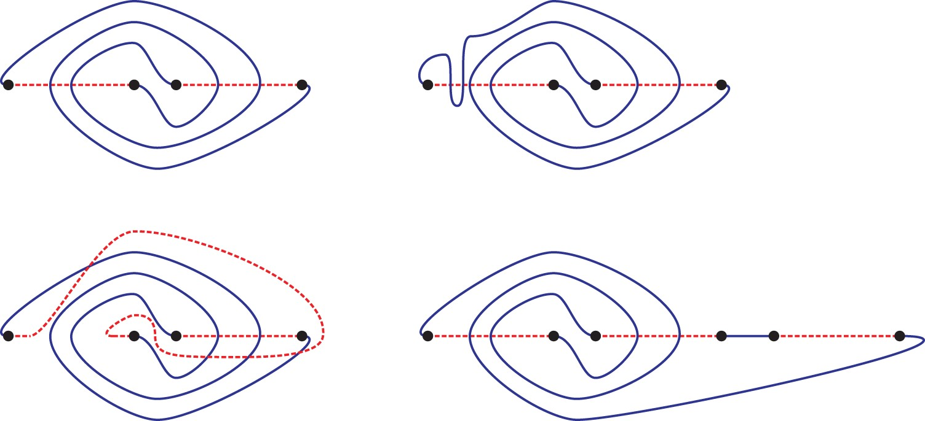
Fig. 13. Moves for bridge diagrams. (a) A bridge diagram. The $A_i$ are dashed and the $B_i$ are solid. (b) The result ...
Notes:
Fig. 13. Moves for bridge diagrams. (a) A bridge diagram. The $A_i$ are dashed and the $B_i$ are solid. (b) The result of an isotopy of the $B_i$. (c) The result of a handleslide (or passing move). (d) The result of a stabilization.
Unless provided in the caption above, the following copyright applies to the content of this slide: © 2016 London Mathematical Society

Slide 14
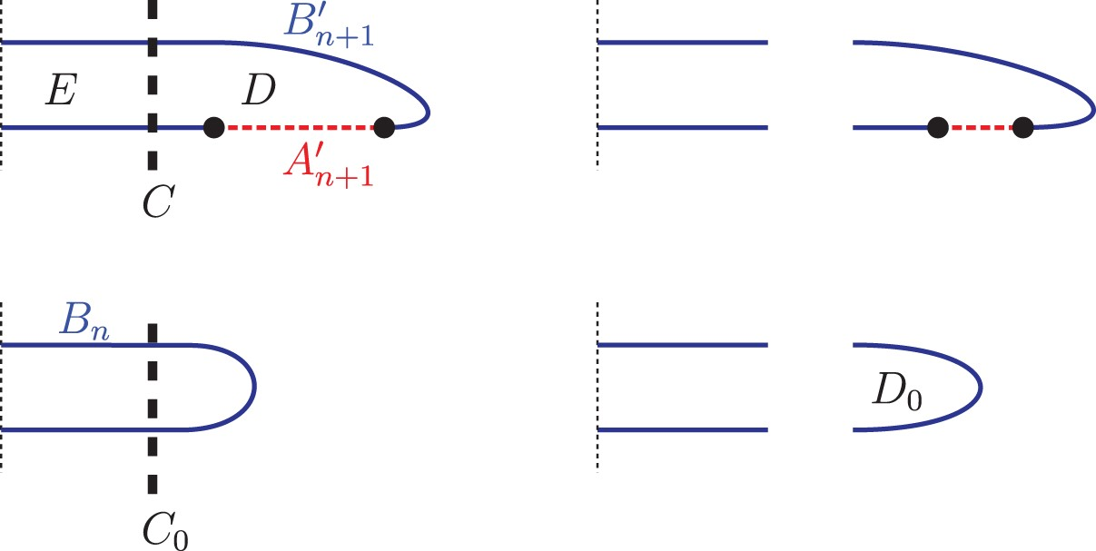
Fig. 14. Stabilization invariance for symplectic Khovanov homology. In all cases, only the stabilization region is ...
Notes:
Fig. 14. Stabilization invariance for symplectic Khovanov homology. In all cases, only the stabilization region is shown; the rest of the knot is to the left.
Unless provided in the caption above, the following copyright applies to the content of this slide: © 2016 London Mathematical Society

Slide 15
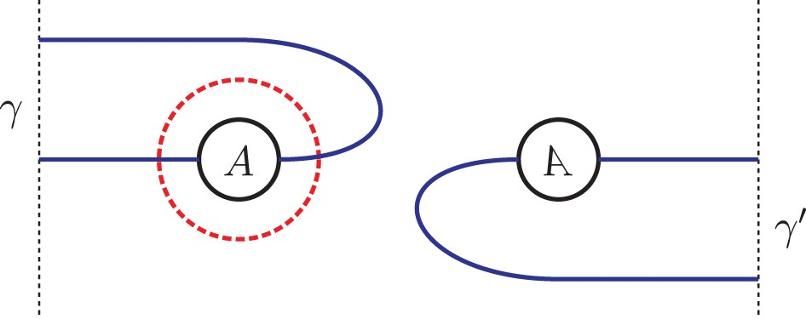
Fig. 15. The surface $i^{-1}(D)\cap \{u=0\}$. This is the branched double cover of $D$ along the points $p_{2n+1}$ and ...
Notes:
Fig. 15. The surface $i^{-1}(D)\cap \{u=0\}$. This is the branched double cover of $D$ along the points $p_{2n+1}$ and $p_{2n+2}$. The circles labeled $A$ are connected by a handle; the branch points are at the intersections of the $\Sigma _{A'_{n+1}}\cap \mathcal {H}$ (dashed) and $(\Sigma _{B'_n}^E\cup \Sigma _{B'_{n+1}}^E)\cap \mathcal {H}$ (solid).
Unless provided in the caption above, the following copyright applies to the content of this slide: © 2016 London Mathematical Society

Slide 16
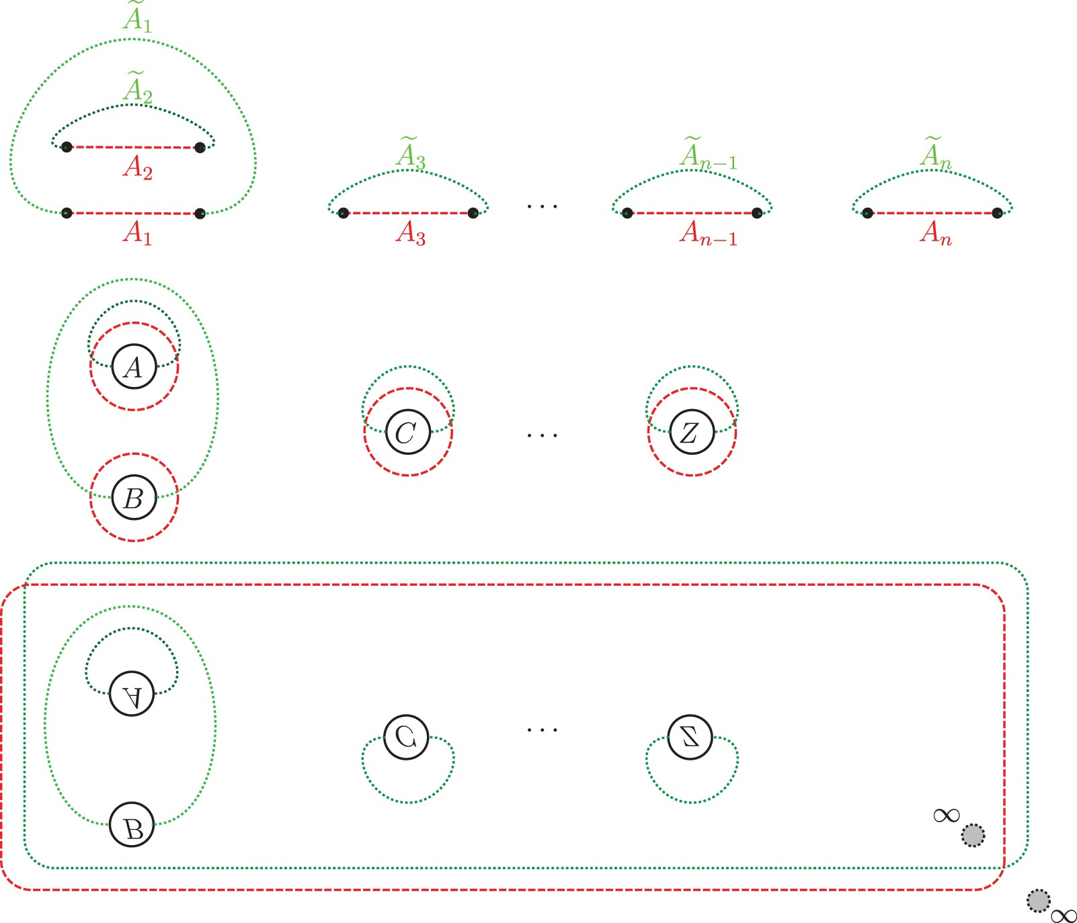
Fig. 16. Equivariant handleslide invariance. Top: Up to diffeomorphism of ${\mathbb C}$, the arcs $A$ and $\widetilde ...
Notes:
Fig. 16. Equivariant handleslide invariance. Top: Up to diffeomorphism of ${\mathbb C}$, the arcs $A$ and $\widetilde {A}$ in the proof of handleslide invariance are as shown. Bottom: the branched double covers of the pieces at the top, branched along the $p_i$. The small gray circles indicate the two non-compact regions.
Unless provided in the caption above, the following copyright applies to the content of this slide: © 2016 London Mathematical Society

Slide 17
Fig. 17. A triple diagram for a handleslide. (a) Part of the triple $(A,A',A'')$. $A$ is dashed, $A'$ is dotted, and ...
Notes:
Fig. 17. A triple diagram for a handleslide. (a) Part of the triple $(A,A',A'')$. $A$ is dashed, $A'$ is dotted, and $A''$ is solid. The $\Theta $s denote $\Theta _{A,A'}$ or $\Theta _{A,A''}$. (b) Orientation convention for triangle maps.
Unless provided in the caption above, the following copyright applies to the content of this slide: © 2016 London Mathematical Society

Slide 18
Fig. 18. Stabilizing when the basepoint is on a one-bridge unknot. The case of the Hopf link is shown, but the ...
Notes:
Fig. 18. Stabilizing when the basepoint is on a one-bridge unknot. The case of the Hopf link is shown, but the un-marked components could, of course, be more complicated. The key features are that the marked component is a one-bridge unknot and the point $p_{2n-1}$, which is drawn as a large black dot, is adjacent to the non-compact region in ${\mathbb C}$. The basepoint $p_{2n}$ is drawn as a large white dot in both pictures.
Unless provided in the caption above, the following copyright applies to the content of this slide: © 2016 London Mathematical Society

