Slide 1
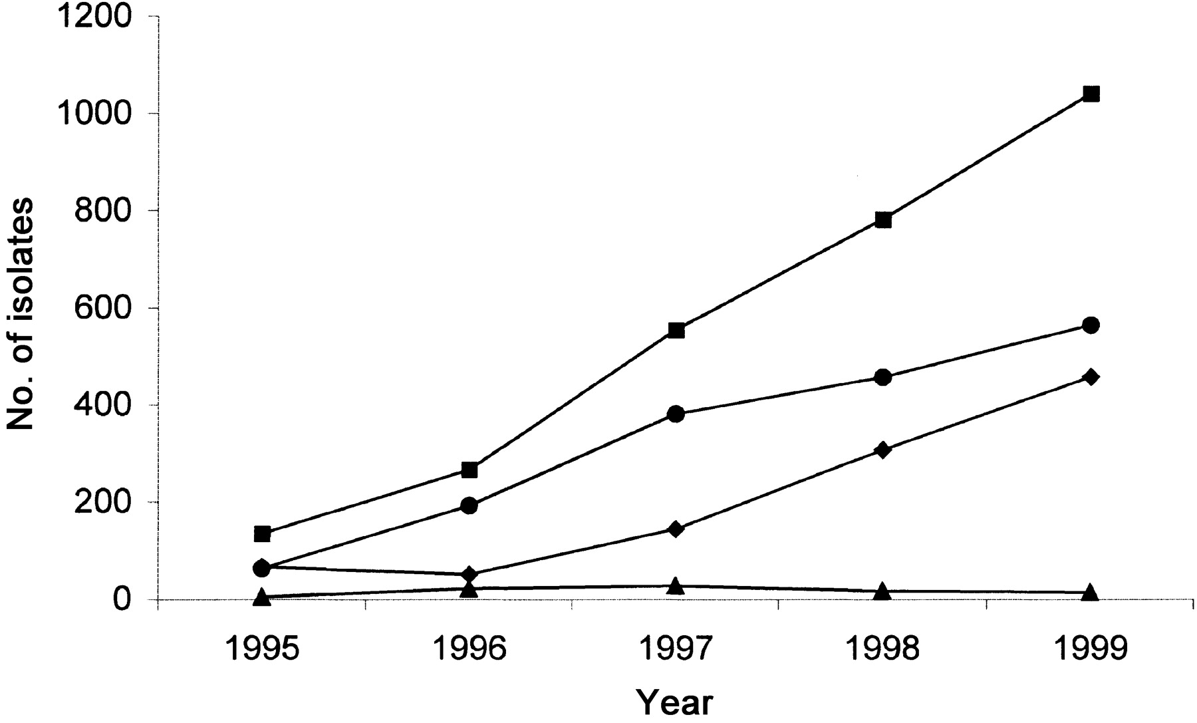
Figure 1 The no. of methicillin-resistant Staphylococcus aureus by year, during a 5-year national surveillance program ...
Notes:
Figure 1 The no. of methicillin-resistant Staphylococcus aureus by year, during a 5-year national surveillance program in Canada (1995–1999). The nos. of strains from the western (♦), central (•), and eastern (▴) regions and total nos. (▪) are shown
Unless provided in the caption above, the following copyright applies to the content of this slide: © 2002 by the Infectious Diseases Society of America

Slide 2
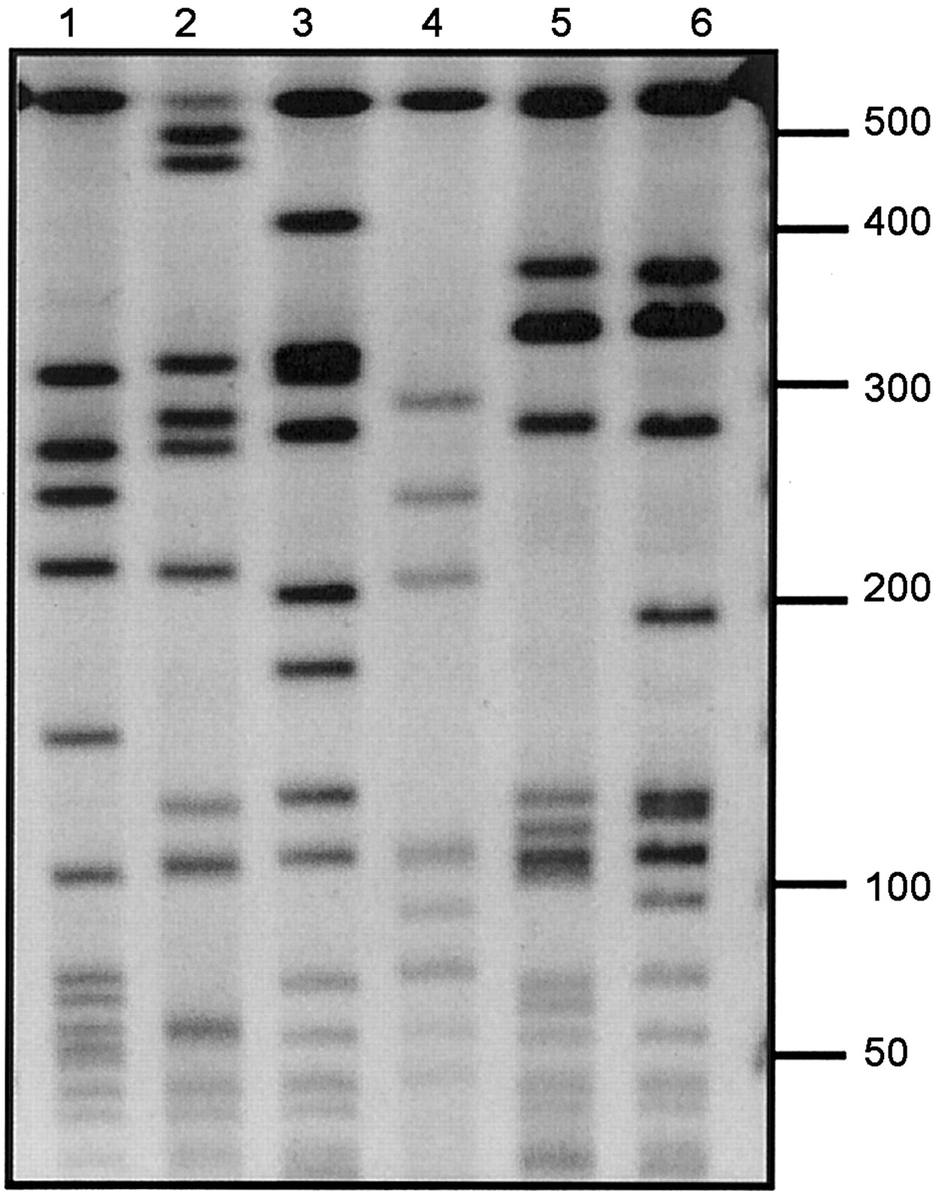
Figure 2 Representative DNA macrorestriction patterns of the various Canadian epidemic methicillin-resistant ...
Notes:
Figure 2 Representative DNA macrorestriction patterns of the various Canadian epidemic methicillin-resistant Staphylococcus aureus (CMRSA). Lanes: 1 CMRSA-1; 2 CMRSA-2; 3, CMRSA-5; 4, CMRSA-4; 5, CMRSA-3; and 6, CMRSA-6. Nos. at the side of the figure represent sizes of λ concatomers, in kilobases
Unless provided in the caption above, the following copyright applies to the content of this slide: © 2002 by the Infectious Diseases Society of America

Slide 3
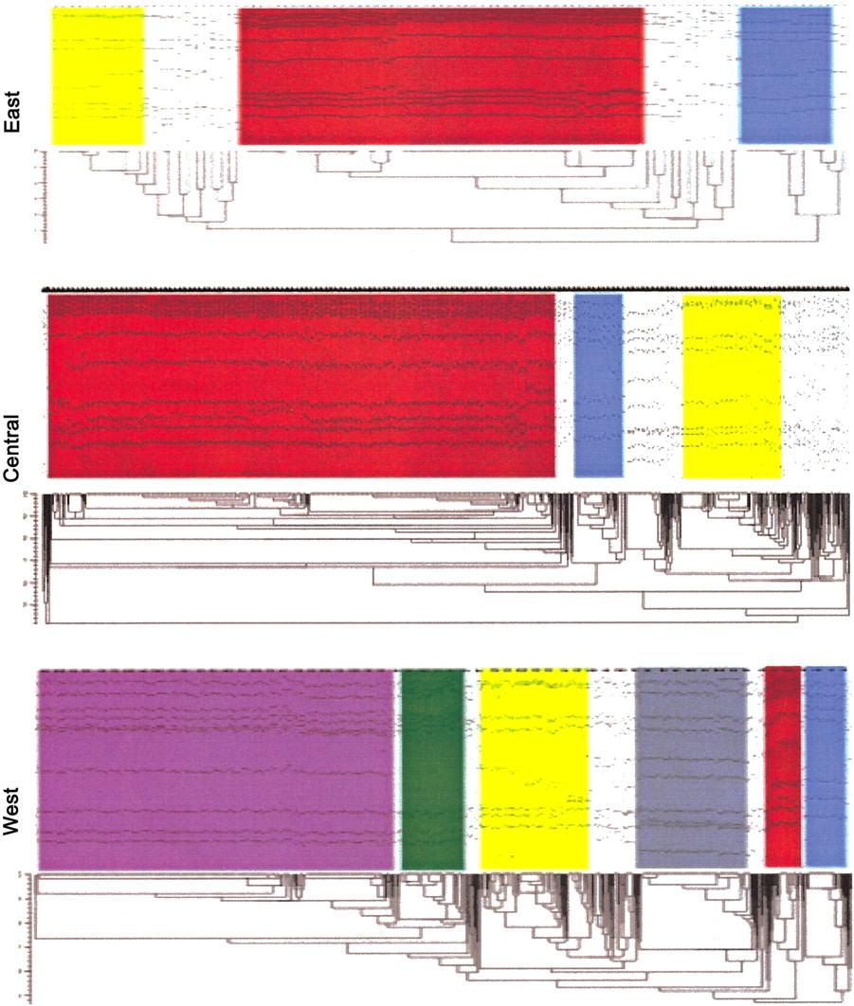
Figure 3 Dendrograms depicting the DNA macrorestriction patterns obtained for Canadian epidemic methicillin-resistant ...
Notes:
Figure 3 Dendrograms depicting the DNA macrorestriction patterns obtained for Canadian epidemic methicillin-resistant Staphylococcus aureus (CMRSA) during a 5-year hospital surveillance in the 3 regions of Canada. Colored blocks indicate clonal epidemic clusters as follows: red, CMRSA-1; yellow, CMRSA-2; green, CMRSA-3; blue CMRSA-4; gray, CMRSA-5; purple CMRSA-6
Unless provided in the caption above, the following copyright applies to the content of this slide: © 2002 by the Infectious Diseases Society of America

Slide 4
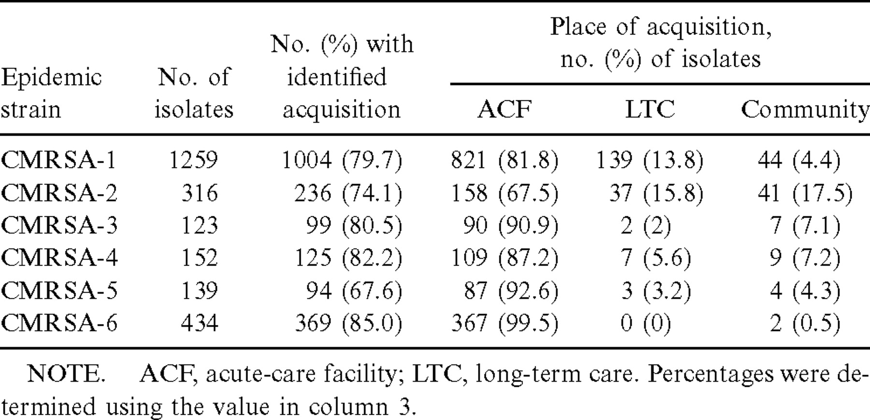
Table 1 Acquisition pattern (by community or facility type) of Canadian epidemic methicillin-resistant Staphylococcus ...
Notes:
Table 1 Acquisition pattern (by community or facility type) of Canadian epidemic methicillin-resistant Staphylococcus aureus (CMRSA) clonal types
Unless provided in the caption above, the following copyright applies to the content of this slide: © 2002 by the Infectious Diseases Society of America

Slide 5
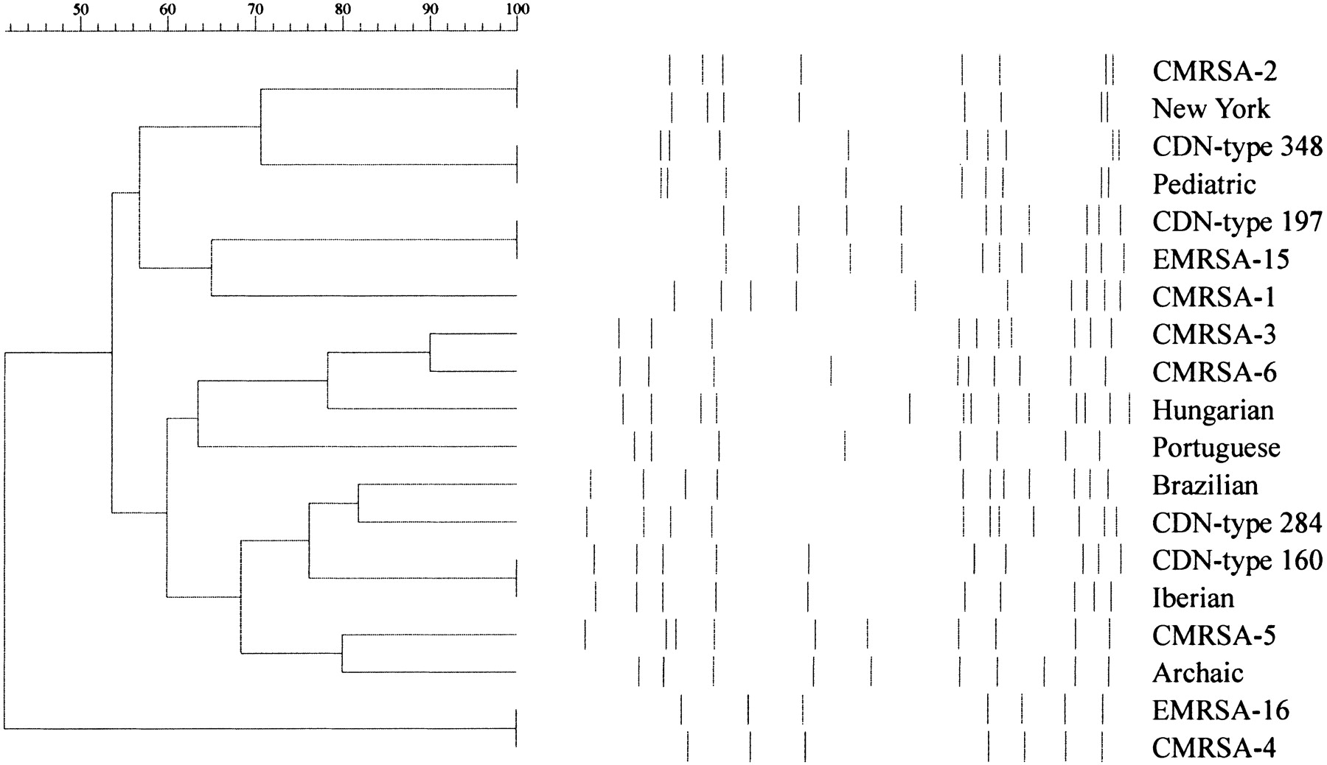
Figure 4 Dendrogram comparing internationally identified epidemic clones and closely related Canadian ...
Notes:
Figure 4 Dendrogram comparing internationally identified epidemic clones and closely related Canadian methicillin-resistant Staphylococcus aureus (CMRSA) isolates. Names of the epidemic clones or Canadian pulsed-field gel electrophoresis types are listed on the right side of the dendrogram
Unless provided in the caption above, the following copyright applies to the content of this slide: © 2002 by the Infectious Diseases Society of America

