Slide 1
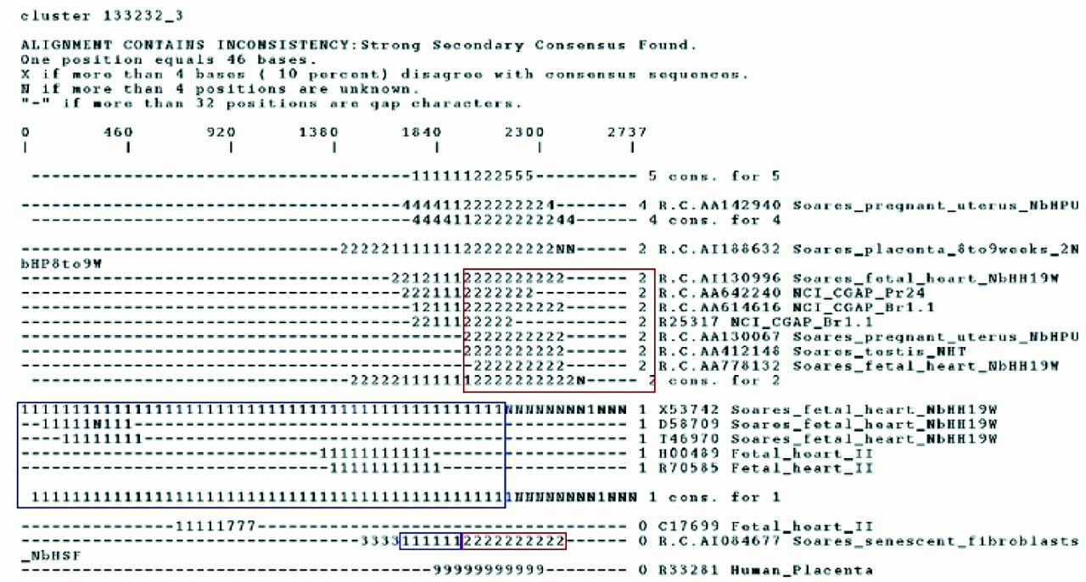
Figure 1. Craw output for a whole-body index cluster displaying alternate gene isoforms of the fibulin gene. ...
Notes:
Figure 1. Craw output for a whole-body index cluster displaying alternate gene isoforms of the fibulin gene. The blue box indicates the region capturing the fibulin-1B isoform whereas sequences capturing fibulin-1C are surrounded by a red box.
Unless provided in the caption above, the following copyright applies to the content of this slide:

Slide 2
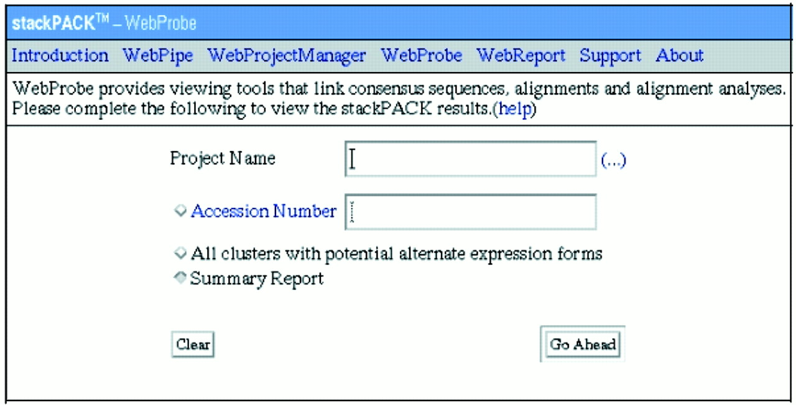
Figure 2. WebProbe, the STACK database extraction and viewing tool. The STACK tissue category is used as ...
Notes:
Figure 2. WebProbe, the STACK database extraction and viewing tool. The STACK tissue category is used as input to the ‘project name’ field that returns a list of all the clustered information.
Unless provided in the caption above, the following copyright applies to the content of this slide:

Slide 3
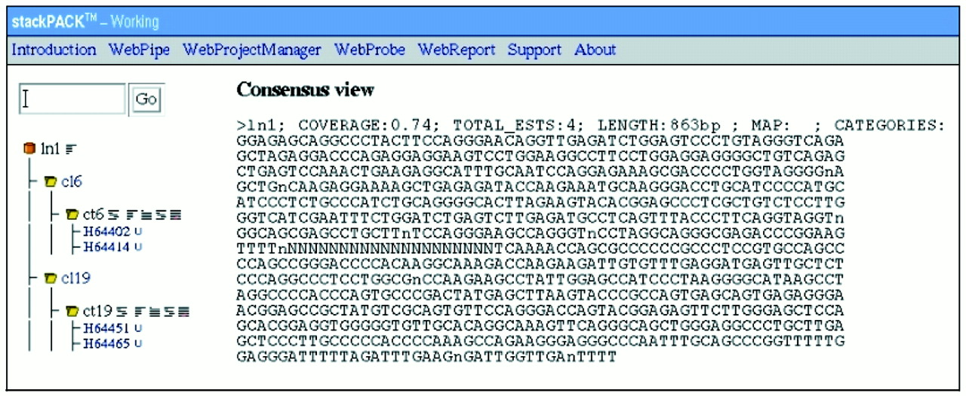
Figure 3. An example linked entry for the olfactory tissue. The clusters contributing to the linked entry are ...
Notes:
Figure 3. An example linked entry for the olfactory tissue. The clusters contributing to the linked entry are displayed together with the ESTs comprising each cluster. A mouse click on a specific clusterID executes the download of the FASTA formatted multi-sequence file. The hyperlinks to the right of the clusterID provides for the display of detailed information pertaining to a cluster such as phrap alignments, consensus sequence and assembly analysis information. UniGene links to each EST are provided if they exist.
Unless provided in the caption above, the following copyright applies to the content of this slide:

