Slide 1
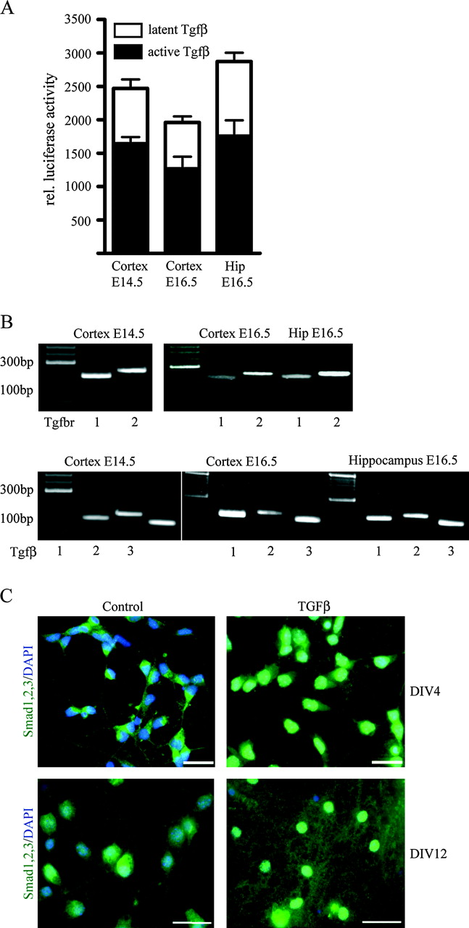
Figure 1. Primary cortical and hippocampal neurons isolated from E14.5 and E16.5 mouse embryonic brains express Tgfβs ...
Notes:
Figure 1. Primary cortical and hippocampal neurons isolated from E14.5 and E16.5 mouse embryonic brains express Tgfβs and their receptors and are responsive to TGFβ treatment. (A) MLEC/PAI–luciferase assay with conditioned medium from DIV4 cortical and hippocampal cultures. Data as mean ± SEM (n = 3). (B) RT-PCR reveals that cortical and hippocampal neurons express Tgfβ receptors I and II, as well as Tgfβ isoforms 1, 2, and 3. (C) Hippocampal neurons activate Smad proteins upon TGFβ stimulation. Smad1/2/3 immunoreactivity in control untreated cells was localized diffusely in the cytoplasm, whereas TGFβ treatment caused a translocation of Smad proteins in the nucleus. Upper panels: DIV4, lower panels: DIV12. Scale bars = 50 μm.
Unless provided in the caption above, the following copyright applies to the content of this slide: © 2009 The AuthorsThis is an Open Access article distributed under the terms of the Creative Commons Attribution Non-Commercial License (http://creativecommons.org/licenses/by-nc/2.0/uk/) which permits unrestricted non-commercial use, distribution, and reproduction in any medium, provided the original work is properly cited.

Slide 2
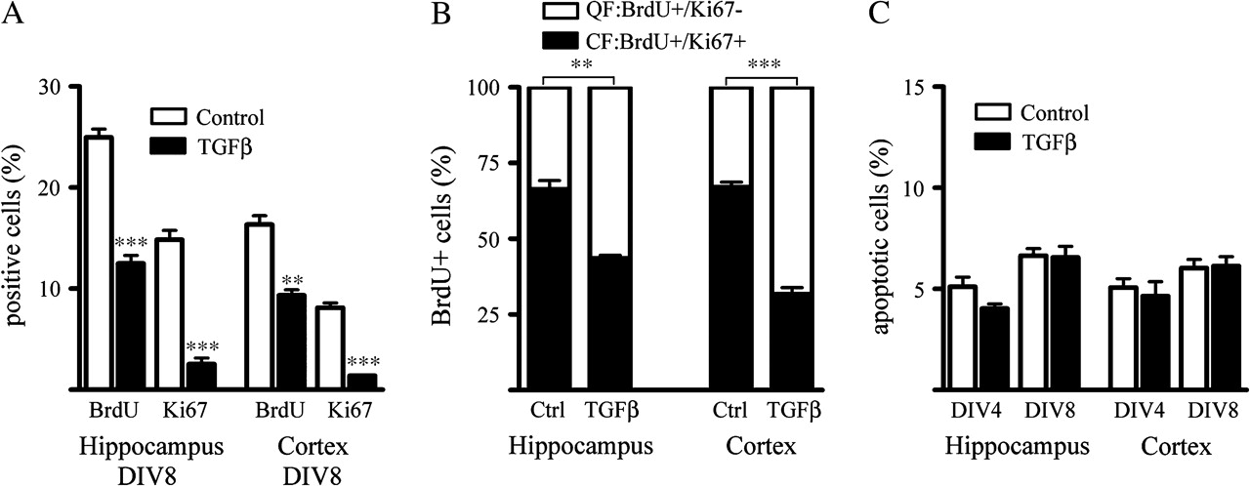
Figure 2. TGFβ promotes exit from the cell cycle. (A) Hippocampal and cortical cultures were treated for 6 days with ...
Notes:
Figure 2. TGFβ promotes exit from the cell cycle. (A) Hippocampal and cortical cultures were treated for 6 days with TGFβ, labeled with BrdU (20 nM) in the last 24 h, and stained for BrdU and Ki67, detecting decreased numbers of proliferating progenitors (n = 3), P values: ***P < 0.001, **P < 0.01, student's t-test. (B) Determination of cells leaving the cell cycle within the first 48 h of TGFβ exposure. Treatment started at DIV2; after 24 h, BrdU was added and after another 24 h, cells were fixed and costained for BrdU and Ki67. BrdU incorporation had not changed at this time point, but there was an increase in the number of cells quitting the cell cycle (QF) and a corresponding decrease of cells that reenter the cell cycle (CF) (all n = 3), P values: ***P < 0.001, **P < 0.01, student's t-test. (C) PI-FACS analysis of apoptotic cells after short-time (DIV2–DIV4) and long-time (DIV2–DIV8) treatment with TGFβ (n = 3).
Unless provided in the caption above, the following copyright applies to the content of this slide: © 2009 The AuthorsThis is an Open Access article distributed under the terms of the Creative Commons Attribution Non-Commercial License (http://creativecommons.org/licenses/by-nc/2.0/uk/) which permits unrestricted non-commercial use, distribution, and reproduction in any medium, provided the original work is properly cited.

Slide 3
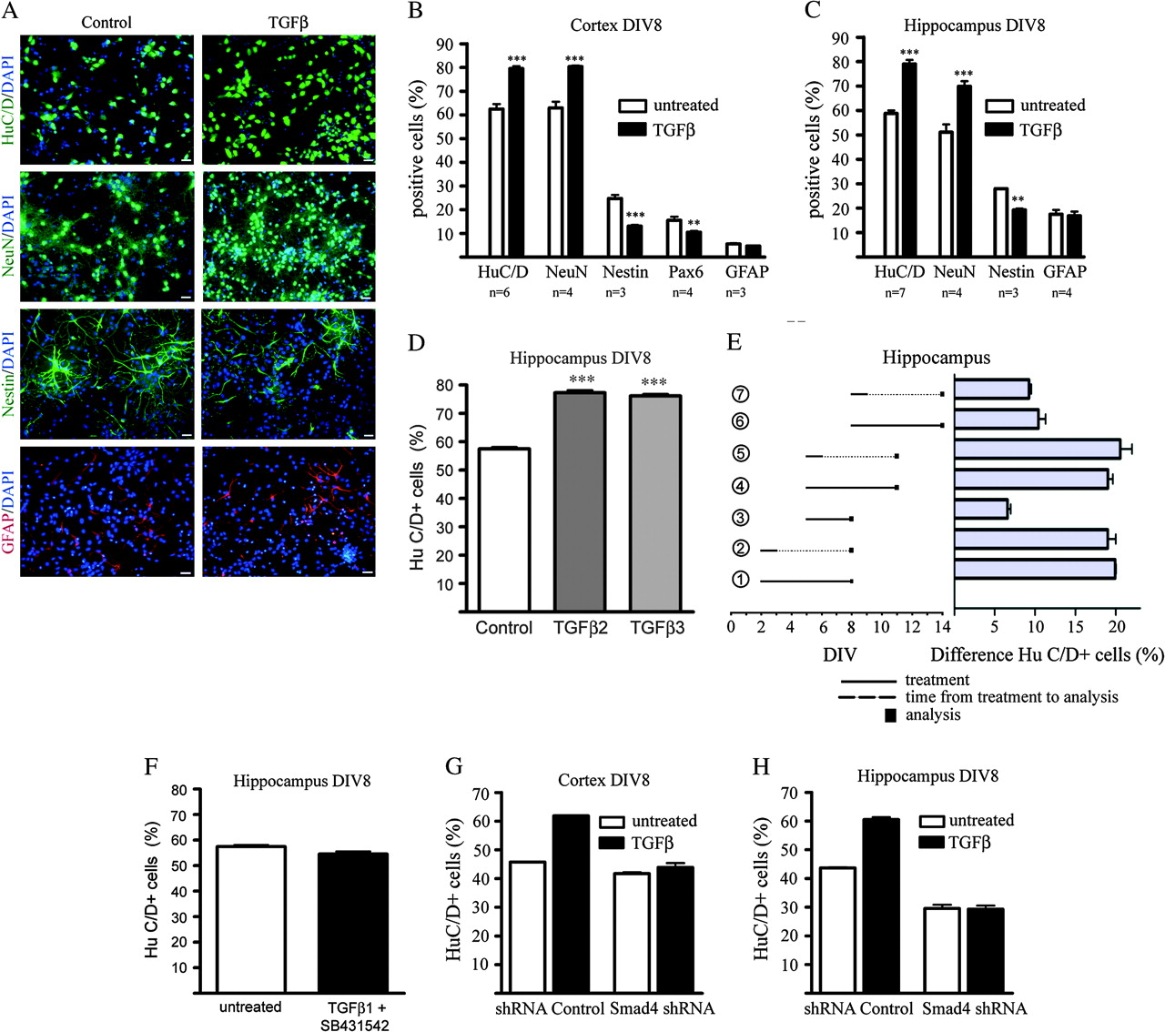
Figure 3. TGFβ promotes neuronal differentiation from hippocampal and cortical progenitors in a Smad-dependent way. (A) ...
Notes:
Figure 3. TGFβ promotes neuronal differentiation from hippocampal and cortical progenitors in a Smad-dependent way. (A) Immunohistochemical appearance of HuC/D and NeuN expressing neurons, Nestin-positive progenitors, and GFAP-positive glia cells in hippocampal cultures after 6 days of TGFβ treatment compared with untreated control cells. Scale bars = 50 μm. (B,C) Quantification of markers reveals an increase of neurons and a decrease in progenitors in TGFβ-treated cultures compared with untreated controls. The number of glia cells remains unchanged. Data are presented as a percentage of the total cell number. Statistical significance was determined by student's t-test with P values: ***P < 0.001, **P < 0.01. (D) Quantification of HuC/D-positive neurons after 6-day stimulation of hippocampal cells with Tgfβ2 and Tgfβ3, respectively, at 8 DIV. (E) Influence of the duration of the TGFβ pulse and the age of the cultures on the TGFβ-induced neurogenetic effect in hippocampal cultures. A short TGFβ pulse of 24 h was sufficient to enhance neuronal differentiation (2,5,7) in the same way as a long pulse of 6 days over the entire cultivation period (1,4,6). TGFβ was also able to promote a neuronal cell fate in older cultures from DIV5 (4,5) at a similar rate as in cultures from DIV2 (1,2). In cultures where TGFβ treatment was started on DIV8 (6,7), there was less increase in the number of HuC/D neurons. Data are presented as percent difference of HuC/D-positive cells of the TGFβ-treated cultures based on the untreated controls and given as mean ± SEM (n = 3). (F) Quantification of HuC/D-positive cells under control conditions and after blocking Tgfβ signaling with Alk4,5,7 inhibitor SB431542. (G,H) TGFβ-mediated neuronal differentiation was abolished after knockdown of Smad4 by lentiviral transduction of cortical (G) and hippocampal (H) cultures. HuC/D-positive neurons were counted after transduction with Smad4 shRNA or nontarget shRNA control with and without TGFβ treatment (n = 3).
Unless provided in the caption above, the following copyright applies to the content of this slide: © 2009 The AuthorsThis is an Open Access article distributed under the terms of the Creative Commons Attribution Non-Commercial License (http://creativecommons.org/licenses/by-nc/2.0/uk/) which permits unrestricted non-commercial use, distribution, and reproduction in any medium, provided the original work is properly cited.

Slide 4
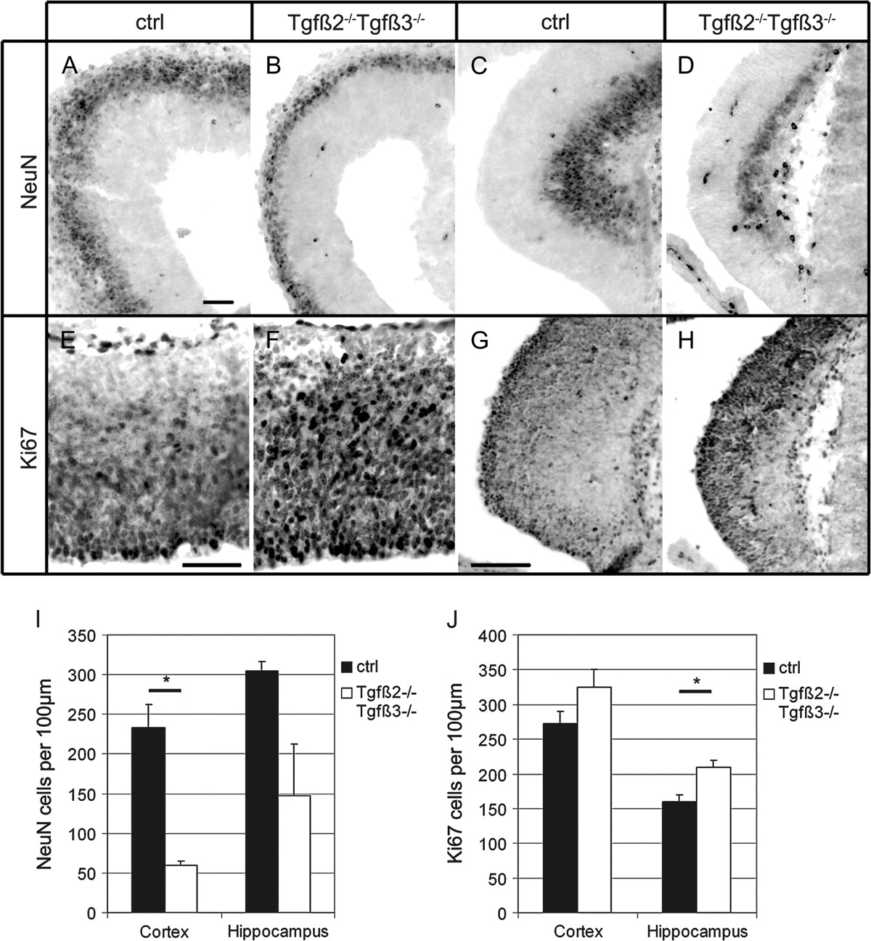
Figure 4. Increased proliferation and decreased neuronal differentiation in Tgfβ2/Tgfβ3 double mutant mice. (A–D) ...
Notes:
Figure 4. Increased proliferation and decreased neuronal differentiation in Tgfβ2/Tgfβ3 double mutant mice. (A–D) Expression of NeuN in control cortex (A) and hippocampus (C), and Tgfβ2/Tgfβ3 double mutant cortex (B) and hippocampus (D) from E14.5 littermates. Scale bar = 50 μm. (E–H) Expression of Ki67 in control (E) and in Tgfβ2/Tgfβ3 double mutant cerebral cortex (F), in control (G) and in Tgfβ2/Tgfβ3 double mutant hippocampus (H). Scale bar E,F = 50 μm, G,H = 100 μm. (I, J) Quantification of NeuN (I) and Ki67 (J) positive cells in the cerebral cortex and hippocampus of age-matched control and Tgfβ2/Tgfβ3 double mutants (n = 2, P value: * P < 0.05, one-tailed student's t-test).
Unless provided in the caption above, the following copyright applies to the content of this slide: © 2009 The AuthorsThis is an Open Access article distributed under the terms of the Creative Commons Attribution Non-Commercial License (http://creativecommons.org/licenses/by-nc/2.0/uk/) which permits unrestricted non-commercial use, distribution, and reproduction in any medium, provided the original work is properly cited.

Slide 5
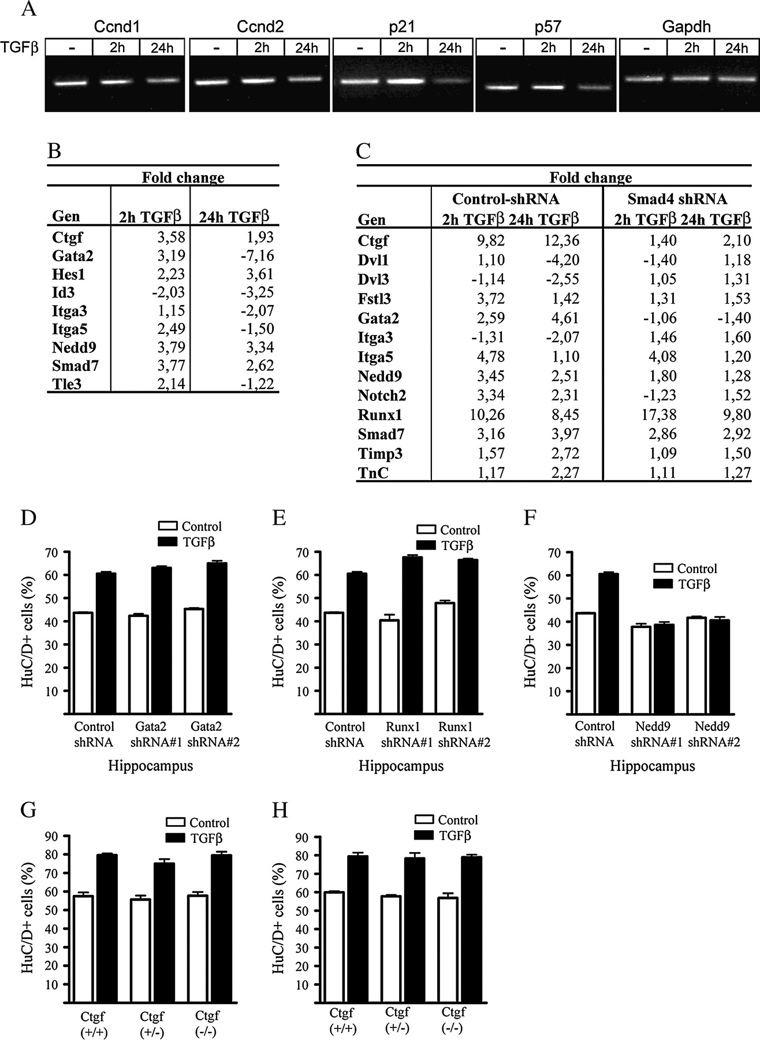
Figure 5. TGFβ-promoted neuronal differentiation depends on the expression of Nedd9. (A) Semiquantitative RT-PCR of ...
Notes:
Figure 5. TGFβ-promoted neuronal differentiation depends on the expression of Nedd9. (A) Semiquantitative RT-PCR of cell cycle regulating genes after TGFβ stimulation of hippocampal cultures at 4DIV for 2 and 24 h. (B) Real-time RT-PCR of different Tgfβ-regulated genes using cDNA from hippocampal cultures at 4DIV. Given are fold changes after 2 and 24 h of Tgfβ treatment, respectively. (C) Real-time RT-PCR of different Tgfβ-regulated genes using cDNA from hippocampal cultures at 12DIV. Given are fold changes after 2 and 24 h of Tgfβ treatment, respectively. Cells were transduced with a nontarget shRNA control lentivirus or with a Smad4 shRNA lentivirus to assess Smad4-dependent gene regulation. (D–H) shRNA-mediated knockdown of target genes showed that TGFβ-promoted neuronal differentiation was independent of Gata2 (D) and Runx1 (E). No increased neuronal differentiation was observed in cultures transduced with Nedd9 shRNA lentivirus (F). Cultures of hippocampal or cortical cells from Ctgf mutant mice (−/−) showed increased neuronal differentiation after Tgfβ treatment in similar ranges as control mice (+/+ and +/−) (G,H).
Unless provided in the caption above, the following copyright applies to the content of this slide: © 2009 The AuthorsThis is an Open Access article distributed under the terms of the Creative Commons Attribution Non-Commercial License (http://creativecommons.org/licenses/by-nc/2.0/uk/) which permits unrestricted non-commercial use, distribution, and reproduction in any medium, provided the original work is properly cited.

Slide 6
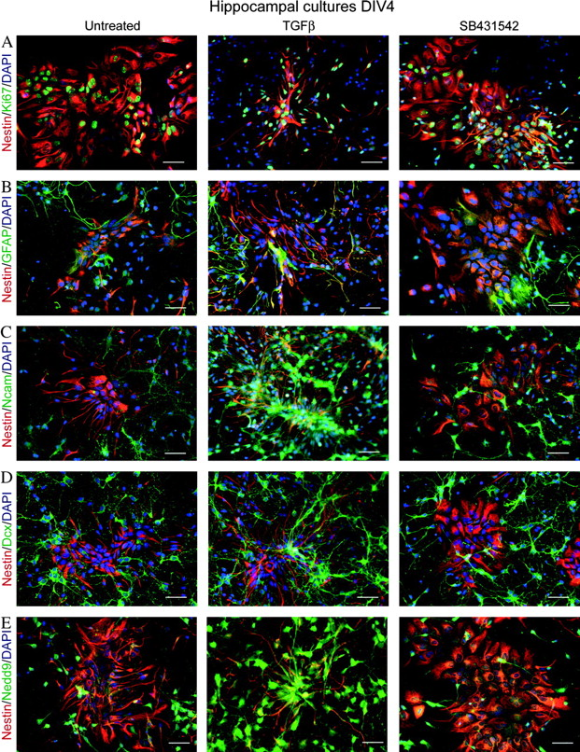
Figure 6. Morphological changes in Nestin-positive progenitors upon TGFβ treatment. (A–E) Preparations of hippocampal ...
Notes:
Figure 6. Morphological changes in Nestin-positive progenitors upon TGFβ treatment. (A–E) Preparations of hippocampal cells contain clusters of Nestin-positive progenitors that have a different morphology in untreated control cultures and also in cultures treated with Alk4,5,7-inhibitor SB431542 compared with TGFβ-treated samples. Immunohistochemical characterization with Nestin and (A) Ki67, (B) GFAP, (C) PSA-NCam, (D) Dcx, and (E) Nedd9. Scale bars = 50 μm.
Unless provided in the caption above, the following copyright applies to the content of this slide: © 2009 The AuthorsThis is an Open Access article distributed under the terms of the Creative Commons Attribution Non-Commercial License (http://creativecommons.org/licenses/by-nc/2.0/uk/) which permits unrestricted non-commercial use, distribution, and reproduction in any medium, provided the original work is properly cited.

