Slide 1
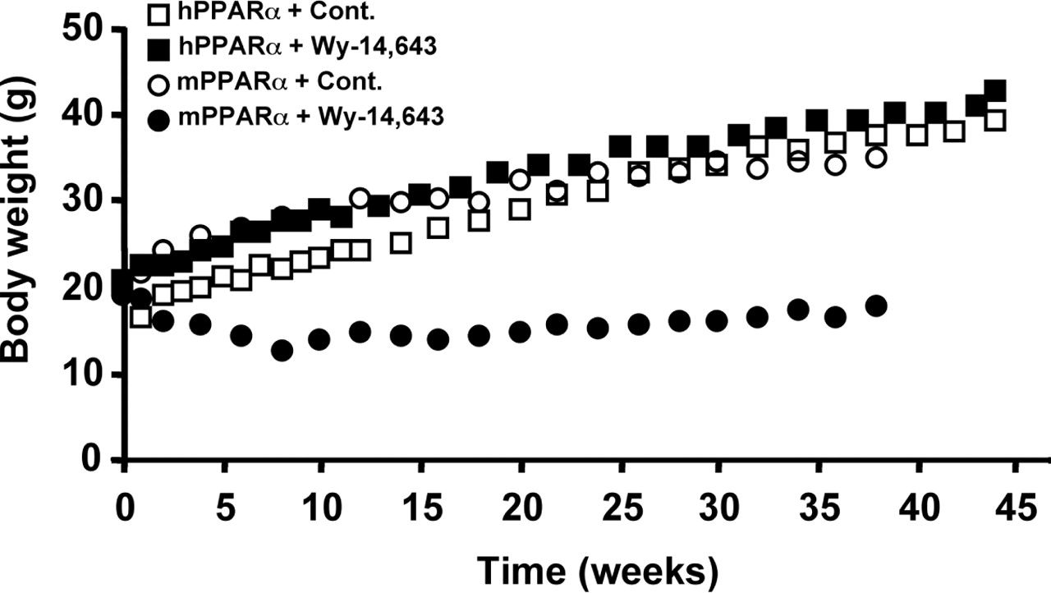
Fig. 1. Time-course changes in mean body weights. Mice were weighed every 2 weeks throughout the course of the study. ...
Notes:
Fig. 1. Time-course changes in mean body weights. Mice were weighed every 2 weeks throughout the course of the study. The mPPARα mice + Wy-14,643 group showed a lower rate of growth from the onset of the experiment.
Unless provided in the caption above, the following copyright applies to the content of this slide: © The Author 2005. Published by Oxford University Press. All rights reserved. For Permissions, please email: journals.permissions@oxfordjournals.org

Slide 2
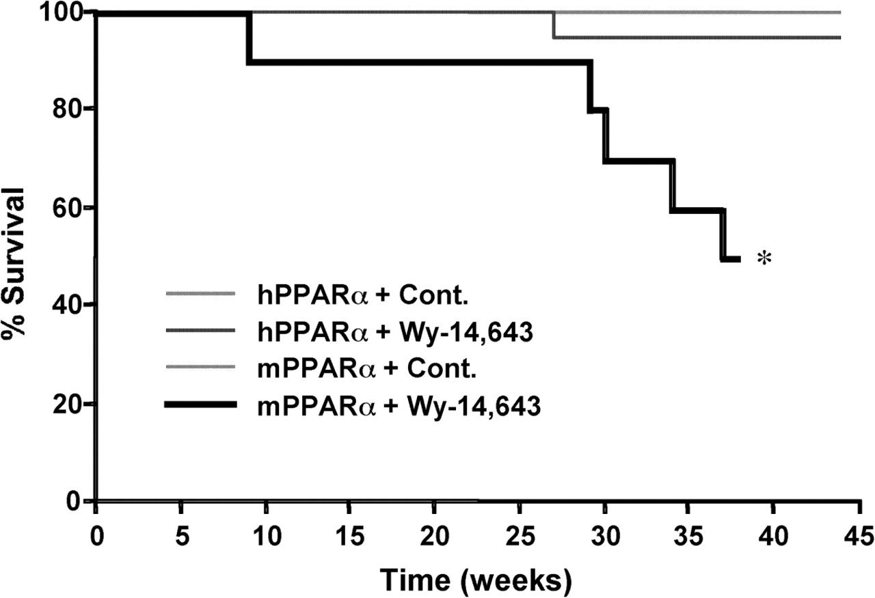
Fig. 2. Time-course changes in survival rates. Mice were examined twice a week and those exhibiting distress were ...
Notes:
Fig. 2. Time-course changes in survival rates. Mice were examined twice a week and those exhibiting distress were killed. Surviving curves were created using the Kaplan–Meier method. *P < 0.05 versus all other groups (log-rank test).
Unless provided in the caption above, the following copyright applies to the content of this slide: © The Author 2005. Published by Oxford University Press. All rights reserved. For Permissions, please email: journals.permissions@oxfordjournals.org

Slide 3
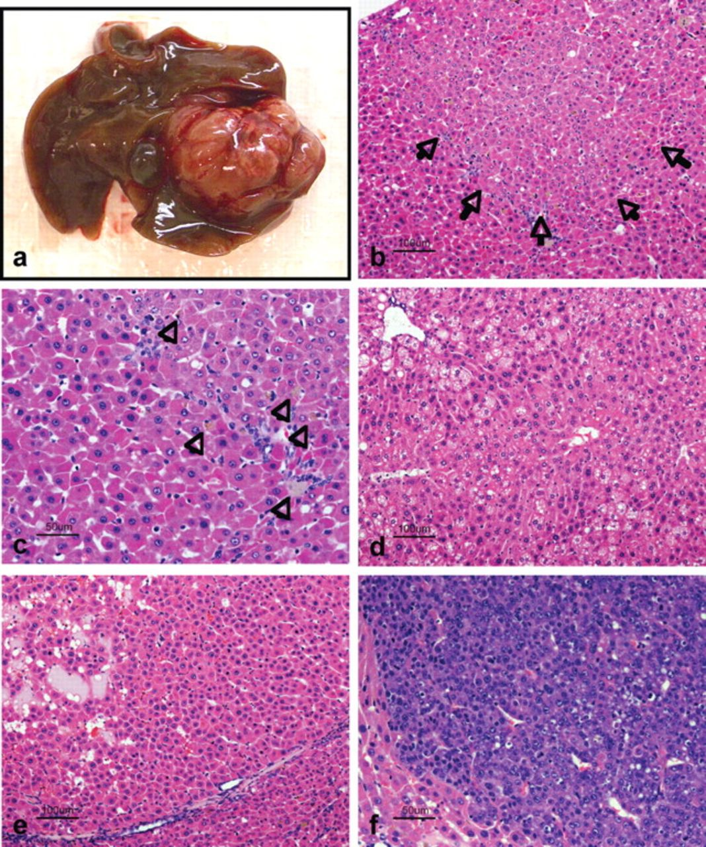
Fig. 3. Representative photomicrographs of liver lesions. ( A ) A grossly visible hepatic nodular mass is seen in ...
Notes:
Fig. 3. Representative photomicrographs of liver lesions. ( A ) A grossly visible hepatic nodular mass is seen in the liver of a wild-type mouse after 38 weeks of Wy-14,643 feeding. ( B ) Photomicrograph of the eosinophilic altered cell foci in a wild-type mouse after 38 weeks of Wy-14,643 feeding. ( C ) High magnification of (B) shows severe toxic lesions including large eosinophilic hepatocytes with eosinophilic granular cytoplasm, pigment accumulation within Kupffer cells (arrows) and small basophilic cells of proliferating oval cells. ( D ) A photomicrograph of livers from a humanized PPARα mouse after 44 weeks of Wy-14,643 feeding. Mild fatty change and glycogen deposition are seen, but the toxic lesions are not evident compared with liver from wild-type mice after 38 weeks of Wy-14,643 feeding. ( E ) and ( F ) A photomicrograph of a representative hepatocellular adenoma and carcinoma in wild-type mouse after 38 weeks of Wy-14,643 feeding, respectively.
Unless provided in the caption above, the following copyright applies to the content of this slide: © The Author 2005. Published by Oxford University Press. All rights reserved. For Permissions, please email: journals.permissions@oxfordjournals.org

Slide 4
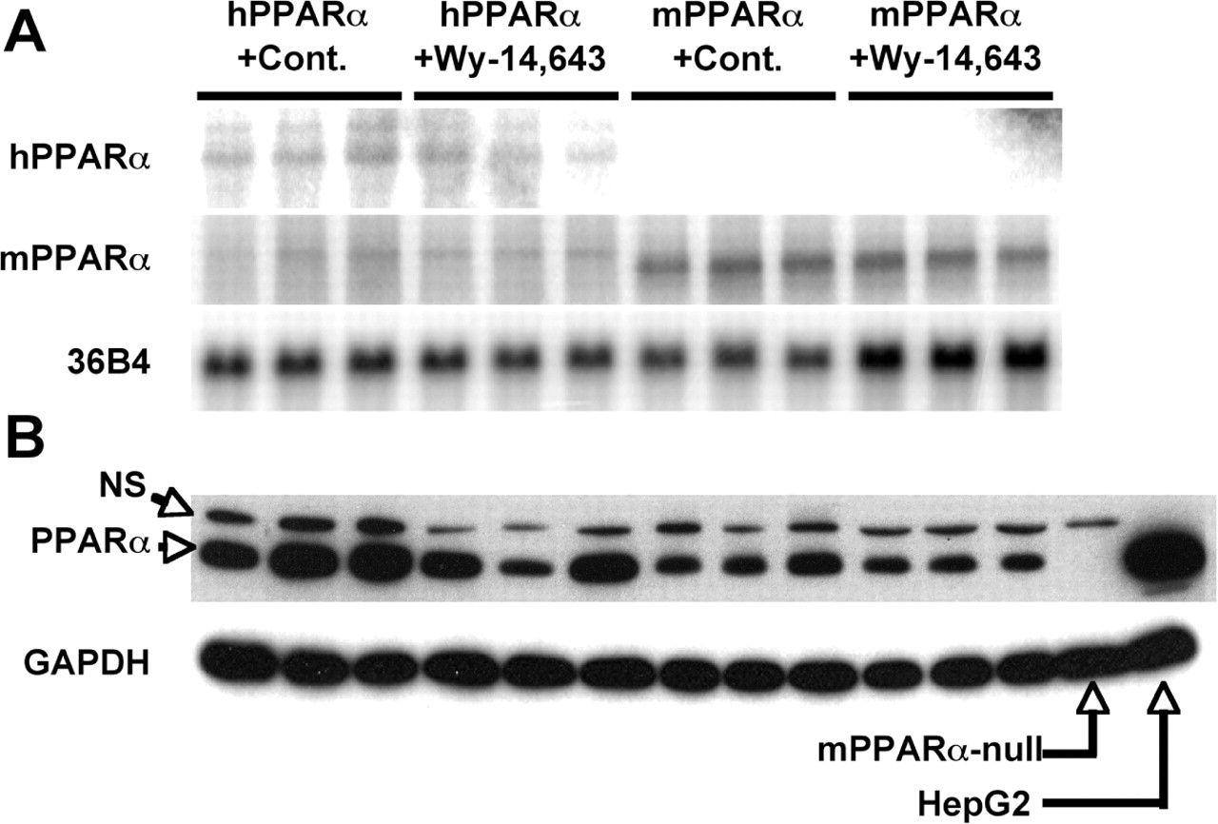
Fig. 4. Gene expression ( A ) and protein expression ( B ) of PPARα. (A) Total RNAs from livers of non-cancerous ...
Notes:
Fig. 4. Gene expression ( A ) and protein expression ( B ) of PPARα. (A) Total RNAs from livers of non-cancerous tissue were hybridized with specific probes for human and mouse PPARα genes. (B) Nuclear extracts proteins were subjected to western blots using polyclonal PPARα antibody. Nuclear extracts from liver tissue of PPARα-null mice and from PPARα expressing HepG2 cells were used as negative and positive controls, respectively. Cont., control diet; Wy-14,643, control diet containing 0.1% Wy-14,643.
Unless provided in the caption above, the following copyright applies to the content of this slide: © The Author 2005. Published by Oxford University Press. All rights reserved. For Permissions, please email: journals.permissions@oxfordjournals.org

Slide 5
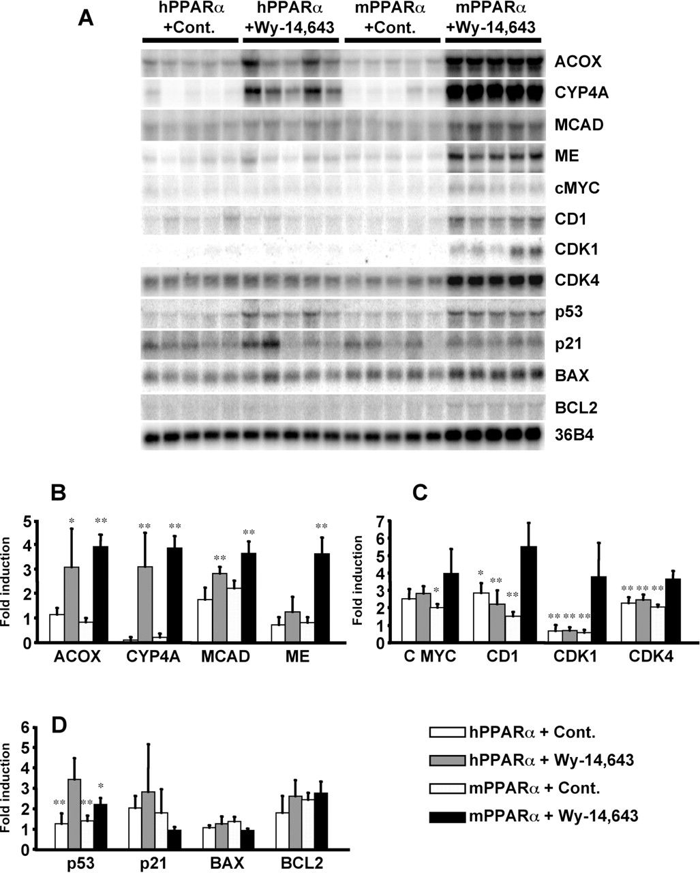
Fig. 5. Northern blot analysis of PPARα target genes and cell cycle/apoptosis regulating genes using probes as ...
Notes:
Fig. 5. Northern blot analysis of PPARα target genes and cell cycle/apoptosis regulating genes using probes as indicated ( A ). Total RNA (10 µg/lane) was isolated from livers of non-cancerous tissue ( n = 5 animals) from each animal. The signal for acidic ribosomal phosphoprotein (36B4) was used as a control for loading and RNA integrity. Cont., control diet; Wy-14,643, control diet containing 0.1% Wy-14,643; ACOX, acyl-CoA oxidase; CYP4A, cytochrome P450 4A family; MCAD, medium chain acyl-CoA dehydrogenase; ME, malic enzyme; C MYC, c-myc; CD1, cyclin D1; CDK, cyclin-dependent kinase. Quantification analysis of gene expression (B, C and D). All values were normalized to the signal for 36B4. Results represent mean ± SD. ( B ) Results for PPARα target genes. *P < 0.05, **P < 0.01 versus corresponding to mice fed with control diet. ( C ) Results for cell cycle regulating genes. *P < 0.05, **P < 0.01 versus mPPARα fed with diet containing 0.1% Wy-14,643. ( D ) Results for apoptosis regulating genes. *P < 0.05, **P < 0.01 versus hPPARα fed with diet containing 0.1% Wy-14,643.
Unless provided in the caption above, the following copyright applies to the content of this slide: © The Author 2005. Published by Oxford University Press. All rights reserved. For Permissions, please email: journals.permissions@oxfordjournals.org

