Slide 1
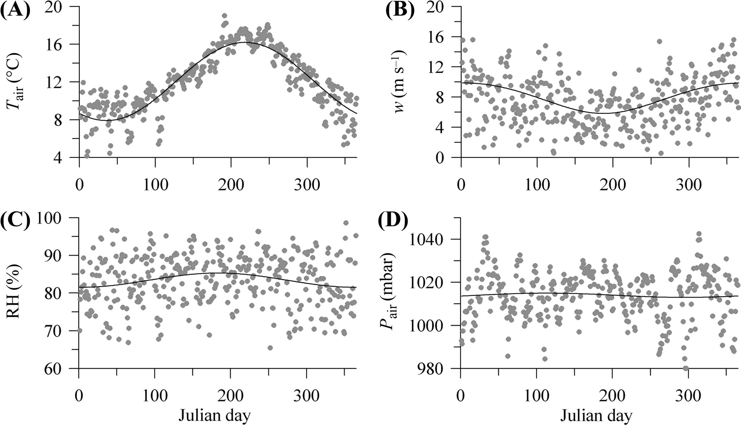
Fig. 1. Time series of the daily-mean meteorological data, (A) air temperature, (B) wind speed, (C) relative humidity ...
Notes:
Fig. 1. Time series of the daily-mean meteorological data, (A) air temperature, (B) wind speed, (C) relative humidity and (D) air pressure. The dots are data from the ERA-40 re-analysis, for a position in the central Celtic Sea and the year 1999. The lines are fits to a seasonal sinusoidal function [see equations (2)–(5)], showing most of the seasonality in the air temperature and wind speed, and smoothing out any short-term weather influences.
Unless provided in the caption above, the following copyright applies to the content of this slide: Published by Oxford University Press

Slide 2
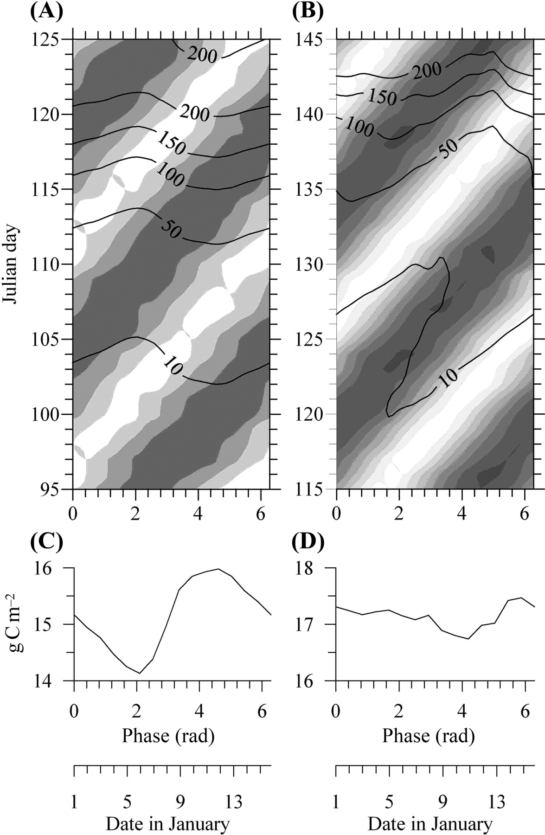
Fig. 2. Spring and early summer surface biomass (line contours, mg C m⁻³) and daily-averaged depth-mean ...
Notes:
Fig. 2. Spring and early summer surface biomass (line contours, mg C m−3) and daily-averaged depth-mean currents (shaded) as a function of the January first phase (or time) difference between the M2 and S2 tidal constituents, for (A) a water depth of 80 m and M2 tidal current amplitude of 0.2 m s−1, and (B) a water depth of 80 m and M2 tidal current amplitude of 0.5 m s−1. Corresponding changes in the integrated carbon fixation from the start of the year to the peak of the spring bloom are shown in (C) and (D) for the M2 amplitudes of 0.2 and 0.5 m s−1 respectively. The shaded contouring illustrates neap tides (white) and spring tides (dark), contoured with a 0.05 m s−1 interval. Neap daily-averaged tidal currents are 0.09 m s−1 in (A) and 0.27 m s−1 in (B). The second x-axes below (C) and (D) allows interpretation of the phase difference in terms of the date of the first January spring tide.
Unless provided in the caption above, the following copyright applies to the content of this slide: Published by Oxford University Press

Slide 3
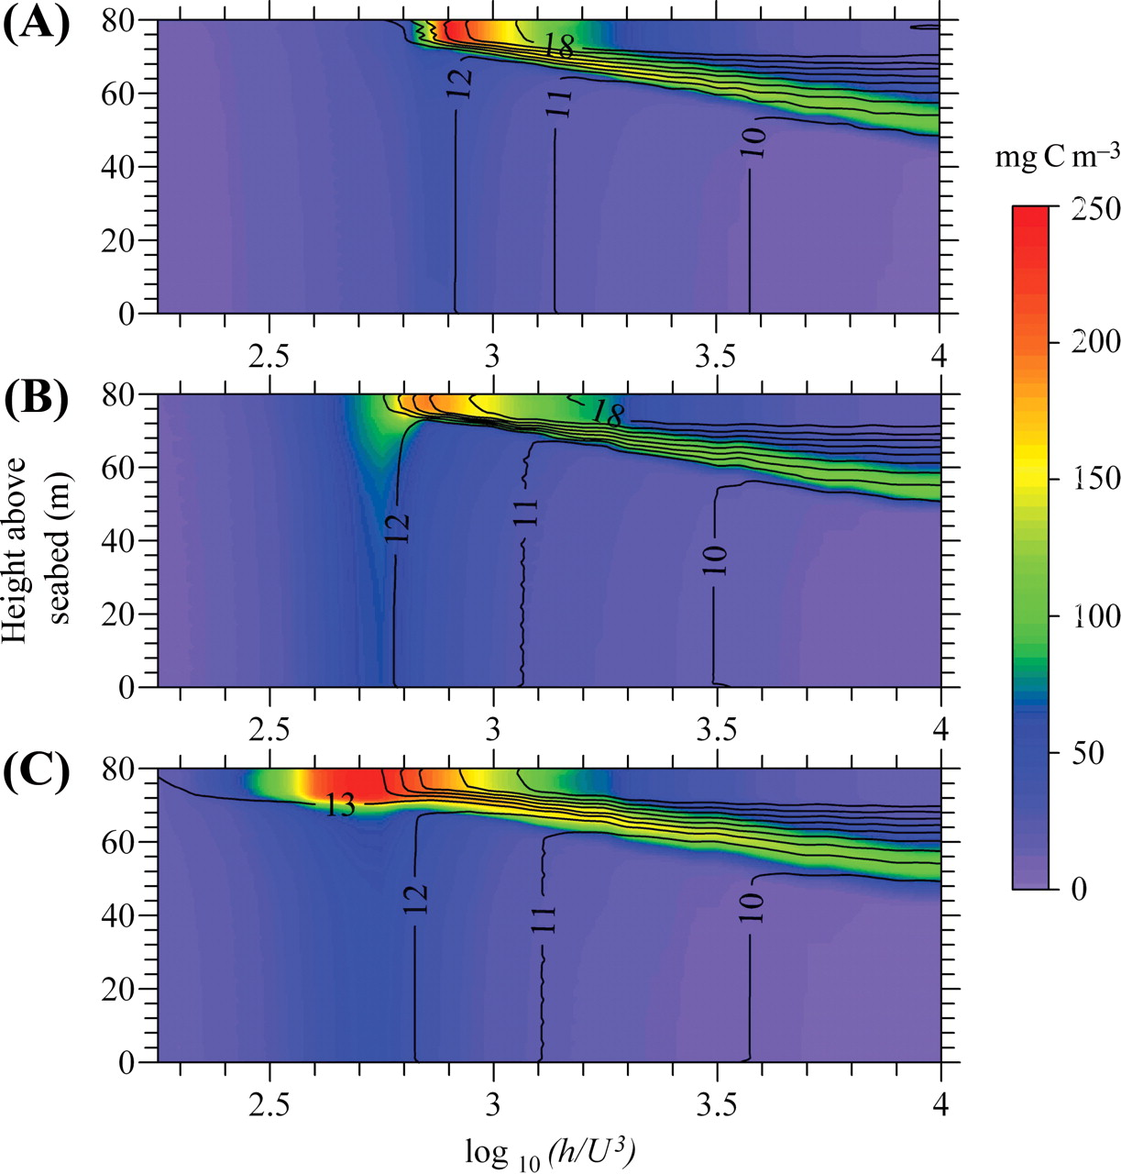
Fig. 3. Cross-frontal slices of temperature (lines) and phytoplankton carbon (colours) for (A) the model with ...
Notes:
Fig. 3. Cross-frontal slices of temperature (lines) and phytoplankton carbon (colours) for (A) the model with M2 tides only on Julian day 182, (B) the model with a spring-neap cycle for Julian day 182 (spring tides), and (C) the model with a spring-neap cycle for Julian day 189 (neap tides).
Unless provided in the caption above, the following copyright applies to the content of this slide: Published by Oxford University Press

Slide 4
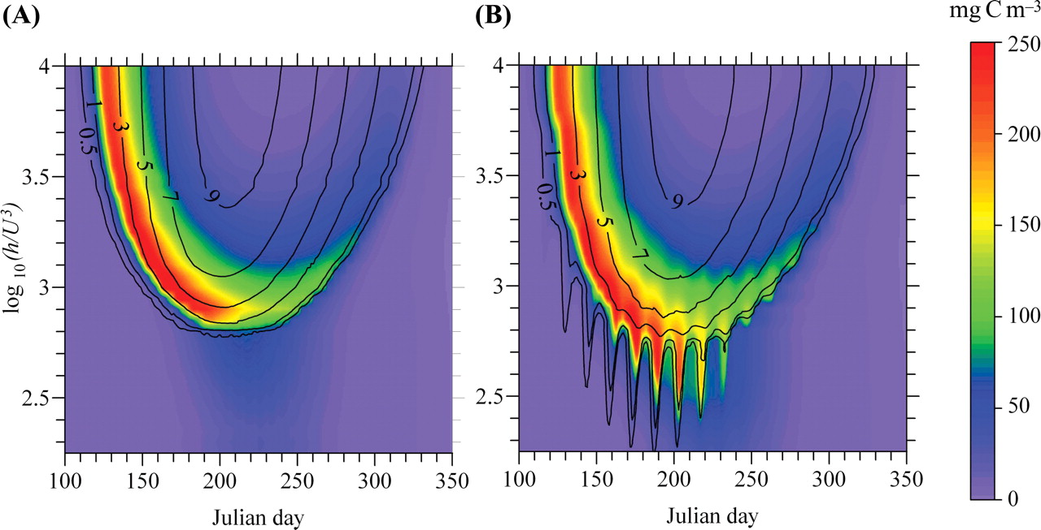
Fig. 4. Variations of cross-front surface phytoplankton carbon (colours) and surface-bottom temperature difference ...
Notes:
Fig. 4. Variations of cross-front surface phytoplankton carbon (colours) and surface-bottom temperature difference (lines) from early spring to late autumn for (A) the model with M2 tides only, and (B) the model with a spring-neap cycle.
Unless provided in the caption above, the following copyright applies to the content of this slide: Published by Oxford University Press

Slide 5
Fig. 5. Time series over one spring neap cycle of (A) surface-bottom temperature difference (solid line) and ...
Notes:
Fig. 5. Time series over one spring neap cycle of (A) surface-bottom temperature difference (solid line) and daily-averaged depth-mean current speed (dashed line), (B) surface phytoplankton (solid line) and surface DIN (dashed line), (C) absolute surface nitrogen uptake rate (solid line) and biomass-specific surface nitrogen uptake (dashed line), and (D) absolute rate of surface carbon fixation (solid line) and biomass-specific surface growth rate (dashed line). In each panel the solid line uses the left axis, and the dashed line uses the right axis.
Unless provided in the caption above, the following copyright applies to the content of this slide: Published by Oxford University Press

Slide 6
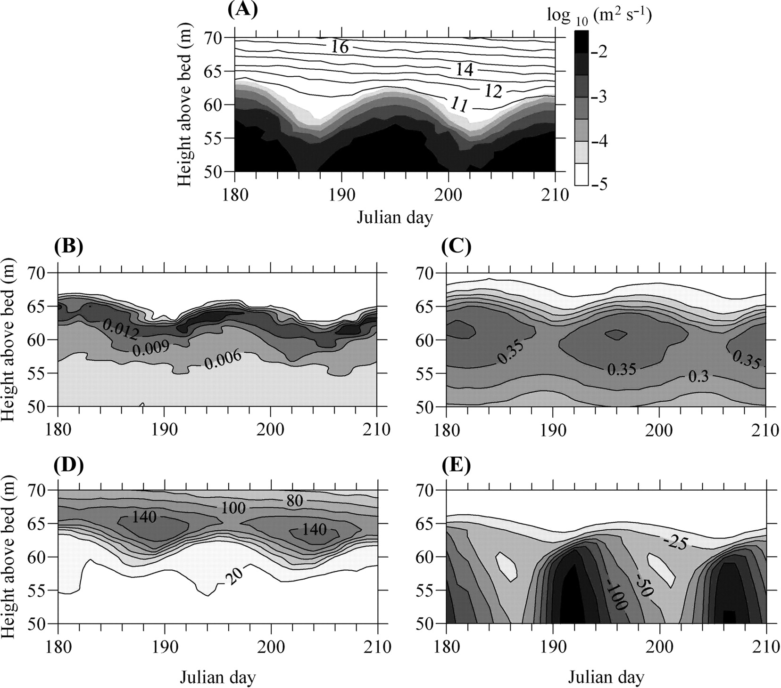
Fig. 6. Spring-neap variability in the thermocline. The physical variability is shown as changes in the temperature ...
Notes:
Fig. 6. Spring-neap variability in the thermocline. The physical variability is shown as changes in the temperature structure (line contours, °C) and vertical eddy diffusivity (shaded) in (A), with spring tides occurring on Julian day 195, neaps tides on Julian days 187 and 202. The corresponding biological signals are (B) nitrogen uptake rate (mmol DIN (mg C)−1 day−1), (C) specific growth rate (day−1), (D) phytoplankton biomass (mg C m−3), and (E) vertical carbon flux (mg C m−2 day−1).
Unless provided in the caption above, the following copyright applies to the content of this slide: Published by Oxford University Press

Slide 7
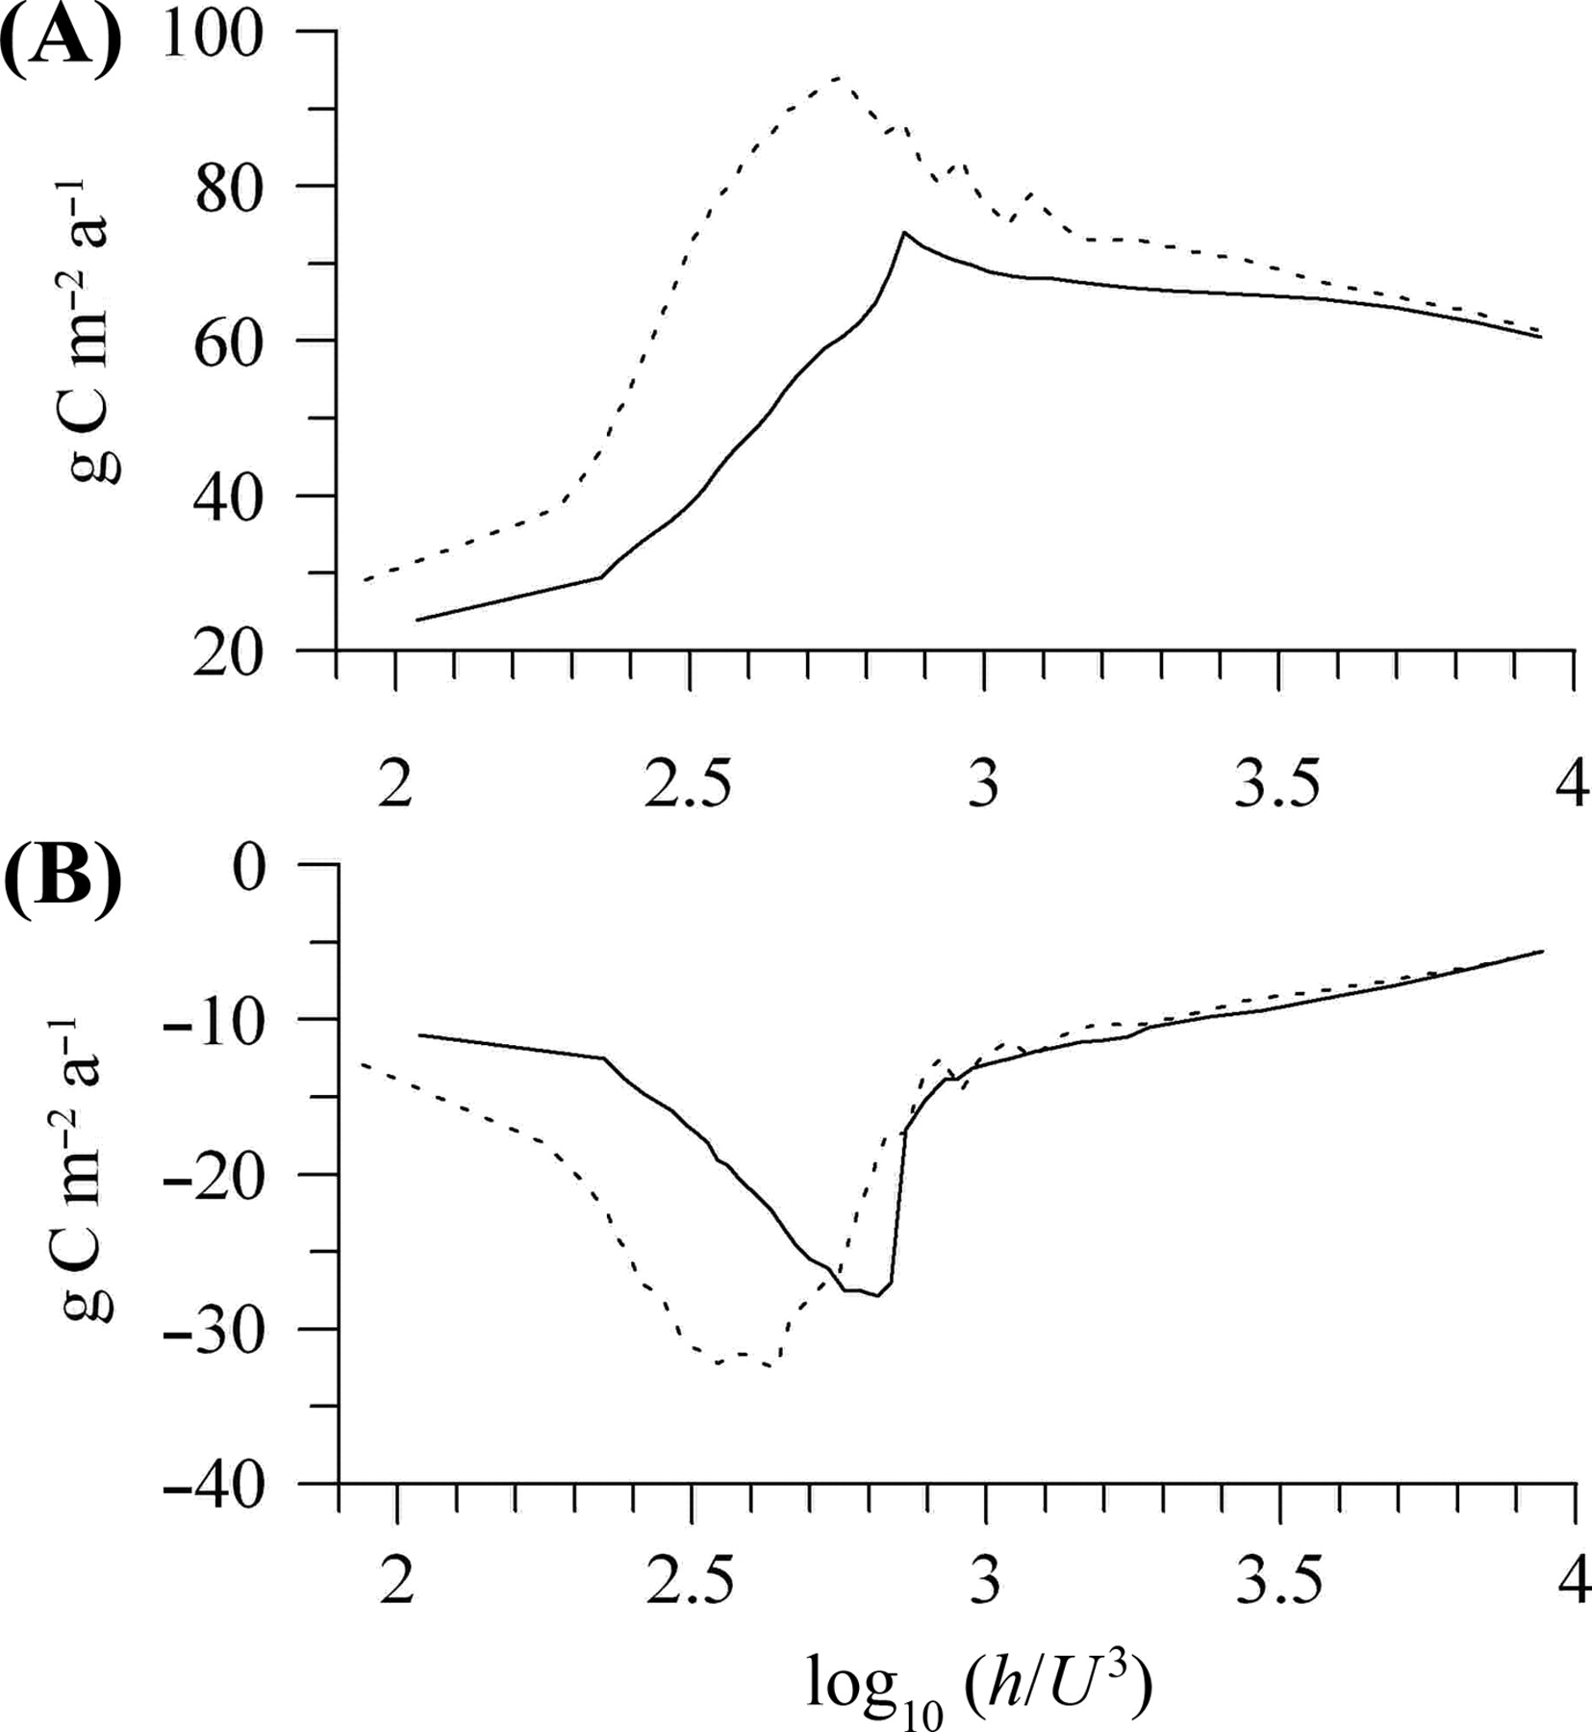
Fig. 7. The impact of the spring-neap cycle on (A) annual carbon fixation and (B) annual vertical carbon flux from ...
Notes:
Fig. 7. The impact of the spring-neap cycle on (A) annual carbon fixation and (B) annual vertical carbon flux from mixed (low log10(h/U3) to stratified (high log10(h/U3) shelf waters. The solid line is for the model run with M2 tides only, and the dashed line is for the model with a spring-neap cycle.
Unless provided in the caption above, the following copyright applies to the content of this slide: Published by Oxford University Press

