Slide 1
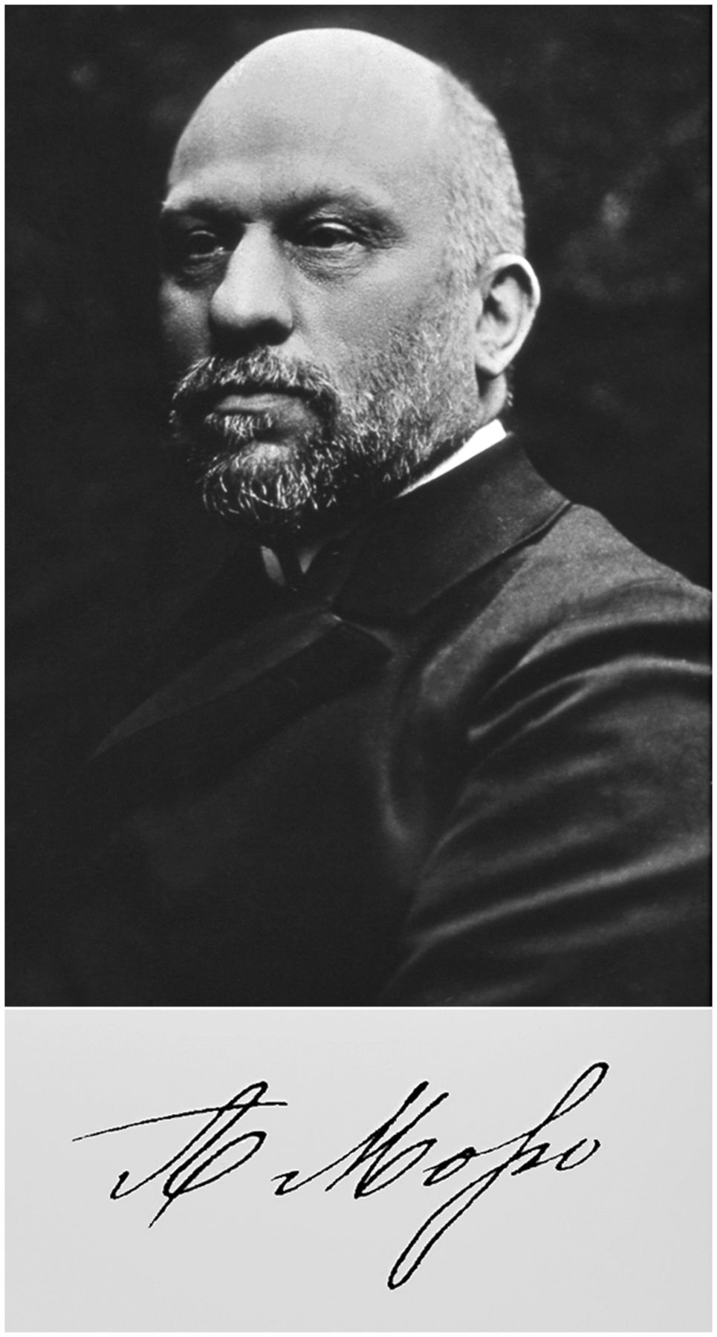
Figure 1 Photograph of Angelo Mosso and his signature (courtesy of Marco R. Galloni).
Notes:
Figure 1 Photograph of Angelo Mosso and his signature (courtesy of Marco R. Galloni).
Unless provided in the caption above, the following copyright applies to the content of this slide: © The Author (2013). Published by Oxford University Press on behalf of the Guarantors of Brain. All rights reserved. For Permissions, please email: journals.permissions@oup.com

Slide 2
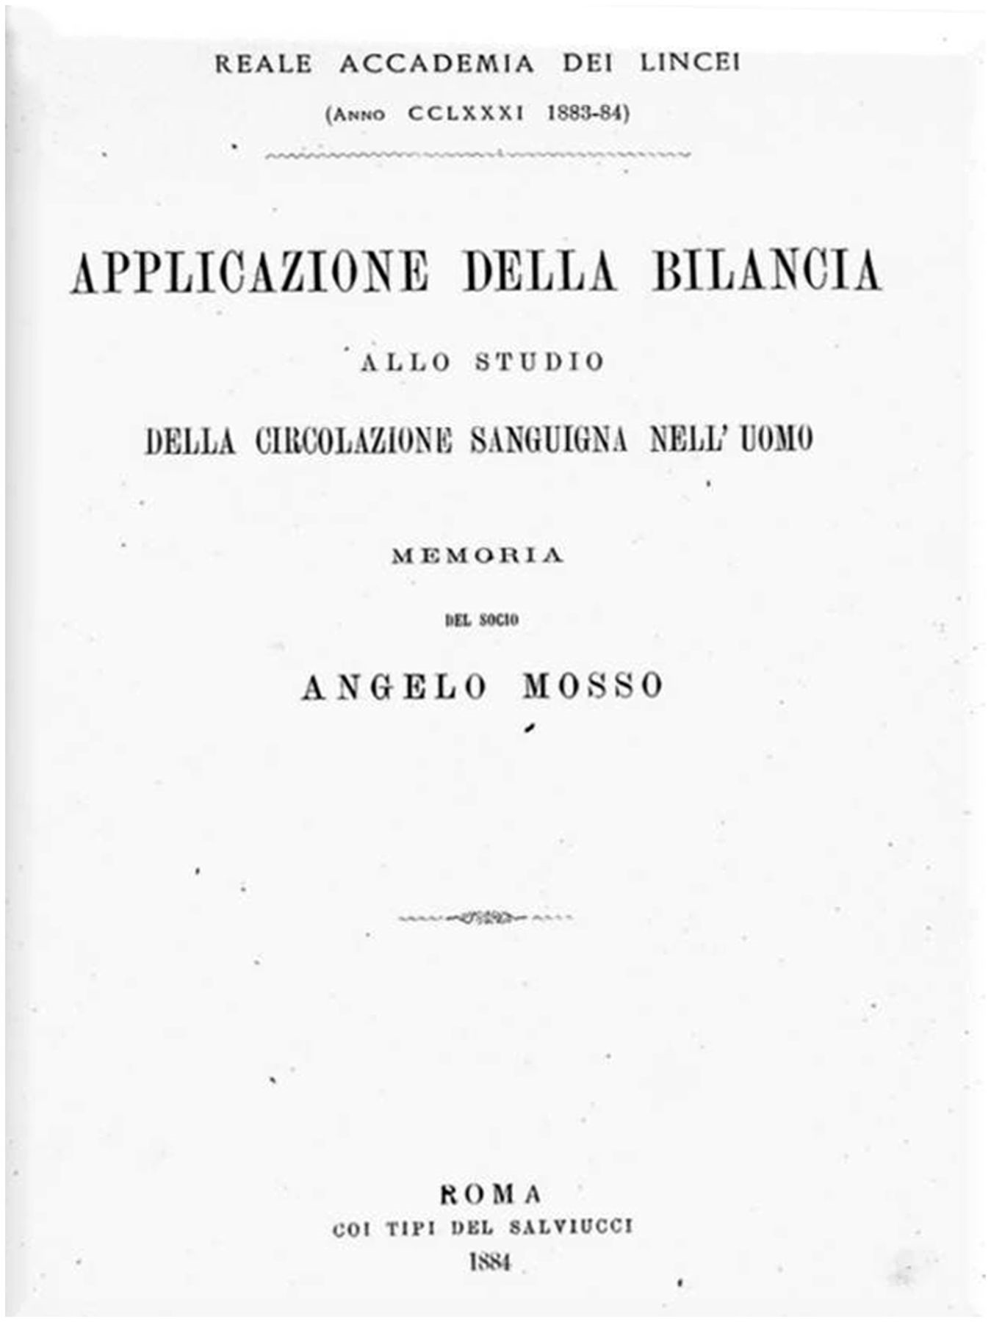
Figure 2 Cover of Angelo Mosso’s 1884 report translated in Appendix 1 (Atti della Reale Accademia dei Lincei).
Notes:
Figure 2 Cover of Angelo Mosso’s 1884 report translated in Appendix 1 (Atti della Reale Accademia dei Lincei).
Unless provided in the caption above, the following copyright applies to the content of this slide: © The Author (2013). Published by Oxford University Press on behalf of the Guarantors of Brain. All rights reserved. For Permissions, please email: journals.permissions@oup.com

Slide 3
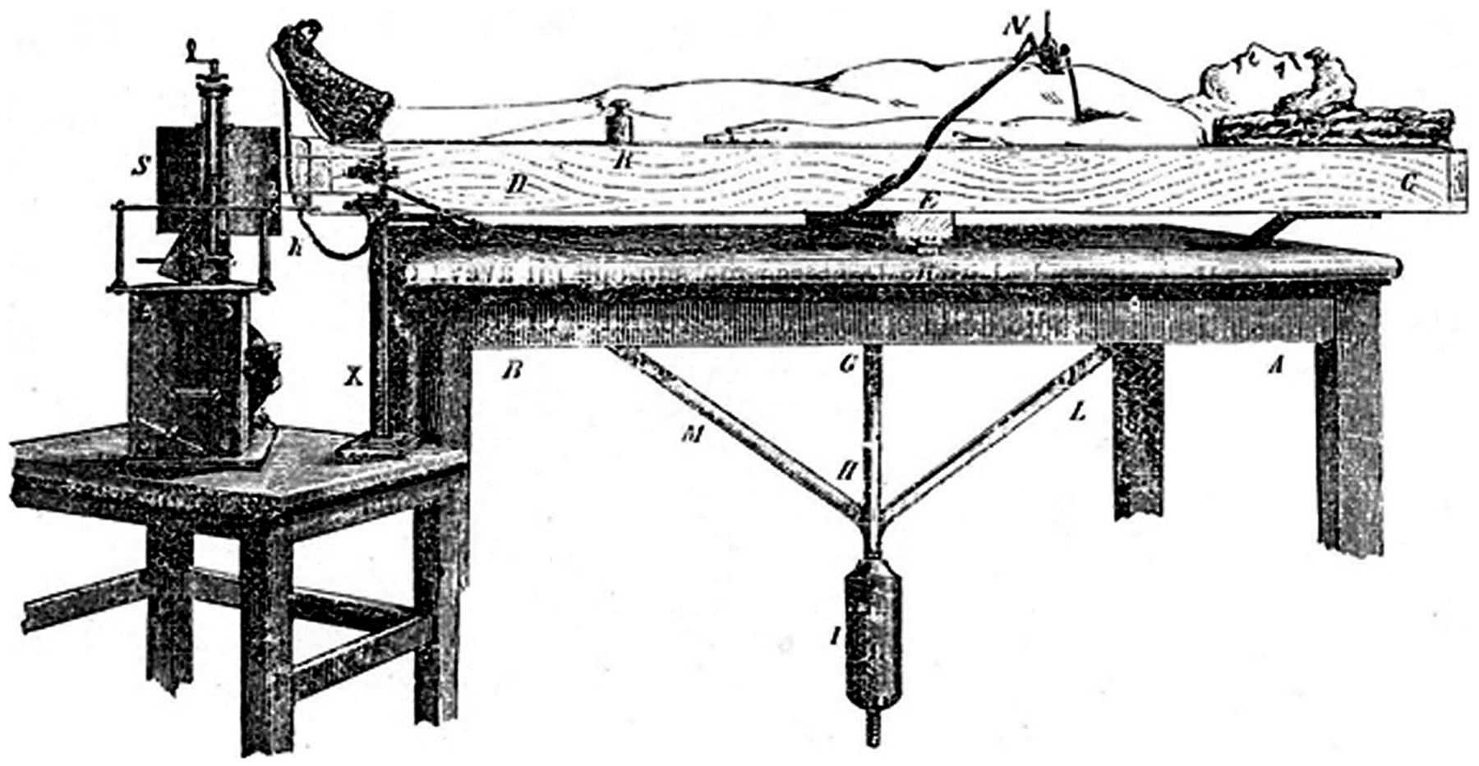
Figure 3 Mosso’s ‘human circulation balance’, used to measure cerebral activity during resting and cognitive states. A ...
Notes:
Figure 3 Mosso’s ‘human circulation balance’, used to measure cerebral activity during resting and cognitive states. A and B = wooden table with three apertures on its top; C and D = tilting bed; E = pivot with steel knife fulcrum; G and H = 1 m long iron rod bearing the counterweight; I = cast iron counterweight with screw regulation; M and L = two iron stiffening bars; N = pneumatic pneumograph; R = equilibrating weight; S = kymograph; X = vertical stand for graphic transducers (Angelo Mosso’s original drawing, modified and adapted from Mosso, 1884, Atti della Reale Accademia dei Lincei).
Unless provided in the caption above, the following copyright applies to the content of this slide: © The Author (2013). Published by Oxford University Press on behalf of the Guarantors of Brain. All rights reserved. For Permissions, please email: journals.permissions@oup.com

Slide 4
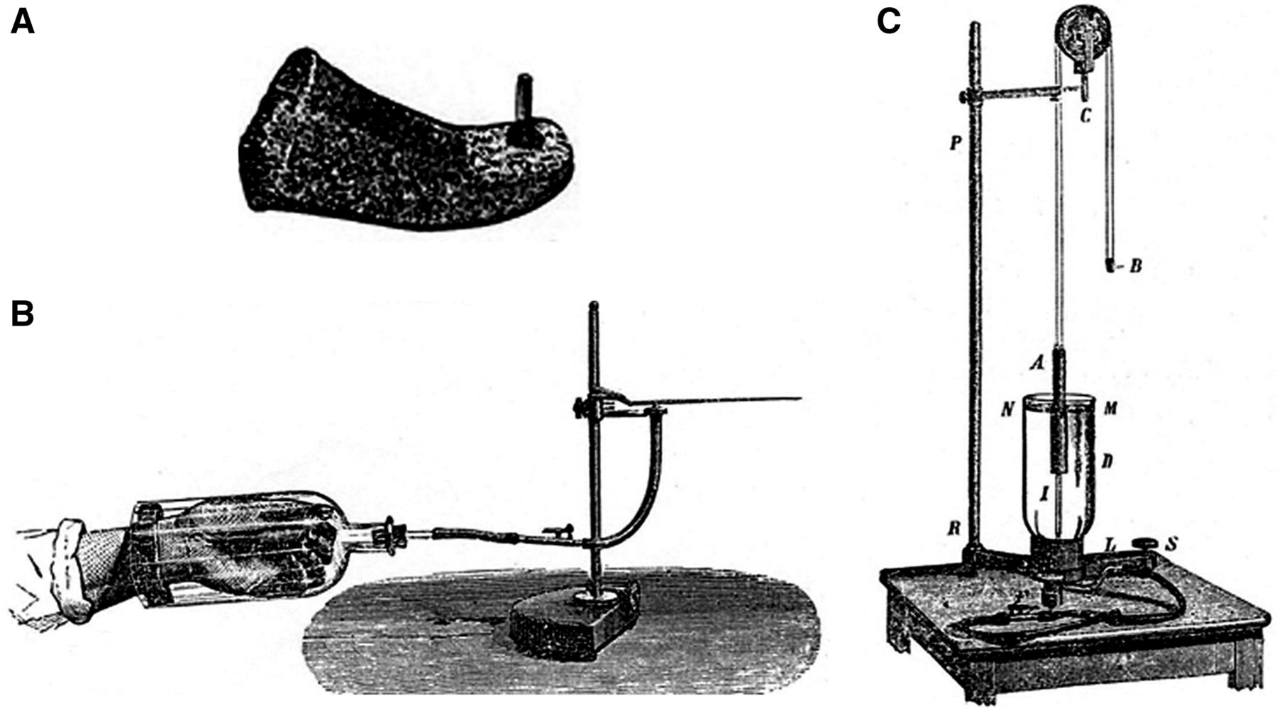
Figure 4 Angelo Mosso’s original drawing of other components of the ‘human circulation balance’. (A) Pneumatic ...
Notes:
Figure 4 Angelo Mosso’s original drawing of other components of the ‘human circulation balance’. (A) Pneumatic sphygmograph made with gutta-percha and connected by a rubber tube with a Marey drum capable of transcribing the pulse of the foot. (B) Pneumatic sphygmograph for the hand, which is inserted into a glass bottle sealed around the wrist with soft cement. (C) Pneumatic plethysmograph. A = thin metal floating bell; B = counterweight with an ink pen writing on a kymograph; C = pulley; D = glass jar full of ether or petrol essence; F = rubber tube receiving air from a hand or foot blood pressure transducer; I = glass tube entering the jar from below and connected with tube F; L = tripod stand; N and M = level of liquid; R = vertical rod; S = levelling screw (modified and adapted from Mosso, 1884, Atti della Reale Accademia dei Lincei).
Unless provided in the caption above, the following copyright applies to the content of this slide: © The Author (2013). Published by Oxford University Press on behalf of the Guarantors of Brain. All rights reserved. For Permissions, please email: journals.permissions@oup.com

Slide 5
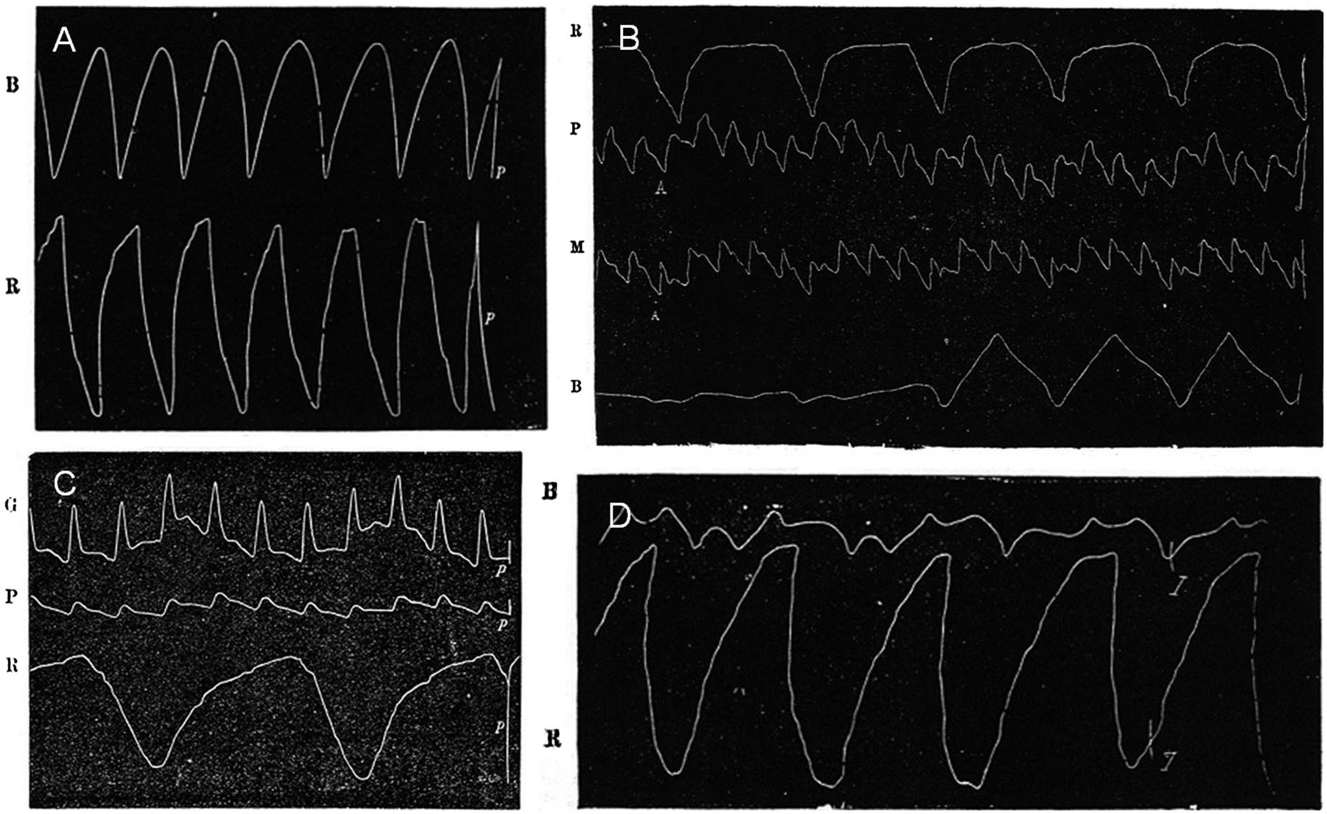
Figure 5 Angelo Mosso’s original recordings. (A) Paper tracing of the balance movements (top line B) and of breathing ...
Notes:
Figure 5 Angelo Mosso’s original recordings. (A) Paper tracing of the balance movements (top line B) and of breathing (R). (B) Paper tracing of four parameters: R = breathing; P = foot pulse; M = hand pulse; B = balance movements. Foot and hand pulses are opposites (simultaneously time maximum in one and time minimum in the other). The left of the foot curve shows an initial accumulation of blood in the distal end, which causes the balance to remain in the lower position; a regular oscillation starts when the blood distributes more evenly through the body. (C) Paper tracing of three parameters: G = leg pulse; P = foot pulse; R = breathing. This experiment was intended to evaluate the separation in time of the maximum blood rush in the leg and in the foot; Mosso could see that the pulse takes ∼2 s to cover the distance in the limb. (D) Paper tracing of the balance movements (top line B) and of breathing (R) with the subject sitting and the diaphragm muscle moving vertically on the axis of the pivot. Line B shows a flutter caused by a rubber dumper that was necessary to reduce wave amplitude (modified and adapted from Mosso, 1884, Atti della Reale Accademia dei Lincei).
Unless provided in the caption above, the following copyright applies to the content of this slide: © The Author (2013). Published by Oxford University Press on behalf of the Guarantors of Brain. All rights reserved. For Permissions, please email: journals.permissions@oup.com

Slide 6
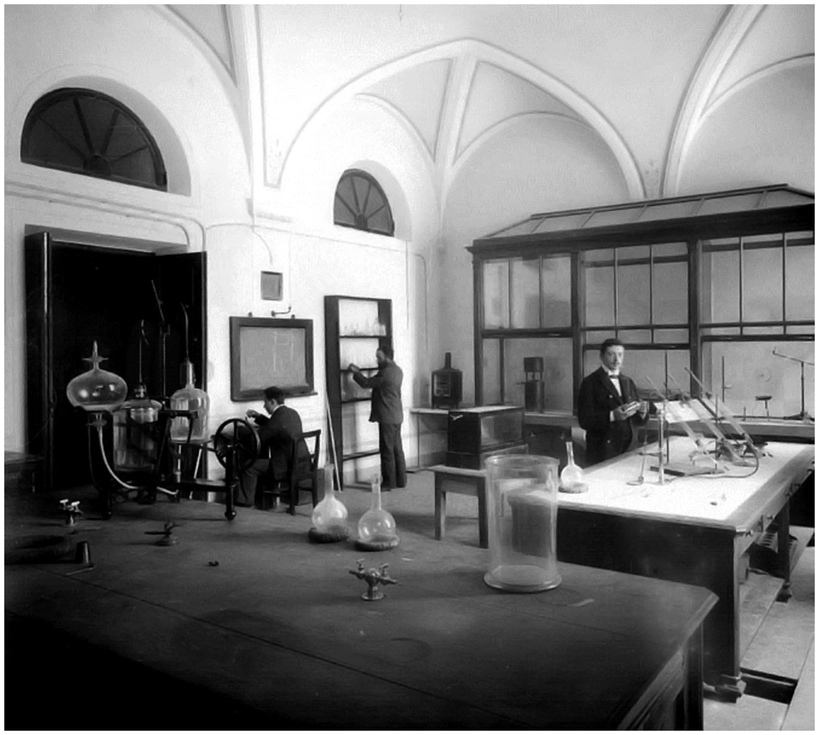
Figure 6 Angelo Mosso’s laboratory in Turin (courtesy of Marco R. Galloni).
Notes:
Figure 6 Angelo Mosso’s laboratory in Turin (courtesy of Marco R. Galloni).
Unless provided in the caption above, the following copyright applies to the content of this slide: © The Author (2013). Published by Oxford University Press on behalf of the Guarantors of Brain. All rights reserved. For Permissions, please email: journals.permissions@oup.com

Slide 7
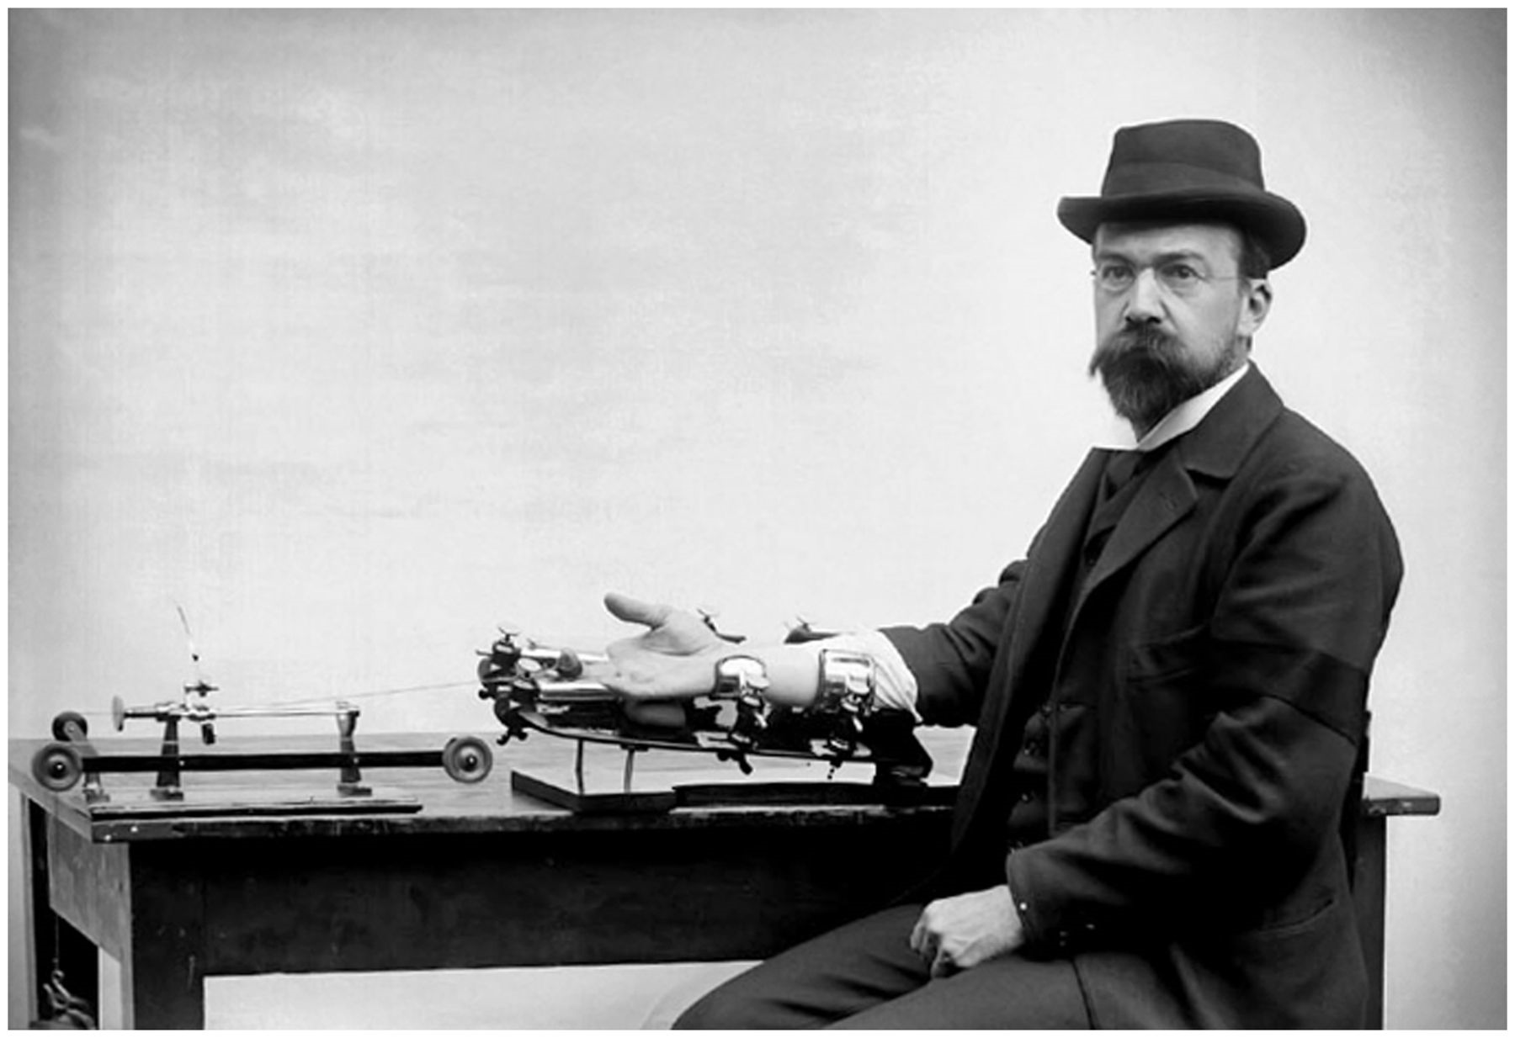
Figure 7 Angelo Mosso performing one of his experiments. Here Mosso is photographed with his pneumograph at pneumatic ...
Notes:
Figure 7 Angelo Mosso performing one of his experiments. Here Mosso is photographed with his pneumograph at pneumatic transduction with two drums, an evolution of Marey’s pneumograph, which in contrast had only one drum with a flexible guttapercha membrane (courtesy of Marco R. Galloni).
Unless provided in the caption above, the following copyright applies to the content of this slide: © The Author (2013). Published by Oxford University Press on behalf of the Guarantors of Brain. All rights reserved. For Permissions, please email: journals.permissions@oup.com

Slide 8
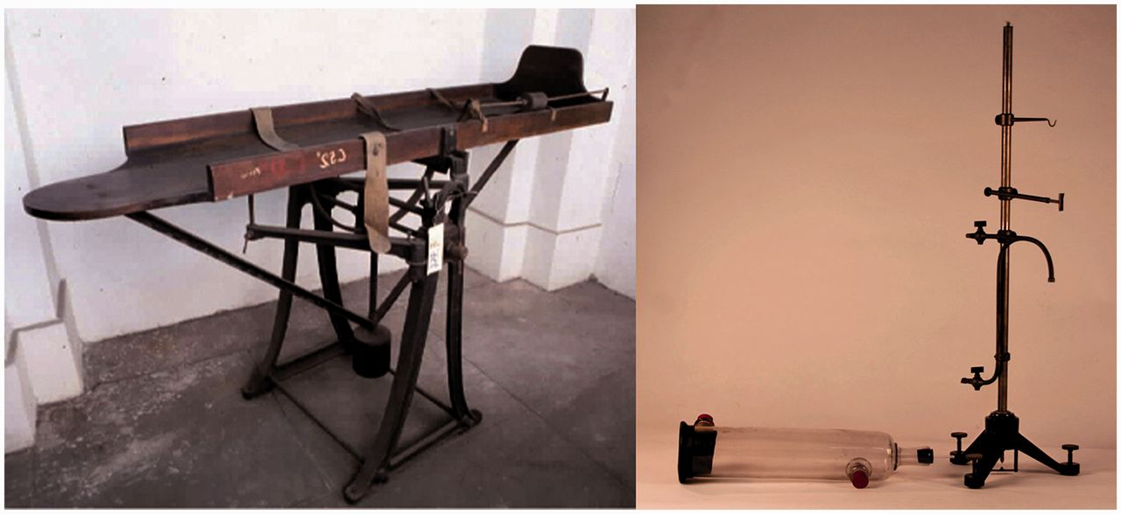
Figure 8 Photography of the balance (left) and the pneumatic sphygmograph (right) as they were found in the Scientific ...
Notes:
Figure 8 Photography of the balance (left) and the pneumatic sphygmograph (right) as they were found in the Scientific and Technological Archives, University of Torino (courtesy of Marco R. Galloni).
Unless provided in the caption above, the following copyright applies to the content of this slide: © The Author (2013). Published by Oxford University Press on behalf of the Guarantors of Brain. All rights reserved. For Permissions, please email: journals.permissions@oup.com

Slide 9
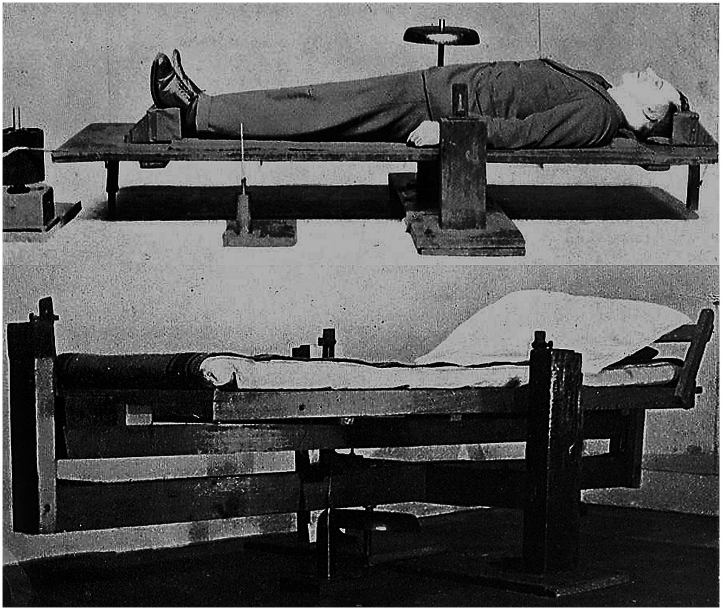
Figure 9 Mosso’s balance (top) and its modified version (bottom) built by Lowe at King's College London (adapted and ...
Notes:
Figure 9 Mosso’s balance (top) and its modified version (bottom) built by Lowe at King's College London (adapted and reprinted with permission from Lowe, 1936).
Unless provided in the caption above, the following copyright applies to the content of this slide: © The Author (2013). Published by Oxford University Press on behalf of the Guarantors of Brain. All rights reserved. For Permissions, please email: journals.permissions@oup.com

