Slide 1
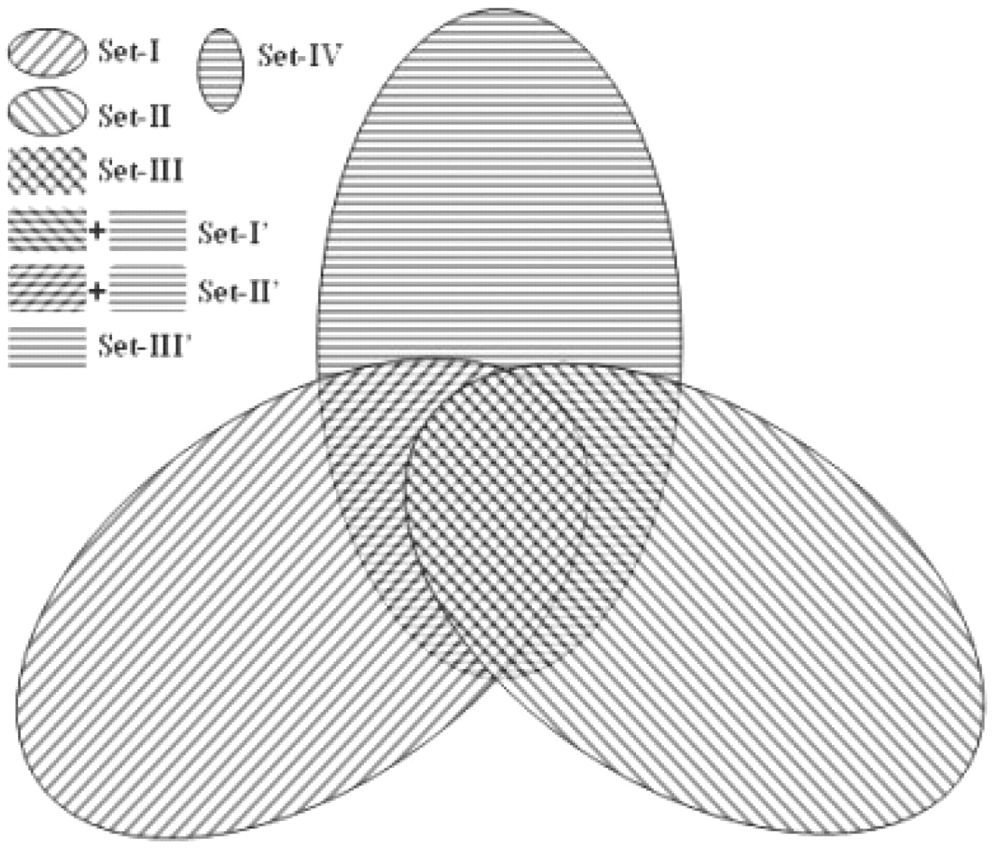
Fig. 1. Venn diagram of datasets of the same/different folds. Set-I contains 746 420 same Fold domain pairs generated ...
Notes:
Fig. 1. Venn diagram of datasets of the same/different folds. Set-I contains 746 420 same Fold domain pairs generated from 11 239 protein domains in SCOP. Set-II consists of 2 769 868 same Topology domain pairs generated from 14 830 protein domains in CATH. Set-III is the overlap part of Set-I and Set-II, which includes 186 359 pairs from 5105 consensus domains. Set-IV contains 13 027 960 all-to-all pairs from the 5105 consensus domains. Set-I′ is the different fold set for SCOP, generated by subtracting a subset of Set-I from Set-IV. Set-II′ is the different fold set for CATH, generated by subtracting a subset of Set-II from Set-IV. Set-III′ is the different fold set for Set-III and obtained by subtracting subsets of Set-I and Set-II from Set-IV.
Unless provided in the caption above, the following copyright applies to the content of this slide: © The Author 2010. Published by Oxford University Press. All rights reserved. For Permissions, please email: journals.permissions@oxfordjournals.org

Slide 2
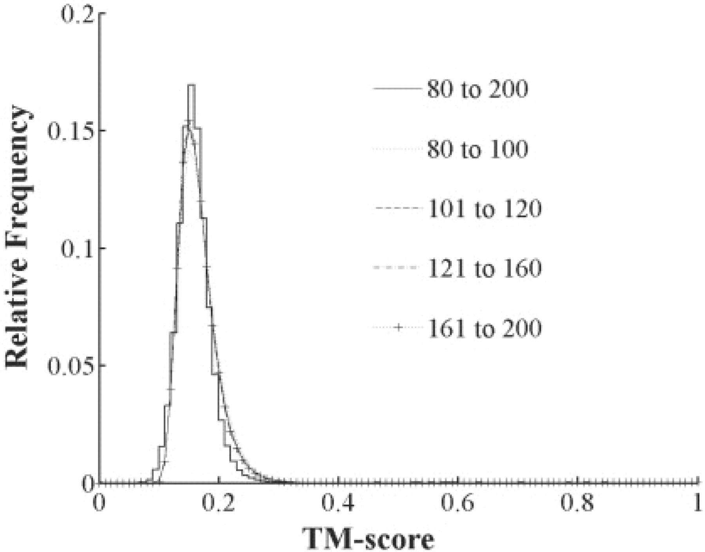
Fig. 2. TM-score distribution of 71 583 085 gapless comparisons among 6684 non-homologous protein structures. The ...
Notes:
Fig. 2. TM-score distribution of 71 583 085 gapless comparisons among 6684 non-homologous protein structures. The continuous curve represents an EVD with the location parameter and the scale parameter being 0.1512 and 0.0242, respectively; the reduced χ2 of fitting is 0.001 obtained by the Evfit module of MATLAB7 software. The TM-score distributions of four subdivisions are from proteins with length in [80, 100], [101, 120], [121, 160] and [161, 200], respectively.
Unless provided in the caption above, the following copyright applies to the content of this slide: © The Author 2010. Published by Oxford University Press. All rights reserved. For Permissions, please email: journals.permissions@oxfordjournals.org

Slide 3
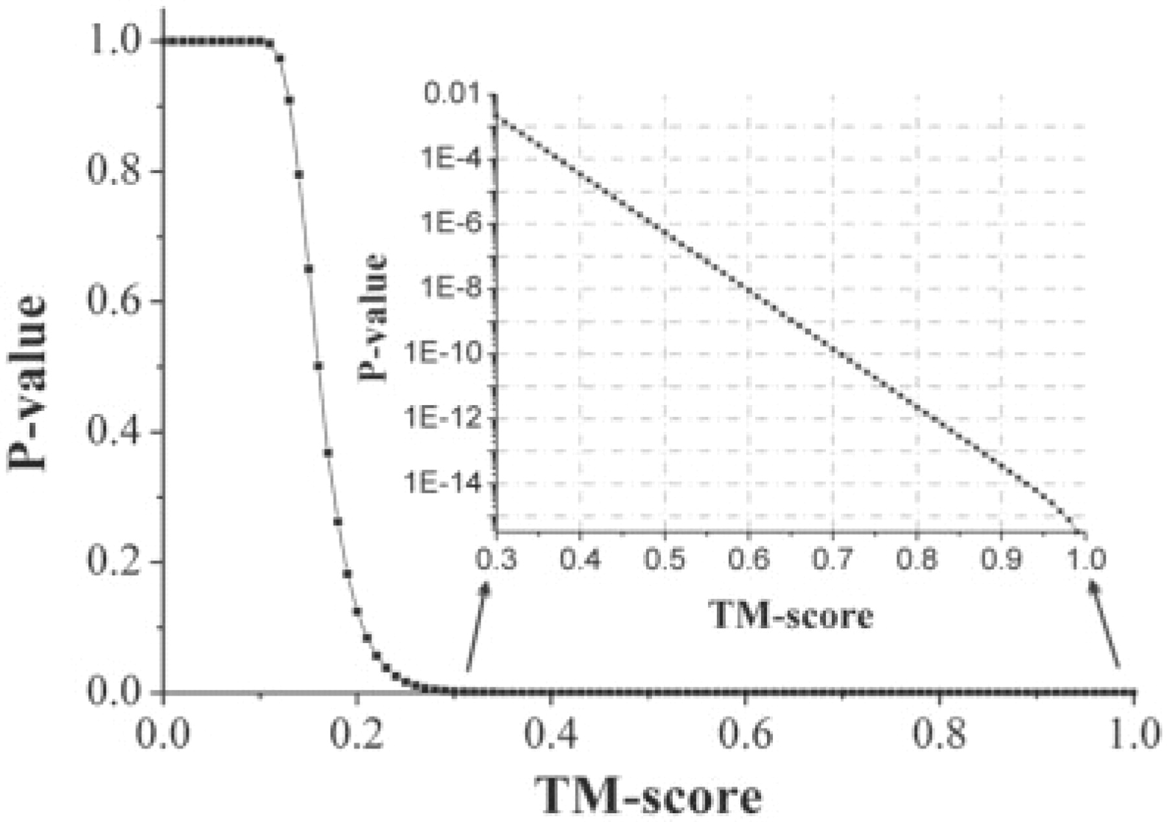
Fig. 3. The P-value versus TM-score. The curve is a sigmoid like Boltzmann function with reduced χ² equal ...
Notes:
Fig. 3. The P-value versus TM-score. The curve is a sigmoid like Boltzmann function with reduced χ2 equal to 0.0001. Inset: P-value (in logarithm scale) versus TM-score in [0.3, 1].
Unless provided in the caption above, the following copyright applies to the content of this slide: © The Author 2010. Published by Oxford University Press. All rights reserved. For Permissions, please email: journals.permissions@oxfordjournals.org

Slide 4
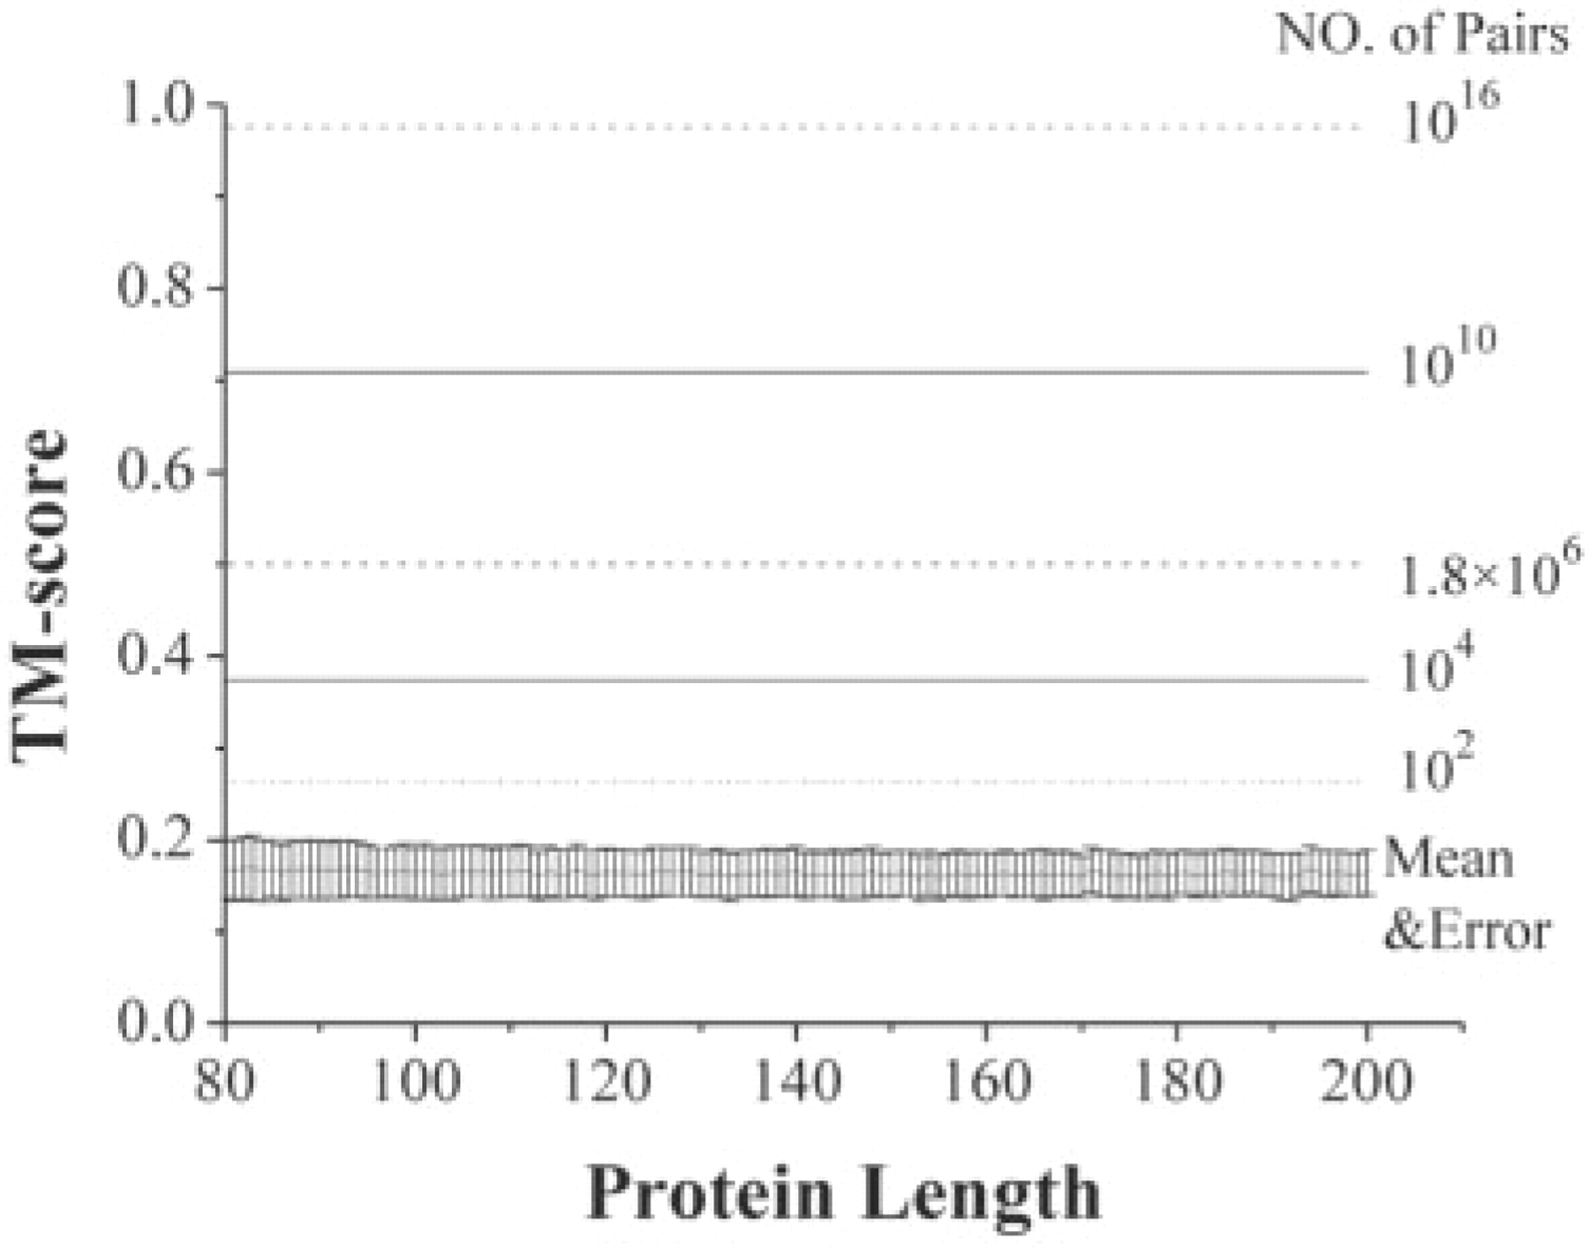
Fig. 4. The average TM-scores (with error bars) of gapless alignment matches on random structural pairs with protein ...
Notes:
Fig. 4. The average TM-scores (with error bars) of gapless alignment matches on random structural pairs with protein length from 80 to 200 amino acids. The straight and dash lines above TM-scores=0.2 indicate the number of random protein pairs (values on the right-hand side) needed to achieve or surpass a certain TM-score level. By doing random structure comparisons in 102, 104, 1010 and 1016 times, one can hit a match with a TM-score ≥0.263, 0.374, 0.709 and 0.977, respectively. 1.8 × 106 random matches are needed to achieve a TM-score ≥0.5.
Unless provided in the caption above, the following copyright applies to the content of this slide: © The Author 2010. Published by Oxford University Press. All rights reserved. For Permissions, please email: journals.permissions@oxfordjournals.org

Slide 5
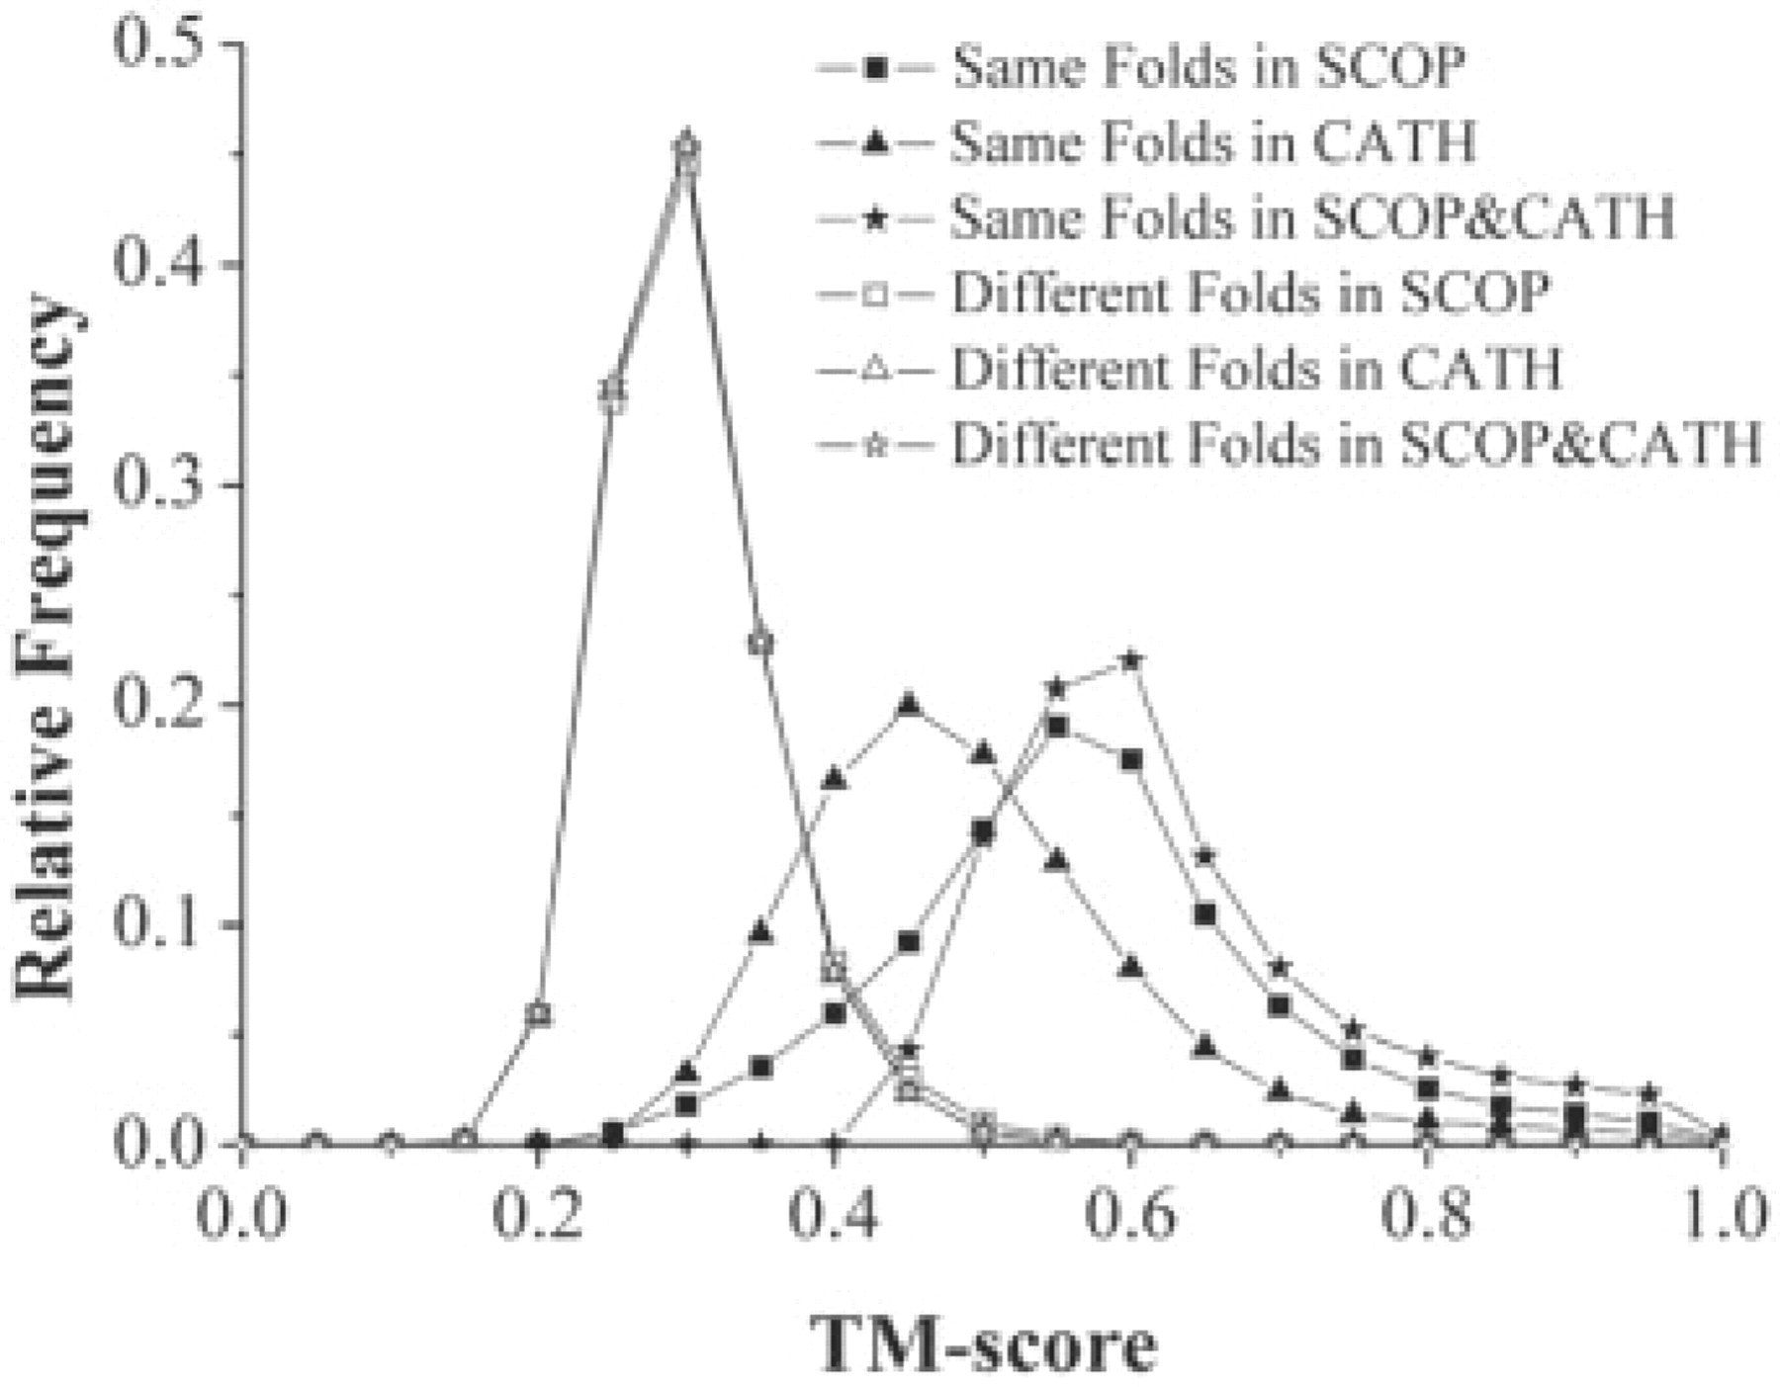
Fig. 5. The conditional probabilities of TM-score for proteins in the same fold and different fold families as ...
Notes:
Fig. 5. The conditional probabilities of TM-score for proteins in the same fold and different fold families as defined by SCOP (Set-I; Set-II′), CATH (Set-II; Set-II′) and SCOP and CATH (Set-III; Set-III′).
Unless provided in the caption above, the following copyright applies to the content of this slide: © The Author 2010. Published by Oxford University Press. All rights reserved. For Permissions, please email: journals.permissions@oxfordjournals.org

Slide 6
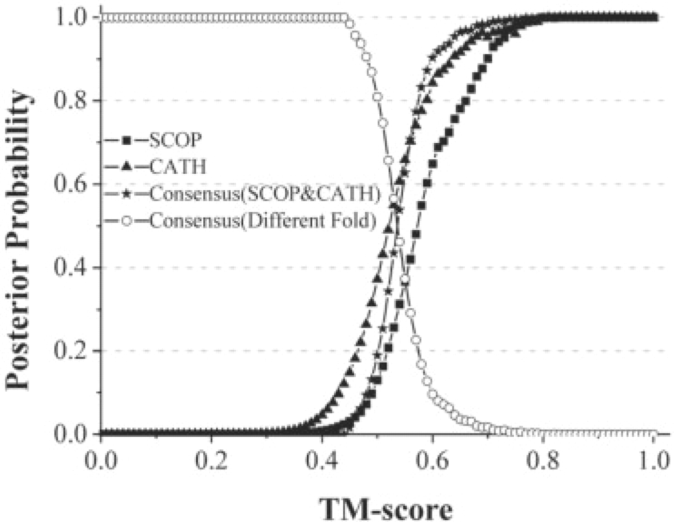
Fig. 6. The posterior probability of proteins with a given TM-score being in the same Fold (squares, triangles and ...
Notes:
Fig. 6. The posterior probability of proteins with a given TM-score being in the same Fold (squares, triangles and stars points) or different Fold family (circle points). The Fold family is defined based on either the SCOP Fold level (SCOP, Set-I) or the CATH Topology level (CATH, Set-II) or a consensus of SCOP Fold and CATH Topology families (Consensus, Set-III).
Unless provided in the caption above, the following copyright applies to the content of this slide: © The Author 2010. Published by Oxford University Press. All rights reserved. For Permissions, please email: journals.permissions@oxfordjournals.org

