Slide 1
Figure 1. Procedure for all 4 experiments. In label + picture trials, subjects viewed the verbal label for 1000 ms, ...
Notes:
Figure 1. Procedure for all 4 experiments. In label + picture trials, subjects viewed the verbal label for 1000 ms, followed 500 ms later by a briefly presented (30 or 80 ms) and masked (400 ms) image, which matched the label on half the trials. Picture-only trials were identical except for the absence of the initial label. Label-only trials were identical except the coherent image was replaced by a mask. Labels in experiment 4 could either indicate specific items (“beach”) or generically cue the identification task (“what is this”).
Unless provided in the caption above, the following copyright applies to the content of this slide: © The Author 2006. Published by Oxford University Press. All rights reserved. For permissions, please e-mail: journals.permissions@oxfordjournals.org

Slide 2
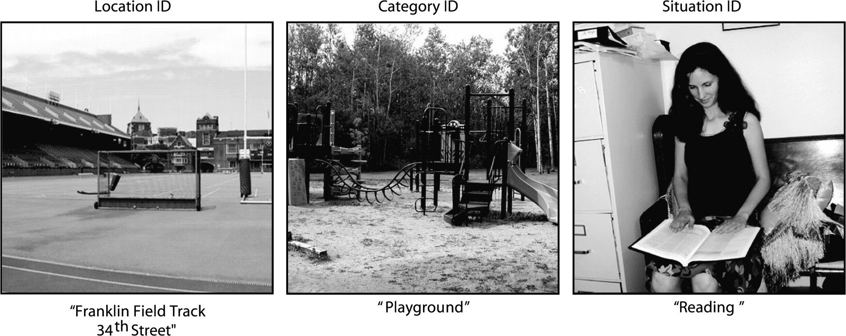
Figure 2. Examples of stimuli used (Franklin Field, Playground) or similar to those used (Reading) in the 3 ...
Notes:
Figure 2. Examples of stimuli used (Franklin Field, Playground) or similar to those used (Reading) in the 3 identification tasks. Scenes presented in location identification and category identification trials contained few or no people, whereas almost all scenes presented in situation identification trials contained people as items of central interest.
Unless provided in the caption above, the following copyright applies to the content of this slide: © The Author 2006. Published by Oxford University Press. All rights reserved. For permissions, please e-mail: journals.permissions@oxfordjournals.org

Slide 3
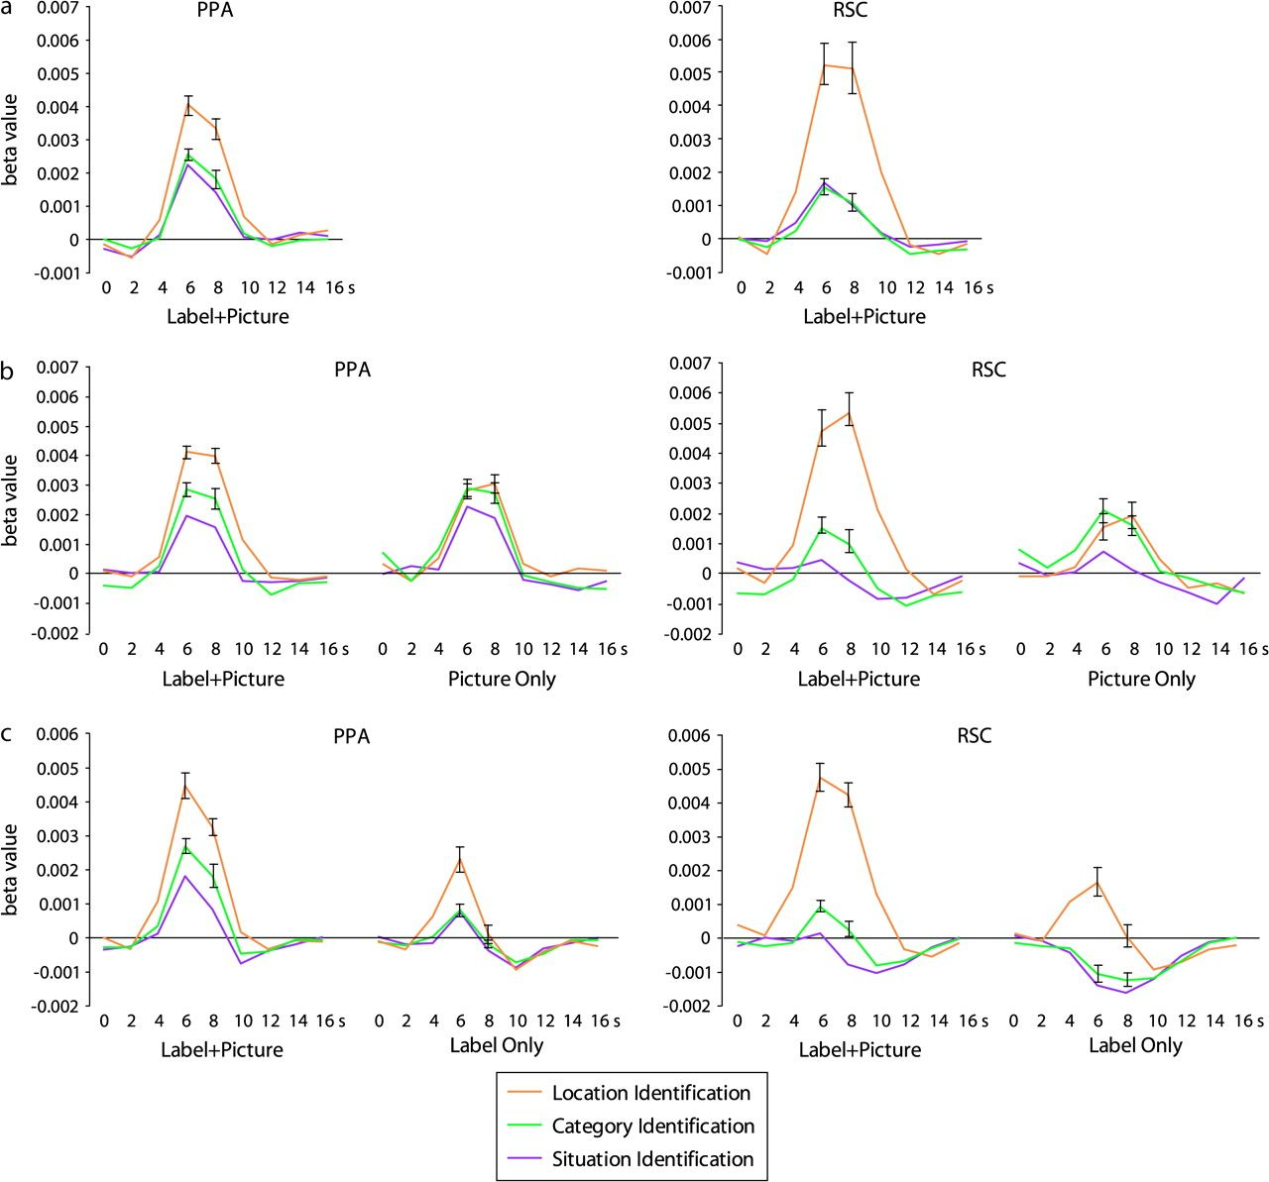
Figure 3. Event-related response in the PPA and RSC in experiments 1–3. Time courses were estimated using a finite ...
Notes:
Figure 3. Event-related response in the PPA and RSC in experiments 1–3. Time courses were estimated using a finite impulse response model; statistics reported in the paper reflect effect sizes estimated using a standard HRF, which gave the same pattern of results. Error markers on the location identification curve reflect ± 1 standard error of the mean (SEM) for the location versus category identification difference at the 6-s and 8-s time points, whereas error bars on the category identification curve reflect ± 1 SEM for the category versus situation identification difference. Units on the y-axis are beta values. (a) Experiment 1: Response during location identification trials was significantly higher than response during category and situation identification trials in both regions. (b) Experiment 2: The location advantage was observed on label + picture trials but not on picture-only trials in which images were presented alone without preceding labels. Note that there was also a significant advantage for category versus situation identification trials, which did not depend on label presence and may reflect preferential response to the category identification images. (c) Experiment 3: The location versus category identification difference was observed on both label + picture and label-only trials, demonstrating that verbal cues can drive this effect even in the absence of a coherent visual scene. In contrast, the category versus situation identification difference is only found on label + picture trials.
Unless provided in the caption above, the following copyright applies to the content of this slide: © The Author 2006. Published by Oxford University Press. All rights reserved. For permissions, please e-mail: journals.permissions@oxfordjournals.org

Slide 4
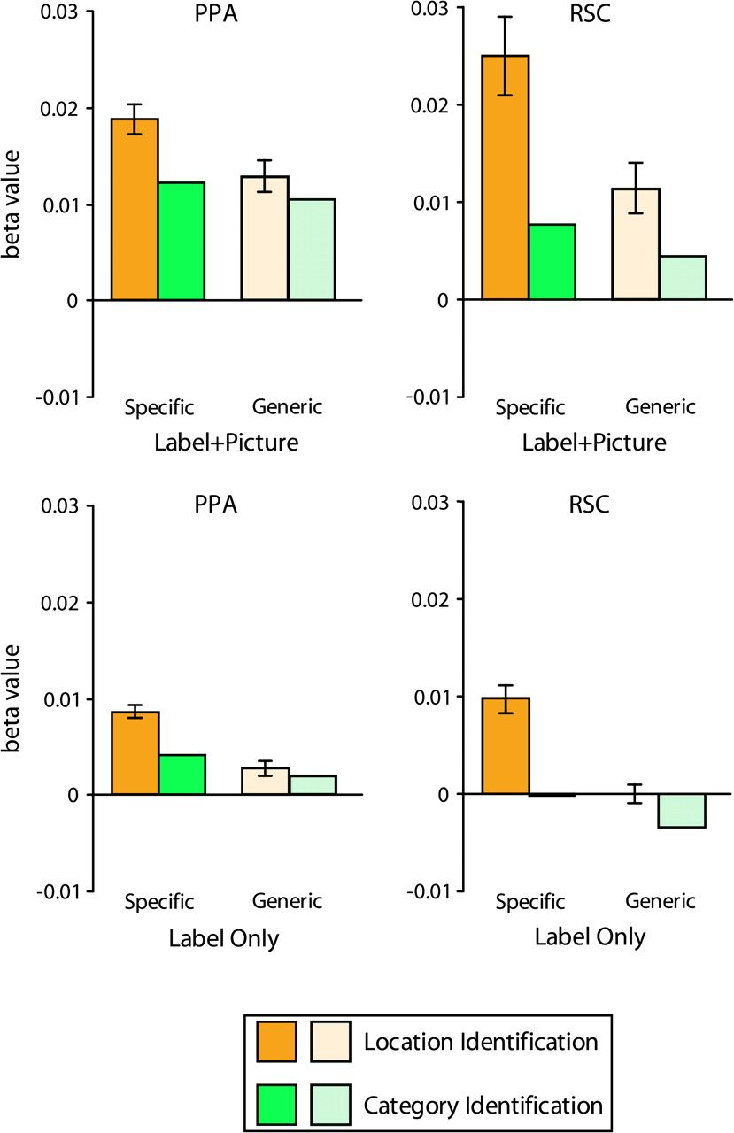
Figure 4. Response in the PPA and RSC in experiment 4. When specific labels were used (solid bars) both the PPA and RSC ...
Notes:
Figure 4. Response in the PPA and RSC in experiment 4. When specific labels were used (solid bars) both the PPA and RSC responded more strongly during location identification than during category identification for both label + picture trials (top panels) and label-only trials (bottom panels), replicating the results of experiment 3. This preferential response during location identification was significantly reduced when generic labels (“Where is this?,” “What is this?”) were used (lighter bars), although significant differences were still observed in the RSC. Error markers on the location arms condition reflect ± 1 standard error of the mean for the location versus category identification difference; units on the y-axis are beta values.
Unless provided in the caption above, the following copyright applies to the content of this slide: © The Author 2006. Published by Oxford University Press. All rights reserved. For permissions, please e-mail: journals.permissions@oxfordjournals.org

Slide 5
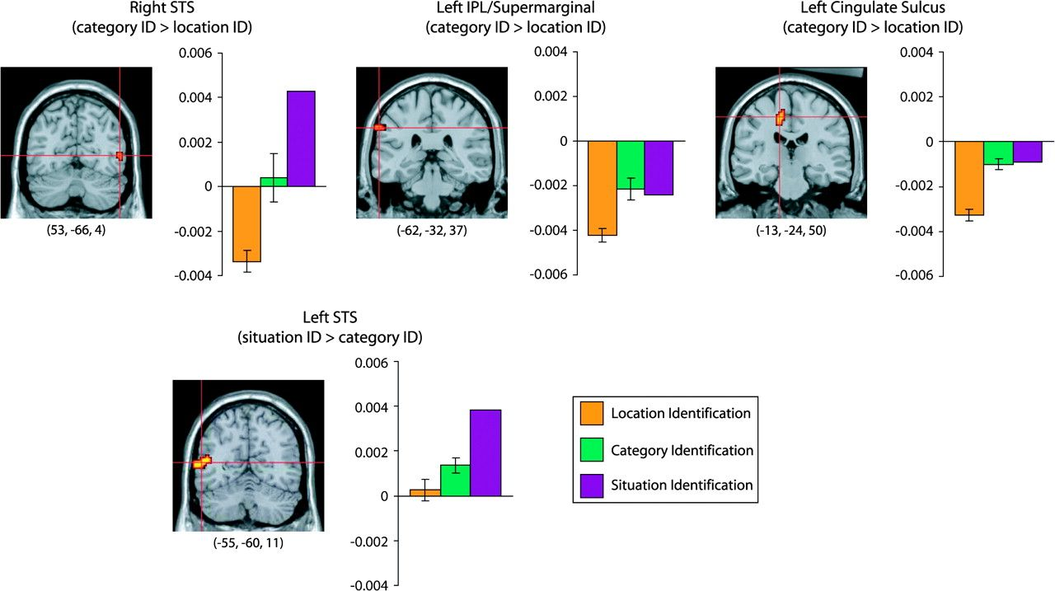
Figure 5. Partial results of the whole-brain group analysis (see also Table 1). Regions responding more strongly (P < ...
Notes:
Figure 5. Partial results of the whole-brain group analysis (see also Table 1). Regions responding more strongly (P < 0.05, 2-tailed, corrected) during category identification trials than to location identification trials (top) or more strongly during situation identification than during category identification trials (bottom) are plotted. Data are combined for label + picture trials across experiments 1–3 and overlaid on a partially inflated template brain in MNI space; right hemisphere is on the right. Bar charts show the mean response to all 3 conditions in each region. Error markers on the location identification bars reflect ± 1 standard error of the mean (SEM) for the location versus category identification difference, whereas error markers on the category identification bars reflect ± 1 SEM for the category versus situation identification difference; units on the y-axis are beta values.
Unless provided in the caption above, the following copyright applies to the content of this slide: © The Author 2006. Published by Oxford University Press. All rights reserved. For permissions, please e-mail: journals.permissions@oxfordjournals.org

Slide 6
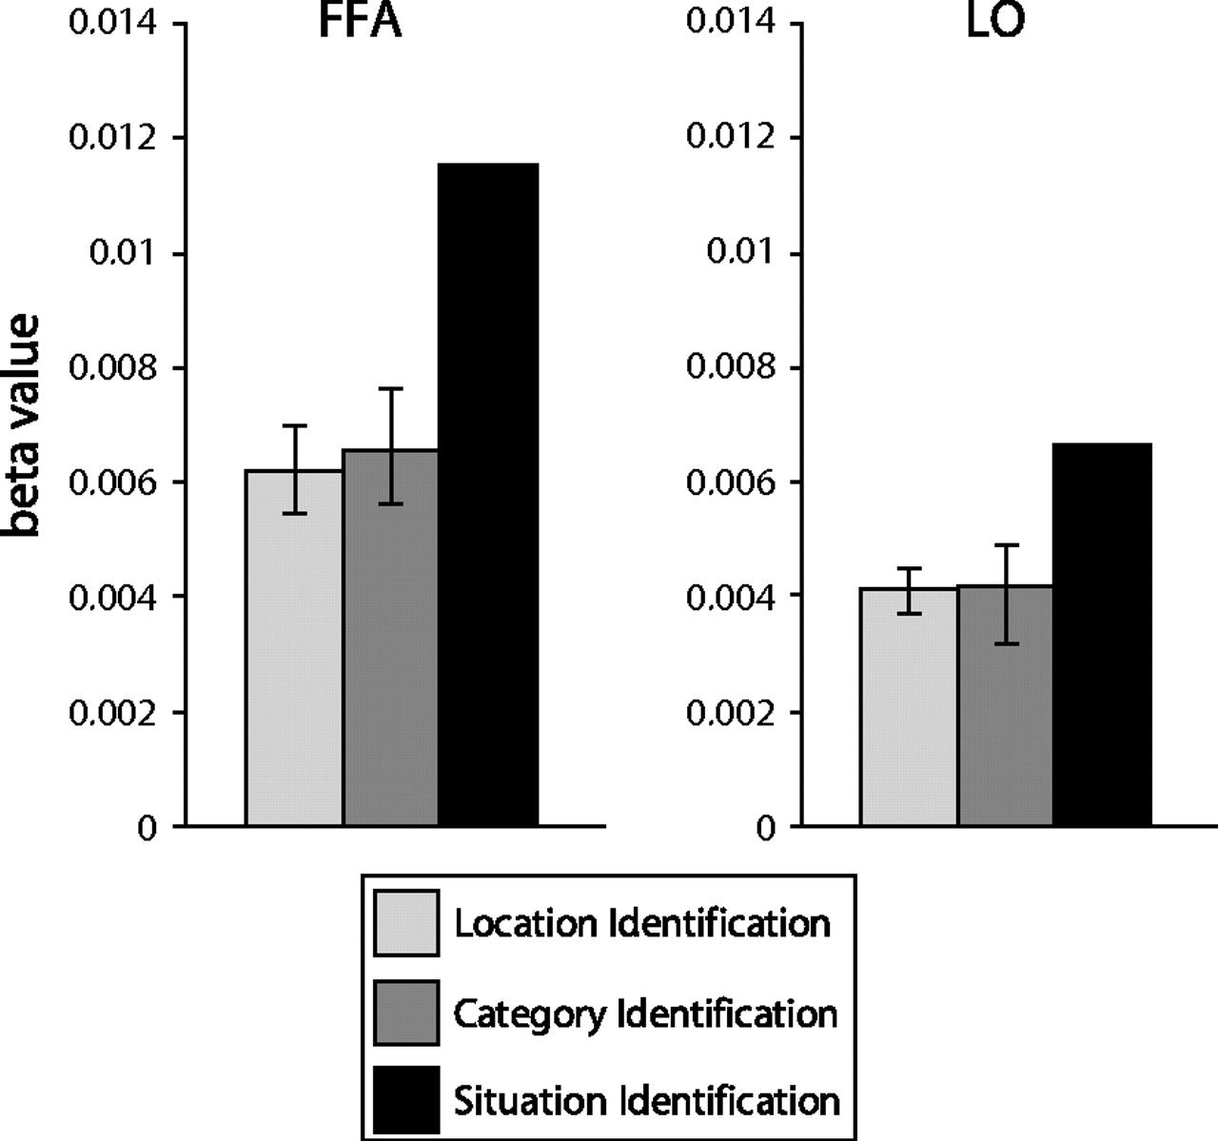
Figure 6. Response in the FFA and LO. Data are combined for label + picture trials across experiments 1–3. Neither ...
Notes:
Figure 6. Response in the FFA and LO. Data are combined for label + picture trials across experiments 1–3. Neither region responded differentially to location versus category identification trials, demonstrating that not all high-level visual regions exhibit the location advantage observed in the PPA and RSC. Both regions responded more strongly to situation identification trials, likely reflecting preferential response to the bodies and faces shown in this condition. Error markers are the same as in Figure 4.
Unless provided in the caption above, the following copyright applies to the content of this slide: © The Author 2006. Published by Oxford University Press. All rights reserved. For permissions, please e-mail: journals.permissions@oxfordjournals.org

