Slide 1
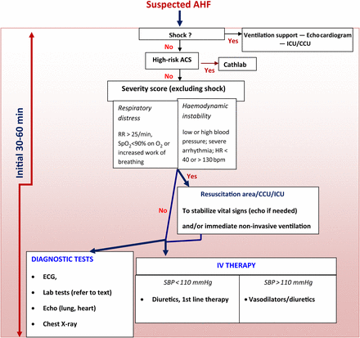
Figure 1
Notes:
Figure 1
Unless provided in the caption above, the following copyright applies to the content of this slide: Published on behalf of the European Society of Cardiology. All rights reserved. © European Society of Cardiology 2015. For permissions please email: journals.permissions@oup.com.

Slide 2
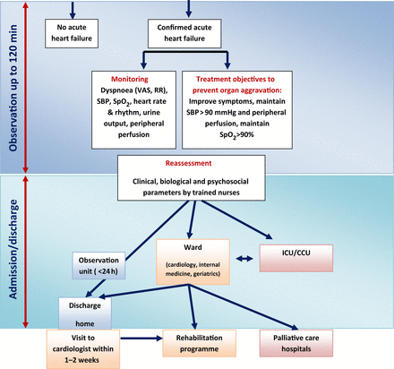
Algorithm for the management of acute heart failure. AHF, acute heart failure; VAS, Visual Analogue Scale for ...
Notes:
Algorithm for the management of acute heart failure. AHF, acute heart failure; VAS, Visual Analogue Scale for dyspnea assessment; RR, respiration rate; SpO2, blood oxygen saturation; HR, heart rate; ICU, intensive care unit; Cathlab, cardiac catheterisation laboratory; CCU, coronary care unit; IV, intravenous; SBP, systolic blood pressure; cTn, cardiac troponin, th, therapy, ACS, acute coronary syndrome.
Unless provided in the caption above, the following copyright applies to the content of this slide: Published on behalf of the European Society of Cardiology. All rights reserved. © European Society of Cardiology 2015. For permissions please email: journals.permissions@oup.com.

Slide 3
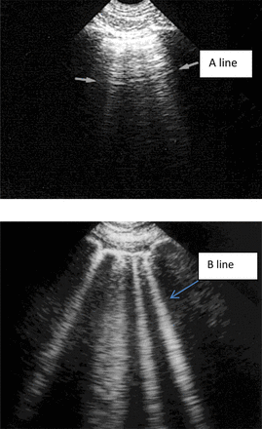
Figure 2 (A and B) Thoracic ultrasound images in normal and AHF patients. (A) From the pleural line, one repetition of ...
Notes:
Figure 2 (A and B) Thoracic ultrasound images in normal and AHF patients. (A) From the pleural line, one repetition of the pleural line, a horizontal line [A line], parallel to the pleural line, is visible, indicating normal lung with no pulmonary oedema. Note some ill-defined vertical comet-tail artefacts, not to be confused with lung rockets. Arrows indicate A lines. (B) Four or five B-lines arise from the pleural line, creating a pattern called lung rockets. B lines are vertical, long, well-defined artefacts erasing the A-lines and moving in concert with lung sliding. B lines indicate pulmonary oedema. From Whole Body Ultrasonography in the Critically Ill, Springer 2010 (with kind permission of Springer Science).
Unless provided in the caption above, the following copyright applies to the content of this slide: Published on behalf of the European Society of Cardiology. All rights reserved. © European Society of Cardiology 2015. For permissions please email: journals.permissions@oup.com.

Slide 4
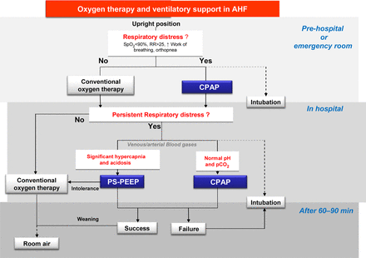
Figure 3 Oxygen and ventilatory support in acute heart failure. PS-PEEP, pressure support-positive end-expiratory ...
Notes:
Figure 3 Oxygen and ventilatory support in acute heart failure. PS-PEEP, pressure support-positive end-expiratory pressure. CPAP, continuous positive airway pressure; RR, respiration rate; SpO2, oxygen saturation.
Unless provided in the caption above, the following copyright applies to the content of this slide: Published on behalf of the European Society of Cardiology. All rights reserved. © European Society of Cardiology 2015. For permissions please email: journals.permissions@oup.com.

