Slide 1
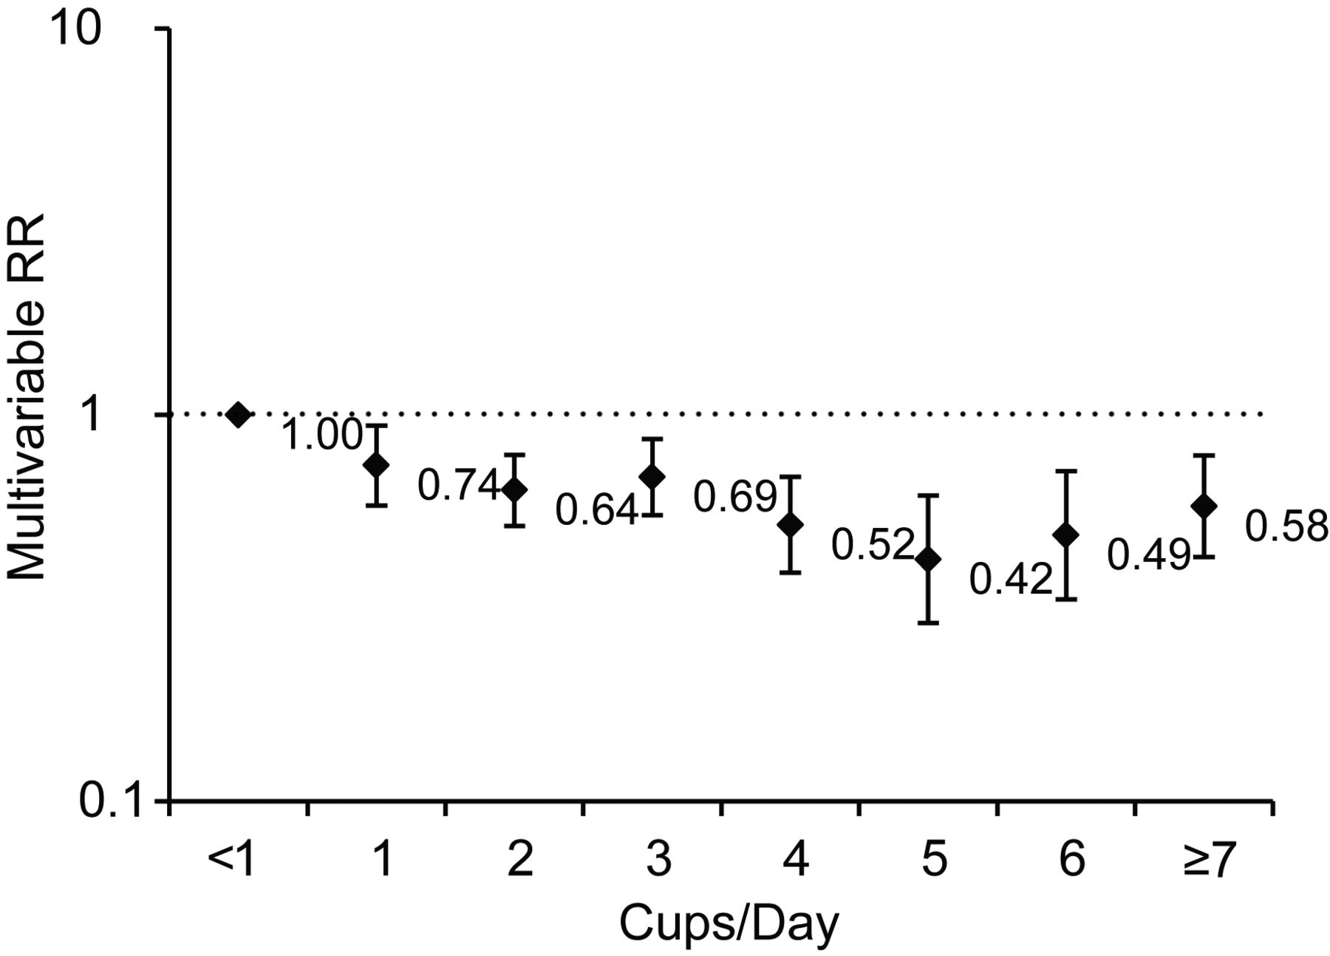
Figure 1. Multivariable relative risk (RR) of death from oral/pharyngeal cancer by single cup/day of caffeinated ...
Notes:
Figure 1. Multivariable relative risk (RR) of death from oral/pharyngeal cancer by single cup/day of caffeinated coffee, Cancer Prevention Study II, 1982–2008. Bars, confidence interval. Ptrend < 0.001, obtained from the Wald test for significance of trend. One cup = 237 ml.
Unless provided in the caption above, the following copyright applies to the content of this slide: © The Author 2012. Published by Oxford University Press on behalf of the Johns Hopkins Bloomberg School of Public Health. All rights reserved. For permissions, please e-mail: journals.permissions@oup.com.

