Slide 1
Figure 1 Phenotypic heterogeneity in LVNC. Family pedigree NC3 showing phenotypic heterogeneity, with ...
Notes:
Figure 1 Phenotypic heterogeneity in LVNC. Family pedigree NC3 showing phenotypic heterogeneity, with isolated DCM, isolated LVNC and LVE co-existing within the same family. The family was screened after the death of a proband (II : 1) with DCM, who died 3 years after a cardiac transplant for end-stage heart failure. His explanted heart showed DCM and on review had no evidence of LVNC or excessive trabeculations of the left ventricle. A sister (II : 2) died of cardiac failure immediately post-partum. Another sister (II : 3) had a mildly dilated left ventricle, and systolic function at the lower limit of normal (FS=26%). A further sister (II : 4) had a history of syncope, isolated left ventricular enlargement, a thickened posterior wall, preserved systolic function, frequent runs of non-sustained ventricular tachycardia on cardiac monitoring, and received a prophylactic ICD. Another sister (II : 5), her daughter (III : 1), and son (III : 2), have extensive LVNC and normal systolic function. Solid square and circle symbols indicate affected males and females with DCM, respectively; open symbols, unaffected; half-symbols, left ventricular enlargement; quarter symbols, LVNC; and slashes, death.
Unless provided in the caption above, the following copyright applies to the content of this slide: European Heart Journal vol. 26 no. 2 © The European Society of Cardiology 2004; all rights reserved.

Slide 2
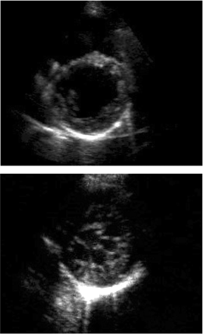
Figure 2 Parasternal short axis views (end-diastole) of a 34-year-old patient (II : 4 in Figure 1) with left ...
Notes:
Figure 2 Parasternal short axis views (end-diastole) of a 34-year-old patient (II : 4 in Figure 1) with left ventricular enlargement (LVED 118% predicted) and minimal posterolateral trabeculations (upper), and her 12-year-old niece (III:1) with an extensive meshwork of trabeculations and recesses communicating with the LV cavity (lower).
Unless provided in the caption above, the following copyright applies to the content of this slide: European Heart Journal vol. 26 no. 2 © The European Society of Cardiology 2004; all rights reserved.

Slide 3
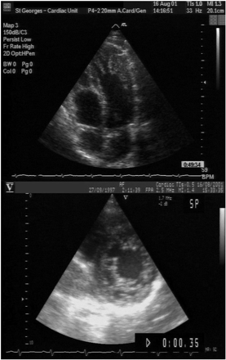
Figure 3 Apical four-chamber view (end-diastole) of a 36-year-old patient (upper) referred with an initial ...
Notes:
Figure 3 Apical four-chamber view (end-diastole) of a 36-year-old patient (upper) referred with an initial diagnosis of apical hypertrophic cardiomyopathy, with extensive apical trabeculations and recesses consistent with LVNC, and (lower) a parasternal short-axis view (end-diastole) of his asymptomatic 4-year-old son, showing a two-layered structure of compacted and non-compacted endomyocardium. Colour Doppler showed flow between the LV cavity and the recesses.
Unless provided in the caption above, the following copyright applies to the content of this slide: European Heart Journal vol. 26 no. 2 © The European Society of Cardiology 2004; all rights reserved.

