Slide 1
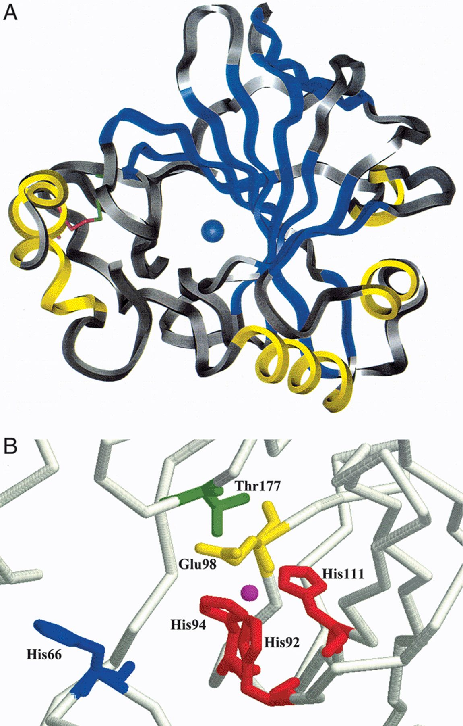
Figure 1 Crystal structure of the N. gonorrhoeaeα class carbonic anhydrase. A: View of the monomeric N. gonorrhoeae ...
Notes:
Figure 1 Crystal structure of the N. gonorrhoeaeα class carbonic anhydrase. A: View of the monomeric N. gonorrhoeae structure. The active site Zn is shown in blue. The α-helices are shown in yellow and the β-strands are shown in blue. Residues Cys-28 (shown in red) and Cys-181 (shown in green) are completely conserved in prokaryotic α class carbonic anhydrase sequences and form a disulfide bond. The crystal structure model was produced by Insight II (Molecular Simulations, San Diego, CA, USA) using the atomic coordinates of the 1.78-Å structure [78]. B: View of the active site. The active site Zn is shown in magenta and the coordinating residues (His-92, His-94 and His-111) are shown in red. His-66, thought to act as a proton shuttle analogously to His-64 of human CA II, is shown in blue. Glu-98 and Thr-177 of the hydrogen bond network are shown in yellow and green, respectively. The active site model was produced by Rasmol (Biomolecular Structure, Glaxo Research and Development; Middlesex, UK) using the atomic coordinates of the 1.78-Å structure [78].
Unless provided in the caption above, the following copyright applies to the content of this slide: © 2000 Federation of European Microbiological Societies.

Slide 2
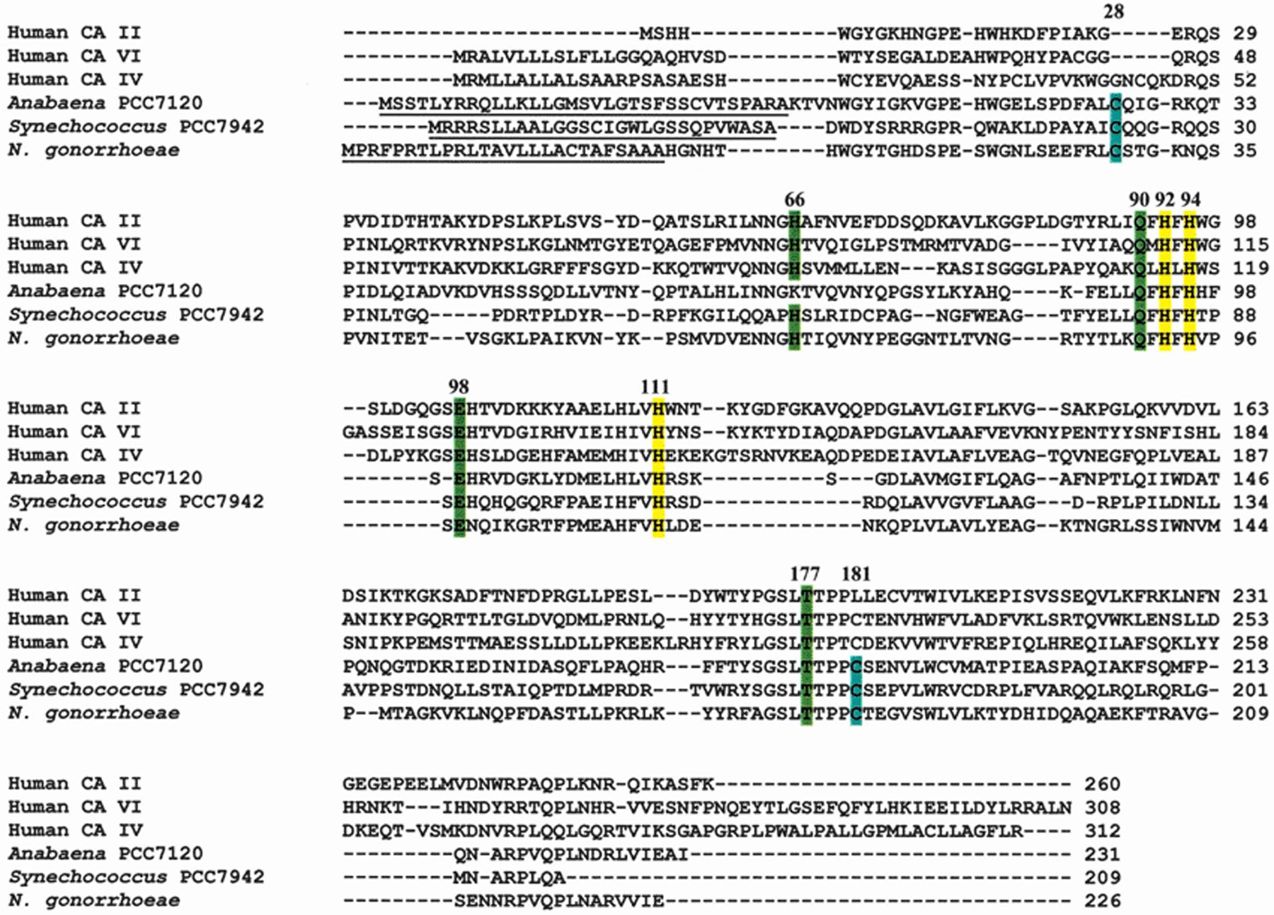
Figure 2 Alignment of α class carbonic anhydrase sequences. The sequences of the documented prokaryotic α class ...
Notes:
Figure 2 Alignment of α class carbonic anhydrase sequences. The sequences of the documented prokaryotic α class carbonic anhydrases were aligned with the sequences of the cytoplasmic CA II, the secreted CA VI and the membrane-bound CA IV human isozymes using Clustal X [190]. The conserved Zn ligands His-92, His-94 and His-111 are shown in yellow. The prokaryotic disulfide bond-forming residues Cys-28 and Cys-181 are shown in blue. Other conserved residues important for enzyme activity (His-66, Gln-90, Glu-98 and Thr-177) are shown in green. Prokaryotic signal sequences are underlined. Numbers indicating residue positions refer to the position in the N. gonorrhoeae sequence.
Unless provided in the caption above, the following copyright applies to the content of this slide: © 2000 Federation of European Microbiological Societies.

Slide 3
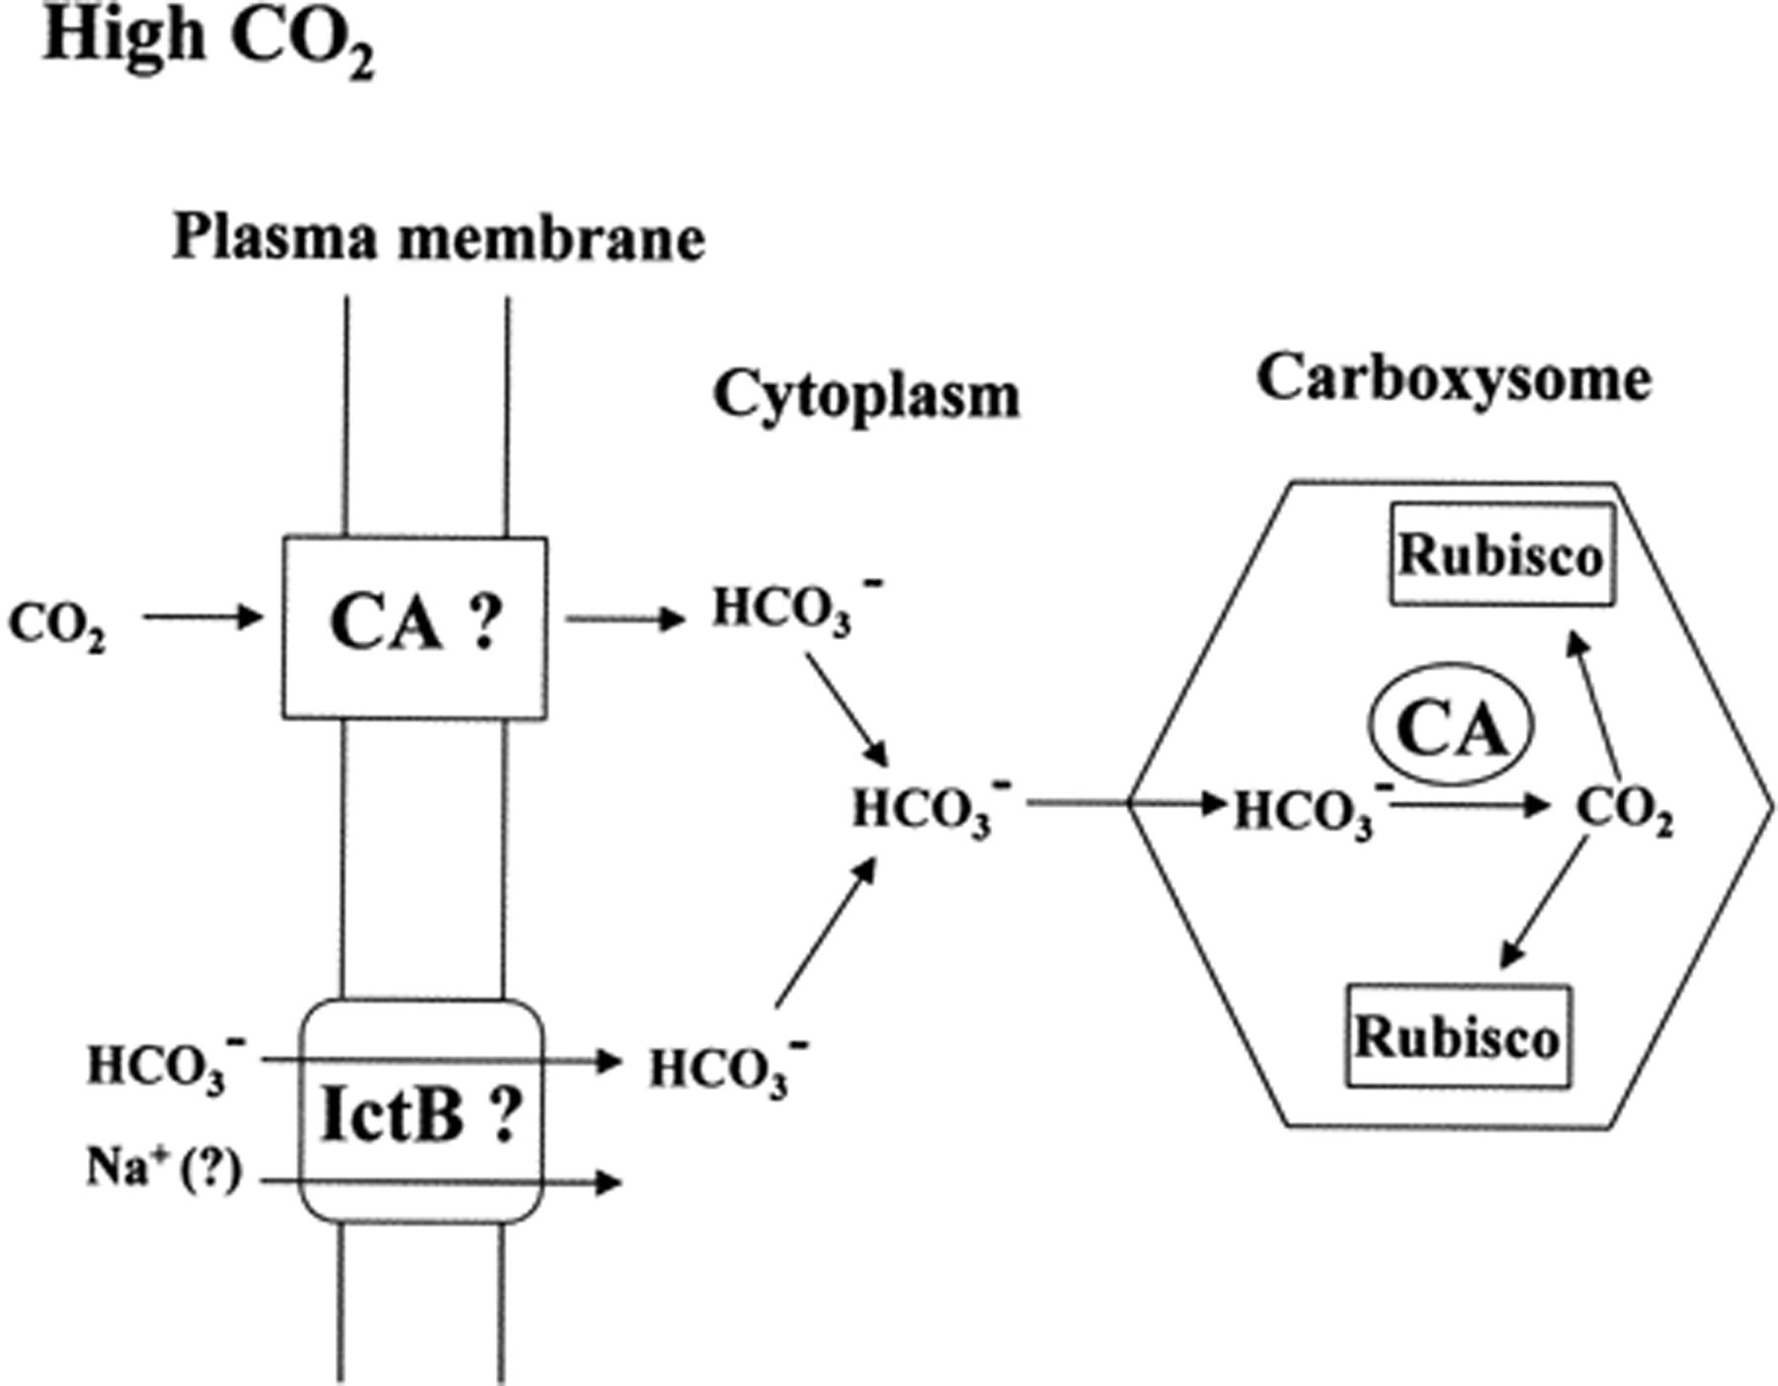
Figure 3 Models showing the role of carbonic anhydrase in the CCM of cyanobacteria.
Notes:
Figure 3 Models showing the role of carbonic anhydrase in the CCM of cyanobacteria.
Unless provided in the caption above, the following copyright applies to the content of this slide: © 2000 Federation of European Microbiological Societies.

Slide 4
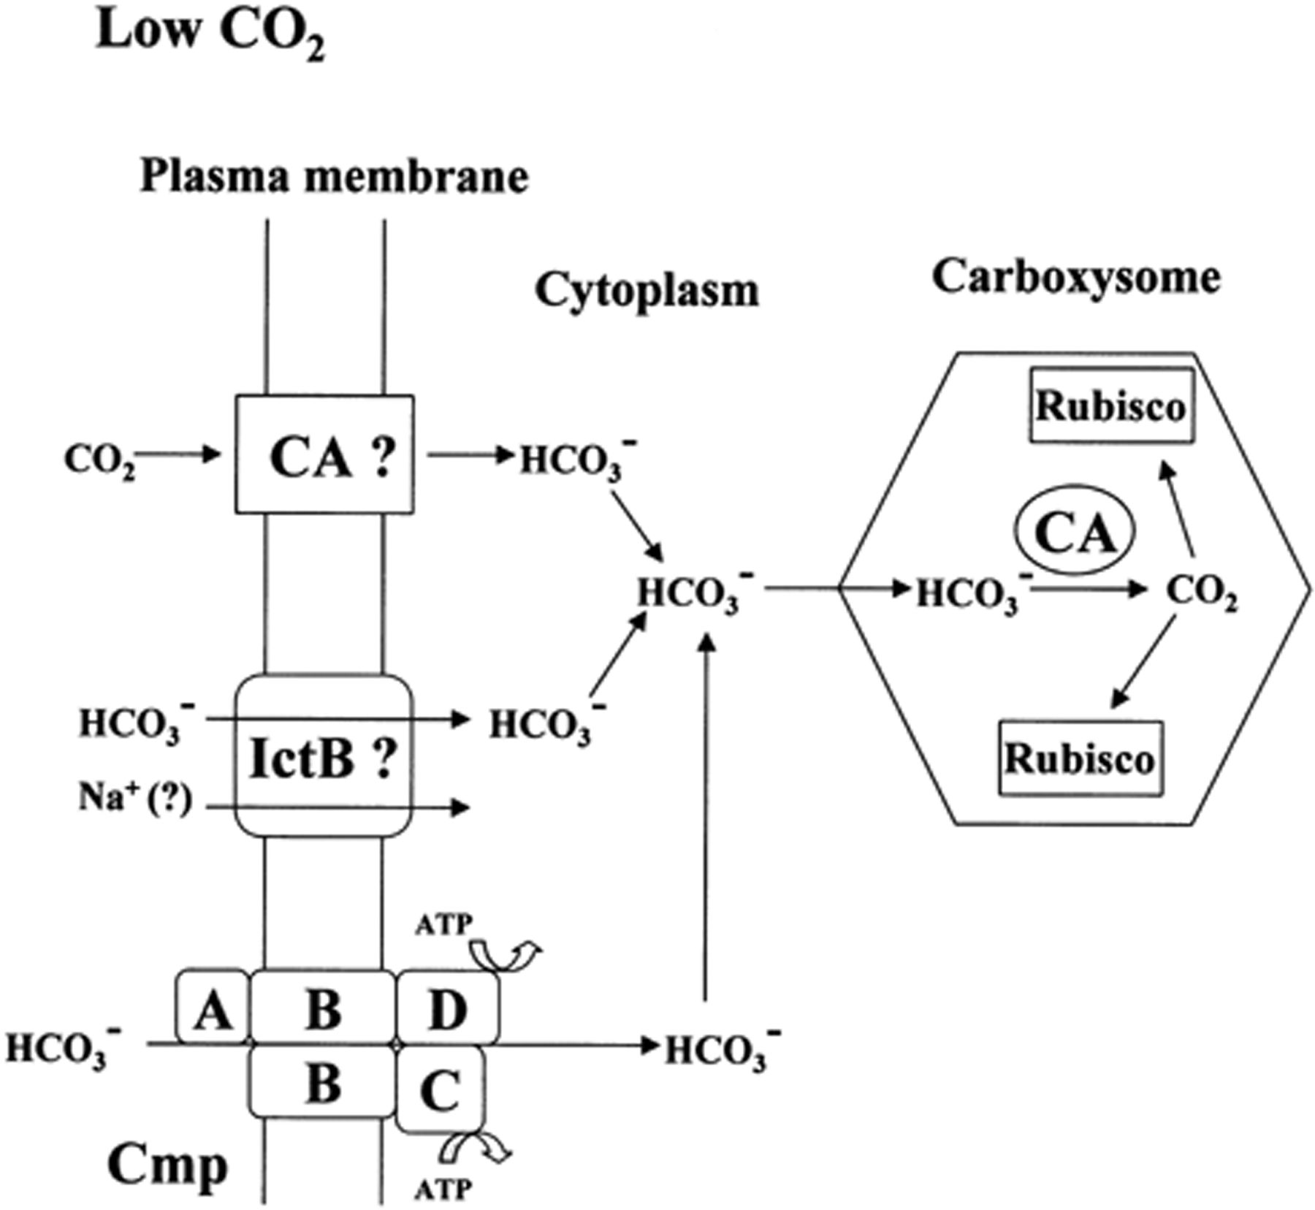
Figure 3 Models showing the role of carbonic anhydrase in the CCM of cyanobacteria.
Notes:
Figure 3 Models showing the role of carbonic anhydrase in the CCM of cyanobacteria.
Unless provided in the caption above, the following copyright applies to the content of this slide: © 2000 Federation of European Microbiological Societies.

Slide 5
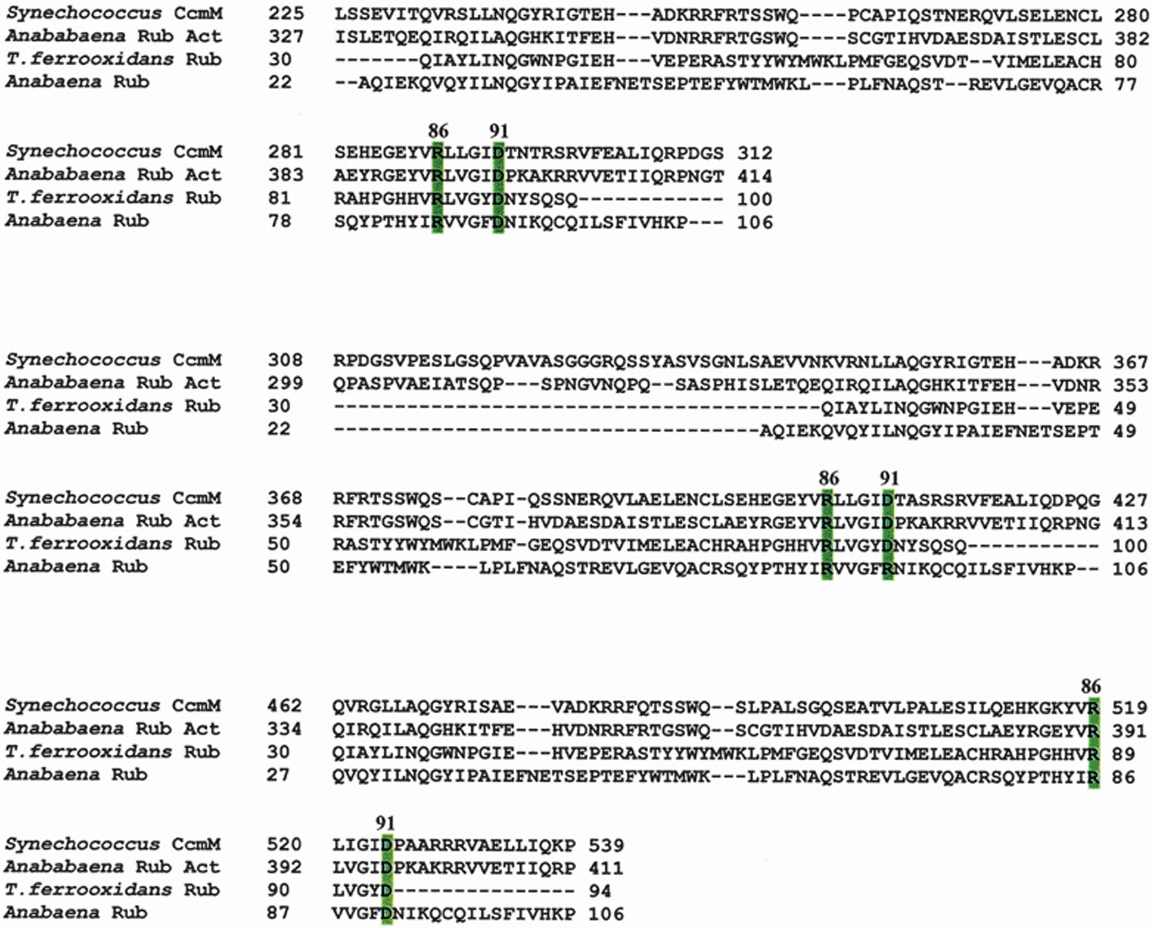
Figure 4 Alignment of the Synechococcus CcmM sequence with the Anabaena Rubisco activase sequence and the Rubisco ...
Notes:
Figure 4 Alignment of the Synechococcus CcmM sequence with the Anabaena Rubisco activase sequence and the Rubisco small subunit sequences from T. ferrooxidans and Anabaena sp. Alignments between the CcmM internal repeat regions with the homologous regions of the Rubisco activase (Rub Act) and Rubisco small subunit (Rub) sequences are shown. Arg-86 and Asp-91 (referring to the position in the Anabaena Rubisco small subunit sequence), thought to be involved in binding of the small Rubisco subunit to the large subunits, are highlighted in green.
Unless provided in the caption above, the following copyright applies to the content of this slide: © 2000 Federation of European Microbiological Societies.

Slide 6
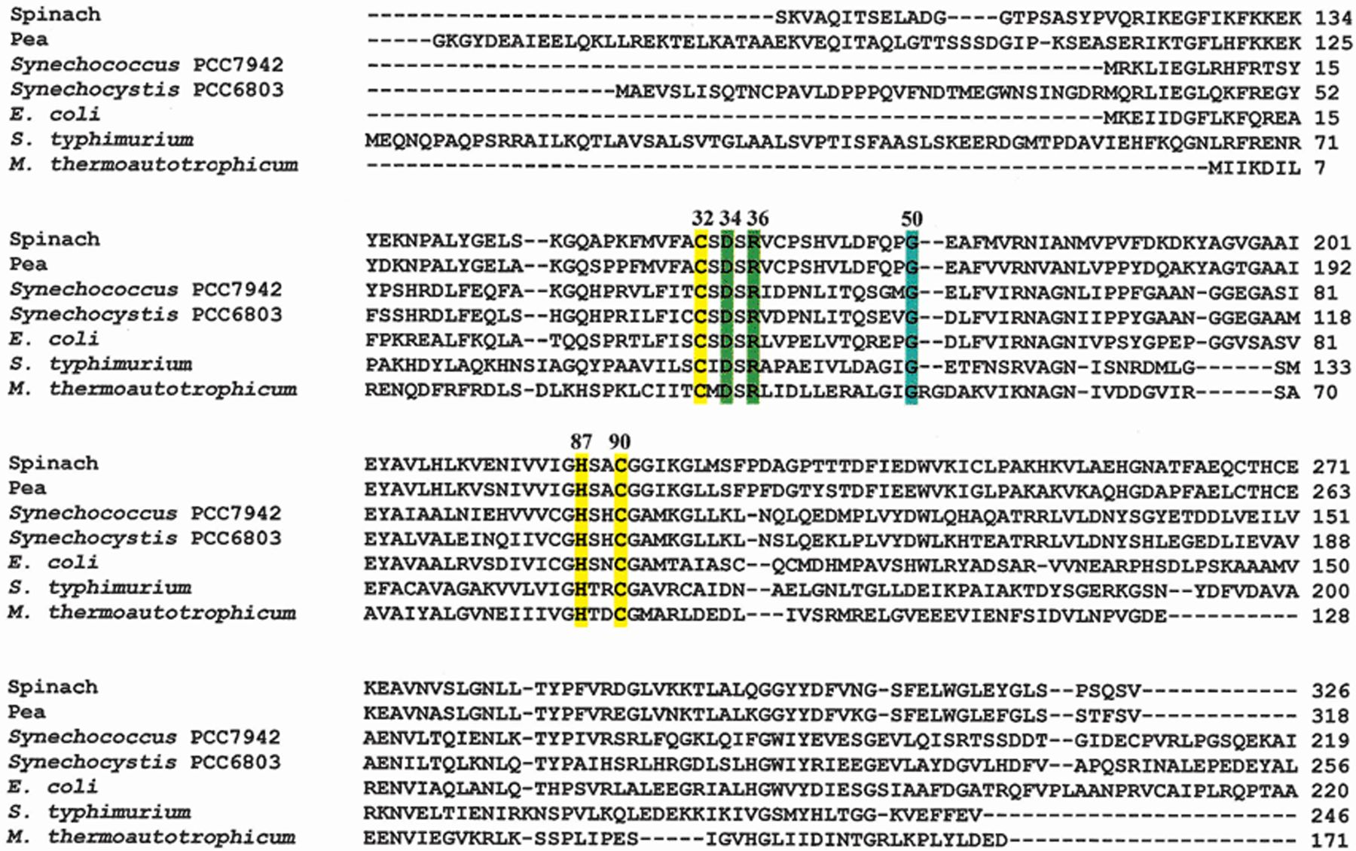
Figure 5 Alignment of β class carbonic anhydrase sequences. The sequences of documented prokaryotic β class carbonic ...
Notes:
Figure 5 Alignment of β class carbonic anhydrase sequences. The sequences of documented prokaryotic β class carbonic anhydrases were aligned with the sequences of the spinach and pea enzymes using Clustal X [190]. The spinach and pea chloroplast transit peptides (amino acids 1–98 for the spinach enzyme and 1–70 for the pea enzyme) were not included in the alignment. The conserved Zn ligands Cys-32, His-87 and Cys-90 are indicated in yellow. The completely conserved residues Asp-34 and Arg-36 are shown in green and the highly conserved Gly-50 is shown in blue. Numbers indicating residue positions refer to the position in the M. thermoautotrophicum sequence.
Unless provided in the caption above, the following copyright applies to the content of this slide: © 2000 Federation of European Microbiological Societies.

Slide 7
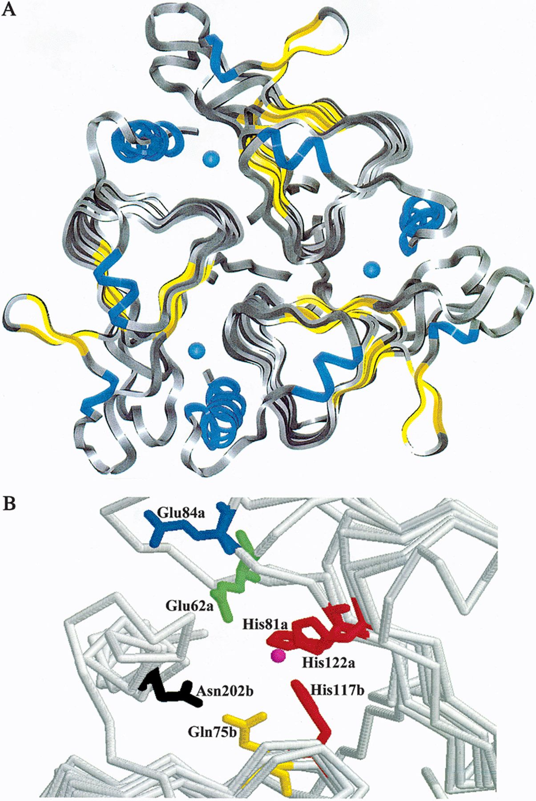
Figure 6 Crystal structure of the Methanosarcina thermophilaγ class carbonic anhydrase. A: View of the trimeric M. ...
Notes:
Figure 6 Crystal structure of the Methanosarcina thermophilaγ class carbonic anhydrase. A: View of the trimeric M. thermophila structure. The active site Zn is shown in blue. The α-helices are shown in yellow and the β-strands are shown in blue. The crystal structure model was produced by Insight II (Molecular Simulations, San Diego, CA, USA) using the atomic coordinates of the 2.8-Å structure [52]. B: View of the active site. The active site is at the interface of two neighboring subunits (designated a and b). The active site Zn is shown in magenta and the coordinating residues (His-81a, His-122a and His-117b) are shown in red. Glu-62a (shown in green) and Glu-84a (shown in blue), conserved among Cam and the cyanobacterial CcmM sequences, are necessary for CO2 hydration and proton transfer, respectively. Gln-75b (shown in yellow) and Asn-202b (shown in black) may function analogously to Glu-98 and Thr-177 of the α class neisserial enzyme which participate in a hydrogen bond network with the Zn-bound hydroxide to orient the lone pair of electrons for attack on CO2. The active site model was produced by RasMol (Biomolecular Structure, Glaxo Research and Development, Middlesex, UK) using the atomic coordinates of the 2.8-Å structure [52].
Unless provided in the caption above, the following copyright applies to the content of this slide: © 2000 Federation of European Microbiological Societies.

Slide 8
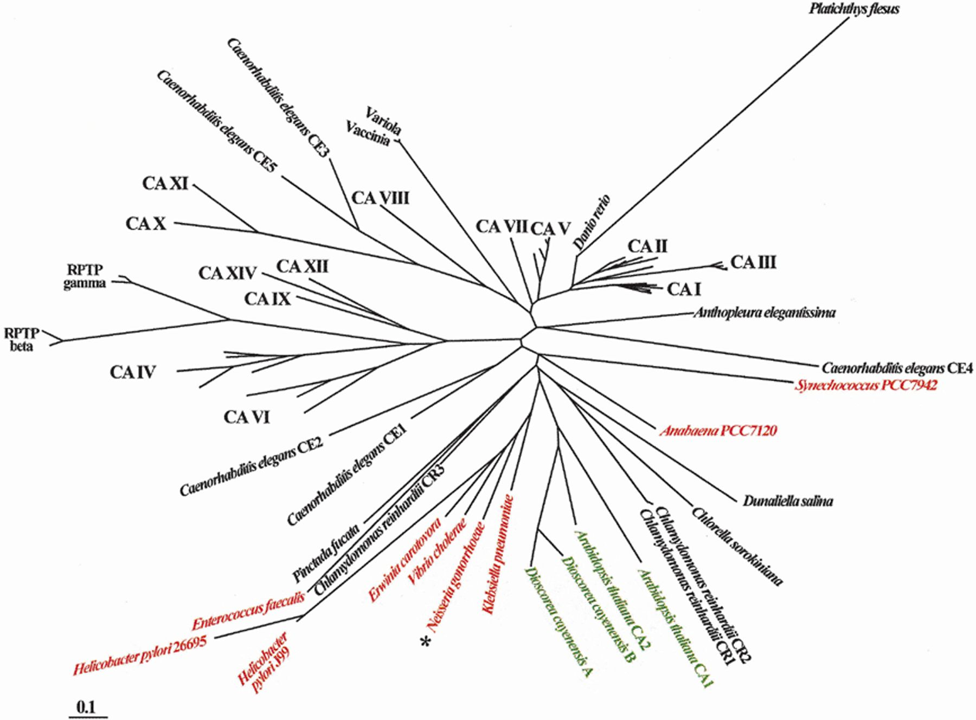
Figure 7 Phylogenetic tree of α class carbonic anhydrase sequences. Putative α class carbonic anhydrase sequences were ...
Notes:
Figure 7 Phylogenetic tree of α class carbonic anhydrase sequences. Putative α class carbonic anhydrase sequences were aligned using Clustal X [190] and analyzed with the MEGA program [158] using a neighbor joining algorithm with a gamma distance estimation (α=2). Phylogenetic trees were constructed based on pairwise distance estimates of the expected number of amino acid replacements per site (0.1 in the scale bar). One thousand bootstrap replicates were performed. Bacterial sequences are shown in red, plant sequences in green and non-plant eukaryotic sequences in black. Clustered, unlabeled branches indicate closely related sequences from multiple mammalian species and only the generic isozyme name is shown for the cluster. The documented α class carbonic anhydrase from N. gonorrhoeae is indicated by an asterisk (*).
Unless provided in the caption above, the following copyright applies to the content of this slide: © 2000 Federation of European Microbiological Societies.

Slide 9
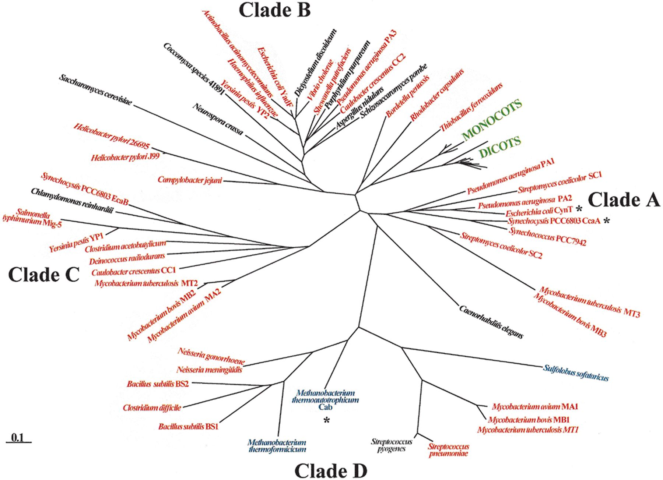
Figure 8 Phylogenetic tree of β class carbonic anhydrase sequences. Putative β class carbonic anhydrase sequences were ...
Notes:
Figure 8 Phylogenetic tree of β class carbonic anhydrase sequences. Putative β class carbonic anhydrase sequences were aligned using Clustal X [190] and analyzed with the MEGA program [158] using a neighbor joining algorithm with a gamma distance estimation (α=2). Phylogenetic trees were constructed based on pairwise distance estimates of the expected number of amino acid replacements per site (0.1 in the scale bar). One thousand bootstrap replicates were performed. Bacterial sequences are shown in red, archaeal sequences in blue and non-plant eukaryotic sequences in black. The monophyletic monocot and dicot plant groups are indicated in green. The documented prokaryotic β class carbonic anhydrases from M. thermoautotrophicum, E. coli and Synechocystis sp. PCC6803 are indicated by asterisks (*). Clades A–D, discussed in the text, are indicated.
Unless provided in the caption above, the following copyright applies to the content of this slide: © 2000 Federation of European Microbiological Societies.

Slide 10
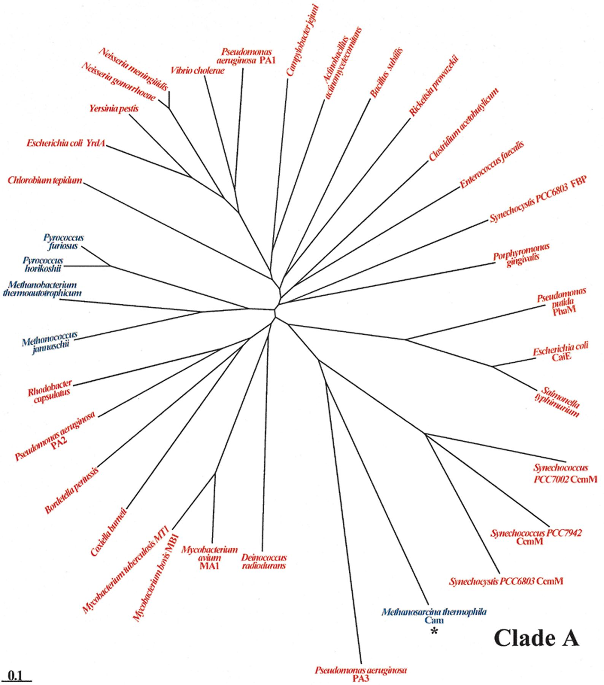
Figure 9 Phylogenetic tree of γ carbonic anhydrase sequences. Putative γ carbonic anhydrase sequences were aligned ...
Notes:
Figure 9 Phylogenetic tree of γ carbonic anhydrase sequences. Putative γ carbonic anhydrase sequences were aligned using Clustal X [190] and analyzed with the MEGA program [158] using a neighbor joining algorithm with a gamma distance estimation (α=2). Phylogenetic trees were constructed based on pairwise distance estimates of the expected number of amino acid replacements per site (0.1 in the scale bar). One thousand bootstrap replicates were performed. Bacterial sequences are shown in red and archaeal sequences in blue. The documented γ carbonic anhydrase from M. thermophila is indicated by an asterisk (*). Clade A, discussed in the text, is indicated.
Unless provided in the caption above, the following copyright applies to the content of this slide: © 2000 Federation of European Microbiological Societies.

Slide 11
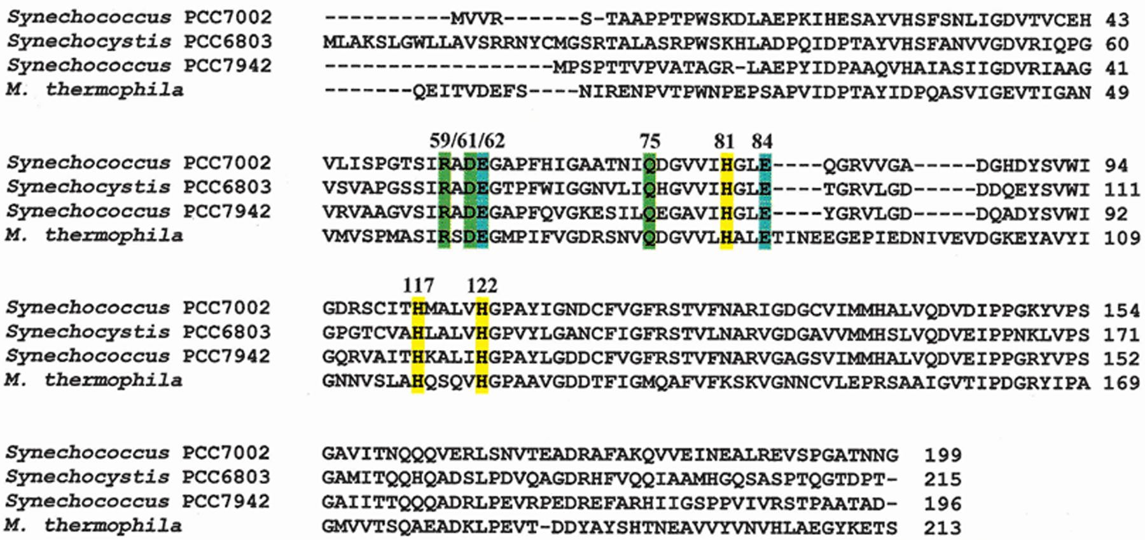
Figure 10 Alignment of γ class carbonic anhydrase sequences. The sequence of Cam, the documented γ class carbonic ...
Notes:
Figure 10 Alignment of γ class carbonic anhydrase sequences. The sequence of Cam, the documented γ class carbonic anhydrase from M. thermophila, was aligned with the cyanobacterial CcmM sequences using Clustal X [190]. The conserved Zn ligands His-81, His-117 and His-122 are indicated in yellow. Arg-59, Asp-61 and Gln-75, shown in green, are completely conserved in all γ class carbonic anhydrase sequences. Glu-62 and Glu-84, necessary for CO2 hydration and proton transfer, respectively, are shown in blue. Numbers indicating residue positions refer to the position in the M. thermophila sequence lacking the signal sequence.
Unless provided in the caption above, the following copyright applies to the content of this slide: © 2000 Federation of European Microbiological Societies.

