Slide 1
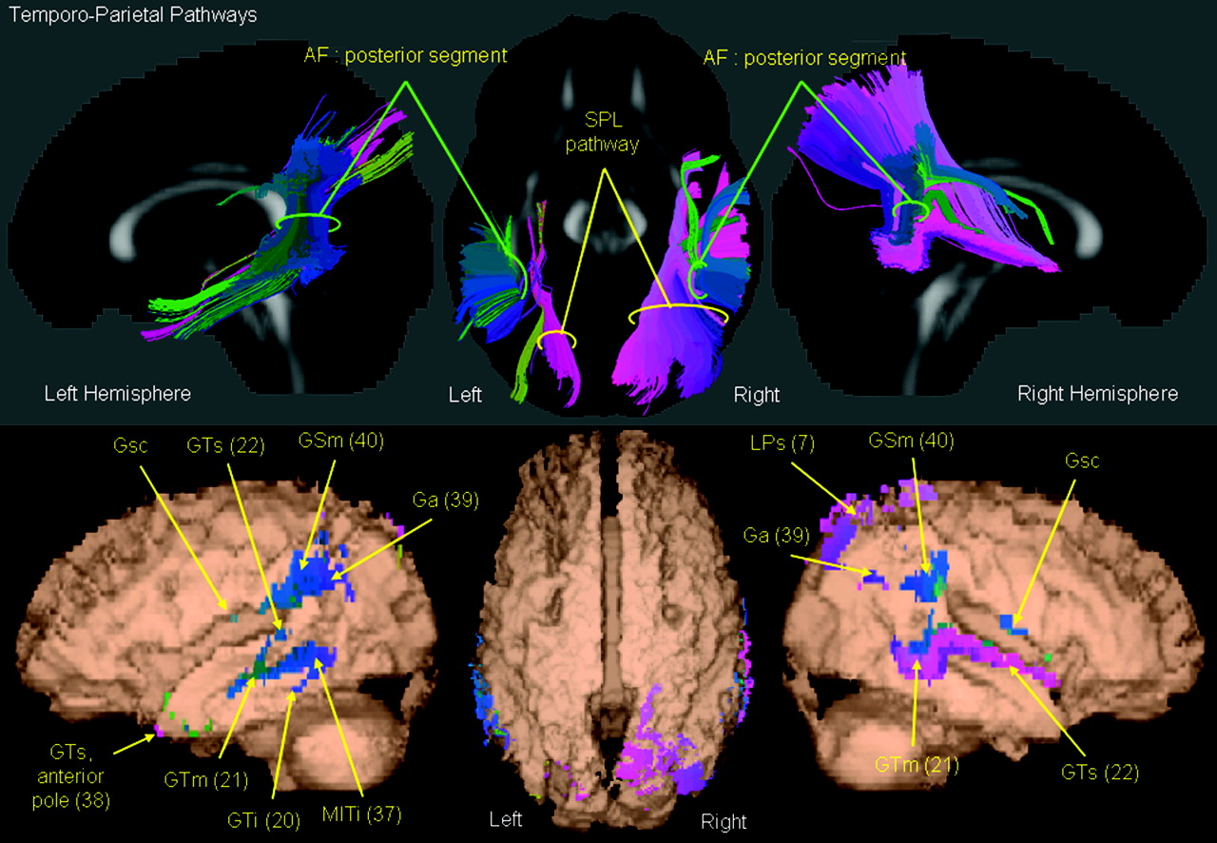
Figure 1. Temporoparietal white matter pathways. White matter fibers are illustrated that pass between the temporal and ...
Notes:
Figure 1. Temporoparietal white matter pathways. White matter fibers are illustrated that pass between the temporal and parietal lobes in the left and right cerebral hemispheres. All fibers were extracted from the mean DTI in standard space and are colored according to the SSC map. 3-dimensional white matter pathway reconstructions are presented above pathway termination coordinates in standard space. All termination coordinates are illustrated on a surface rendered FA map (FA ≥ 0.08) and colored according to the SSC map to enable assessment of the regions connected together by the tractography results. White matter pathways are annotated on the 3-dimensional streamline reconstructions, and anatomical regions (including BAs in parentheses) are annotated on the streamline termination maps. Gray matter: Ga, angular gyrus; Gsc, subcentral gyrus; GSm, supramarginal gyrus; GTi, inferior temporal gyrus; GTm, middle temporal gyrus; GTs, superior temporal gyrus; LPs, superior parietal lobule; MITi, middle-inferior temporal isthmus. White matter: AF, arcuate fasciculus; SPL, superior parietal lobule pathway.
Unless provided in the caption above, the following copyright applies to the content of this slide: © The Author 2006. Published by Oxford University Press. All rights reserved. For permissions, please e-mail: journals.permissions@oxfordjournals.org

Slide 2
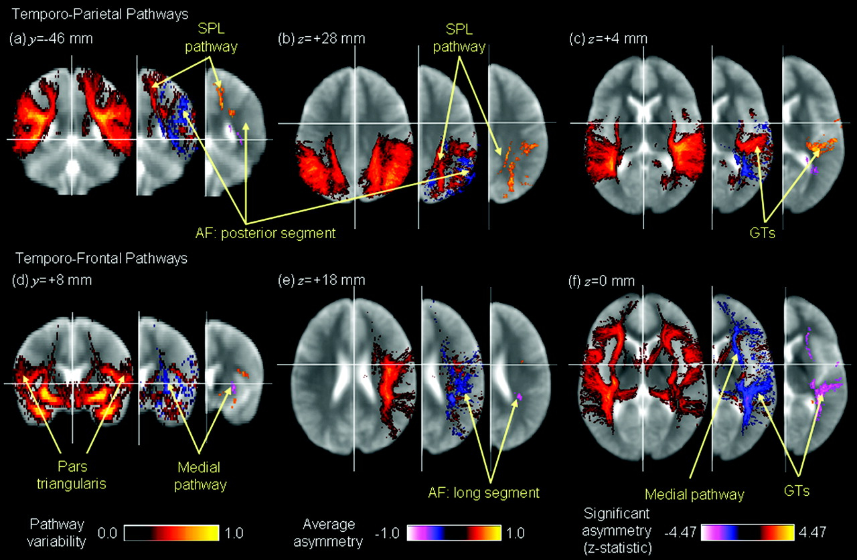
Figure 2. Pathway variability, asymmetry, and statistical significance maps of white matter pathways that pass between ...
Notes:
Figure 2. Pathway variability, asymmetry, and statistical significance maps of white matter pathways that pass between the temporal and parietal lobes (upper row) and the temporal and frontal lobes (lower row) are shown in neurological format for the 30 right-handed young healthy subjects overlain on the mean echo planar T2-weighted image without diffusion sensitization. Intersubject pathway variability maps are illustrated using a hot color map (black = 0, to yellow = 1) and are presented for the left and right hemispheres in the same image slices. Asymmetry maps are shown adjacent to intersubject pathway variability maps in the right hemisphere only (as they are symmetrical about the midsagittal plane in standard space). These are colored using cold and hot colors to represent leftward (white = −1, to black = 0) and rightward asymmetry (yellow = 1, to black = 0), respectively. In particular, absolute values close to 1 represent pathway asymmetries that are present in all subjects, whereas absolute values close to 0 represent symmetry throughout the subjects. Finally, to the right of the asymmetry maps are significant asymmetry maps of the z statistic. Cold and hot colors represent significant leftward and rightward asymmetries, respectively. Gray matter: GTs, superior temporal gyrus. White matter: AF, arcuate fasciculus; SPL, superior parietal lobule pathway.
Unless provided in the caption above, the following copyright applies to the content of this slide: © The Author 2006. Published by Oxford University Press. All rights reserved. For permissions, please e-mail: journals.permissions@oxfordjournals.org

Slide 3
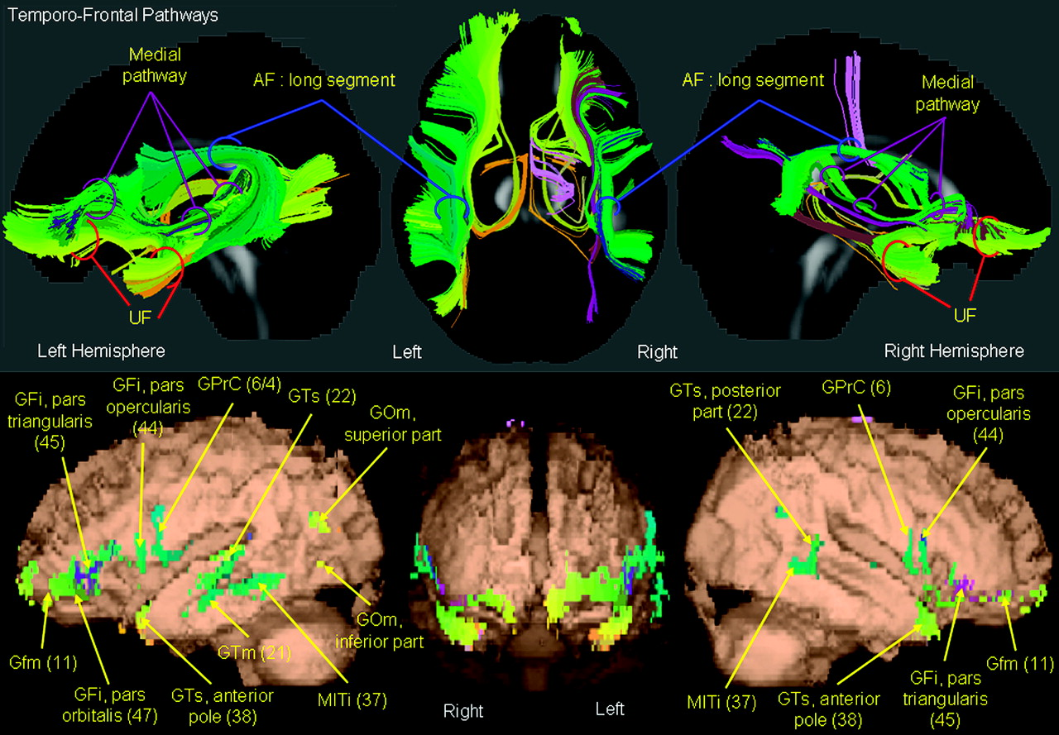
Figure 3. Temporofrontal white matter pathways. White matter fibers are illustrated that pass between the temporal and ...
Notes:
Figure 3. Temporofrontal white matter pathways. White matter fibers are illustrated that pass between the temporal and frontal lobes in the left and right cerebral hemispheres. All fibers were extracted from the mean DTI in standard space and are colored according to the SSC map. 3-dimensional white matter pathway reconstructions are presented above pathway termination coordinates in standard space. All termination coordinates are illustrated on a surface rendered FA map (FA ≥ 0.08) and colored according to the SSC map to enable assessment of the regions connected together by the tractography results. White matter pathways are annotated on the 3-dimensional streamline reconstructions, and anatomical regions (including BAs in parentheses) are annotated on the streamline termination maps. Gray matter: GFi, inferior frontal gyrus; Gfm, frontomarginal gyrus; GOm, middle occipital gyrus; GPrC, precentral gyrus; GTm, middle temporal gyrus; GTs, superior temporal gyrus; MITi, middle-inferior temporal isthmus. White matter: AF, arcuate fasciculus; UF, uncinate fasciculus.
Unless provided in the caption above, the following copyright applies to the content of this slide: © The Author 2006. Published by Oxford University Press. All rights reserved. For permissions, please e-mail: journals.permissions@oxfordjournals.org

