Slide 1
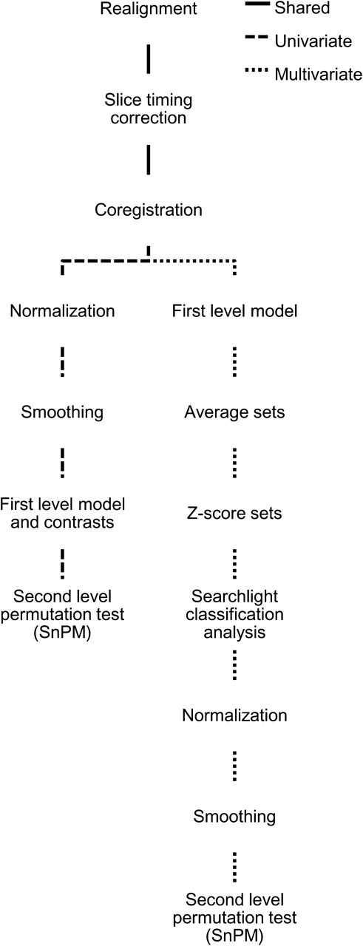
Figure 2. Processing pathways for fMRI analysis. All processing nodes take the result of the previous node in the ...
Notes:
Figure 2. Processing pathways for fMRI analysis. All processing nodes take the result of the previous node in the hierarchy as input. With the exception of the searchlight classification analysis, all processing steps were implemented using standard SPM5 functionality.
Unless provided in the caption above, the following copyright applies to the content of this slide: © The Authors 2011. Published by Oxford University Press.This is an Open Access article distributed under the terms of the Creative Commons Attribution Non-Commercial License (http://creativecommons.org/licenses/by-nc/2.5), which permits unrestricted non-commercial use, distribution, and reproduction in any medium, provided the original work is properly cited.

Slide 2
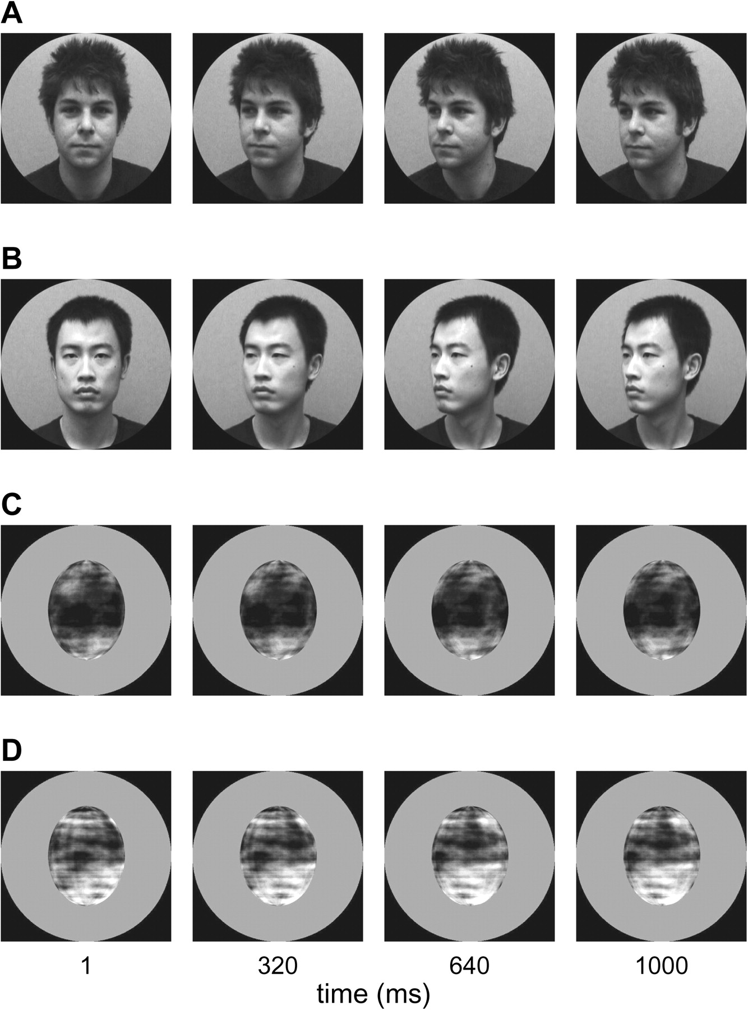
Figure 1. Example video frames for turning heads (A–B) and rotating ellipsoids (C–D). The stimuli were full color but ...
Notes:
Figure 1. Example video frames for turning heads (A–B) and rotating ellipsoids (C–D). The stimuli were full color but are presented in grayscale for printing purposes (for full color stimuli, see Supplementary Videos). The videos were presented at 24 frames per second. All video frames are from leftward motion conditions. Rightward conditions were created through mirror reversal of the same video clips. The 2 ellipsoid identities (C–D) were created by Fourier-scrambling face textures from the first frame of the 2 head videos (A–B).
Unless provided in the caption above, the following copyright applies to the content of this slide: © The Authors 2011. Published by Oxford University Press.This is an Open Access article distributed under the terms of the Creative Commons Attribution Non-Commercial License (http://creativecommons.org/licenses/by-nc/2.5), which permits unrestricted non-commercial use, distribution, and reproduction in any medium, provided the original work is properly cited.

Slide 3
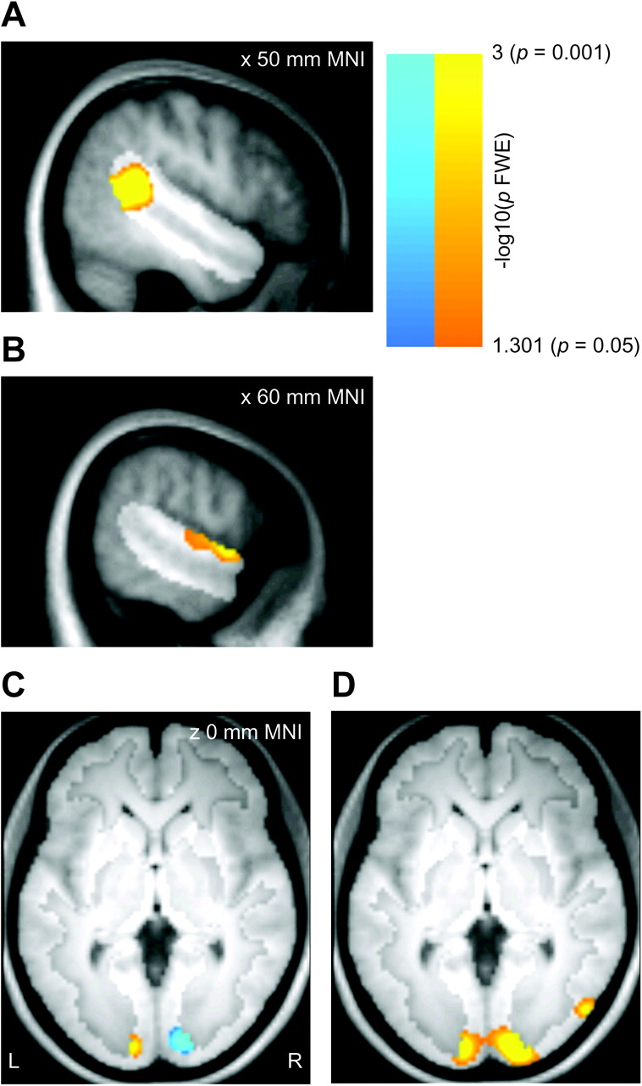
Figure 4. Group results for the univariate analysis, displayed on the mean T₁ volume for the sample. Effects ...
Notes:
Figure 4. Group results for the univariate analysis, displayed on the mean T1 volume for the sample. Effects are displayed corrected for multiple comparisons within the right STS region (panels A–B; hypothesis-driven analysis, P < 0.05 FWE) or the full gray matter volume (panels C–D; exploratory analysis, P < 0.05 FWE). The highlighted portion of each panel shows the extent of the mask. (A) Greater univariate responses to heads than to ellipsoids in the right STS region. (B) Greater univariate responses to ellipsoids than to heads in the right STS region. (C) Gray matter regions with greater univariate responses to left than to right head turns (warm colors) or with greater univariate responses to right than to left head turns (cool colors). The effects do not overlap at any site. (D) Gray matter regions with greater univariate responses to heads than to ellipsoids.
Unless provided in the caption above, the following copyright applies to the content of this slide: © The Authors 2011. Published by Oxford University Press.This is an Open Access article distributed under the terms of the Creative Commons Attribution Non-Commercial License (http://creativecommons.org/licenses/by-nc/2.5), which permits unrestricted non-commercial use, distribution, and reproduction in any medium, provided the original work is properly cited.

Slide 4
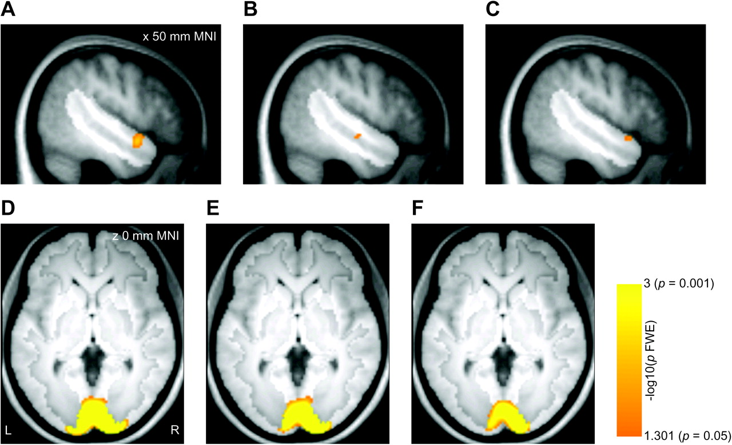
Figure 3. Group results for MVPA, displayed on the mean T₁ volume for the sample. Effects are displayed ...
Notes:
Figure 3. Group results for MVPA, displayed on the mean T1 volume for the sample. Effects are displayed corrected for multiple comparisons within the right STS region (panels A–C; hypothesis-driven analysis, P < 0.05 FWE) or the full gray matter volume (panels D–F; exploratory analysis, P < 0.05 FWE). The highlighted portion of each panel shows the extent of the mask. (A) Classification of left–right head turns in the right STS/STG region. (B) Classification of left–right ellipsoid rotations in the right STS region. (C) Right STS regions where left–right classification of head turns was more accurate than classification of ellipsoid rotations. (D) Classification of left–right head turns in the full gray matter volume. (E): Gray matter regions where left–right classification of head turns was more accurate than classification of ellipsoid rotations. (F) Gray matter regions where the weights acquired by training the classifier on left–right head turns for one head identity generalized to left–right head turns in the other head identity.
Unless provided in the caption above, the following copyright applies to the content of this slide: © The Authors 2011. Published by Oxford University Press.This is an Open Access article distributed under the terms of the Creative Commons Attribution Non-Commercial License (http://creativecommons.org/licenses/by-nc/2.5), which permits unrestricted non-commercial use, distribution, and reproduction in any medium, provided the original work is properly cited.

Slide 5
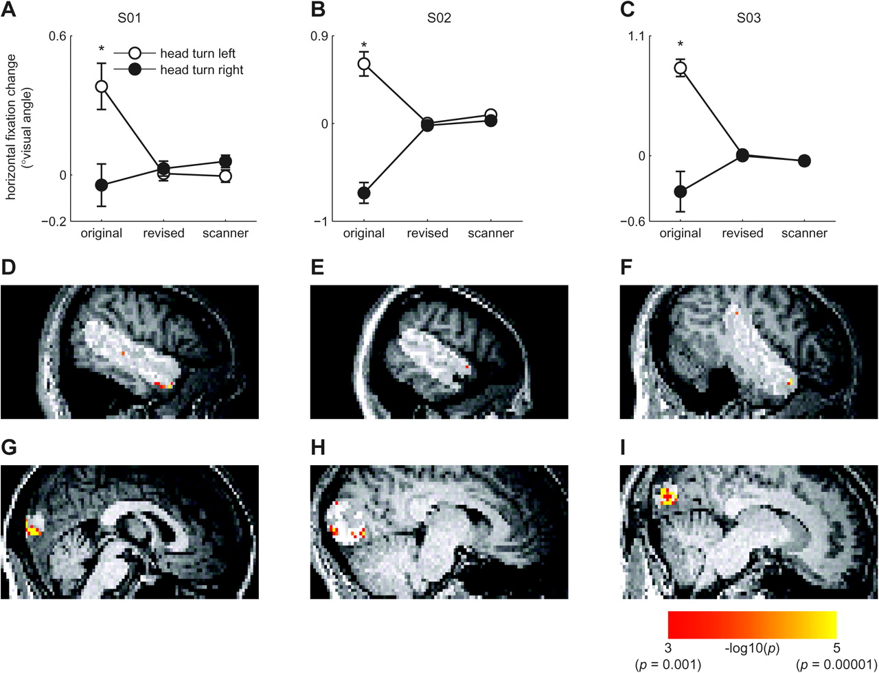
Figure 5. Follow-up eye tracking and fMRI experiments. (A–C) Mean horizontal fixation change plotted separately for the ...
Notes:
Figure 5. Follow-up eye tracking and fMRI experiments. (A–C) Mean horizontal fixation change plotted separately for the 3 volunteers selected for the final analysis in the revised fMRI experiment. Positive values reflect a leftward shift in fixation over the trial, while negative values reflect a rightward shift. The horizontal axis gives fixation performance in the original task, the revised task, and the revised task as measured during the fMRI experiment. The error bars give ±1 standard error of the mean. Comparisons with significant differences between the head turn directions are highlighted by asterisks (t-tests, P < 0.05). It can be seen that the revised design abolished the eye movement effect in these volunteers. (D–F) Left–right head turn classification results for the 3 volunteers in the final sample of the fMRI experiment. The volunteers are shown in the same order as in A–C. Results are overlaid on each volunteer's T1 volume and are masked to only include effects within the highlighted right STS region (P < 0.001, uncorrected). It can be seen that even in the absence of eye movement effects, anterior STS/STG codes head turn direction. (G–I) Results as in D–F but masked to show effects within a 20 mm radius of the peak early visual head turn classification effect from the main study. It can be seen that the effects in early visual cortex also remain when eye movements are controlled.
Unless provided in the caption above, the following copyright applies to the content of this slide: © The Authors 2011. Published by Oxford University Press.This is an Open Access article distributed under the terms of the Creative Commons Attribution Non-Commercial License (http://creativecommons.org/licenses/by-nc/2.5), which permits unrestricted non-commercial use, distribution, and reproduction in any medium, provided the original work is properly cited.

