Slide 1
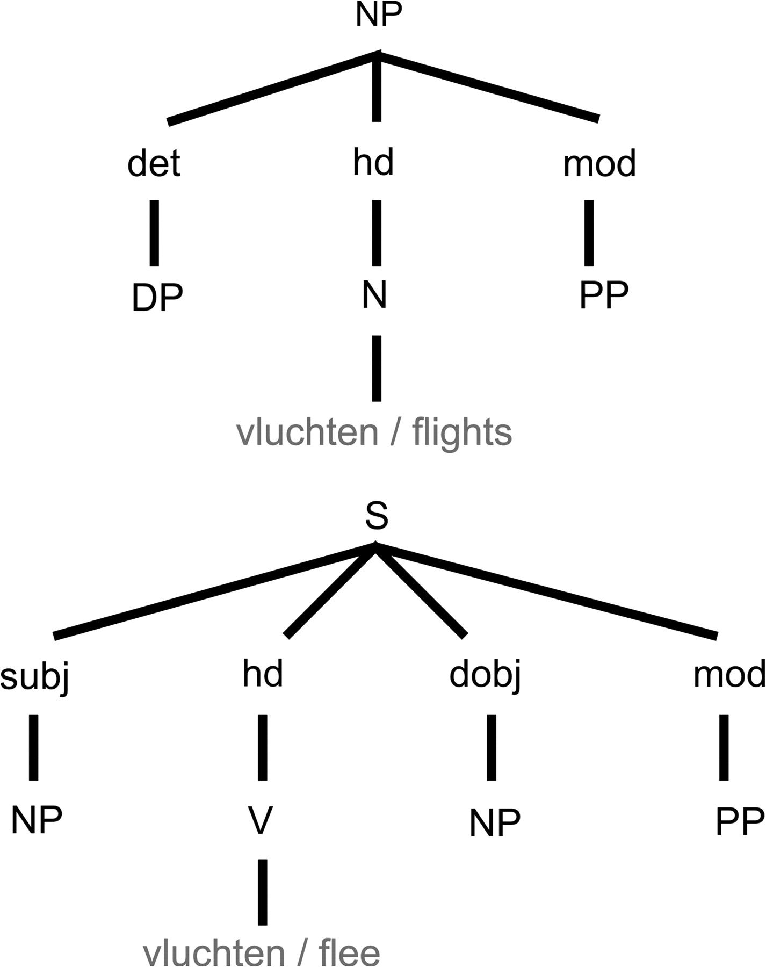
Figure 1. Lexical frames for the noun vluchten “flights” and the verb vluchten “flee.” When encountering the word ...
Notes:
Figure 1. Lexical frames for the noun vluchten “flights” and the verb vluchten “flee.” When encountering the word vluchten, the lexical frame of both the noun and the verb will be retrieved. In the Vosse and Kempen model, lexical frames consist of 3-tiered treelets. The top-layer of a frame consists of a single phrasal node (e.g., NP). This “root”-node is connected to one or more functional nodes in the second layer (e.g., subject, head, direct object, modifier). Every functional node is linked to again a phrasal node in the third layer. Each lexical frame is attached to one lexical item (situated under the “head” node).
Unless provided in the caption above, the following copyright applies to the content of this slide: © The Author 2008. Published by Oxford University Press. All rights reserved. For permissions, please e-mail: journals.permissions@oxfordjournals.org

Slide 2
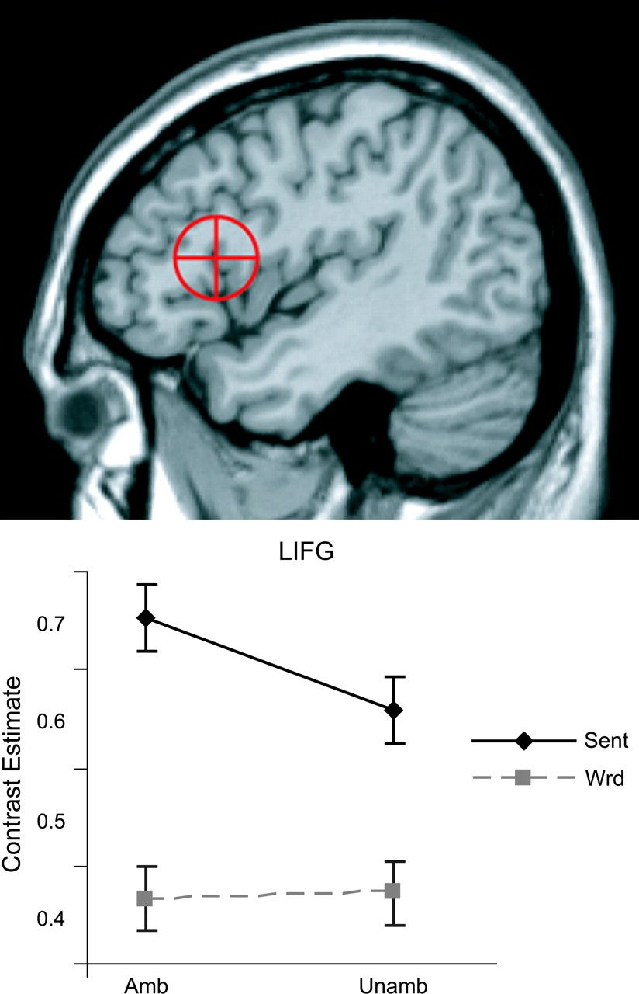
Figure 2. ROI results. Mean contrast estimates for LIFG for SA, SU, WA, and WU. The ROI used is shown on top (13 mm ...
Notes:
Figure 2. ROI results. Mean contrast estimates for LIFG for SA, SU, WA, and WU. The ROI used is shown on top (13 mm sphere around coordinates [−44,19,14]).
Unless provided in the caption above, the following copyright applies to the content of this slide: © The Author 2008. Published by Oxford University Press. All rights reserved. For permissions, please e-mail: journals.permissions@oxfordjournals.org

Slide 3
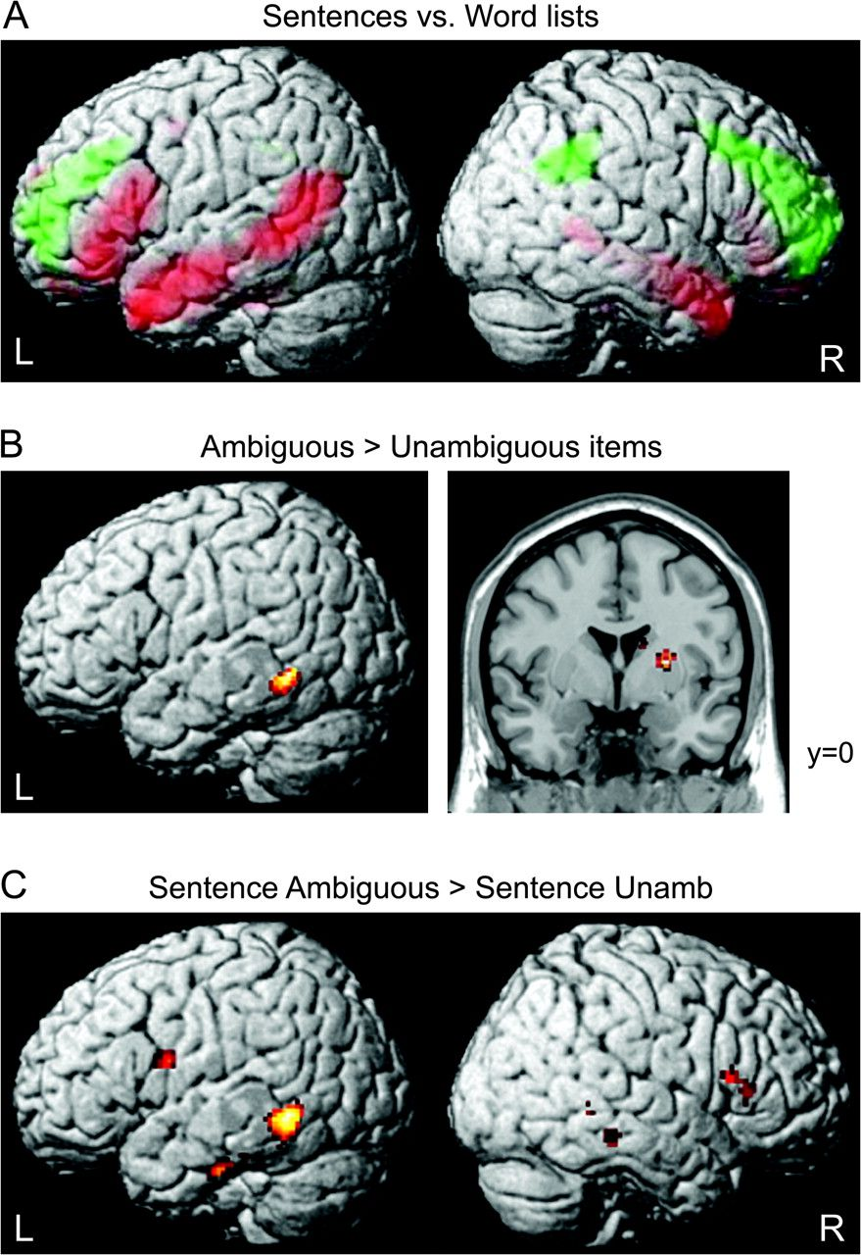
Figure 3. Whole-brain analysis. Significant activations projected onto a rendered template brain surface in MNI ...
Notes:
Figure 3. Whole-brain analysis. Significant activations projected onto a rendered template brain surface in MNI stereotactic space. (A) Effect of grammaticality. Enhanced activity within sentences is shown in red, increased signal for words is shown in green. (Activations shown at voxel-level PFWE < 0.05, cluster-size threshold 20 voxels.) (B) Effect of ambiguity: enhanced activity for ambiguous as compared to unambiguous conditions. The right panel shows a coronal view of the brain at y = 0, displaying the ambiguity effect in the right striatum. (Activations shown at voxel-level Puncorr < 0.002, cluster-size threshold 50 voxels.) (C) Effect of ambiguity within sentences: enhanced activity for ambiguous sentences as compared to unambiguous sentences. (Activations shown at voxel-level Puncorr < 0.002, cluster-size threshold 50 voxels.)
Unless provided in the caption above, the following copyright applies to the content of this slide: © The Author 2008. Published by Oxford University Press. All rights reserved. For permissions, please e-mail: journals.permissions@oxfordjournals.org

Slide 4
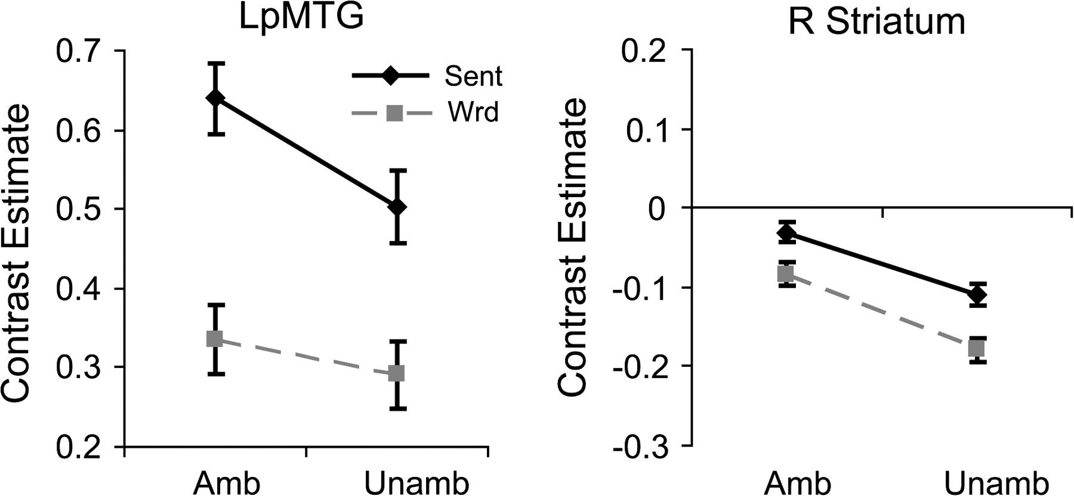
Figure 4. Mean contrast estimates for LpMTG and the right striatum (clusters identified by the whole-brain ambiguity ...
Notes:
Figure 4. Mean contrast estimates for LpMTG and the right striatum (clusters identified by the whole-brain ambiguity effect) for SA, SU, WA, and WU.
Unless provided in the caption above, the following copyright applies to the content of this slide: © The Author 2008. Published by Oxford University Press. All rights reserved. For permissions, please e-mail: journals.permissions@oxfordjournals.org

Slide 5
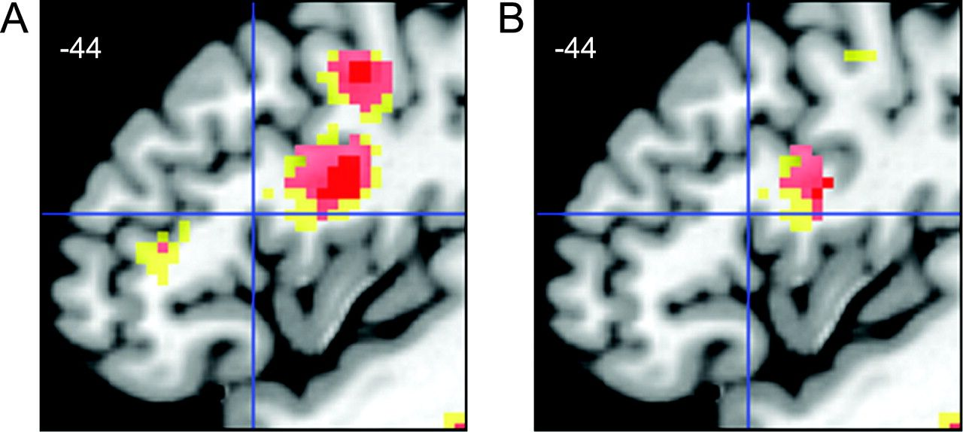
Figure 5. LIFG effect: comparison of ROI and whole-brain analysis (exploratory thresholds). Activations from the ...
Notes:
Figure 5. LIFG effect: comparison of ROI and whole-brain analysis (exploratory thresholds). Activations from the whole-brain analysis are displayed on a template (frontal cortex, sagittal view). Voxel-level Puncorr: yellow P < 0.01; pink P < 0.005; red P SU). (B) Effect of ambiguity within sentences (SA > SU), masked (inclusively) with the effect of grammaticality (sentences > words) at PFWE < 0.05. Regions contributing to the syntactic unification process should show this pattern of activation.
Unless provided in the caption above, the following copyright applies to the content of this slide: © The Author 2008. Published by Oxford University Press. All rights reserved. For permissions, please e-mail: journals.permissions@oxfordjournals.org

