Slide 1
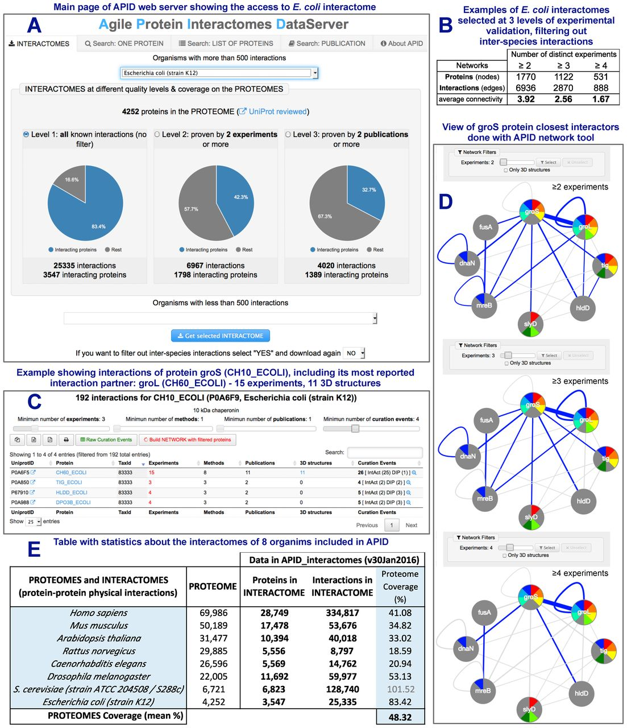
Figure 1. Presentation of APID (Agile Protein Interactomes DataServer) including five panels with different views and ...
Notes:
Figure 1. Presentation of APID (Agile Protein Interactomes DataServer) including five panels with different views and information. (A) Panel showing the main web page of the APID web server after selecting ‘E. coli (strain K12)’ to present its interactomes. (B) Table presenting the size that the interactome datasets from E. coli produced at three levels of experimental validation and filtering out inter-species interactions. (C) Example showing the interactions of protein groS (CH10_ECOLI), including its most reported interaction partner: groL (CH60_ECOLI), that has been validated in 15 experiments and in 11 3D structures. (D) View of the closest protein interactors of the groS protein using the APID network tool which allows coloring the nodes according to specific functional terms annotated to the proteins and also allows selection of the edges (in blue) according to the number of experiments that validate each interaction. (E) Table with the numbers included in APID about interactome sizes and proteome coverage for eight model organisms.
Unless provided in the caption above, the following copyright applies to the content of this slide: © The Author(s) 2016. Published by Oxford University Press on behalf of Nucleic Acids Research.This is an Open Access article distributed under the terms of the Creative Commons Attribution License (http://creativecommons.org/licenses/by-nc/4.0/), which permits non-commercial re-use, distribution, and reproduction in any medium, provided the original work is properly cited. For commercial re-use, please contact journals.permissions@oup.com

