Slide 1
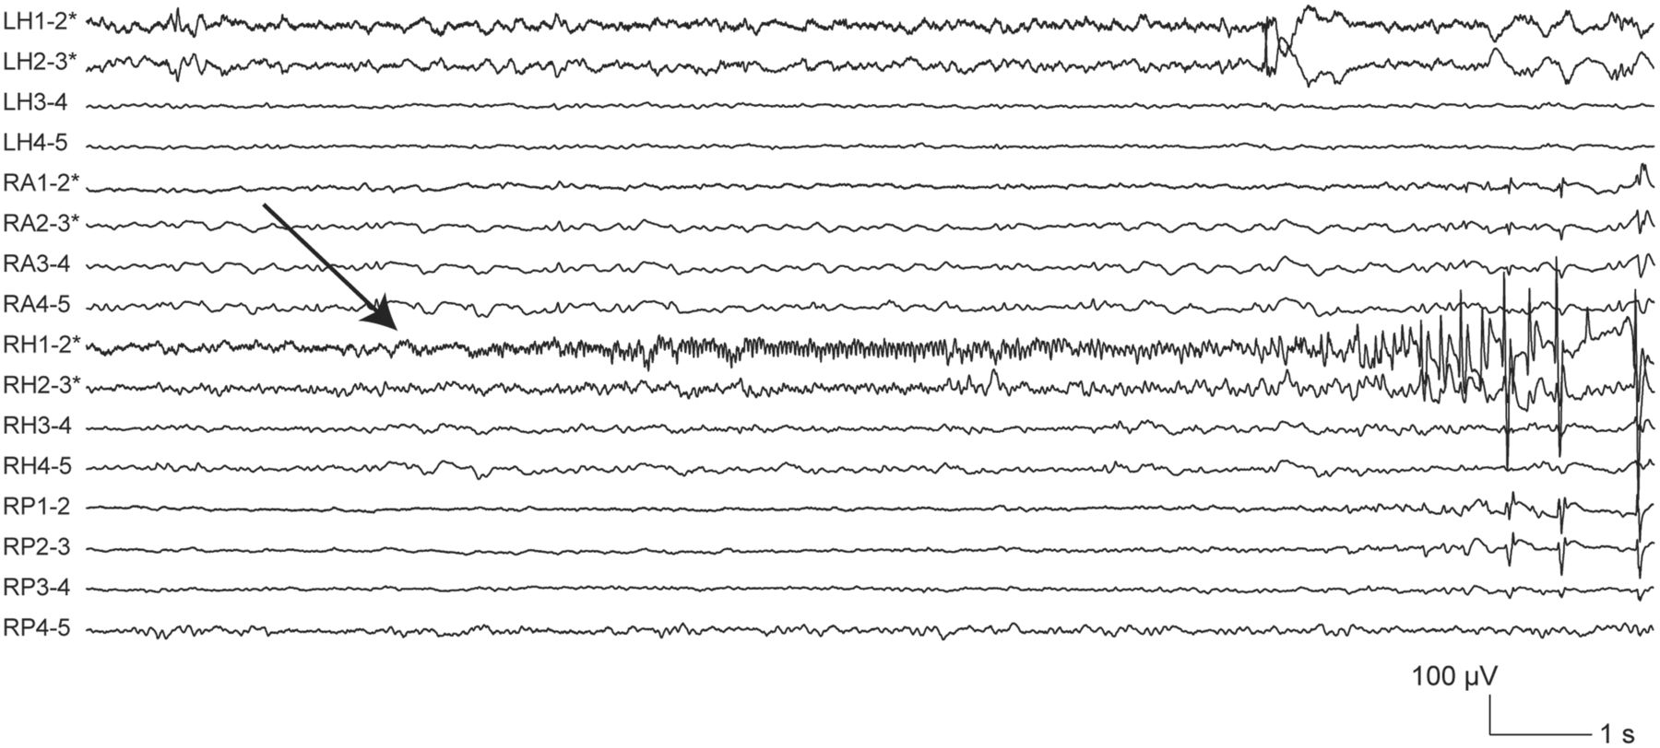
Figure 1 Low-voltage fast activity at seizure-onset. In this ictal intracranial EEG recording (electrographic seizure) ...
Notes:
Figure 1 Low-voltage fast activity at seizure-onset. In this ictal intracranial EEG recording (electrographic seizure) from a patient with bilateral mesial temporal atrophy/sclerosis, seizure-onset (arrow) was characterized by a clearly visible rhythmic activity at 20–30 Hz, initially <10 μV in amplitude, which remained confined for several seconds to contacts RH1–2. The patient had seizures arising independently from each mesial temporal lobe, but more frequently from the right side. A right anterior temporal lobectomy was carried out, which resulted in an improvement in the overall seizure frequency, with persistence of seizures only from the left temporal lobe (Engel class III; post-surgical follow-up: 12 months) (Engel et al., 1993). Electrode targets: LH = left hippocampus; RA = right amygdala; RH = right hippocampus; RP = right posterior hippocampus. Asterisk indicates electrode contacts located in lesional/peri-lesional tissue.
Unless provided in the caption above, the following copyright applies to the content of this slide: © The Author (2013). Published by Oxford University Press on behalf of the Guarantors of Brain. All rights reserved. For Permissions, please email: journals.permissions@oup.com

Slide 2
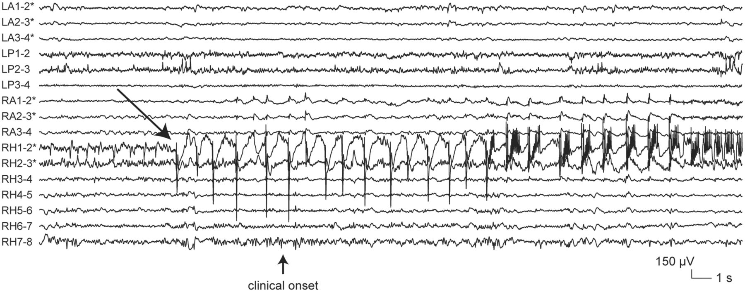
Figure 2 Low-frequency high-amplitude periodic spikes at seizure-onset. In this ictal intracranial EEG recording from ...
Notes:
Figure 2 Low-frequency high-amplitude periodic spikes at seizure-onset. In this ictal intracranial EEG recording from a patient with bilateral mesial temporal atrophy/sclerosis (the same described in Fig. 1), seizure-onset (arrow) consisted in the appearance of high-voltage spiking at 1 Hz, lasting for ∼15 s at contacts RH1–2. Electrode targets: LA = left amygdala; LP = left posterior hippocampus; RA = right amygdala; RH = right hippocampus. Asterisk indicates electrode contacts located in lesional/perilesional tissue.
Unless provided in the caption above, the following copyright applies to the content of this slide: © The Author (2013). Published by Oxford University Press on behalf of the Guarantors of Brain. All rights reserved. For Permissions, please email: journals.permissions@oup.com

Slide 3
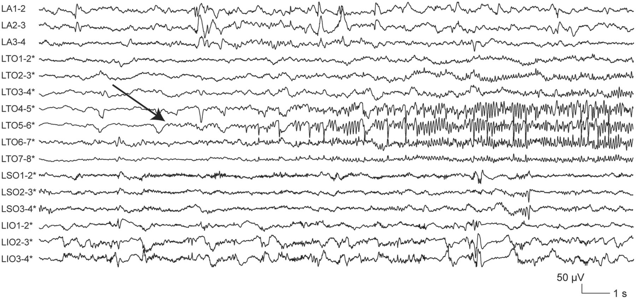
Figure 3 Sharp activity at ≤13 Hz at seizure-onset. In this ictal intracranial EEG recording (electrographic seizure) ...
Notes:
Figure 3 Sharp activity at ≤13 Hz at seizure-onset. In this ictal intracranial EEG recording (electrographic seizure) from a patient with left temporo-parieto-occipital periventricular nodular heterotopia, seizure-onset (arrow) was characterized by the progressive build-up of a low-to medium-voltage sharply-contoured rhythmic activity at 6 Hz starting at contacts LTO5–6. The patient did not undergo surgery because the epileptogenic lesion was located in close proximity to eloquent cortex (speech area). Electrode targets: LA = left amygdala; LTO = left lingual gyrus; LSO = left precuneus; LIO = left cuneus. Asterisk indicates electrode contacts located in lesional/perilesional tissue.
Unless provided in the caption above, the following copyright applies to the content of this slide: © The Author (2013). Published by Oxford University Press on behalf of the Guarantors of Brain. All rights reserved. For Permissions, please email: journals.permissions@oup.com

Slide 4
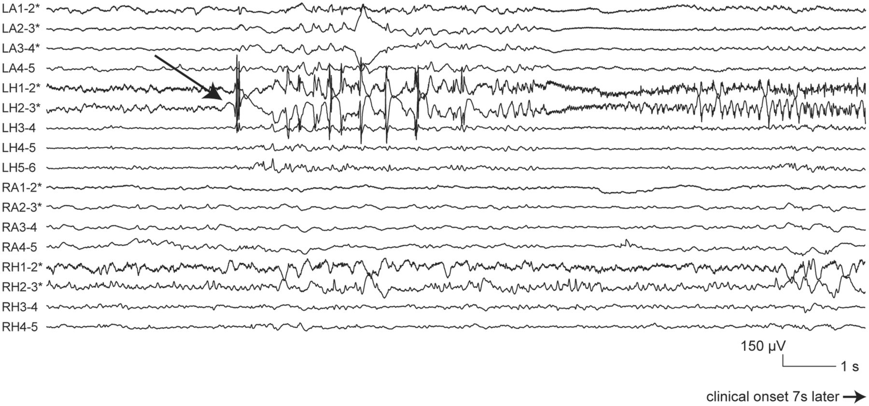
Figure 4 Spike-and-wave activity at seizure-onset. In this ictal intracranial EEG recording from a patient with ...
Notes:
Figure 4 Spike-and-wave activity at seizure-onset. In this ictal intracranial EEG recording from a patient with bilateral mesial temporal atrophy/sclerosis (the same described in Fig. 1), seizure-onset (arrow) consisted in the appearance of high-voltage spike-and-wave complexes at 2–3 Hz at contacts LH1–2 and 2–3. Electrode targets: LA = left amygdala; LP = left posterior hippocampus; RA = right amygdala; RH = right hippocampus. Asterisk indicates electrode contacts located in lesional/perilesional tissue.
Unless provided in the caption above, the following copyright applies to the content of this slide: © The Author (2013). Published by Oxford University Press on behalf of the Guarantors of Brain. All rights reserved. For Permissions, please email: journals.permissions@oup.com

Slide 5
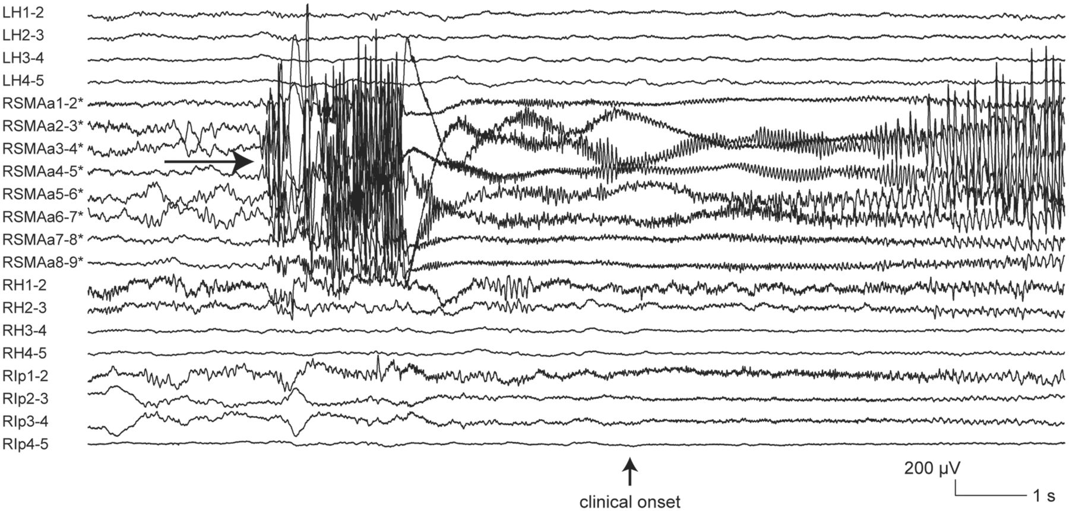
Figure 5 Burst of high-amplitude polyspikes at seizure-onset. In this ictal intracranial EEG recording from a patient ...
Notes:
Figure 5 Burst of high-amplitude polyspikes at seizure-onset. In this ictal intracranial EEG recording from a patient with right superior frontal focal cortical dysplasia, seizure-onset (arrow) consisted in a 2-s burst of repetitive high-voltage spikes at all contacts of electrode RSMAa. The patient underwent an incomplete lesionectomy, sparing the portion of the lesion overlapping with the primary motor cortex, with no change in seizure frequency (Engel class IV; post-surgical follow-up: 15 months). Histopathological examination of the resected specimen revealed focal cortical dysplasia type IIa (Blümcke et al., 2011). Electrode targets: LH = left hippocampus; RSMAa = anterior aspect of right supplementary motor area; RH = right hippocampus; RIP = right posterior cingulate gyrus. Asterisk indicates electrode contacts located in lesional/peri-lesional tissue.
Unless provided in the caption above, the following copyright applies to the content of this slide: © The Author (2013). Published by Oxford University Press on behalf of the Guarantors of Brain. All rights reserved. For Permissions, please email: journals.permissions@oup.com

Slide 6
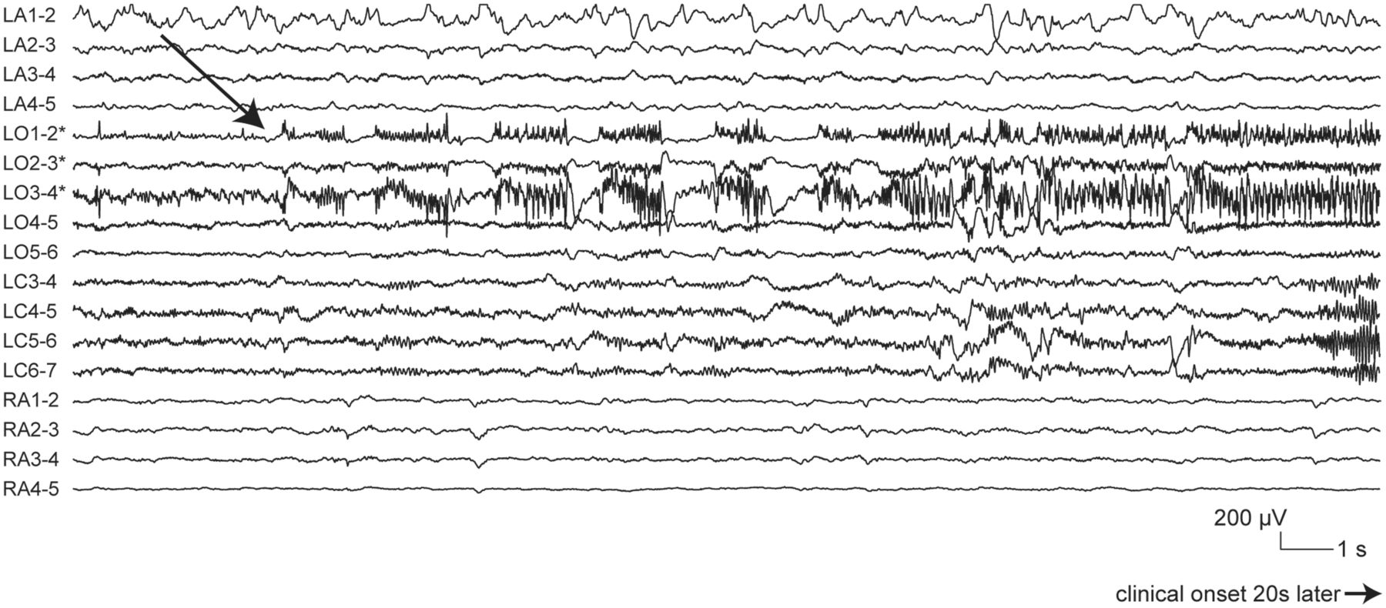
Figure 6 Burst suppression at seizure-onset. In this ictal intracranial EEG recording from a patient with tuberous ...
Notes:
Figure 6 Burst suppression at seizure-onset. In this ictal intracranial EEG recording from a patient with tuberous sclerosis complex, seizure-onset (arrow) was characterized by 1.5-s bursts of medium- to high-voltage polyspikes alternating with 0.5-s periods of voltage attenuation at contacts LO1-2, 2-3 and 3-4. The patient had tubers in both frontal lobes and in the left temporal lobe. Two large tubers, one in the left orbitofrontal region and the other in the left temporal pole, were resected, resulting in a significant improvement in seizure frequency (Engel class III; post-surgical follow-up: 79 months). Electrode targets: LA = left amygdala; LO = left orbitofrontal cortex; LC = left anterior cingulate gyrus; RA = right amygdala. Asterisk indicates electrode contacts located in lesional/peri-lesional tissue.
Unless provided in the caption above, the following copyright applies to the content of this slide: © The Author (2013). Published by Oxford University Press on behalf of the Guarantors of Brain. All rights reserved. For Permissions, please email: journals.permissions@oup.com

Slide 7
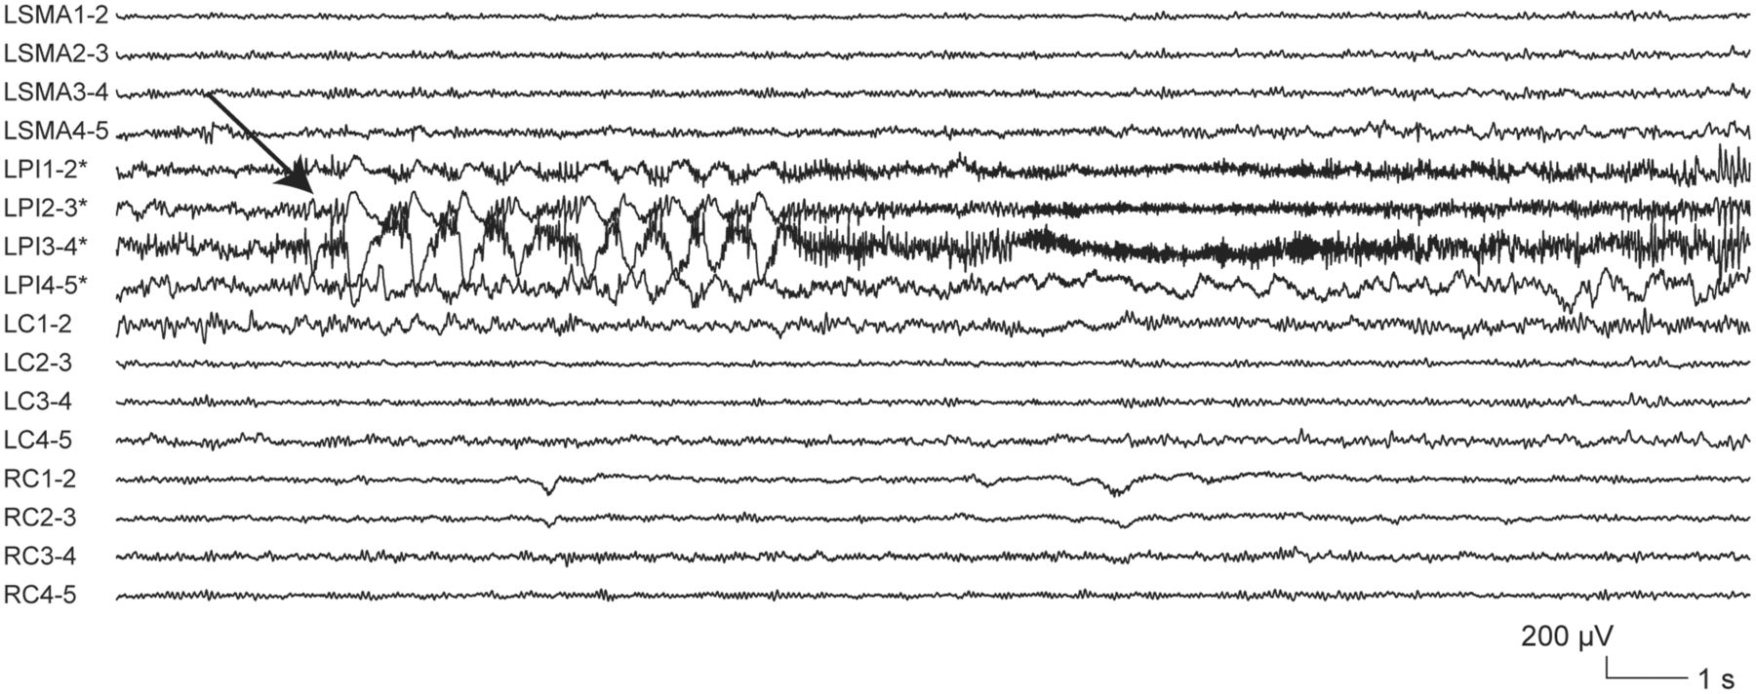
Figure 7 Delta brush at seizure-onset. In this ictal intracranial EEG recording (electrographic seizure) from a ...
Notes:
Figure 7 Delta brush at seizure-onset. In this ictal intracranial EEG recording (electrographic seizure) from a patient with left inferior parietal focal cortical dysplasia, seizure-onset (arrow) consisted of the appearance of rhythmic delta waves at 1–2 Hz with superimposed 0.5-s bursts of 20–30 Hz activity at contacts LPI1–2, 2–3 and 3–4. The patient did not undergo surgery because the epileptogenic lesion overlapped with eloquent cortex (speech area). Electrode targets: LSMA = left supplementary motor area; LPI = left infero-parietal region; LC = left anterior cingulate gyrus; RC = right anterior cingulate gyrus. Asterisk indicates electrode contacts located in lesional/perilesional tissue.
Unless provided in the caption above, the following copyright applies to the content of this slide: © The Author (2013). Published by Oxford University Press on behalf of the Guarantors of Brain. All rights reserved. For Permissions, please email: journals.permissions@oup.com

Slide 8
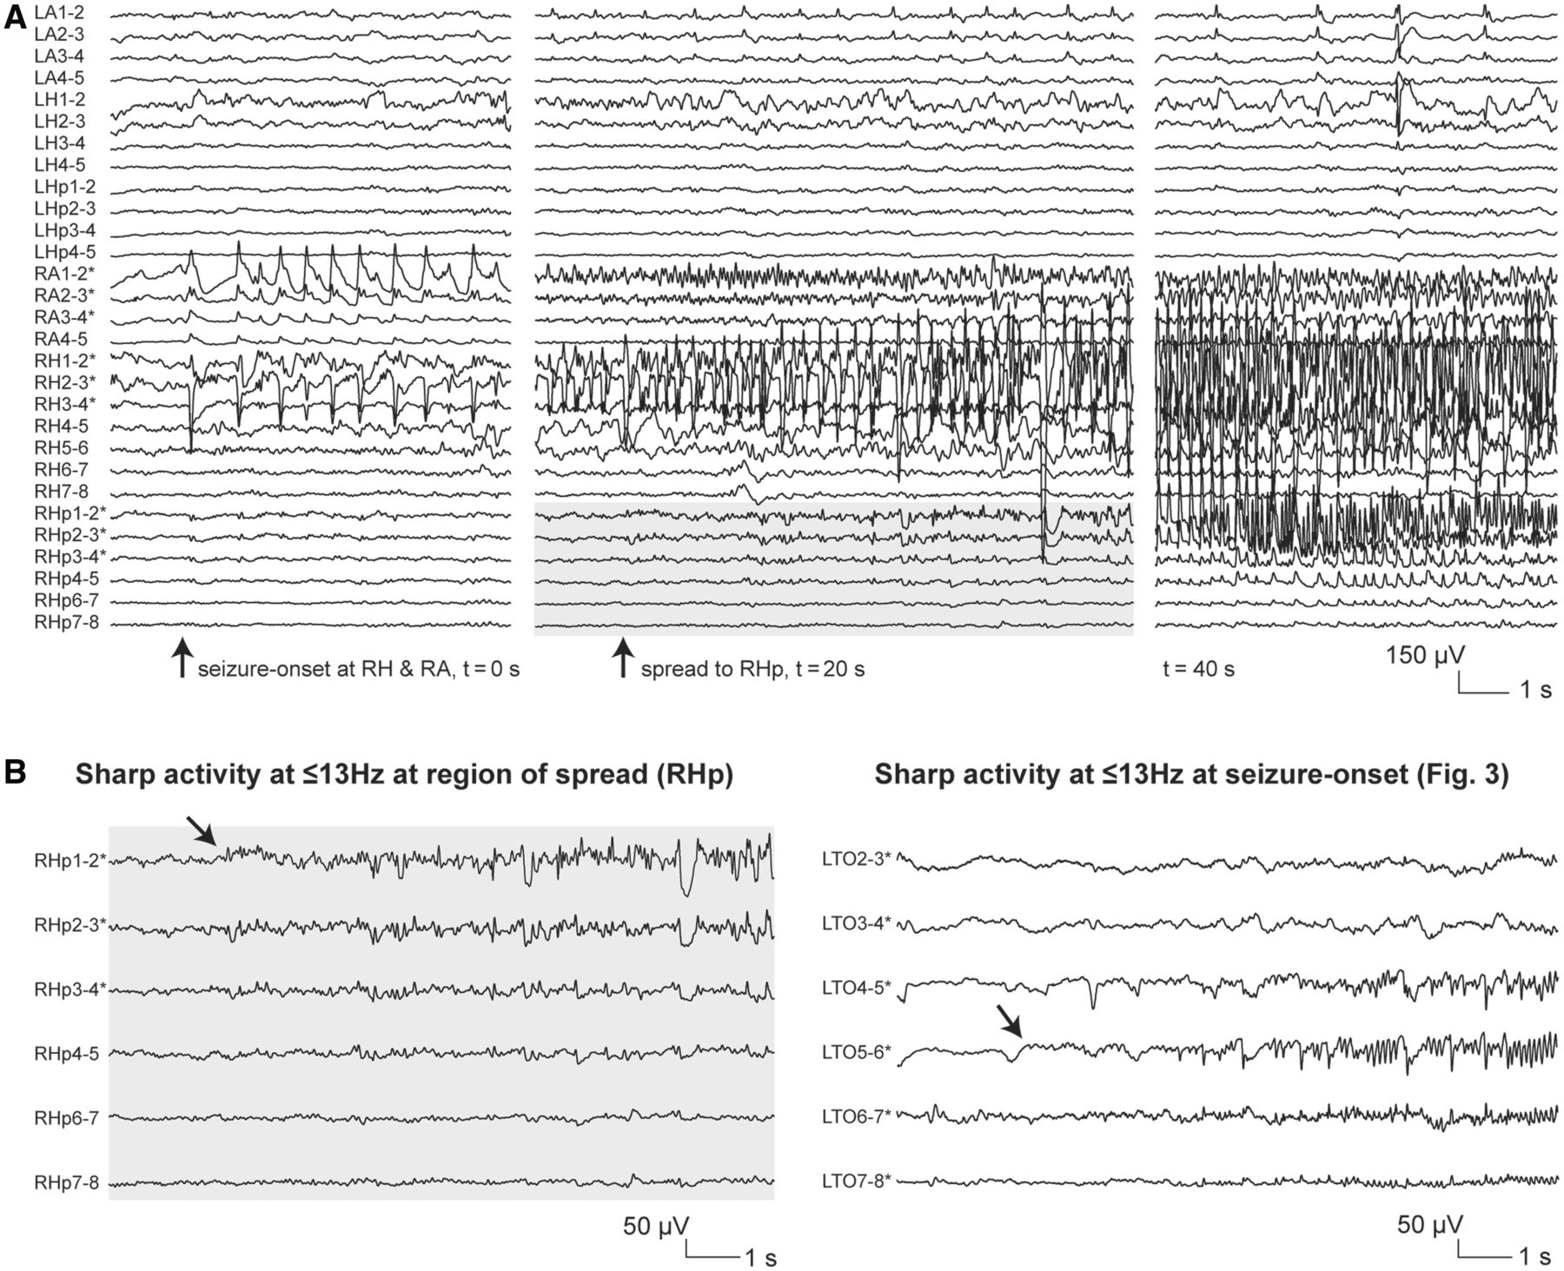
Figure 8 Sharp activity at ≤13 Hz in a region of seizure spread. (A) Ictal intracranial EEG recording (electrographic ...
Notes:
Figure 8 Sharp activity at ≤13 Hz in a region of seizure spread. (A) Ictal intracranial EEG recording (electrographic seizure) from a patient with right mesial temporal atrophy/sclerosis showing seizure-onset at RA1–2 and RH1–2, 2–3 with low-frequency high-amplitude periodic spikes (t = 0 s), followed by seizure spread to right posterior hippocampus starting with the progressive build-up of low- to medium-voltage sharp activity at 9–10 Hz (t = 20 s, grey box), later evolving into high-amplitude rhythmic spiking at 5–6 Hz (t = 40 s). The patient had seizures arising independently from each mesial temporal lobe, but more frequently from the right side. A right anterior temporal lobe resection was performed, with no substantial change in seizure frequency (Engel class IV; post-surgical follow-up: 12 months). (B) Comparison of sharp activity at ≤13 Hz at a region of spread (grey box from A) versus seizure-onset (intracranial EEG section excerpted from Fig. 3). Note the similarity of the discharge at the two sites, and, in particular, the fact that there are no features differentiating the site of origin of this pattern. Electrode targets: LA = left amygdala; LH = left hippocampus; LHp = left posterior hippocampus; RA = right amygdala; RH = right hippocampus; RHp = right posterior hippocampus. Asterisk indicates electrode contacts located in lesional/perilesional tissue.
Unless provided in the caption above, the following copyright applies to the content of this slide: © The Author (2013). Published by Oxford University Press on behalf of the Guarantors of Brain. All rights reserved. For Permissions, please email: journals.permissions@oup.com

Slide 9
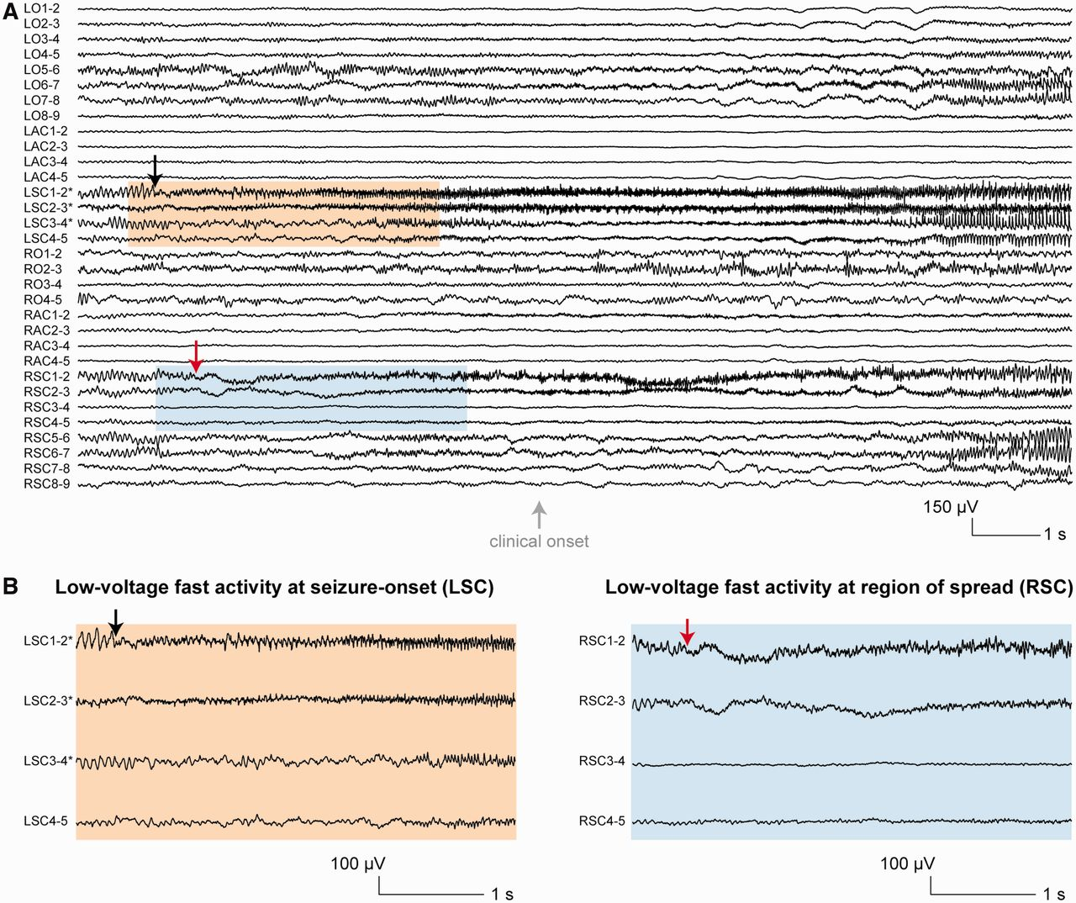
Figure 9 Low-voltage fast activity at the onset of seizure activity in a region of spread. (A) Ictal intracranial EEG ...
Notes:
Figure 9 Low-voltage fast activity at the onset of seizure activity in a region of spread. (A) Ictal intracranial EEG recording from a patient with left frontal focal cortical dysplasia showing seizure-onset at LSC1–2 with low-voltage fast activity (black arrow), followed by rapid (600 ms) seizure spread to RSC1–2 and 2–3 also starting with low-voltage fast activity (red arrow). The patient underwent a lesionectomy, resulting in a significant improvement in seizure frequency (Engel class III; post-surgical follow-up: 28 months). Histopathological examination of the resected specimen revealed focal cortical dysplasia type IIb (Blümcke et al., 2011). Of note, a post-surgical MRI suggested residual dysplastic tissue along the borders of the surgical cavity. (B) Comparison of low-voltage fast activity at seizure-onset (orange box from A) versus at a region of spread (blue box from A). Note the similarity of the discharge at the two sites, and, in particular, the fact that there are no features differentiating the site of origin of this pattern. Electrode targets: LO = left orbito-frontal cortex; LAC = left anterior cingulate gyrus; LSC = superior aspect of left anterior cingulate gyrus; RO = right orbito-frontal cortex; RAC = right anterior cingulate gyrus; RSC = superior aspect of right anterior cingulate gyrus. Asterisk indicates electrode contacts located in lesional/perilesional tissue.
Unless provided in the caption above, the following copyright applies to the content of this slide: © The Author (2013). Published by Oxford University Press on behalf of the Guarantors of Brain. All rights reserved. For Permissions, please email: journals.permissions@oup.com

Slide 10
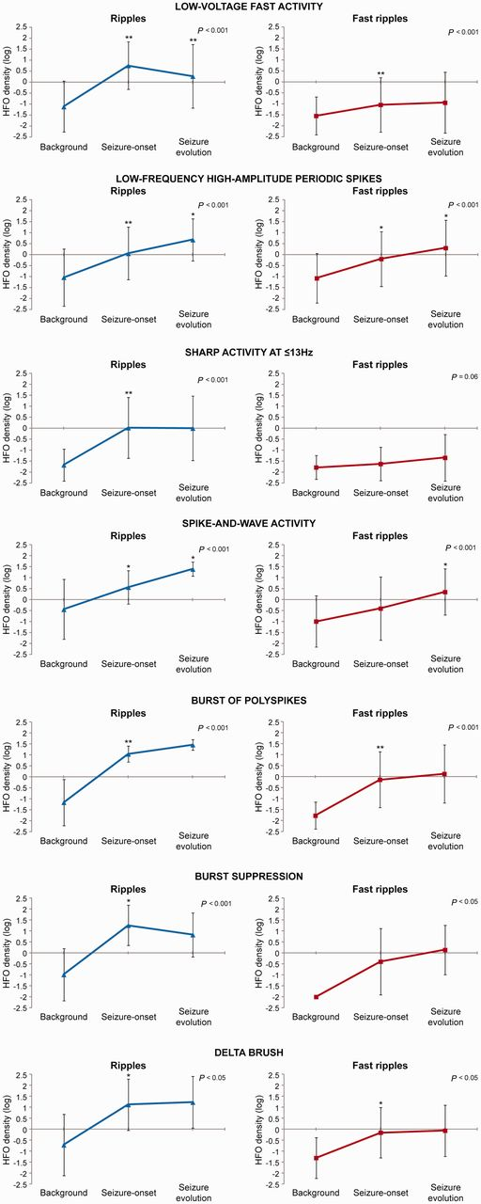
Figure 10 HFO profiles of each of the identified seizure-onset patterns. In each pattern, the HFO density (shown ...
Notes:
Figure 10 HFO profiles of each of the identified seizure-onset patterns. In each pattern, the HFO density (shown separately for ripples and fast ripples) in electrode contacts located in lesional/peri-lesional tissue and the SOZ increased significantly across the three intracranial EEG sections. This was mainly due to a significant HFO increase at seizure-onset, which was found across all patterns. Values are mean HFO density (log transformed) ± SD (vertical bars). *P < 0.05 and **P < 0.001, for comparisons between the background and seizure-onset sections and for comparisons between the seizure-onset and seizure evolution sections (repeated-measures ANOVA with Bonferroni correction).
Unless provided in the caption above, the following copyright applies to the content of this slide: © The Author (2013). Published by Oxford University Press on behalf of the Guarantors of Brain. All rights reserved. For Permissions, please email: journals.permissions@oup.com

