Slide 1
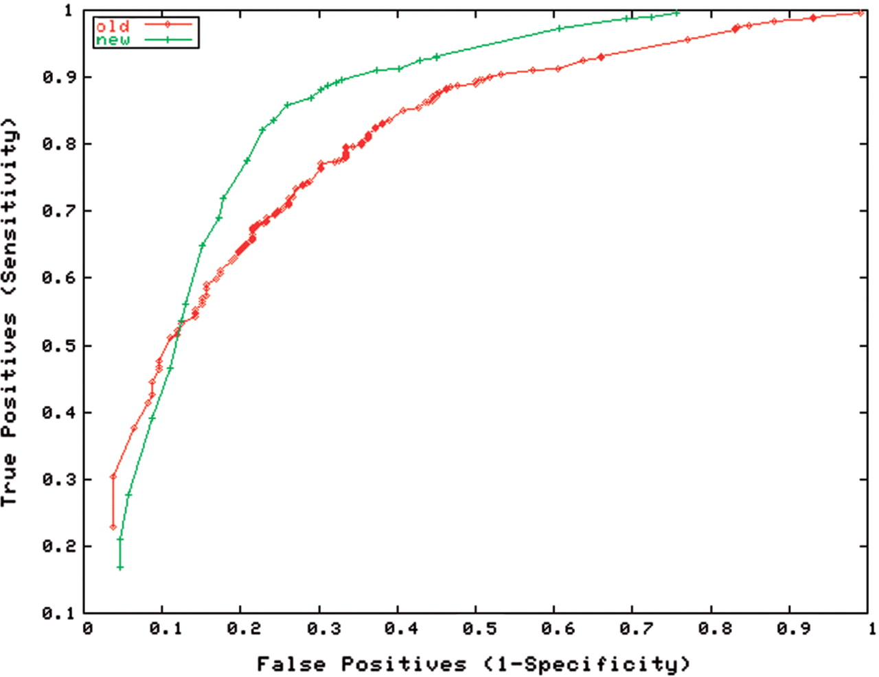
Figure 1. OperonDB ROC curves computed using the original prediction algorithm from 2001 (‘old’) versus the new ...
Notes:
Figure 1. OperonDB ROC curves computed using the original prediction algorithm from 2001 (‘old’) versus the new improved algorithm (‘new’). True and false positive rates are computed on a set of 602 E. coli experimentally confirmed operon pairs from RegulonDB.
Unless provided in the caption above, the following copyright applies to the content of this slide: © 2008 The Author(s)This is an Open Access article distributed under the terms of the Creative Commons Attribution Non-Commercial License (http://creativecommons.org/licenses/by-nc/2.0/uk/) which permits unrestricted non-commercial use, distribution, and reproduction in any medium, provided the original work is properly cited.

Slide 2
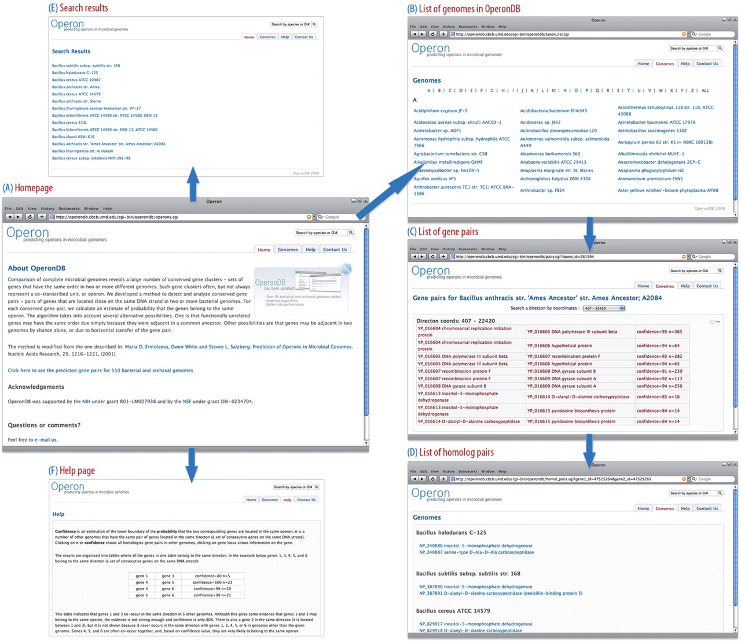
Figure 2. Site map of OperonDB. (A) Homepage of OperonDB. (B) Genomes are browsed by clicking the ‘Genomes’ navigation ...
Notes:
Figure 2. Site map of OperonDB. (A) Homepage of OperonDB. (B) Genomes are browsed by clicking the ‘Genomes’ navigation tab, which brings up an alphabetically ordered list of species. (C) The user can obtain a list of predicted operon gene pairs and their associated confidence values by selecting a specific organism. (D) Clicking on the number of genomes in which a particular pair is conserved retrieves the list of homologous gene pairs in those genomes. Each gene name is linked to the corresponding Gene Information page at NCBI. (E) Alternatively, a user can search for a genome by entering an organism's name or its NCBI GenInfo (GI) number in the search box located above the navigation tabs and mirrored on every page of the website. The search will return a comprehensive list of organisms that match the search query. (F) OperonDB's help page.
Unless provided in the caption above, the following copyright applies to the content of this slide: © 2008 The Author(s)This is an Open Access article distributed under the terms of the Creative Commons Attribution Non-Commercial License (http://creativecommons.org/licenses/by-nc/2.0/uk/) which permits unrestricted non-commercial use, distribution, and reproduction in any medium, provided the original work is properly cited.

