Slide 1
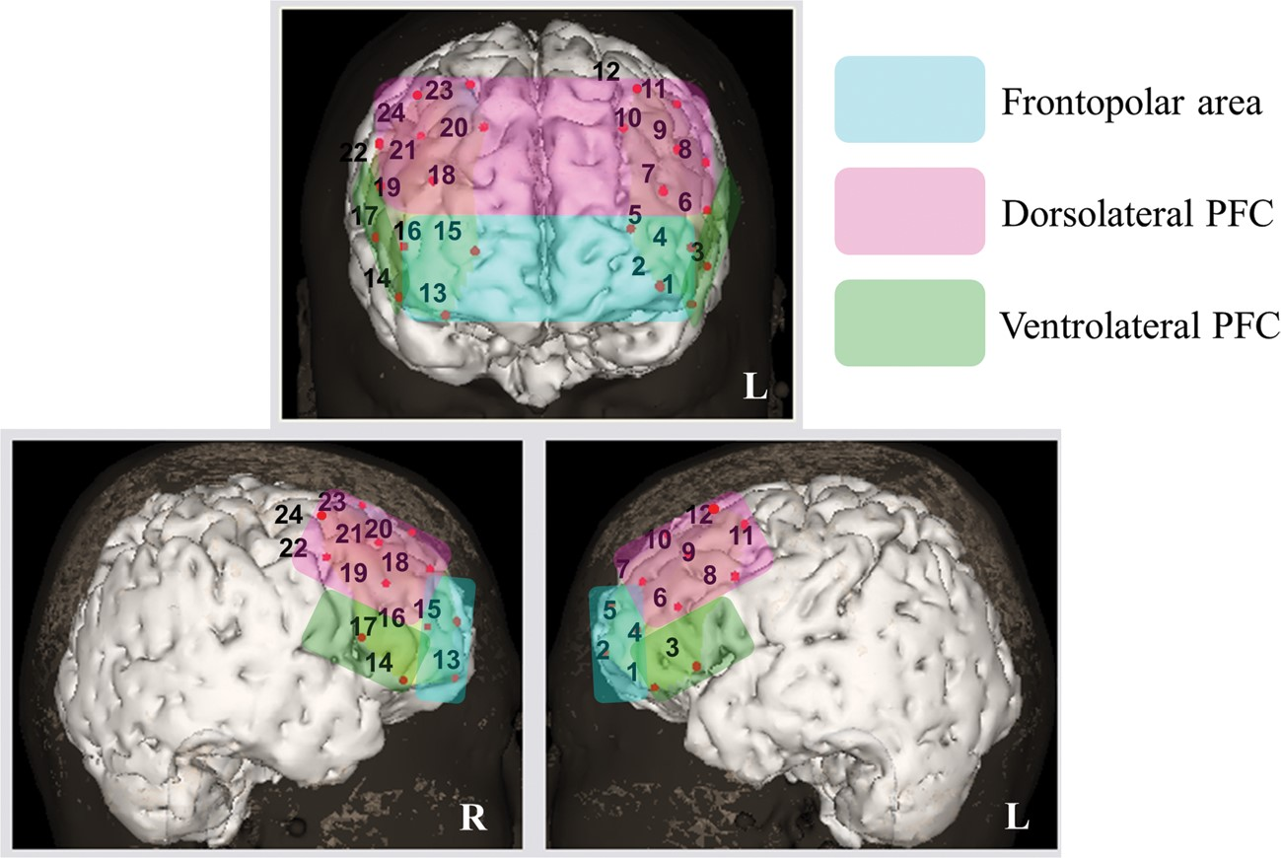
Figure 1. The measurement positions used in the present study. In this image, the channel positions are superimposed on ...
Notes:
Figure 1. The measurement positions used in the present study. In this image, the channel positions are superimposed on a 3-D MRI reconstruction of the cerebral cortex. For each subject, 2 sets of probes, covering an area of 6 × 6 cm2, were placed on the bilateral frontal regions. The channel numbers are indicated just above the corresponding measurement location. The 3 lateral subregions of the PFC are also indicated.
Unless provided in the caption above, the following copyright applies to the content of this slide: © The Author 2013. Published by Oxford University Press. All rights reserved. For Permissions, please e-mail: journals.permissions@oup.com

Slide 2
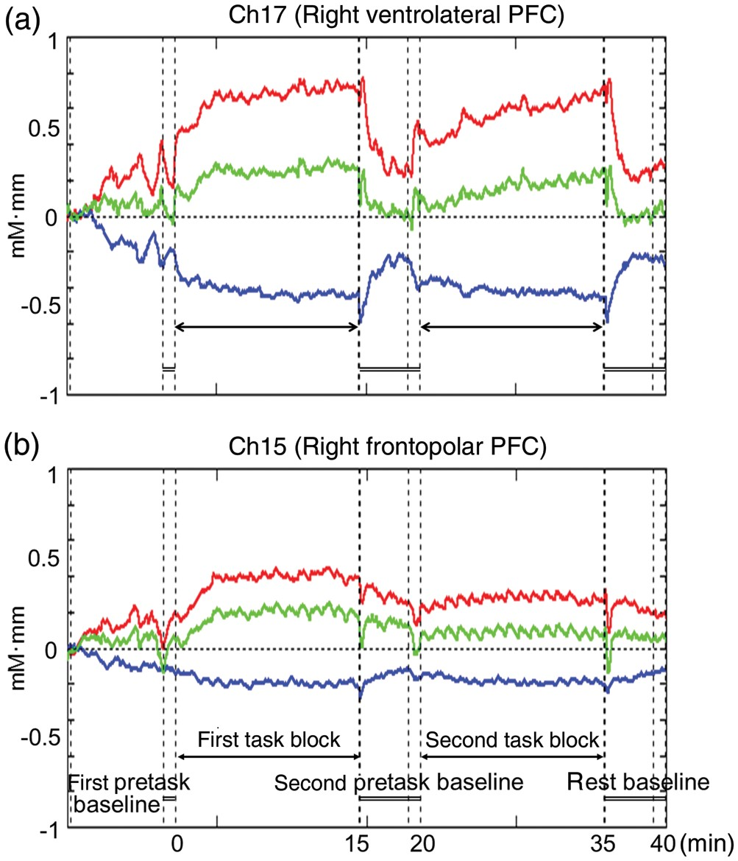
Figure 2. NIRS signal waveforms during the UKT. Changes in [oxy-Hb] and [deoxy-Hb] signals during the UKT. Data are ...
Notes:
Figure 2. NIRS signal waveforms during the UKT. Changes in [oxy-Hb] and [deoxy-Hb] signals during the UKT. Data are presented as grand-average waveforms in 2 representative channels (red: [oxy-Hb] signal and blue: [deoxy-Hb] signal). Green line represents the sum of the [oxy-Hb] and [deoxy-Hb] signals, often called total-hemoglobin signal (data not shown).
Unless provided in the caption above, the following copyright applies to the content of this slide: © The Author 2013. Published by Oxford University Press. All rights reserved. For Permissions, please e-mail: journals.permissions@oup.com

Slide 3
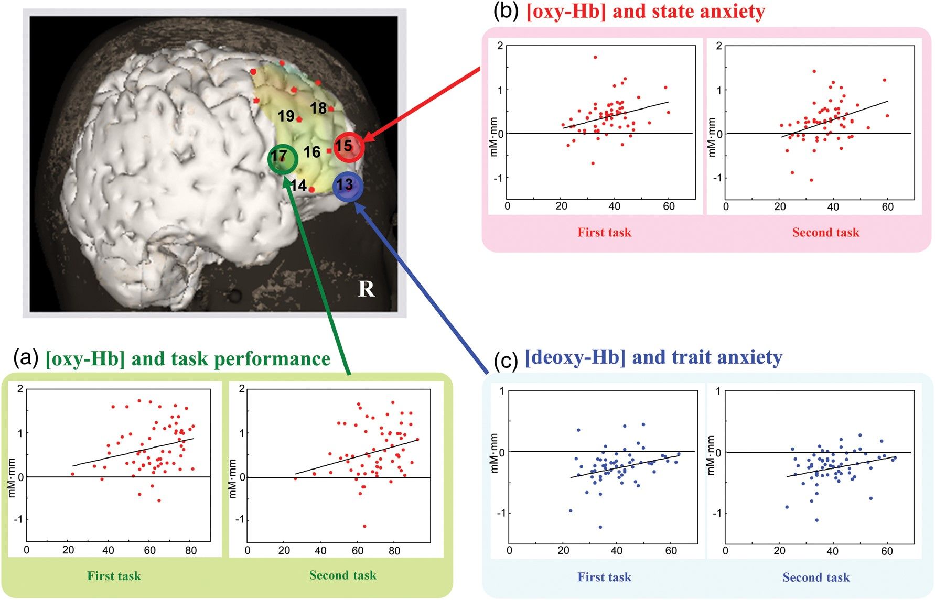
Figure 3. The association between NIRS signals and measures of anxiety and task performance. The 3 representative ...
Notes:
Figure 3. The association between NIRS signals and measures of anxiety and task performance. The 3 representative channels with significant associations throughout both the first and the second task blocks are presented. (a) The correlation between [oxy-Hb] and task performance. (b) The correlation between [oxy-Hb] and state anxiety. (c) The correlation between [deoxy-Hb] and trait anxiety.
Unless provided in the caption above, the following copyright applies to the content of this slide: © The Author 2013. Published by Oxford University Press. All rights reserved. For Permissions, please e-mail: journals.permissions@oup.com

