Slide 1
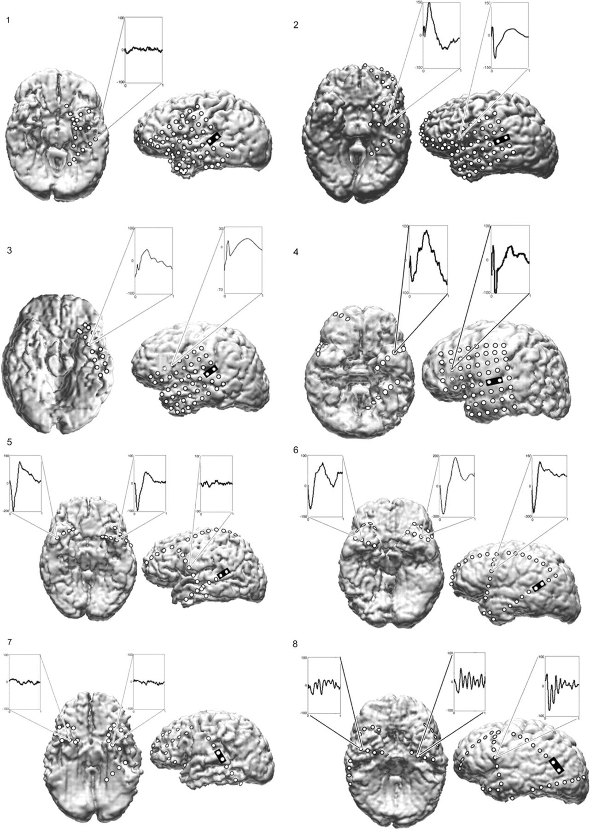
Figure 1. Cortical surface rendering of preoperative MRIs of all patients, with the location of subdural electrodes ...
Notes:
Figure 1. Cortical surface rendering of preoperative MRIs of all patients, with the location of subdural electrodes from a postoperative CT scan superimposed, allowing 3D visualization of the implanted electrodes in relation to gyral anatomy. The coregistration is done with Curry software Compumedics Neuroscan, El Paso, TX. In patients 1–4, grid electrodes were implanted over left frontal and temporal lobes covering the perisylvian cortex, and strip electrodes sampled BT cortex. In patients 5–8, bilateral strip electrodes were placed through burr holes in order to help lateralize the seizure focus. Three or 4 strips were placed through each of the frontal and temporal burr holes on each side. For the purposes of this study, only left lateral and basal views are shown. Black rectangles mark electrode pairs where single pulse stimulation was applied within the PLAs in patients 1–4 and the LPSTG in patients 5–8. The most robust CCEPs are shown. These were recorded very focally, with the surrounding electrodes showing no CCEPs or ones with significantly lower voltage.
Unless provided in the caption above, the following copyright applies to the content of this slide: © The Author 2011. Published by Oxford University Press. All rights reserved. For permissions, please e-mail: journals.permissions@oup.com

Slide 2
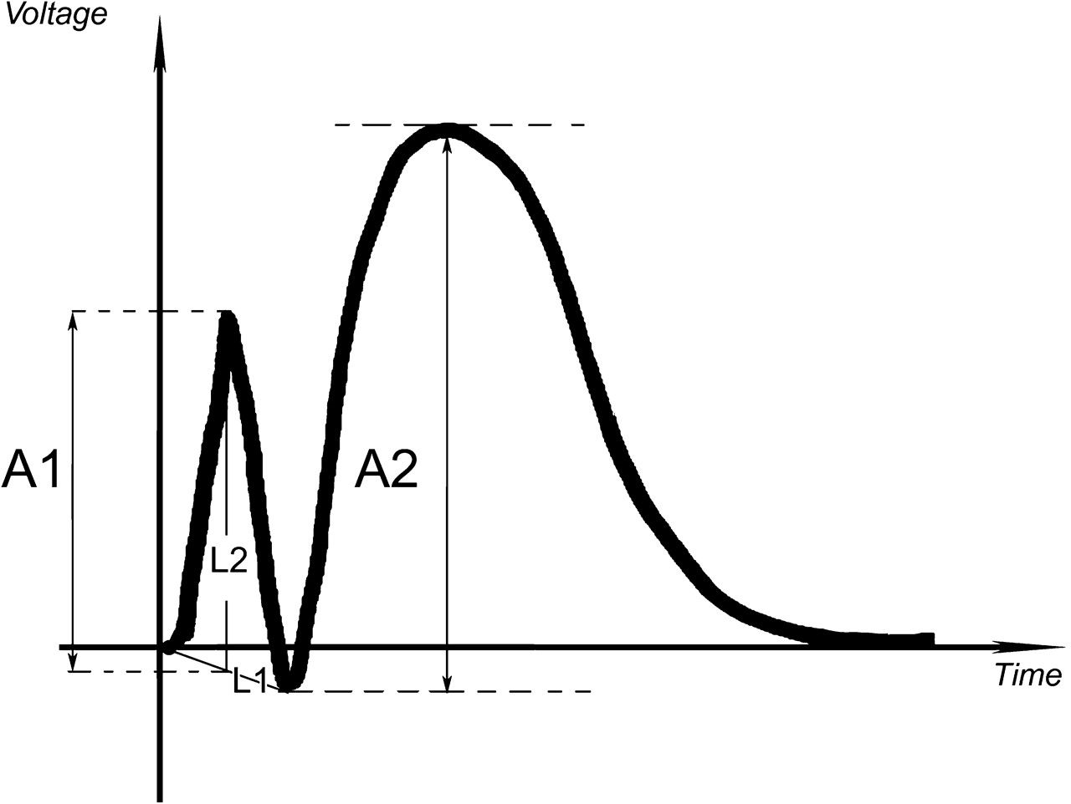
Figure 2. An illustration of the method used to measure the voltage of the peaks of the CCEPs as in Matsumoto et al. ...
Notes:
Figure 2. An illustration of the method used to measure the voltage of the peaks of the CCEPs as in Matsumoto et al. (2004). The voltage of the initial component (A1) corresponds to the vertical segment drawn between a horizontal tangent to the initial peak and the intersection of L1 (joining the onset of the ascending phase of the first peak and the aftergoing positive trough) and L2 (a vertical line drawn through the initial peak). The voltage of second component (A2) corresponds to the vertical segment drawn between a horizontal tangent to the second peak and another horizontal tangent to the positive trough between the 2 peaks.
Unless provided in the caption above, the following copyright applies to the content of this slide: © The Author 2011. Published by Oxford University Press. All rights reserved. For permissions, please e-mail: journals.permissions@oup.com

Slide 3
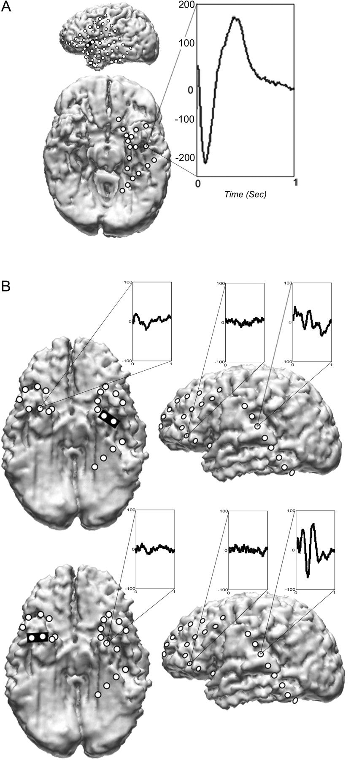
Figure 3. (A) CCEP recorded in the BT area upon stimulation of the ALA in patient 1. (B) CCEPs recorded in the LPSTG in ...
Notes:
Figure 3. (A) CCEP recorded in the BT area upon stimulation of the ALA in patient 1. (B) CCEPs recorded in the LPSTG in patient 7 upon stimulation of the left (upper part) and the right BT area (lower part). The stimulated electrode pairs are marked by black rectangles. Lower voltage and less-defined contralateral BT and frontal responses are shown as controls.
Unless provided in the caption above, the following copyright applies to the content of this slide: © The Author 2011. Published by Oxford University Press. All rights reserved. For permissions, please e-mail: journals.permissions@oup.com

Slide 4
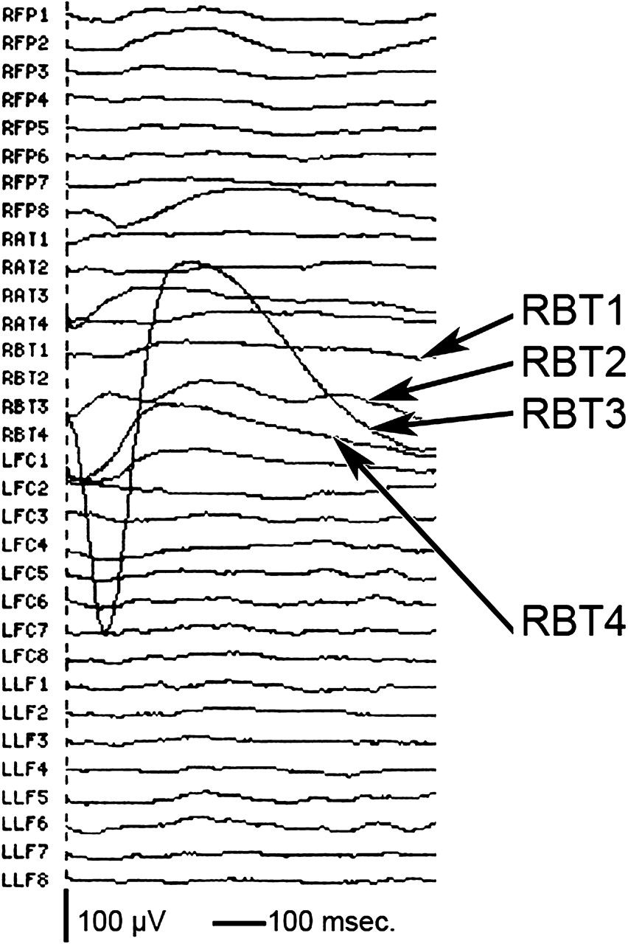
Figure 4. CCEPs in one subject averaged over multiple strips, including right basal temporal (RBT) upon stimulation of ...
Notes:
Figure 4. CCEPs in one subject averaged over multiple strips, including right basal temporal (RBT) upon stimulation of the LPSTG. The maximum recorded response is over RBT3 which is only 1 cm from RBT2 and 1 cm from RBT4 where much smaller responses were recorded.
Unless provided in the caption above, the following copyright applies to the content of this slide: © The Author 2011. Published by Oxford University Press. All rights reserved. For permissions, please e-mail: journals.permissions@oup.com

