Slide 1
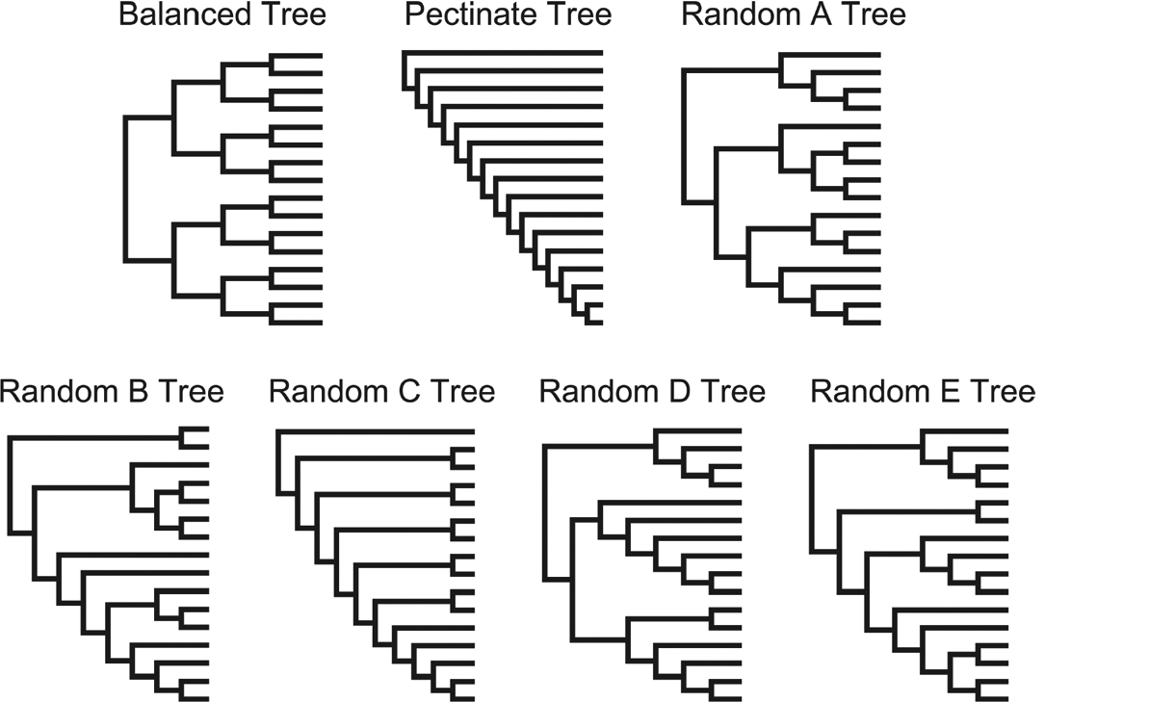
Figure 1 The seven topologies used to explore the effect of tree shape on alignment accuracy and tree reconstruction ...
Notes:
Figure 1 The seven topologies used to explore the effect of tree shape on alignment accuracy and tree reconstruction consisted of a balanced tree, a pectinate tree, and five random Yule trees (A–E).
Unless provided in the caption above, the following copyright applies to the content of this slide: © 2006 Society of Systematic BiologistsThis article is published and distributed under the terms of the Oxford University Press, Standard Journals Publication Model (https://academic.oup.com/journals/pages/open_access/funder_policies/chorus/standard_publication_model)

Slide 2
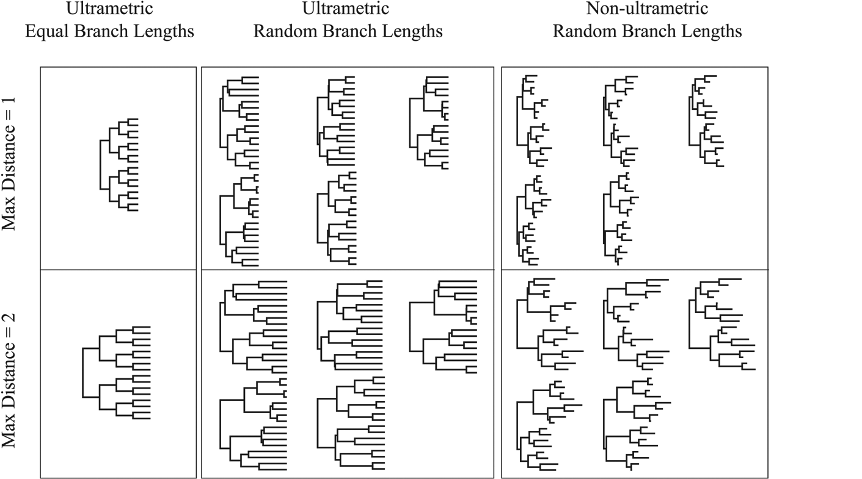
Figure 2 An example of the 22 model trees for the balanced tree shape, consisting of ultrametric equal branch length, ...
Notes:
Figure 2 An example of the 22 model trees for the balanced tree shape, consisting of ultrametric equal branch length, ultrametric random branch length (five sets), and nonultrametric random branch lengths (five sets). Each of these 11 conditions was scaled such that the maximum evolutionary distance between a pair of sequences was equal to 1.0 or 2.0.
Unless provided in the caption above, the following copyright applies to the content of this slide: © 2006 Society of Systematic BiologistsThis article is published and distributed under the terms of the Oxford University Press, Standard Journals Publication Model (https://academic.oup.com/journals/pages/open_access/funder_policies/chorus/standard_publication_model)

Slide 3
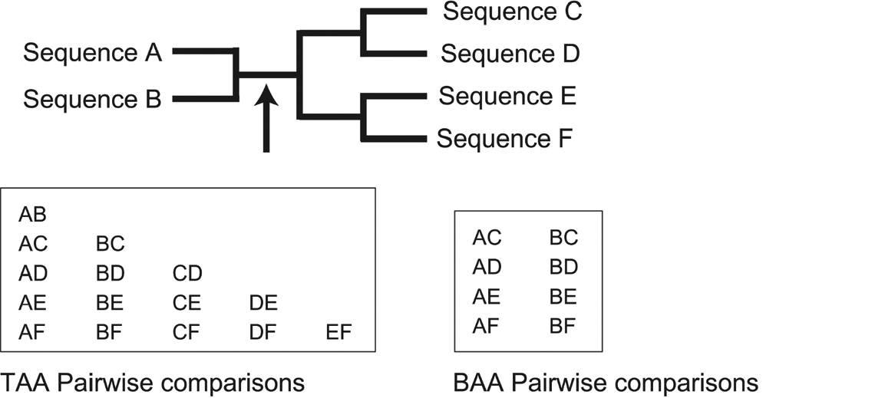
Figure 3 The pairwise comparisons (given the example six-taxon tree) that would be used to calculate the TAA and BAA ...
Notes:
Figure 3 The pairwise comparisons (given the example six-taxon tree) that would be used to calculate the TAA and BAA values.
Unless provided in the caption above, the following copyright applies to the content of this slide: © 2006 Society of Systematic BiologistsThis article is published and distributed under the terms of the Oxford University Press, Standard Journals Publication Model (https://academic.oup.com/journals/pages/open_access/funder_policies/chorus/standard_publication_model)

Slide 4
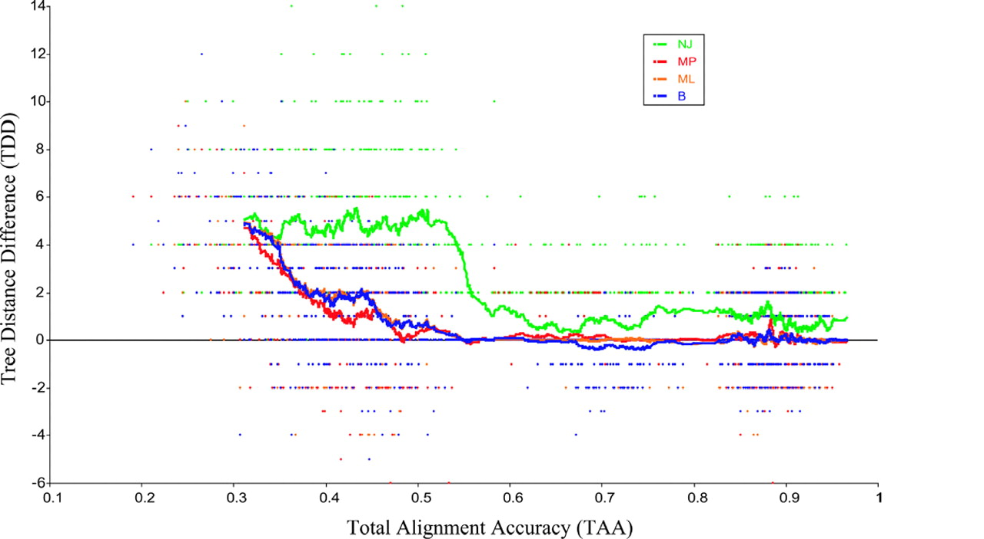
Figure 4 Relationship of Total Alignment Accuracy (TAA) and Tree Distance Difference (TDD) for balanced tree shape ...
Notes:
Figure 4 Relationship of Total Alignment Accuracy (TAA) and Tree Distance Difference (TDD) for balanced tree shape (all 22 model conditions pooled). Points to the far right are the most accurate alignments, whereas points to the left are the least accurate alignments. Points above the 0 TDD line are cases where the TA reconstructed tree was more accurate than the HA reconstructed tree, and the opposite is true for points below the 0 TDD line. Many points may be superimposed upon one another. The lines are moving averages based on an overlapping sliding window of 50 consecutive points. Note that the likelihood moving average line is essentially coincident and hidden by the Bayes line.
Unless provided in the caption above, the following copyright applies to the content of this slide: © 2006 Society of Systematic BiologistsThis article is published and distributed under the terms of the Oxford University Press, Standard Journals Publication Model (https://academic.oup.com/journals/pages/open_access/funder_policies/chorus/standard_publication_model)

Slide 5
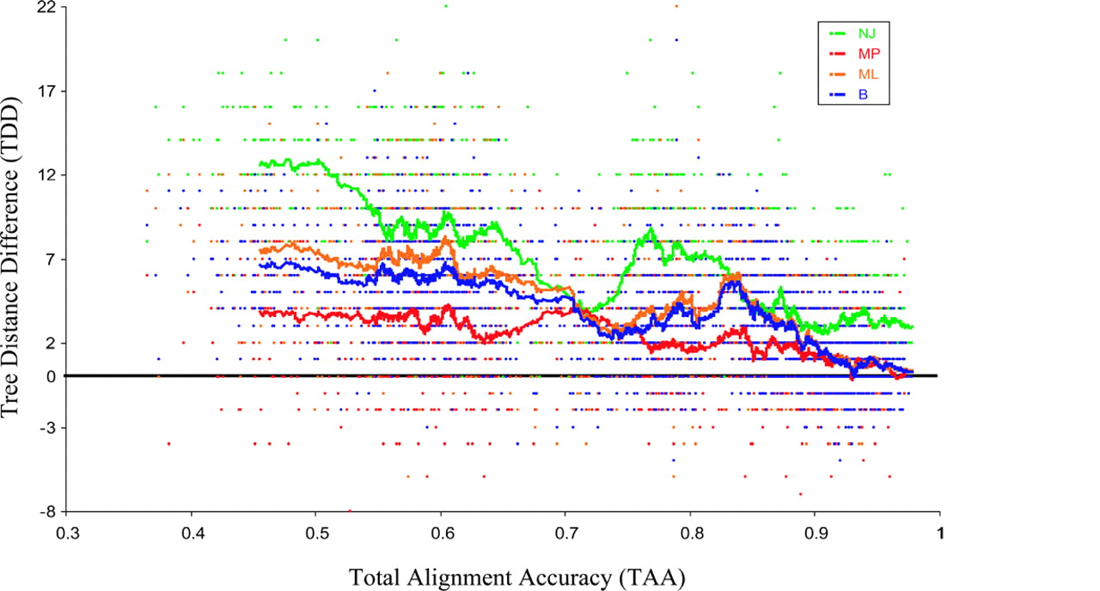
Figure 5 Relationship of Total Alignment Accuracy (TAA) and Tree Distance Difference (TDD) for pectinate tree shape ...
Notes:
Figure 5 Relationship of Total Alignment Accuracy (TAA) and Tree Distance Difference (TDD) for pectinate tree shape (all 22 model conditions pooled). Points to the far right are the most accurate alignments, whereas points to the left are the least accurate alignments. Points above the 0 TDD line are cases where the TA reconstructed tree was more accurate than the HA reconstructed tree, and the opposite is true for points below the 0 TDD line. Many points may be superimposed upon one another. The lines are moving averages based on an overlapping sliding window of 50 consecutive points.
Unless provided in the caption above, the following copyright applies to the content of this slide: © 2006 Society of Systematic BiologistsThis article is published and distributed under the terms of the Oxford University Press, Standard Journals Publication Model (https://academic.oup.com/journals/pages/open_access/funder_policies/chorus/standard_publication_model)

Slide 6
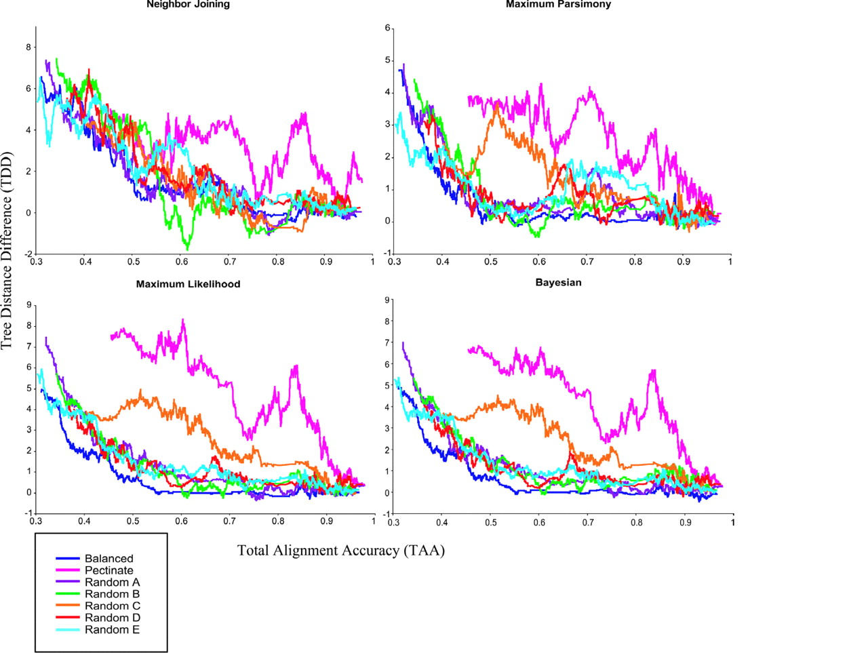
Figure 6 Moving average lines showing the relationship of Total Alignment Accuracy (TAA) and Tree Distance Difference ...
Notes:
Figure 6 Moving average lines showing the relationship of Total Alignment Accuracy (TAA) and Tree Distance Difference (TDD) separated by the four methods of tree reconstruction and tree shape.
Unless provided in the caption above, the following copyright applies to the content of this slide: © 2006 Society of Systematic BiologistsThis article is published and distributed under the terms of the Oxford University Press, Standard Journals Publication Model (https://academic.oup.com/journals/pages/open_access/funder_policies/chorus/standard_publication_model)

Slide 7
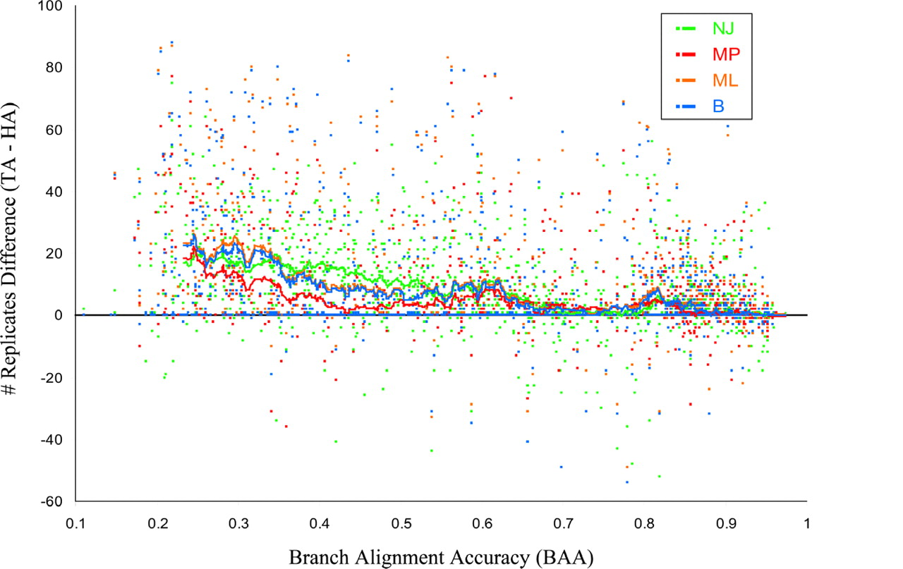
Figure 7 Relationship of Branch Alignment Accuracy (BAA) and number of replicates difference. Points to the far right ...
Notes:
Figure 7 Relationship of Branch Alignment Accuracy (BAA) and number of replicates difference. Points to the far right are the most accurate alignments by branch, whereas points to the left are the least accurate alignments by branch. Points above the 0 line are cases where the TA reconstructed tree recovered the particular branch in more replicates than the HA reconstructed tree, and the opposite is true for points below the line. Many points may be superimposed upon one another. The lines are moving averages based on an overlapping sliding window of 50 consecutive points.
Unless provided in the caption above, the following copyright applies to the content of this slide: © 2006 Society of Systematic BiologistsThis article is published and distributed under the terms of the Oxford University Press, Standard Journals Publication Model (https://academic.oup.com/journals/pages/open_access/funder_policies/chorus/standard_publication_model)

Slide 8
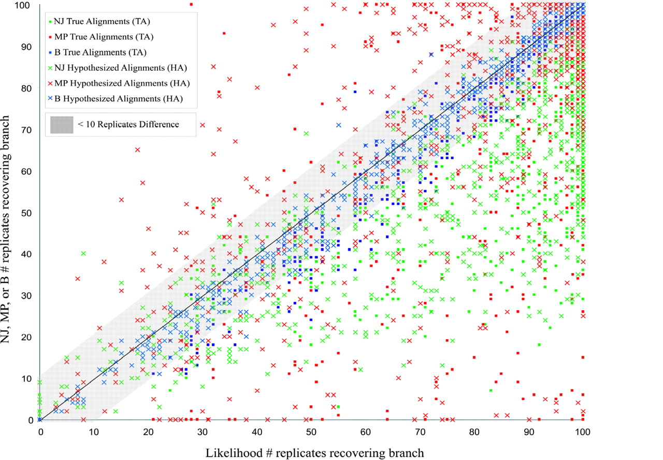
Figure 8 Topological accuracy comparison of ML versus the other tree reconstruction methods (NJ, MP, and B). The ...
Notes:
Figure 8 Topological accuracy comparison of ML versus the other tree reconstruction methods (NJ, MP, and B). The shaded area represents 86% of all comparisons between ML and the other methods where there was a difference < 10 in the number of replicates that recovered the branch. Outside the shaded area are the remaining 14% of the contrasts where there was a difference ≥10 in the number of replicates that recovered the branch. See Table 2 for a detailed breakdown of the cases outside the shaded area.
Unless provided in the caption above, the following copyright applies to the content of this slide: © 2006 Society of Systematic BiologistsThis article is published and distributed under the terms of the Oxford University Press, Standard Journals Publication Model (https://academic.oup.com/journals/pages/open_access/funder_policies/chorus/standard_publication_model)

Slide 9
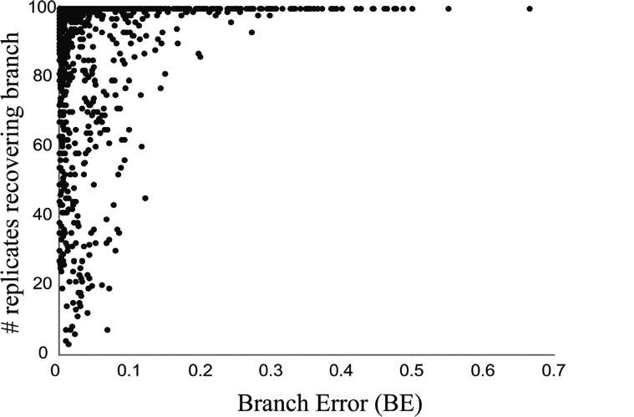
Figure 9 Relationship of Branch Error (BE) and topological accuracy, as measured by the number of replicates (out of ...
Notes:
Figure 9 Relationship of Branch Error (BE) and topological accuracy, as measured by the number of replicates (out of 100) that recovered each branch. Each point represents a single internal branch from a specific model tree. Points to the far left are data sets that contained little or no branch alignment error, whereas points to the right contained more alignment error. Only the ML analyses are shown on this graph, but the other methods show the same general trend.
Unless provided in the caption above, the following copyright applies to the content of this slide: © 2006 Society of Systematic BiologistsThis article is published and distributed under the terms of the Oxford University Press, Standard Journals Publication Model (https://academic.oup.com/journals/pages/open_access/funder_policies/chorus/standard_publication_model)

Slide 10
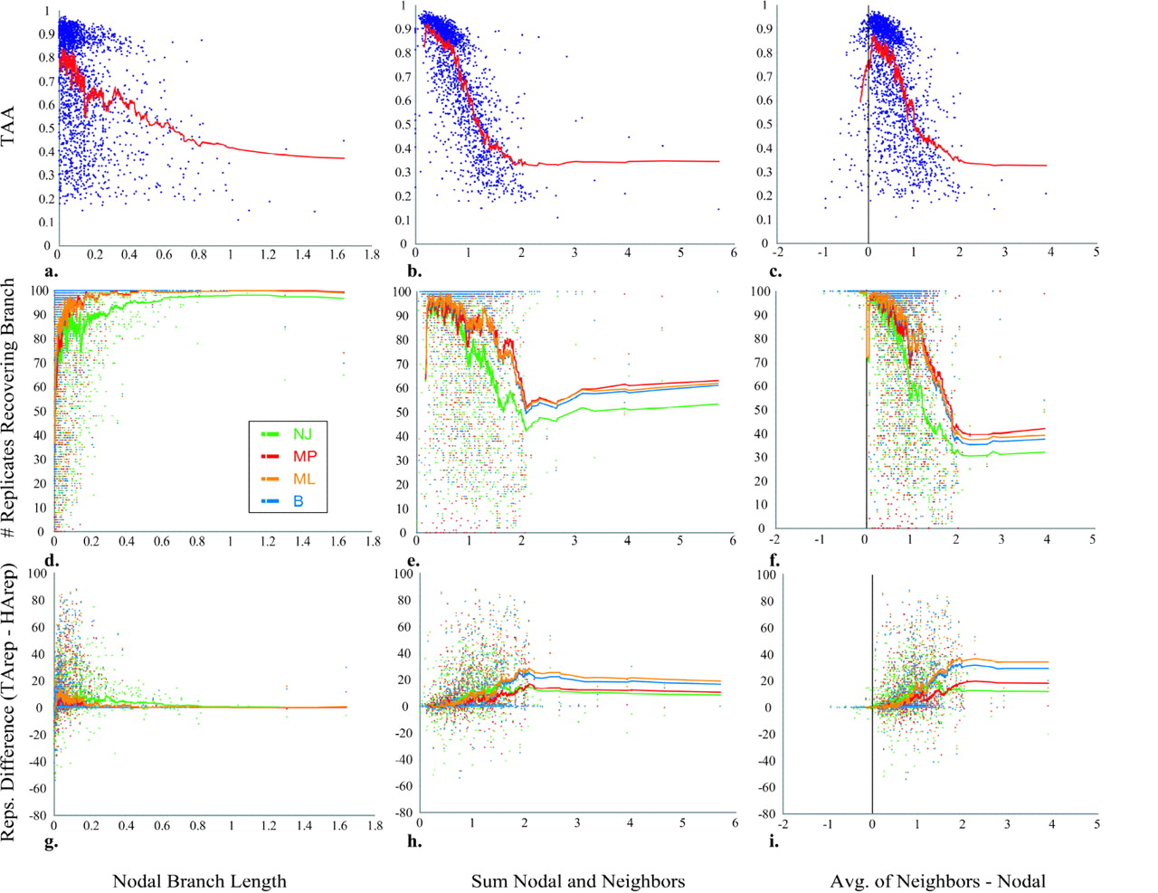
Figure 10 Results of the three ways branch length was quantified: the nodal branch length (length of the branch being ...
Notes:
Figure 10 Results of the three ways branch length was quantified: the nodal branch length (length of the branch being analyzed); the sum of the nodal branch length and the lengths of the four neighboring branches; and the average length of the four neighboring branches minus the nodal branch length. Each branch length summary is plotted against the TAA (Total Alignment Accuracy), the number of replicates (out of 100) that recovered each branch, and the difference between the True Alignment (TA) reconstructions and the Hypothesized Alignment (HA) reconstructions in the number of replicates (out of 100) that recovered each branch. For the TAA row (a–c), all tree shape cases and methods are pooled together, whereas in the remaining panels (d–i) results are separated by tree reconstruction method.
Unless provided in the caption above, the following copyright applies to the content of this slide: © 2006 Society of Systematic BiologistsThis article is published and distributed under the terms of the Oxford University Press, Standard Journals Publication Model (https://academic.oup.com/journals/pages/open_access/funder_policies/chorus/standard_publication_model)

