Slide 1
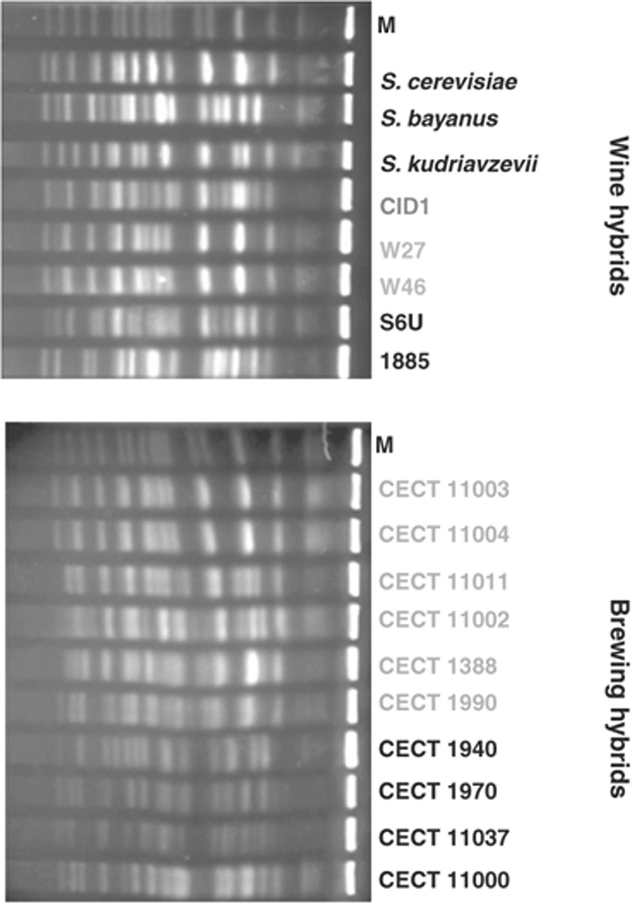
1 Electrophoretic karyotyping of wine and brewing yeasts: chromosomal profiles of the parental strains ...
Notes:
1 Electrophoretic karyotyping of wine and brewing yeasts: chromosomal profiles of the parental strains Saccharomyces cerevisiae (FY 1679), Saccharomyces bayanus (CECT 1969) and Saccharomyces kudriavzevii (IFO 1802T) and a number of S. cerevisiae×S. kudriavzevii (grey) and S. cerevisiae×S. bayanus (Saccharomyces pastorianus) hybrids (black), isolated from wine or beer fermentations. The cider strain triple hybrid CID1 is also shown. Lane m corresponds to the standard marker strain S. cerevisiae YNN295 (BioRad).
Unless provided in the caption above, the following copyright applies to the content of this slide: © 2009 Federation of European Microbiological Societies. Published by Blackwell Publishing Ltd. All rights reserved

Slide 2
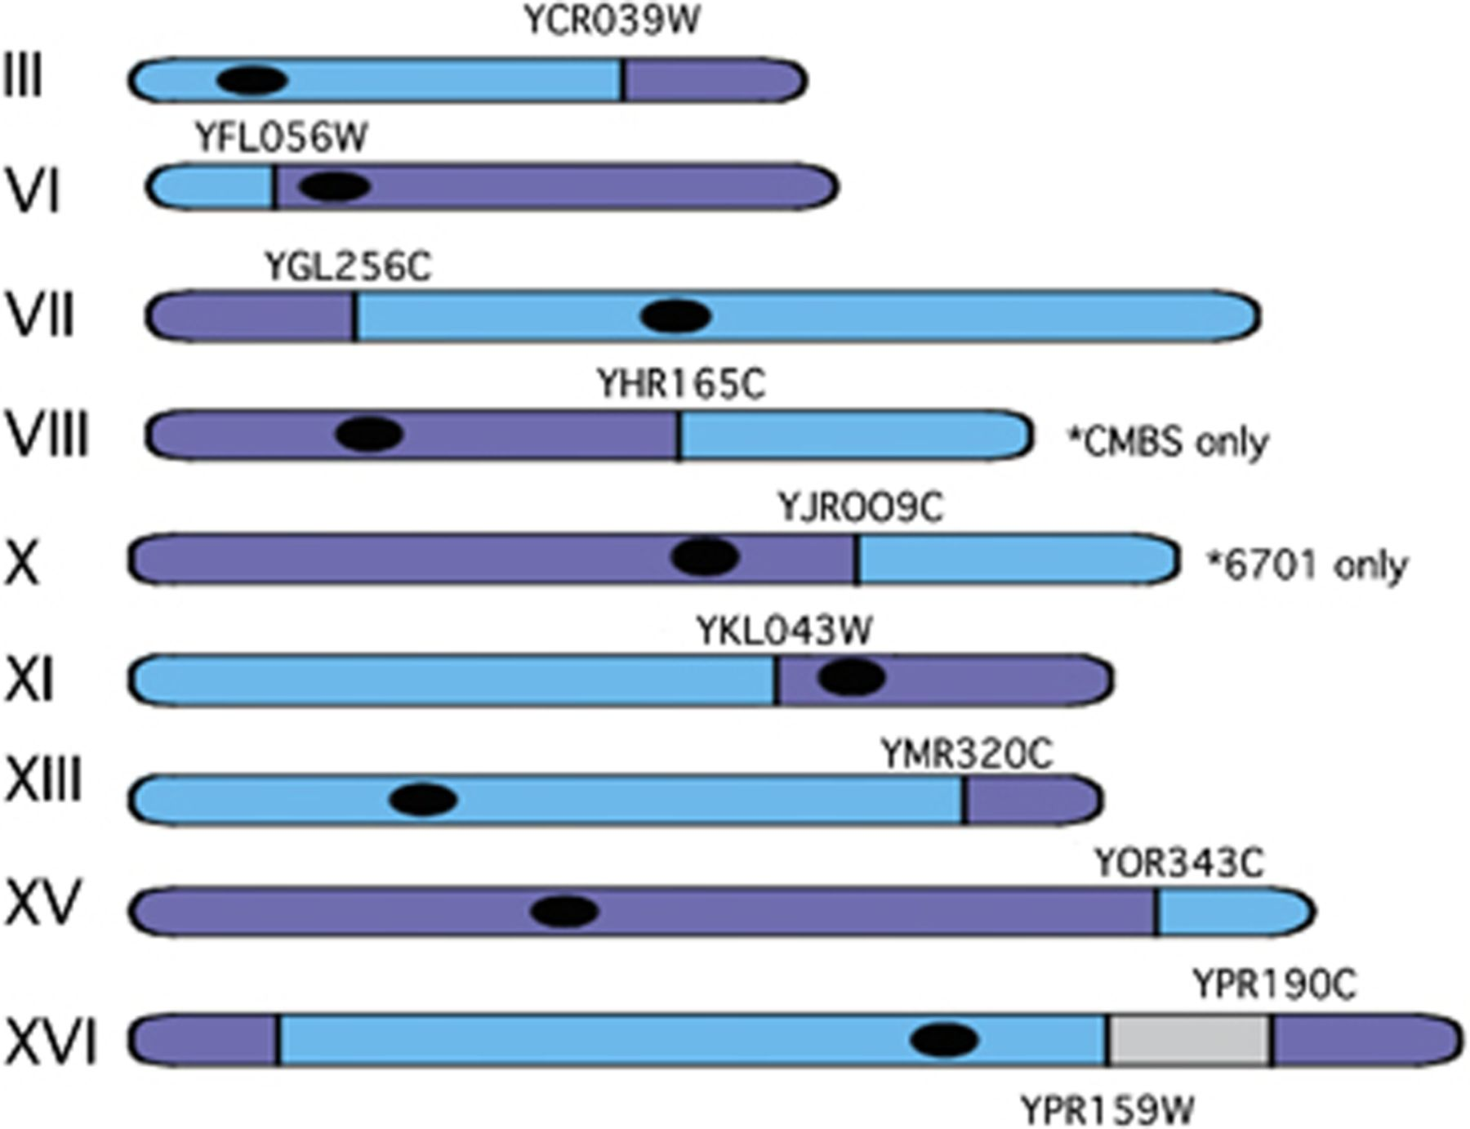
2 Saccharomyces pastorianus strains possess mosaic chromosomes resulting from recombination between the ...
Notes:
2 Saccharomyces pastorianus strains possess mosaic chromosomes resulting from recombination between the parental homoeologous chromosome (depicted by blue and navy sections). The locations of the sites of recombination are shown in relation to the centromeres (black dots). The grey region on XVI depicts a region consisting of Saccharomyces bayanus genes only. Certain rearrangements are unique to specific strains*. Generated from data presented in Bond et al. (2004).
Unless provided in the caption above, the following copyright applies to the content of this slide: © 2009 Federation of European Microbiological Societies. Published by Blackwell Publishing Ltd. All rights reserved

Slide 3
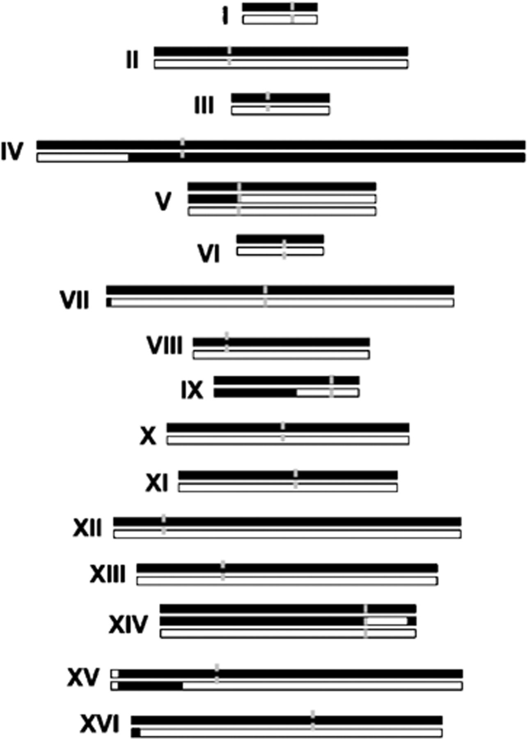
3 Genome composition in wine hybrids of Saccharomyces cerevisiae×S. kudriazevii. Saccharomyces cerevisiae ...
Notes:
3 Genome composition in wine hybrids of Saccharomyces cerevisiae×S. kudriazevii. Saccharomyces cerevisiae chromosomes are represented as black lines and S. kudriazevii by white lines. Chimeric chromosomes IV, V, IX, XIV, XII and XV are indicated by black and white segments. Centromeres are shown as grey lines.
Unless provided in the caption above, the following copyright applies to the content of this slide: © 2009 Federation of European Microbiological Societies. Published by Blackwell Publishing Ltd. All rights reserved

Slide 4
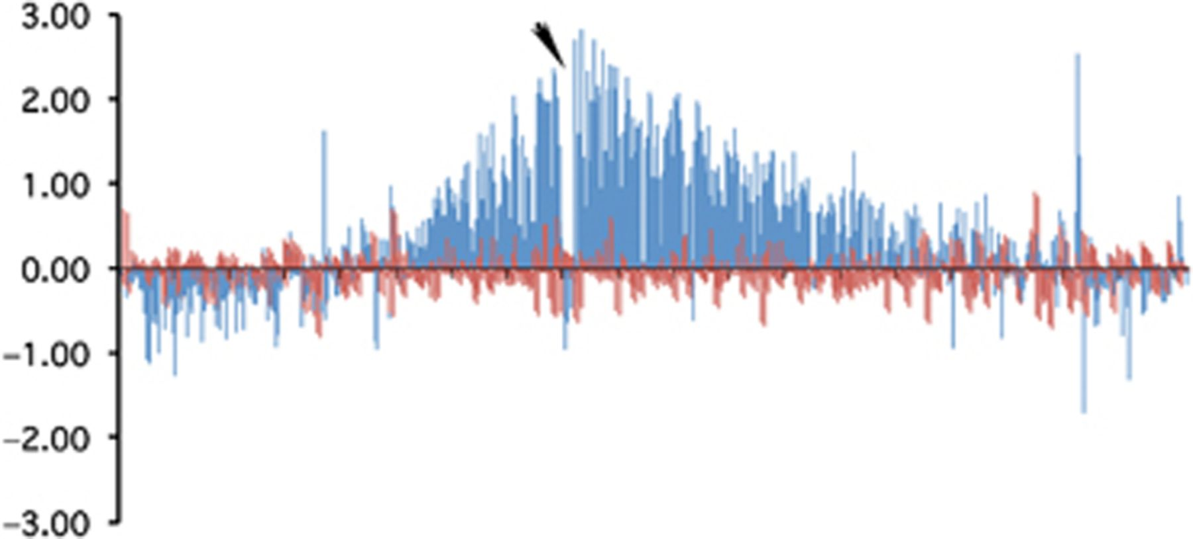
4 CGH analysis of a lager yeast strain fermented in high specific gravity wort (22% maltose). DNA was isolated ...
Notes:
4 CGH analysis of a lager yeast strain fermented in high specific gravity wort (22% maltose). DNA was isolated on day 1 and day 8 of fermentation and differentially labelled with Cy5 and Cy3. Copy number variations, as depicted by changes in ratio of hybridization (y-axis, log2 scale), are observed for genes surrounding the rRNA gene locus (arrow) on chromosome XII when comparing DNA from day 1 and day 8 (blue). CGH of DNA from day 1 differentially labelled with Cy5 and Cy3 shows no variation (red). Adapted from Fig. 3, James et al. (2008), with permission from Springer.
Unless provided in the caption above, the following copyright applies to the content of this slide: © 2009 Federation of European Microbiological Societies. Published by Blackwell Publishing Ltd. All rights reserved

