Slide 1
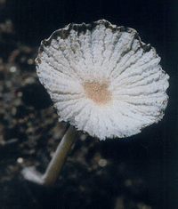
1 Photograph of a fruiting body of strain G (=Coprinellus curtus GM-21) formed on sterilized soil incubated at ...
Notes:
1 Photograph of a fruiting body of strain G (=Coprinellus curtus GM-21) formed on sterilized soil incubated at 27°C for 7days.
Unless provided in the caption above, the following copyright applies to the content of this slide: © 2007 Federation of European Microbiological Societies

Slide 2
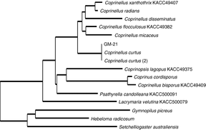
2 Phylogenetic tree of Coprinellus curtus GM-21 based on the analysis of ITS — 5.8S rRNA gene sequences (DDBJ ...
Notes:
2 Phylogenetic tree of Coprinellus curtus GM-21 based on the analysis of ITS — 5.8S rRNA gene sequences (DDBJ accession no. AB266447). The tree was constructed by the neighbor-joining method.
Unless provided in the caption above, the following copyright applies to the content of this slide: © 2007 Federation of European Microbiological Societies

Slide 3
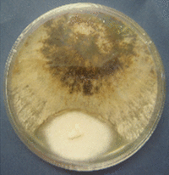
3 The mycelial interaction between Coprinellus curtus GM-21 and the pathogenic fungus responsible for pak-choi ...
Notes:
3 The mycelial interaction between Coprinellus curtus GM-21 and the pathogenic fungus responsible for pak-choi bottom-rot disease (Rhizoctonia solani Pak-choi 2). The fungi spotted at the upper and the lower points are the pathogen and C. curtus GM-21, respectively. A clear barrier was observed at the boundary of the two growth areas of these fungi.
Unless provided in the caption above, the following copyright applies to the content of this slide: © 2007 Federation of European Microbiological Societies

Slide 4
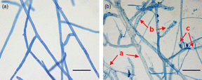
4 Micrographs of Rhizoctonia solani Pak-choi 2: (a) healthy hyphae; (b) damaged hyphae during confrontation ...
Notes:
4 Micrographs of Rhizoctonia solani Pak-choi 2: (a) healthy hyphae; (b) damaged hyphae during confrontation with thin hyphae of Coprinellus curtus GM-21. Key: a, light or no staining with lactophenol-cotton blue; b, granulation; c, vacuolation. The scale bar represents 50 µm.
Unless provided in the caption above, the following copyright applies to the content of this slide: © 2007 Federation of European Microbiological Societies

