Slide 1
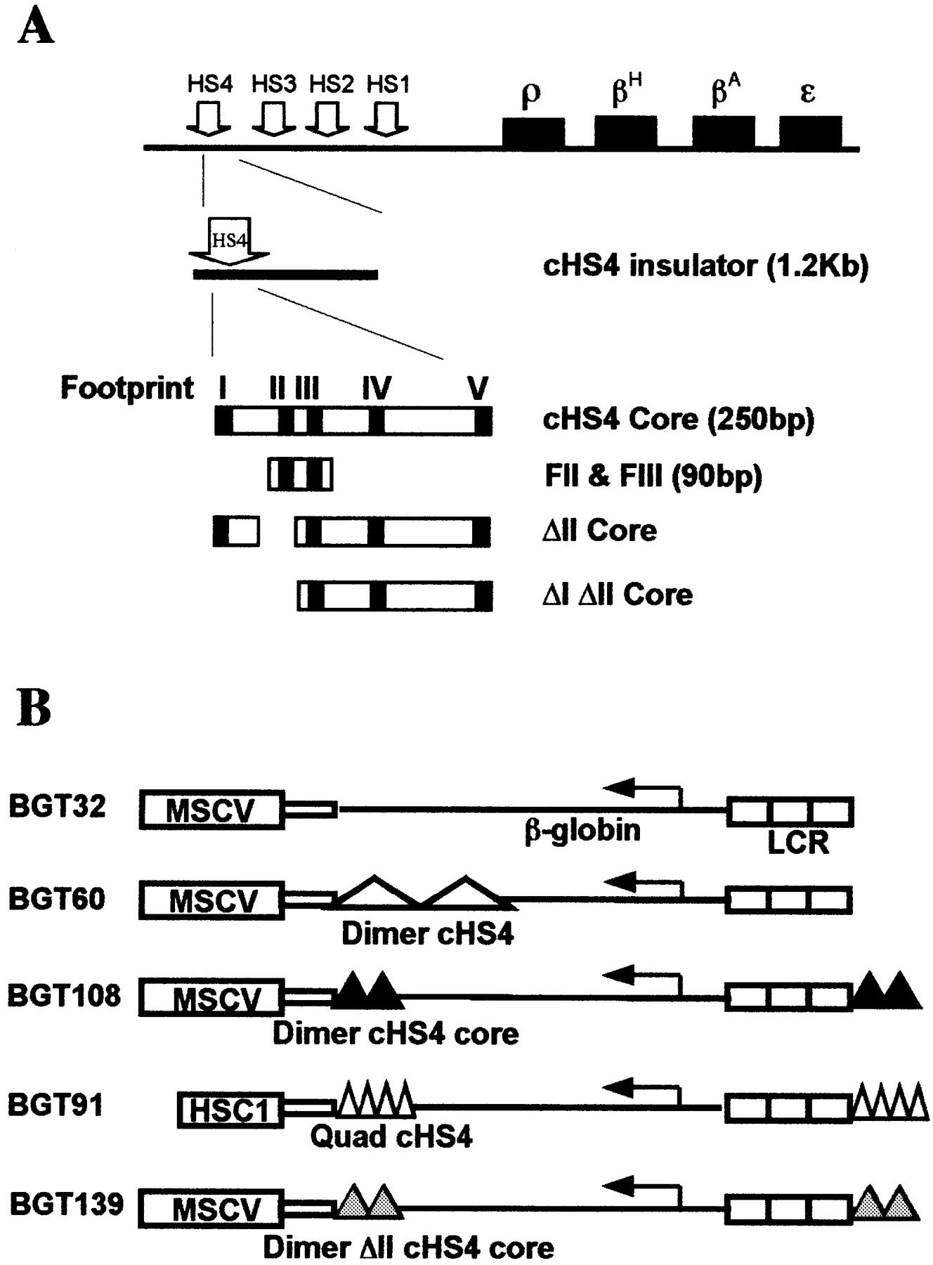
Figure 1. cHS4 insulator fragments and transgene constructs designed to test silencer blocking activity. The ...
Notes:
Figure 1. cHS4 insulator fragments and transgene constructs designed to test silencer blocking activity. The MSCV retrovirus vector sequence acts as a dominant silencer of the human LCRβ‐globin reporter gene in the fetal liver of transgenic mice ( 16 , 21 ). ( A ) Location of the cHS4 insulator at the endogenous chicken β‐globin locus and maps of the cHS4 insulator fragments tested. CTCF binds to the FII binding site. ( B ) Transgene silencer blocking constructs containing the dimer 1.2 kb fragment (two large triangles), the dimer 250 bp core fragment (two black triangles), the quad of 90 bp fragments of footprints II and III (four small triangles) and the dimer ΔII cHS4 core (two gray triangles).
Unless provided in the caption above, the following copyright applies to the content of this slide:

Slide 2
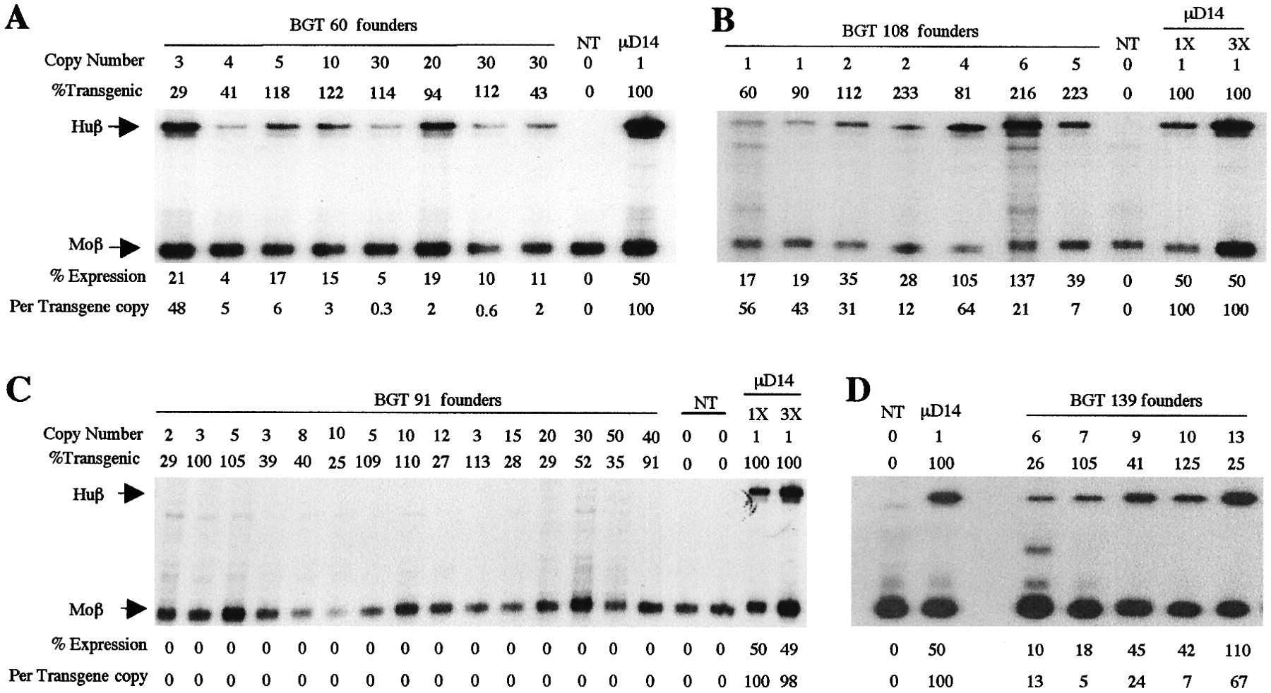
Figure 2. MSCV retrovirus silencer blocking by cHS4 permits expression of the human LCRβ‐globin reporter gene ...
Notes:
Figure 2. MSCV retrovirus silencer blocking by cHS4 permits expression of the human LCRβ‐globin reporter gene in transgenic mice. All panels are S1 nuclease protection assays on fetal liver RNA of 15.5 day founder transgenic mice. ( A ) The dimer 1.2 kb cHS4 blocks MSCV silencing of the LCRβ‐globin reporter at all BGT60 integration sites. ( B ) Double internal dimer cHS4 cores block MSCV silencing at all BGT108 integration sites. ( C ) Double internal quad cHS4 exacerbates HSC1 silencing ( 21 ) at all BGT91 integration sites. ( D ) Double internal dimer ΔII cHS4 cores block MSCV silencing at all BGT139 integration sites. Huβ, human β‐globin; Moβ, mouse β‐major; NT, non‐transgenic; µD14, one copy µD14 microlocus line.
Unless provided in the caption above, the following copyright applies to the content of this slide:

Slide 3
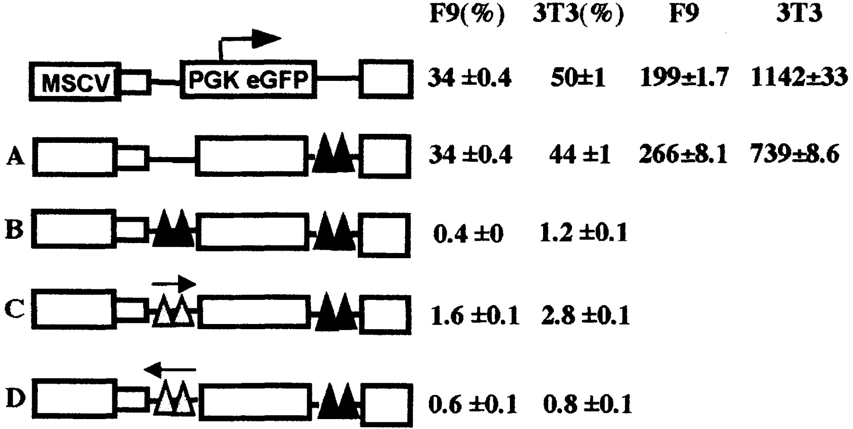
Figure 3. One but not two internal dimer cHS4 cores can be transmitted through a retrovirus vector. (Left) ...
Notes:
Figure 3. One but not two internal dimer cHS4 cores can be transmitted through a retrovirus vector. (Left) Maps of the MSCV‐based retrovirus vectors containing a PGK‐EGFP reporter and internal dimer cHS4 cores (two black triangles) or dimer ΔII cHS4 cores (two gray triangles). (Right) The titer expressed as GFP+ cell percent and EGFP mean fluorescence detected by flow cytometry in F9 and NIH 3T3 cells infected in triplicate, with standard error shown.
Unless provided in the caption above, the following copyright applies to the content of this slide:

Slide 4
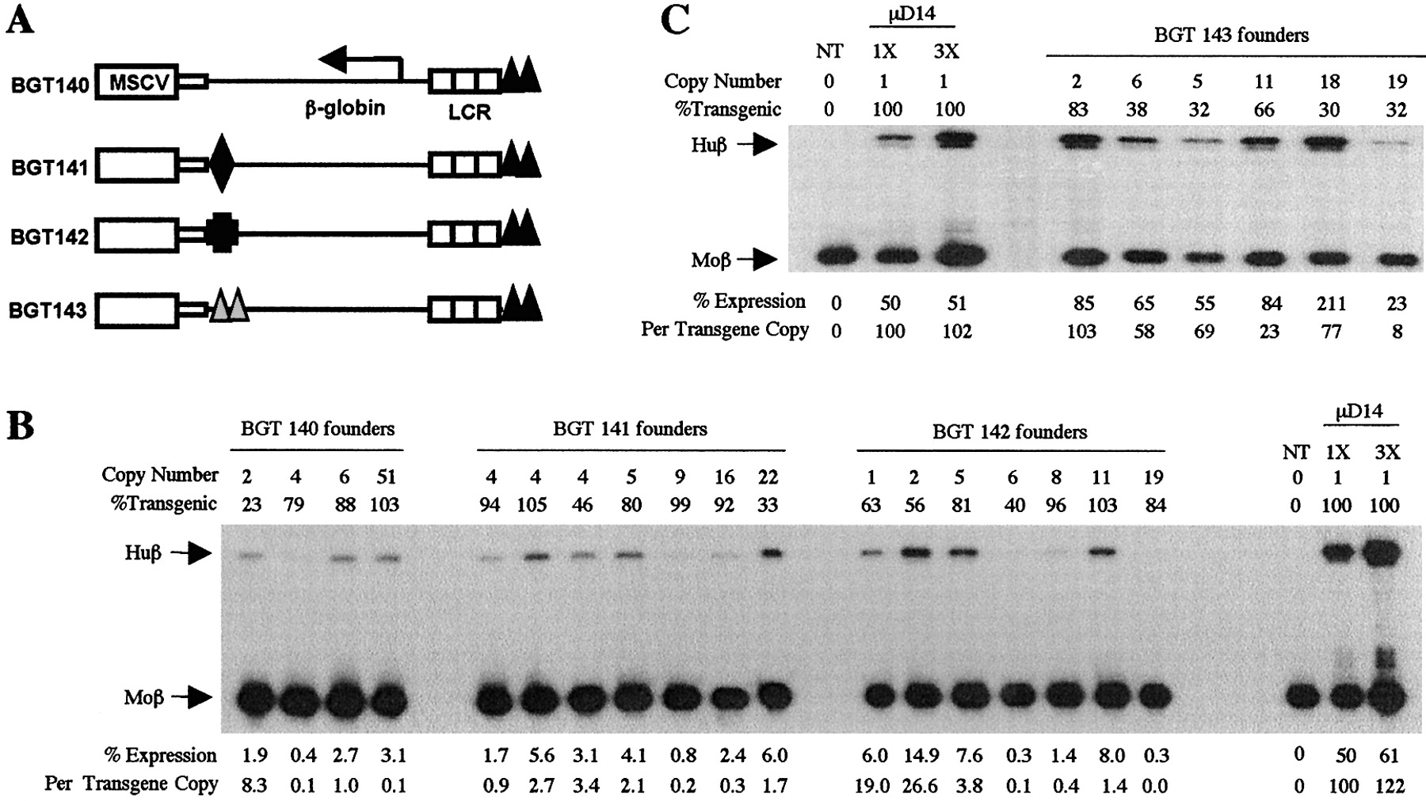
Figure 4. Lack of cooperation by gypsy and Scs with the downstream dimer cHS4 core to block 5′‐LTR silencing ...
Notes:
Figure 4. Lack of cooperation by gypsy and Scs with the downstream dimer cHS4 core to block 5′‐LTR silencing by MSCV in the transgenic mouse retrovirus silencer blocking assay. ( A ) Transgenic mouse constructs to test cooperative silencer blocking activity. Dimer cHS4 core (two black triangles), gypsy (diamond), Scs (heavy black cross) and dimer ΔII cHS4 cores (two gray triangles). ( B ) S1 nuclease analysis showing that the downstream dimer cHS4 core permits very low expression at all BGT140 integration sites. An internal gypsy or Scs fails to cooperate with the downstream dimer cHS4 core in BGT141 and BGT142, respectively. ( C ) S1 nuclease analysis showing strong cooperation between dimer ΔII cHS4 cores and wild‐type cHS4 cores in BGT143 mice.
Unless provided in the caption above, the following copyright applies to the content of this slide:

Slide 5
Figure 5. Increased expression in transduced cells induced by gypsy in the LTRs of the HSC1 retrovirus ...
Notes:
Figure 5. Increased expression in transduced cells induced by gypsy in the LTRs of the HSC1 retrovirus vector. (Left) Maps of the HSC1‐based retrovirus vectors containing a PGK‐EGFP reporter with insulators located in the LTRs (symbols as described in Fig. 4A). (Right) The titer expressed as GFP+ cell percent and EGFP mean fluorescence detected by flow cytometry in F9 and NIH 3T3 cells infected in triplicate, with standard error shown. The HSC1 data was obtained using a 2‐fold dilution of virus; all other constructs were not diluted.
Unless provided in the caption above, the following copyright applies to the content of this slide:

