Slide 1
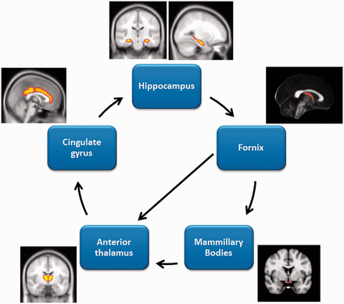
Figure 1 Schematic diagram of the Papez circuit regions.
Notes:
Figure 1 Schematic diagram of the Papez circuit regions.
Unless provided in the caption above, the following copyright applies to the content of this slide: © The Author (2012). Published by Oxford University Press on behalf of the Guarantors of Brain. All rights reserved. For Permissions, please email: journals.permissions@oup.com

Slide 2
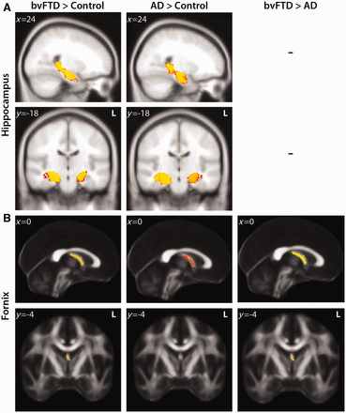
Figure 2 VBM and DTI analyses showing grey matter atrophy and white matter degeneration for the hippocampus and ...
Notes:
Figure 2 VBM and DTI analyses showing grey matter atrophy and white matter degeneration for the hippocampus and fornix, respectively. Clusters are overlaid on the MNI standard brain (t > 2.41). Coloured voxels show regions that were significant in the analyses for P < 0.001 FDR corrected and a cluster threshold of 20 contiguous voxels. AD = Alzheimer’s disease; bvFTD = behavioural variant FTD.
Unless provided in the caption above, the following copyright applies to the content of this slide: © The Author (2012). Published by Oxford University Press on behalf of the Guarantors of Brain. All rights reserved. For Permissions, please email: journals.permissions@oup.com

Slide 3
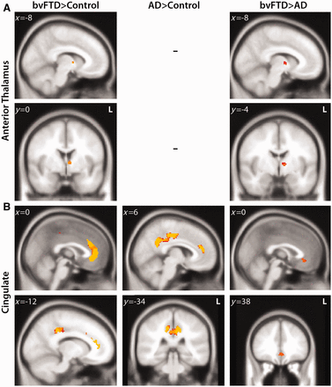
Figure 3 VBM analyses showing grey matter atrophy for the anterior thalamus and cingulate cortex. Clusters are ...
Notes:
Figure 3 VBM analyses showing grey matter atrophy for the anterior thalamus and cingulate cortex. Clusters are overlaid on the MNI standard brain (t > 2.41). Coloured voxels show regions that were significant in the analyses for P < 0.001 FDR corrected and a cluster threshold of 20 contiguous voxels. AD = Alzheimer’s disease; bvFTD = behavioural variant FTD.
Unless provided in the caption above, the following copyright applies to the content of this slide: © The Author (2012). Published by Oxford University Press on behalf of the Guarantors of Brain. All rights reserved. For Permissions, please email: journals.permissions@oup.com

Slide 4
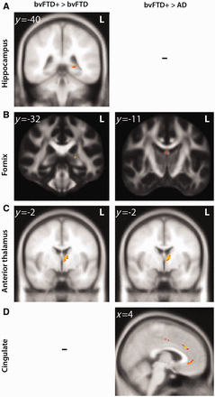
Figure 4 VBM and DTI analyses showing grey matter atrophy and white matter degeneration for: (i) more ...
Notes:
Figure 4 VBM and DTI analyses showing grey matter atrophy and white matter degeneration for: (i) more (bvFTD+) versus less (bvFTD–) memory impaired behavioural variant FTD patients; (ii) more (bvFTD+) memory impaired behavioural variant FTD versus patients with Alzheimer’s disease. Clusters are overlaid on the MNI standard brain (t > 2.41). Coloured voxels show regions that were significant in the analyses for P < 0.001 FDR corrected and a cluster threshold of 20 contiguous voxels. AD = Alzheimer’s disease; bvFTD = behavioural variant FTD.
Unless provided in the caption above, the following copyright applies to the content of this slide: © The Author (2012). Published by Oxford University Press on behalf of the Guarantors of Brain. All rights reserved. For Permissions, please email: journals.permissions@oup.com

