Slide 1
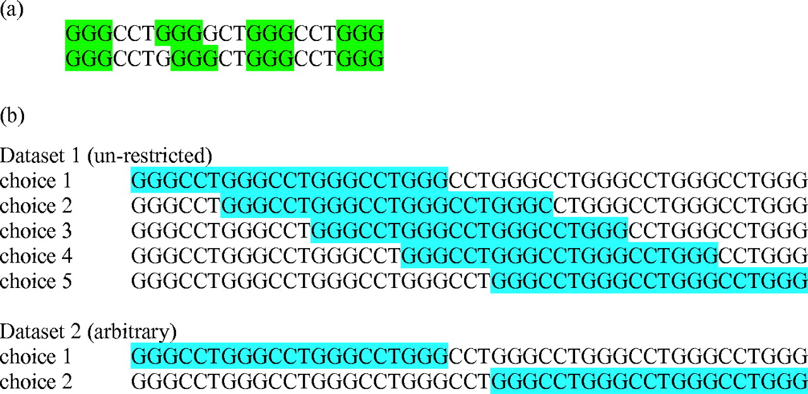
Figure 1 Ways in which quadruplex-fold ambiguity can occur. ( a ) Shaded regions represent the guanines contributing ...
Notes:
Figure 1 Ways in which quadruplex-fold ambiguity can occur. ( a ) Shaded regions represent the guanines contributing to the G-quartets and the unshaded regions the loops. Regions of high guanine density tend to have more quadruplex hits which in some cases lead to many hits for a single region of DNA. ( b ) Overlapping quadruplexes. In the first (un-restricted) dataset, the above sequence would produce five possible quadruplex folds, and in the second (arbitrary) dataset, this sequence would only have been counted as two distinct quadruplexes.
Unless provided in the caption above, the following copyright applies to the content of this slide: © The Author 2005. Published by Oxford University Press. All rights reserved The online version of this article has been published under an open access model. Users are entitled to use, reproduce, disseminate, or display the open access version of this article for non-commercial purposes provided that: the original authorship is properly and fully attributed; the Journal and Oxford University Press are attributed as the original place of publication with the correct citation details given; if an article is subsequently reproduced or disseminated not in its entirety but only in part or as a derivative work this must be clearly indicated. For commercial re-use, please contact journals.permissions@oupjournals.org

Slide 2
Figure 2 Consensus sequences for ( a ) CCTGTCA and ( b ) CCTGTT sequence types. Diagrams were generated with the ...
Notes:
Figure 2 Consensus sequences for ( a ) CCTGTCA and ( b ) CCTGTT sequence types. Diagrams were generated with the program MakeLogo ( 33 ). A total of 1956 sequences were used to find the consensus sequence for CCTGTCA and 2361 sequences for the CCTGTT type. The height of each letter is proportional to the number of times each base appeared in that position.
Unless provided in the caption above, the following copyright applies to the content of this slide: © The Author 2005. Published by Oxford University Press. All rights reserved The online version of this article has been published under an open access model. Users are entitled to use, reproduce, disseminate, or display the open access version of this article for non-commercial purposes provided that: the original authorship is properly and fully attributed; the Journal and Oxford University Press are attributed as the original place of publication with the correct citation details given; if an article is subsequently reproduced or disseminated not in its entirety but only in part or as a derivative work this must be clearly indicated. For commercial re-use, please contact journals.permissions@oupjournals.org

