Slide 1
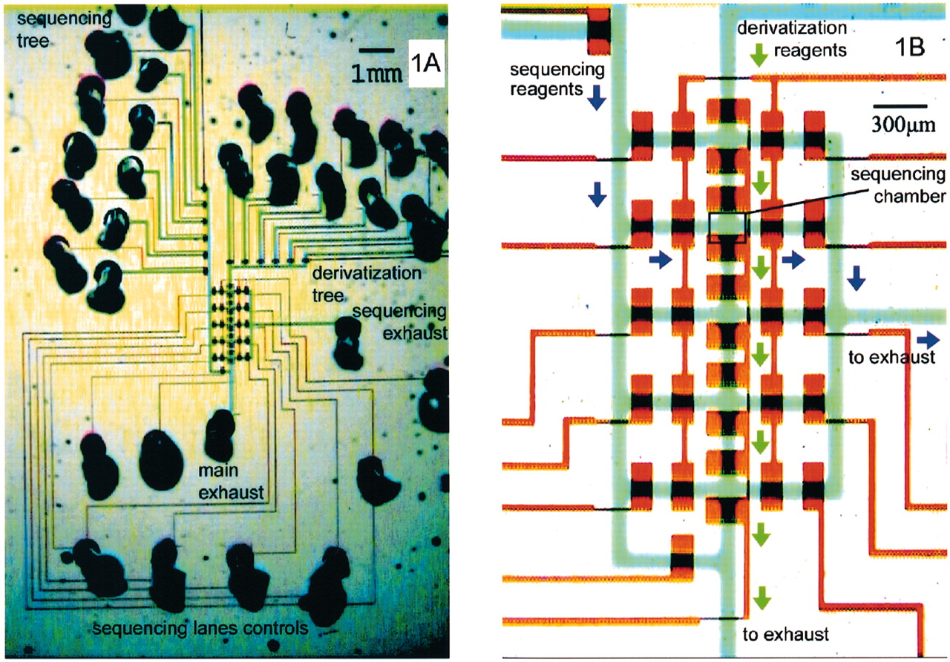
Figure 1. Chip architecture. (A) The microchannels are filled with food dyes to accentuate features—blue ...
Notes:
Figure 1. Chip architecture. (A) The microchannels are filled with food dyes to accentuate features—blue (flow layer), red (control layer). The derivatization tree supplies reagents to form surface chemistry in all five sequencing chambers at once. Lane controls direct flow of sequencing reagents from the sequencing tree into any chamber of choice. (B) Valves are formed only where wide control segments cross over flow segments. Arrows indicate the flow direction during operation—derivatization (green) and sequencing (purple). This microfluidic architecture is applicable in any situation combining parallel derivatization of an array with individual addressability of its elements.
Unless provided in the caption above, the following copyright applies to the content of this slide: Oxford University Press

Slide 2
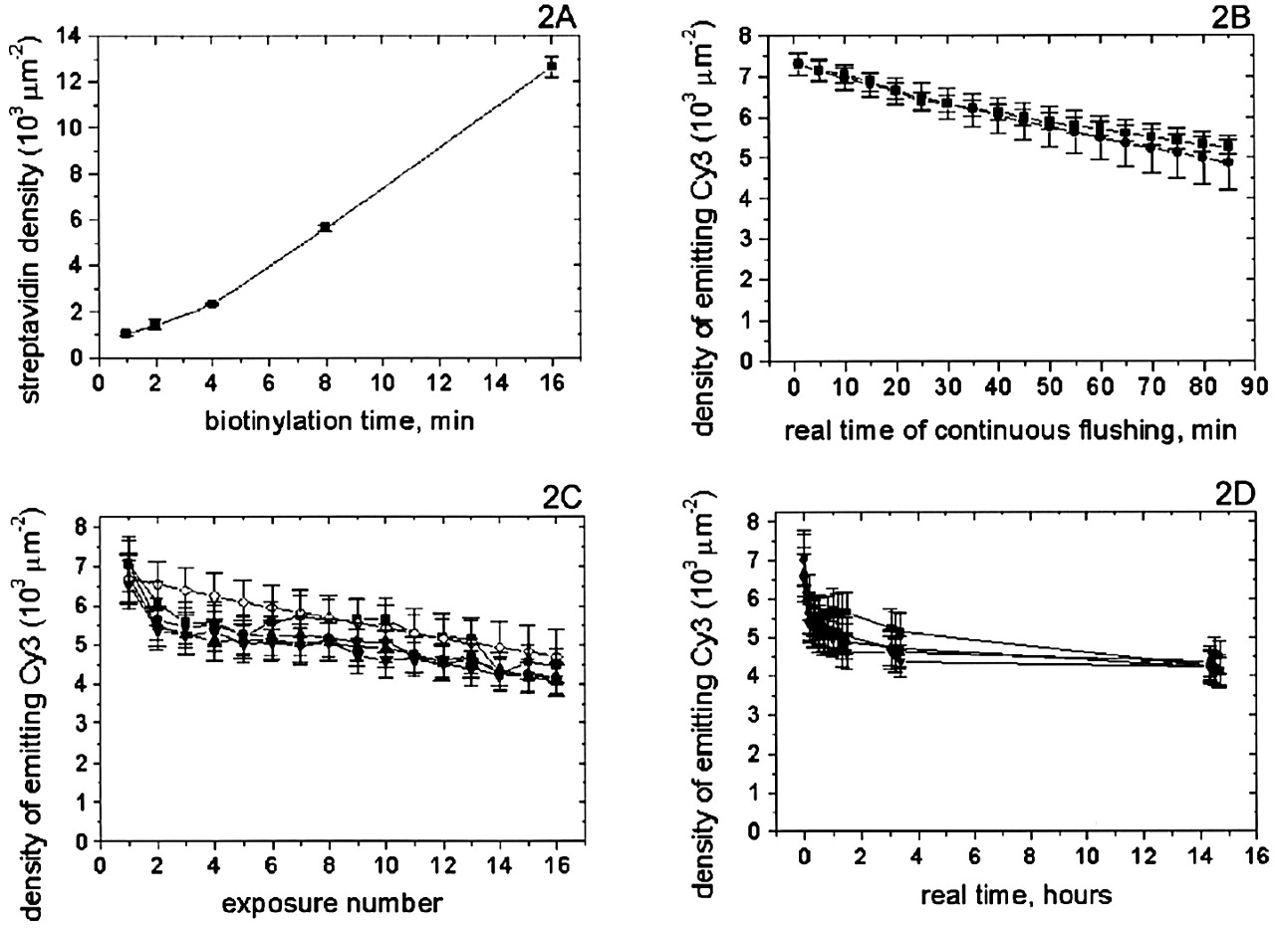
Figure 2. Chip surface chemistry diagnostics. (A) The chambers of the same device were biotinylated over ...
Notes:
Figure 2. Chip surface chemistry diagnostics. (A) The chambers of the same device were biotinylated over varying times. Tagged streptavidin saturated the surface sites and measured biotin density. The linear dependence with time is a good tool to tune the DNA surface density as desired. (B) Surface chemistry is stable with prolonged continuous flushing since the signal from anchored tagged DNA (squares) is consistent with the fluorescence bleaching prediction (circles). (C) Signals from tagged DNA anchored in different chambers of the same device (black symbols) are consistent with the bleaching prediction (empty diamonds). The consistency in behavior among chambers shows desired homogeneity of conditions over the array. (D) Same data as in (C) plotted with respect to real time, shows surface chemistry is stable over 14 h at room temperature.
Unless provided in the caption above, the following copyright applies to the content of this slide: Oxford University Press

Slide 3
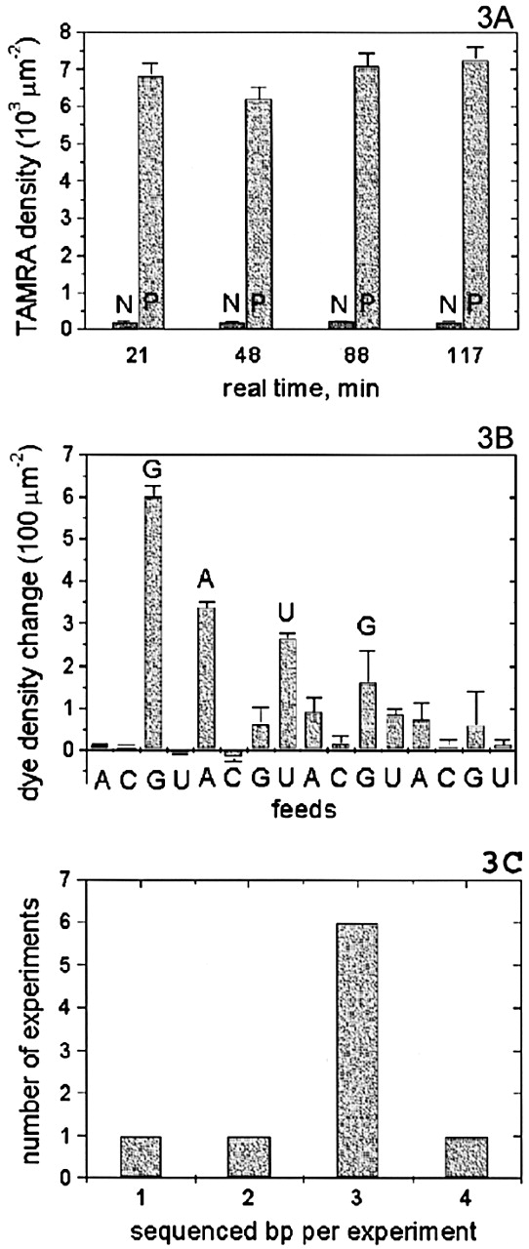
Figure 3. DNA sequencing. (A) The same sequencing reagents with polymerase (P) and without it (N) were fed ...
Notes:
Figure 3. DNA sequencing. (A) The same sequencing reagents with polymerase (P) and without it (N) were fed into same‐device chambers at different times. Tagged nucleotide incorporation was confirmed by the P‐N difference in each case. P’s over time show sequencing reagents retain activity over at least 2 h. (B) A mixture of tagged and non‐tagged nucleotides of the same type is fed into a single sequencing chamber. Incorporation is detected as increase in fluorophore surface density. The read GAUG corresponds exactly to the template sequence CTAC. (C) Statistics over nine sequencing experiments shows the most likely read length is 3 bp from a single chamber.
Unless provided in the caption above, the following copyright applies to the content of this slide: Oxford University Press

