Slide 1
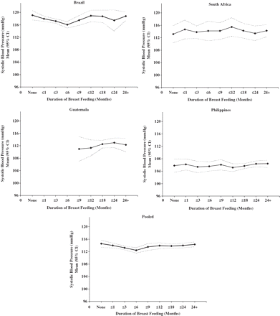
Figure 1 Associations of duration of breastfeeding with SBP in the four cohorts with available data, and in the pooled ...
Notes:
Figure 1 Associations of duration of breastfeeding with SBP in the four cohorts with available data, and in the pooled data
Unless provided in the caption above, the following copyright applies to the content of this slide: Published by Oxford University Press on behalf of the International Epidemiological Association © The Author 2010; all rights reserved.This is an Open Access article distributed under the terms of the Creative Commons Attribution Non-Commercial License (http://creativecommons.org/licenses/by-nc/2.5), which permits unrestricted non-commercial use, distribution, and reproduction in any medium, provided the original work is properly cited.

Slide 2
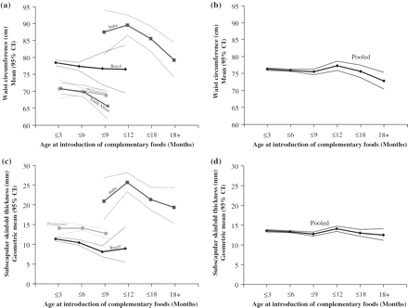
Figure 2 Associations of age of introduction of complementary foods with adult waist circumference (a and b), and ...
Notes:
Figure 2 Associations of age of introduction of complementary foods with adult waist circumference (a and b), and subscapular skinfold measurement (c and d) (fully adjusted models) in the four cohorts with available data separately and pooled
Unless provided in the caption above, the following copyright applies to the content of this slide: Published by Oxford University Press on behalf of the International Epidemiological Association © The Author 2010; all rights reserved.This is an Open Access article distributed under the terms of the Creative Commons Attribution Non-Commercial License (http://creativecommons.org/licenses/by-nc/2.5), which permits unrestricted non-commercial use, distribution, and reproduction in any medium, provided the original work is properly cited.

