Slide 1
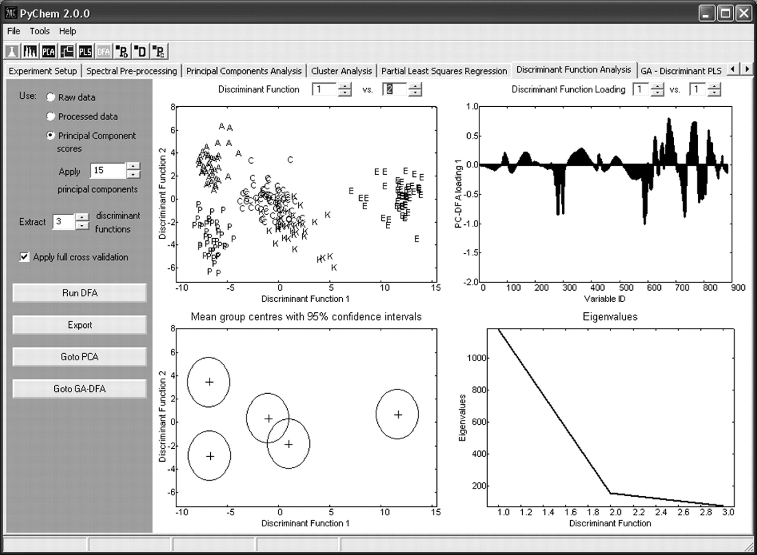
Fig. 1 A screenshot demonstrating the feature selection functionality available in PyChem, in this example ...
Notes:
Fig. 1 A screenshot demonstrating the feature selection functionality available in PyChem, in this example microarray data (Golub et al., 1999) have been analysed consisting of 72 samples represented by 7070 genes. The GA directed search can be used to highlight genes that are particularly important for discrimination.
Unless provided in the caption above, the following copyright applies to the content of this slide: © 2006 The Author(s)This is an Open Access article distributed under the terms of the Creative Commons Attribution Non-Commercial License () which permits unrestricted non-commercial use, distribution, and reproduction in any medium, provided the original work is properly cited.

