Slide 1
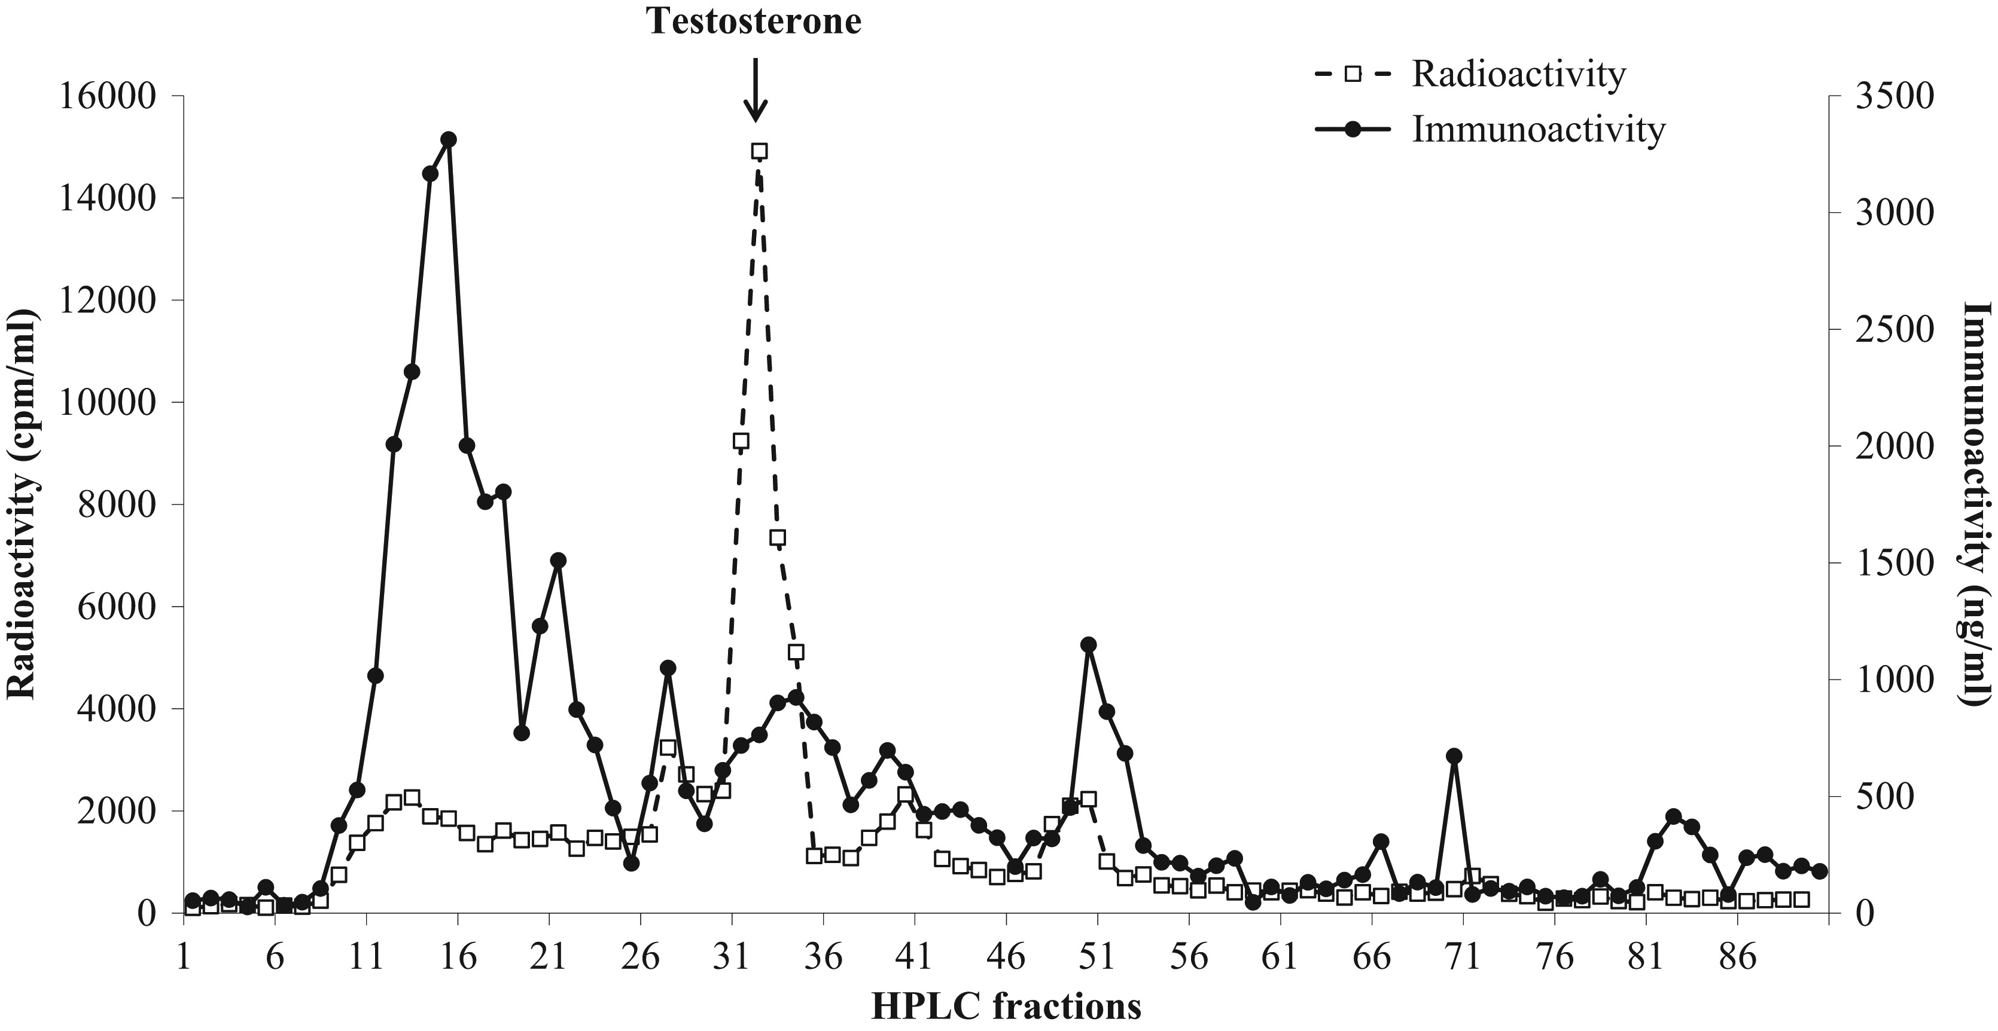
Figure 1: Co-chromatographic high-performance liquid chromatography separation of faecal testosterone metabolites of ...
Notes:
Figure 1: Co-chromatographic high-performance liquid chromatography separation of faecal testosterone metabolites of male dholes.
Unless provided in the caption above, the following copyright applies to the content of this slide: © The Author 2017. Published by Oxford University Press and the Society for Experimental Biology.This is an Open Access article distributed under the terms of the Creative Commons Attribution License (http://creativecommons.org/licenses/by/4.0/), which permits unrestricted reuse, distribution, and reproduction in any medium, provided the original work is properly cited.

Slide 2
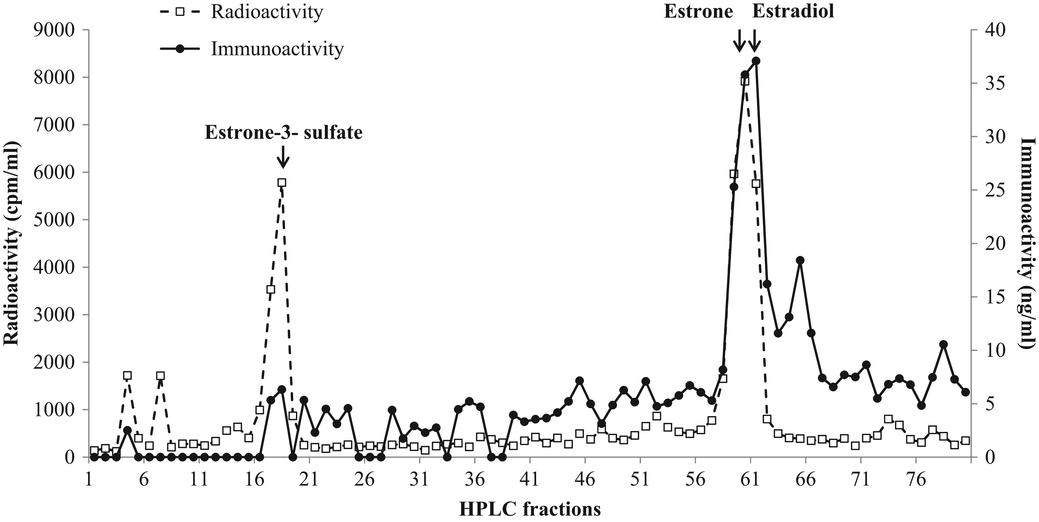
Figure 2: Co-chromatographic high-performance liquid chromatography separation of faecal oestrogen metabolites of ...
Notes:
Figure 2: Co-chromatographic high-performance liquid chromatography separation of faecal oestrogen metabolites of female dholes.
Unless provided in the caption above, the following copyright applies to the content of this slide: © The Author 2017. Published by Oxford University Press and the Society for Experimental Biology.This is an Open Access article distributed under the terms of the Creative Commons Attribution License (http://creativecommons.org/licenses/by/4.0/), which permits unrestricted reuse, distribution, and reproduction in any medium, provided the original work is properly cited.

Slide 3
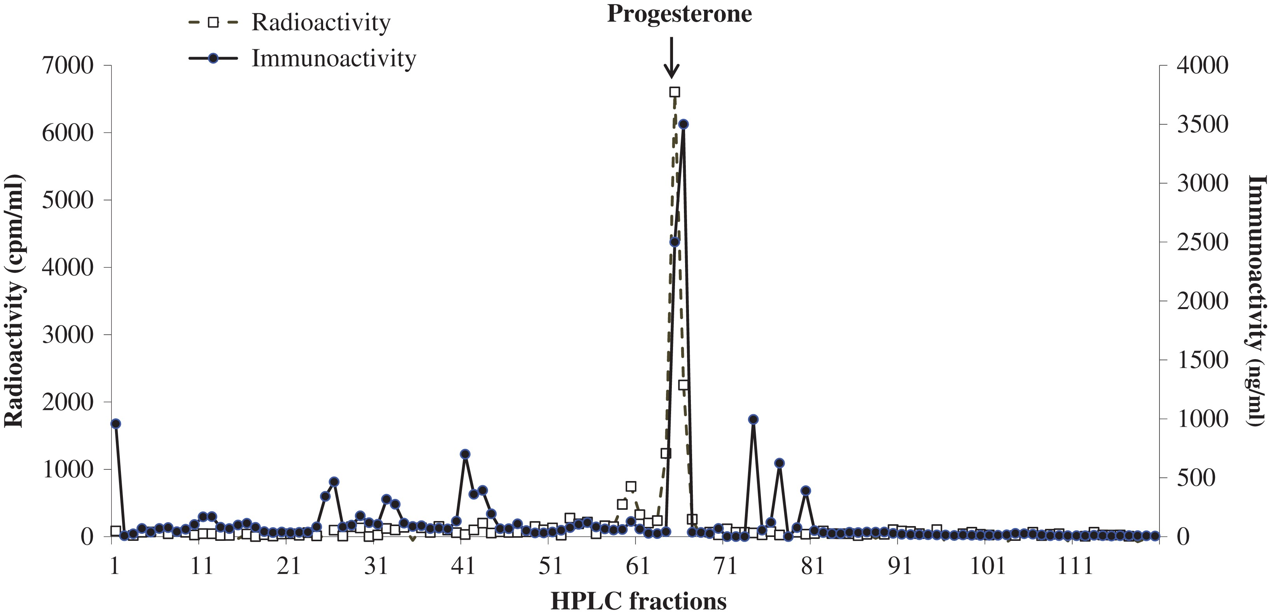
Figure 3: Co-chromatographic high-performance liquid chromatography separation of faecal progestagen metabolites of ...
Notes:
Figure 3: Co-chromatographic high-performance liquid chromatography separation of faecal progestagen metabolites of female dholes.
Unless provided in the caption above, the following copyright applies to the content of this slide: © The Author 2017. Published by Oxford University Press and the Society for Experimental Biology.This is an Open Access article distributed under the terms of the Creative Commons Attribution License (http://creativecommons.org/licenses/by/4.0/), which permits unrestricted reuse, distribution, and reproduction in any medium, provided the original work is properly cited.

Slide 4
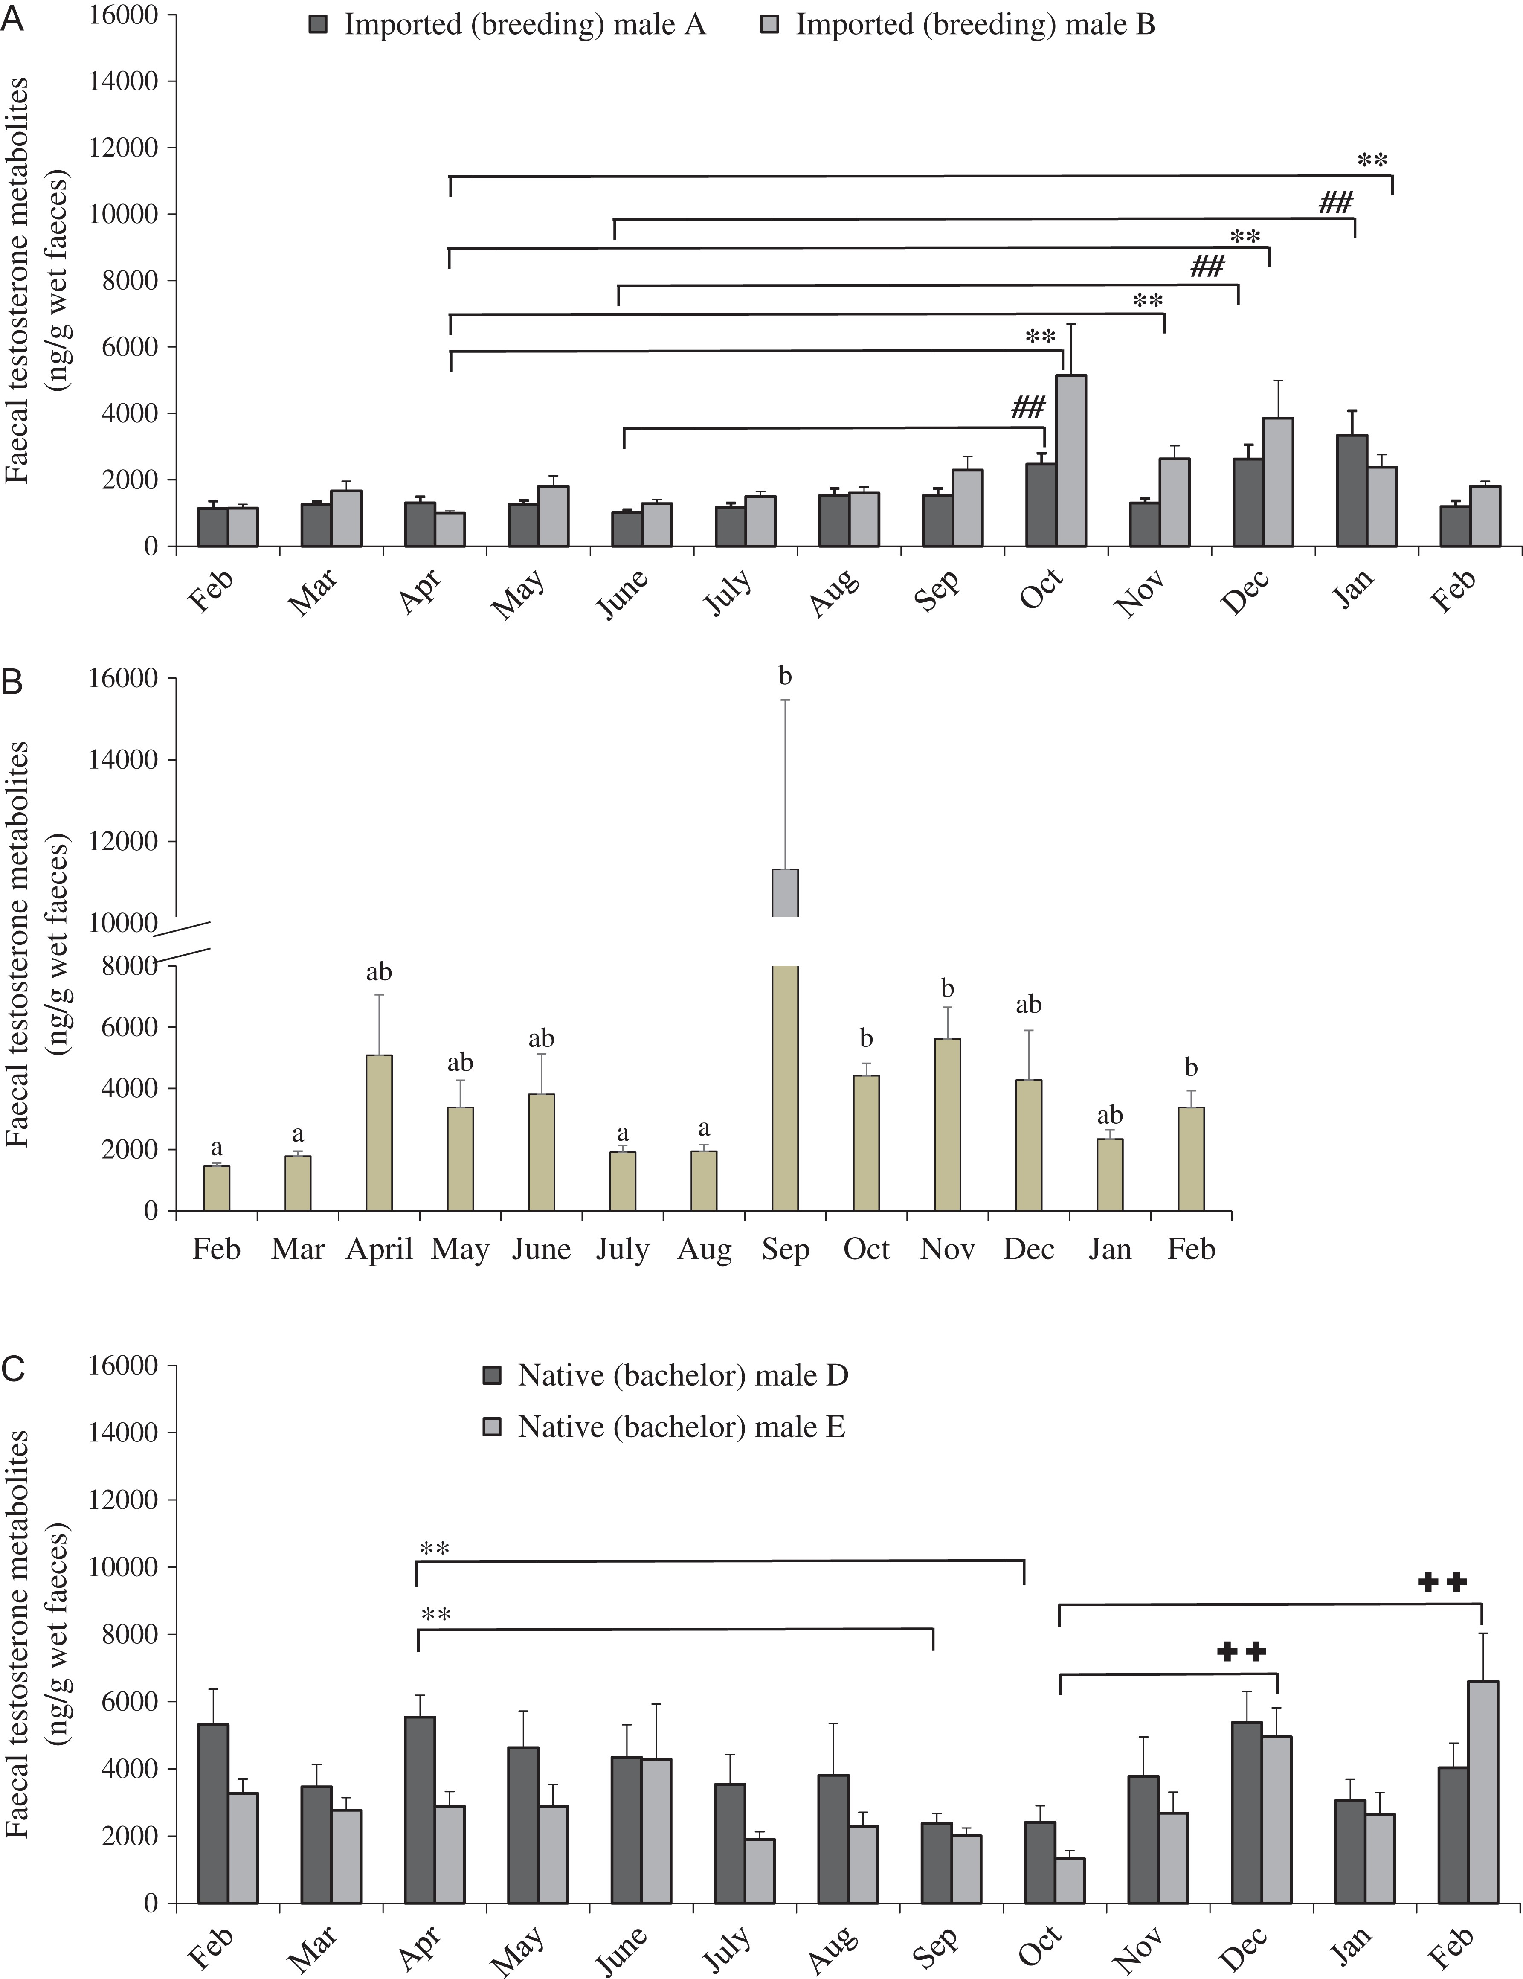
Figure 4: Mean ± SEM testosterone metabolite concentrations of two imported males housed in breeding pairs (A), a ...
Notes:
Figure 4: Mean ± SEM testosterone metabolite concentrations of two imported males housed in breeding pairs (A), a native male housed in a breeding pair (B) and two native males housed as a bachelor group (C). **, ##, ++ Symbols or a,b superscript letters indicate significant differences among months within the same male. P < 0.05.
Unless provided in the caption above, the following copyright applies to the content of this slide: © The Author 2017. Published by Oxford University Press and the Society for Experimental Biology.This is an Open Access article distributed under the terms of the Creative Commons Attribution License (http://creativecommons.org/licenses/by/4.0/), which permits unrestricted reuse, distribution, and reproduction in any medium, provided the original work is properly cited.

Slide 5
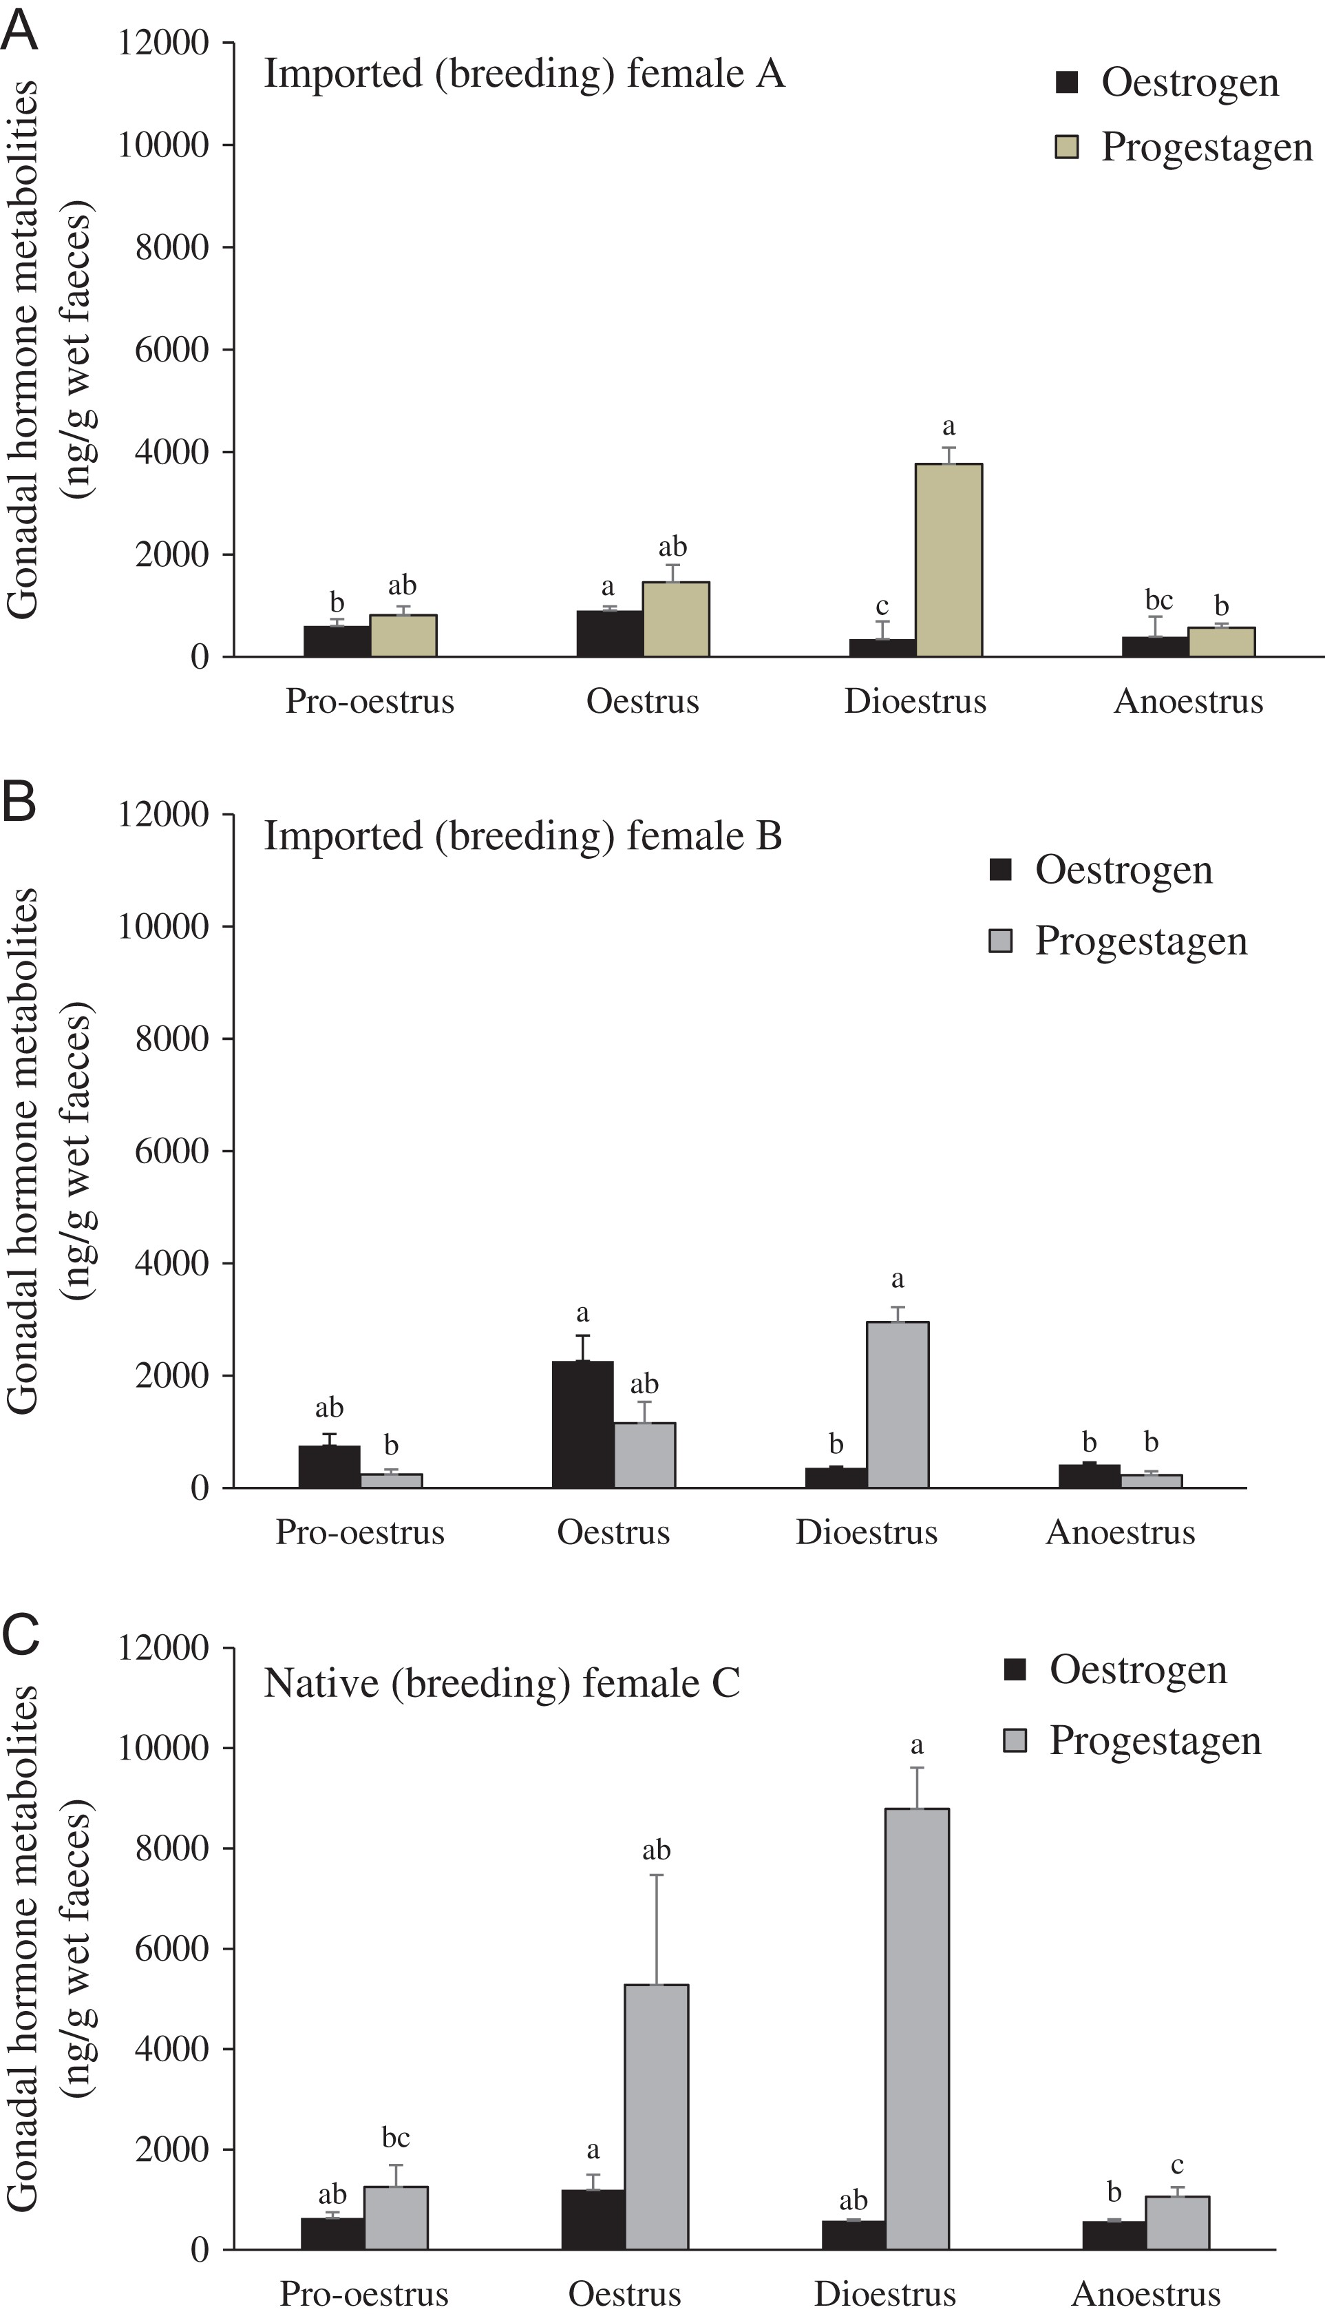
Figure 5: Mean ± SEM concentrations of ovarian steroid metabolites during pro-oestrus (days −10 to −1 of the oestrogen ...
Notes:
Figure 5: Mean ± SEM concentrations of ovarian steroid metabolites during pro-oestrus (days −10 to −1 of the oestrogen peak), oestrus (days 0–6), dioestrus (days 7–93) and anoestrus (days −30 to −11) of the two imported females (A and B) and the native female (C). abcDifferent superscript letters indicate significant differences among reproductive cycles within the same individual for each steroid hormone (P < 0.05).
Unless provided in the caption above, the following copyright applies to the content of this slide: © The Author 2017. Published by Oxford University Press and the Society for Experimental Biology.This is an Open Access article distributed under the terms of the Creative Commons Attribution License (http://creativecommons.org/licenses/by/4.0/), which permits unrestricted reuse, distribution, and reproduction in any medium, provided the original work is properly cited.

Slide 6
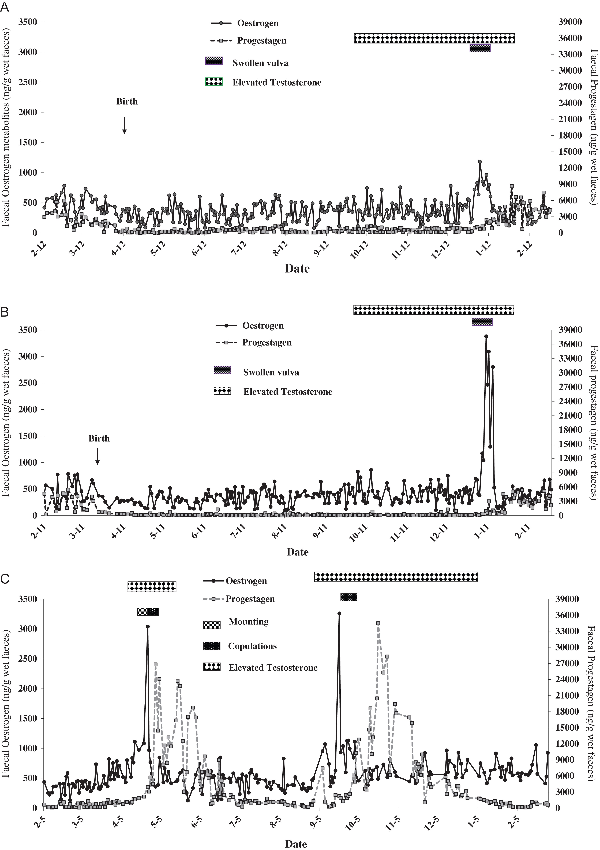
Figure 6: Longitudinal profile of gonadal steroids of the two imported females (A and B) and the native female (C) ...
Notes:
Figure 6: Longitudinal profile of gonadal steroids of the two imported females (A and B) and the native female (C) overlaid with reproductive events/behaviours and the interval during which elevated testosterone metabolites were observed in the respective male.
Unless provided in the caption above, the following copyright applies to the content of this slide: © The Author 2017. Published by Oxford University Press and the Society for Experimental Biology.This is an Open Access article distributed under the terms of the Creative Commons Attribution License (http://creativecommons.org/licenses/by/4.0/), which permits unrestricted reuse, distribution, and reproduction in any medium, provided the original work is properly cited.

