Slide 1
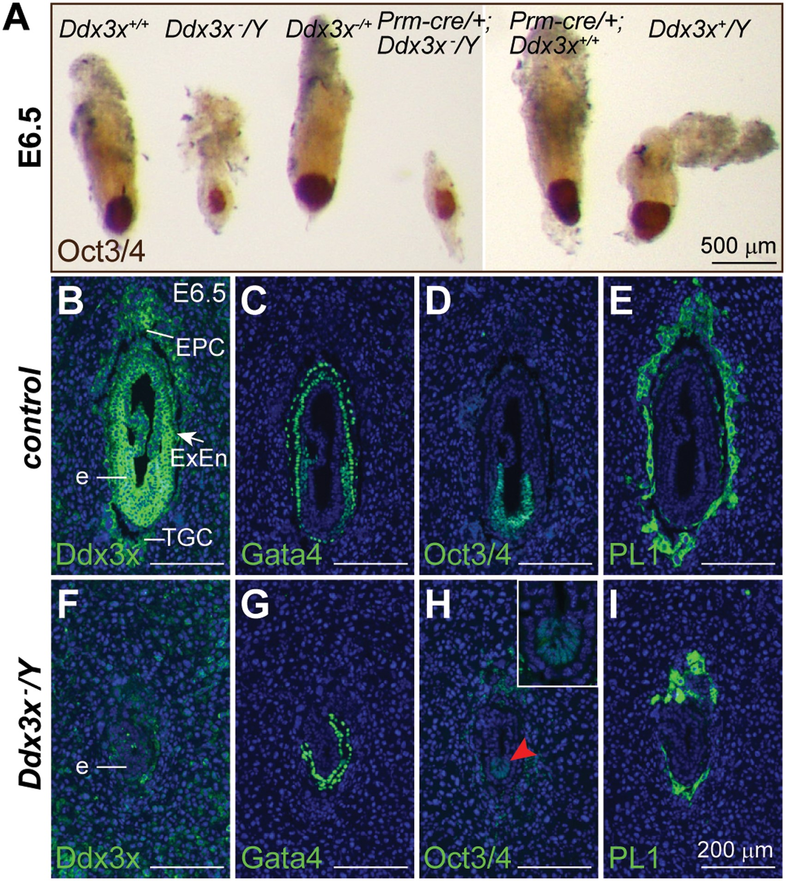
Figure 1. Loss of Ddx3x results in early embryonic lethality. (A) Whole-mount morphology of Ddx3x⁻/Y mutants ...
Notes:
Figure 1. Loss of Ddx3x results in early embryonic lethality. (A) Whole-mount morphology of Ddx3x−/Y mutants and their littermates at E6.5. Representative E6.5 embryos with the indicated genotypes from the mating between Prm-cre/+;Ddx3x+/− female and Ddx3x+/Y male were immunostained with an antibody against Oct3/4 (brown). The Ddx3x−/Y mutants have a severely retarded growth compared with their littermate controls. (B−I) Immunohistochemical analysis of E6.5 embryos. Antibody against Ddx3x confirmed that Ddx3x protein was absent in Ddx3x−/Y embryos (F). Expression of GATA4, Oct3/4 and PL1 in adjacent sections revealed the presence of parietal and visceral endoderm, epiblast and trophoblast cell lineages, respectively, in littermate control and Ddx3x−/Y embryos. Higher magnification of epiblast (red arrowhead) in H is shown in the inset. Nuclei were stained with DAPI (blue). e, embryo; EPC, ectoplacental cone; ExEn, extraembryonic endoderm; TGC, trophoblast giant cell. Scale bars, 500 μm (A); 200 μm (B−I).
Unless provided in the caption above, the following copyright applies to the content of this slide: © The Author 2016. Published by Oxford University Press. All rights reserved. For permissions, please e-mail: journals.permissions@oup.com

Slide 2
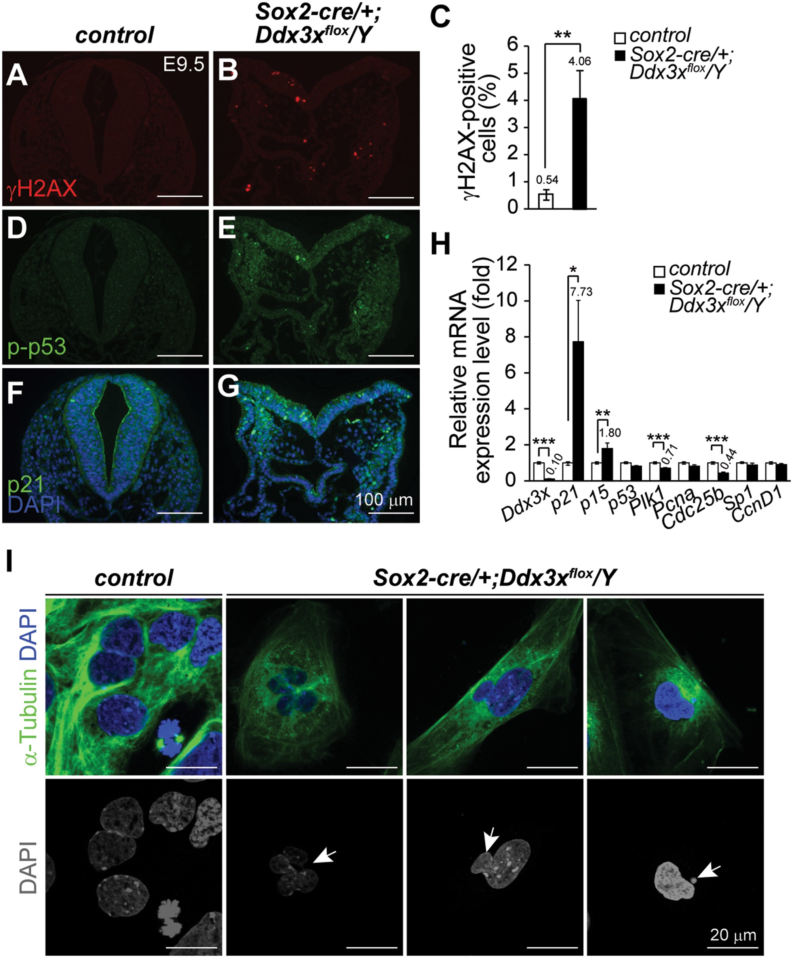
Figure 9. Increased DNA damage and nuclear abnormality in Sox2-cre/+;Ddx3x^{flox}/Y mutants. (A−C) ...
Notes:
Figure 9. Increased DNA damage and nuclear abnormality in Sox2-cre/+;Ddx3xflox/Y mutants. (A−C) Representative γH2AX immunostaining in control and Sox2-cre/+;Ddx3xflox/Y mutant at E9.5. Significantly greater numbers of γH2AX-positive cells (red) were detected in Sox2-cre/+;Ddx3xflox/Y mutants than in controls (C). Percentages of γH2AX-positive cells in controls (n = 5) and Sox2-cre/+;Ddx3xflox/Y mutants (n = 6) were determined by the number of positive cells/total cells in each region and presented as mean±SEM. For each embryo, at least two adjacent sections were counted. (D−G) Expression levels of p21 and p-p53ser15 (green) were higher in Sox2-cre/+;Ddx3xflox/Y mutants than in littermate controls. Nuclei were counterstained with DAPI (blue). (H) Quantitative RT-PCR analysis of Ddx3x and cell cycle regulators in E9.5 controls and Sox2-cre/+;Ddx3xflox/Y mutants. *P < 0.05, **P < 0.01, ***P < 0.005. (I) Abnormal nuclei are observed in primary cells from Sox2-cre/+;Ddx3xflox/Y mutants. Disaggregated primary cells from E8.5 littermate controls and Sox2-cre/+;Ddx3xflox/Y embryos were immunostained with anti-α-Tubulin antibody and analyzed by confocal microscope (Olympus FV1000). Nuclei were visualized by DAPI staining. Merged images of α-Tubulin (green) and DAPI (blue) are shown in the upper panel, while the bottom panel show DAPI only (gray). Representative abnormal nuclei (arrows) were detected in primary cells from Sox2-cre/+;Ddx3xflox/Y mutants. Scale bars, 100 μm (A, B, D, E, F, G); 20 μm (I).
Unless provided in the caption above, the following copyright applies to the content of this slide: © The Author 2016. Published by Oxford University Press. All rights reserved. For permissions, please e-mail: journals.permissions@oup.com

Slide 3
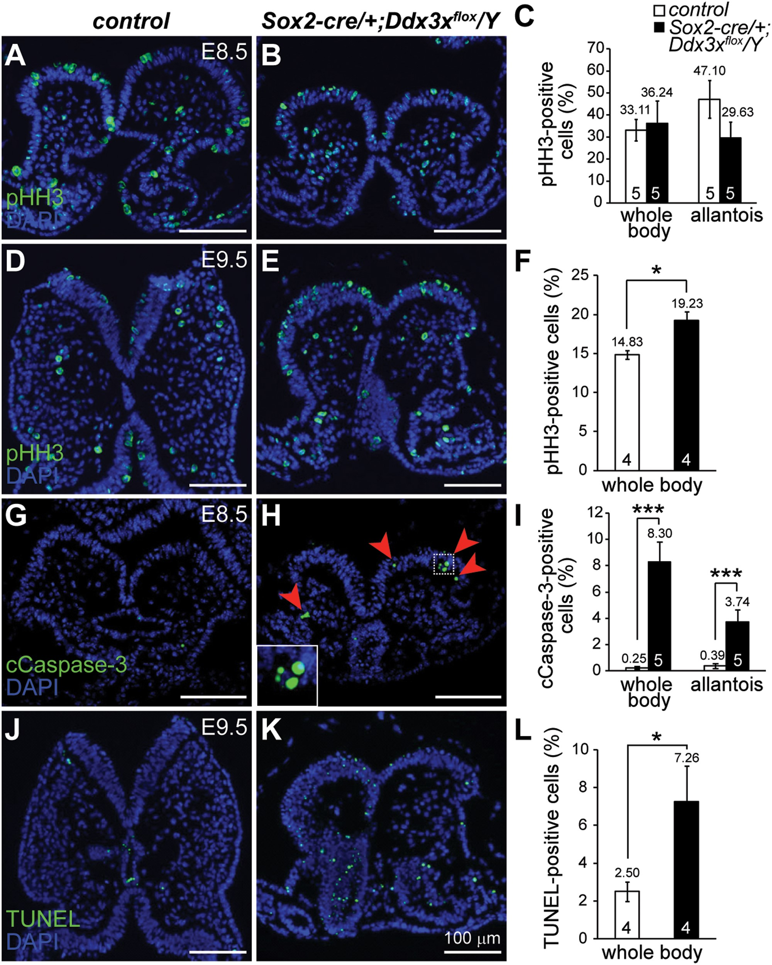
Figure 8. Cell proliferation and cell apoptosis in Sox2-cre/+;Ddx3x^{flox}/Y mutant embryos. Mitotic marker ...
Notes:
Figure 8. Cell proliferation and cell apoptosis in Sox2-cre/+;Ddx3xflox/Y mutant embryos. Mitotic marker pHH3-positive cells in controls (A and D) and Sox2-cre/+;Ddx3xflox/Y mutants (B and E). At early E8.5 before embryo turning, there were no significant differences in pHH3-positive cells (green) between controls and mutants (A and B). The number of pHH3-positive cells was significantly higher in E9.5 Sox2-cre/+;Ddx3xflox/Y mutant (E) than in control (D). cCaspase-3- and TUNEL-positive cells in controls and Sox2-cre/+;Ddx3xflox/Y mutants. cCaspase-3-positive cells (green) were barely detectable in the E8.5 control (G), whereas the Sox2-cre/+;Ddx3xflox/Y mutant (H) contained more cCaspase-3-positive cells (arrowheads). Higher magnification view of the boxed area is shown in the inset. There was a significant increase in TUNEL-positive cells (green) in E9.5 Sox2-cre/+;Ddx3xflox/Y mutant (K) compared with that of the control (J). Nuclei were stained with DAPI (blue). Quantitative analysis of pHH3- (C and F), cCaspase-3- (I), and TUNEL-positive (L) cells in the whole body and allantois of controls and Sox2-cre/+;Ddx3xflox/Y mutants was determined by the percentage of positive cells with respect to total cells in each region, and presented as mean ± SEM. For each embryo, at least two adjacent sections were counted. n = 5 for E8.5 embryos and n = 4 for E9.5 embryos. *P < 0.05 and ***P < 0.005.
Unless provided in the caption above, the following copyright applies to the content of this slide: © The Author 2016. Published by Oxford University Press. All rights reserved. For permissions, please e-mail: journals.permissions@oup.com

Slide 4
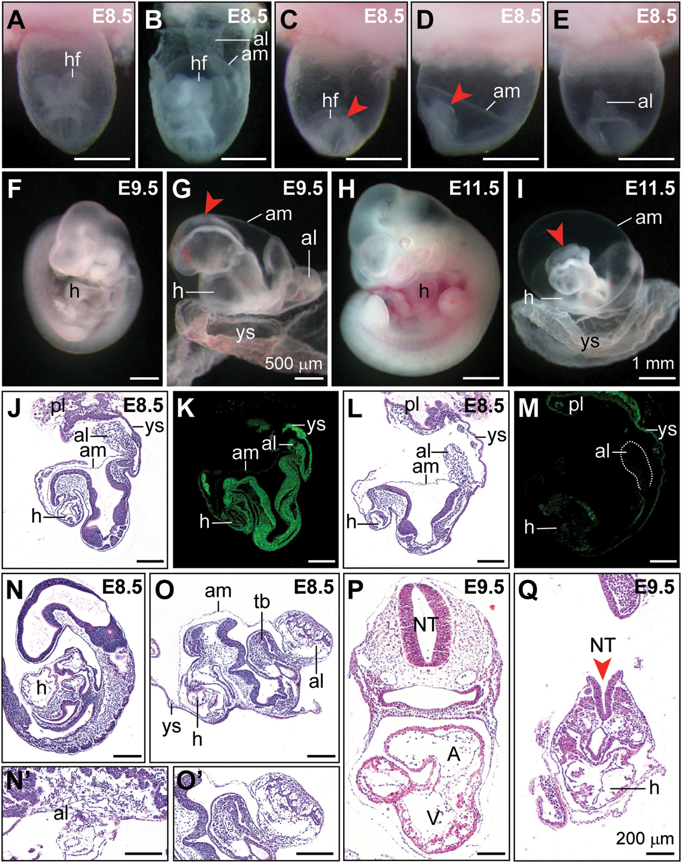
Figure 7. Developmental defects in Sox2-cre/+;Ddx3x^{flox}/Y mutants. (A−I) Representative images of littermate ...
Notes:
Figure 7. Developmental defects in Sox2-cre/+;Ddx3xflox/Y mutants. (A−I) Representative images of littermate controls and Sox2-cre/+;Ddx3xflox/Y mutants at E8.5, E9.5, and E11.5. Frontal view of the control embryo within the yolk sac (A) showed the normal appearance of the head region. In the early E8.5 control embryo (B) with the yolk sac partially dissected, the allantois was attached to the chorion. Abnormal headfolds (arrowheads) were observed in Sox2-cre/+;Ddx3xflox/Y mutants (C, frontal view; D, lateral view, anterior to the left). In Sox2-cre/+;Ddx3xflox/Y mutants (E, dorsal view), the allantois did not fuse to the chorion and appears as a bud. At E9.5, control embryo was dissected from the yolk sac and showed normal turned appearance (F). The Sox2-cre/+;Ddx3xflox/Y mutant displayed severe growth retardation, abnormal headfolds (arrowhead), and failure to turn (G). At E11.5, the allantois did not fuse to the chorion and appeared as an abnormal balloon-like shape in the Sox2-cre/+;Ddx3xflox/Y mutant (I). Defective neural tube closure (arrowhead) and strikingly disorganized posterior body were observed in the Sox2-cre/+;Ddx3xflox/Y mutant compared with those in the littermate control (H). H&E stained sagittal sections of E8.5 littermate control (J) and Sox2-cre/+;Ddx3xflox/Y mutant (L). Sox2-cre/+;Ddx3xflox/Y mutant exhibited a shorter allantois that had not expanded to make contact with the chorion. Immunohistochemical staining showed that Ddx3x protein was strongly localized in the embryo proper of the control (K), whereas very weak Ddx3x protein staining was observed in the Sox2-cre/+;Ddx3xflox/Y mutant (M). Histological sections of late-stage E8.5 littermate control (N) that had completed turning and established allantois contact with the chorion (N’). Sox2-cre/+;Ddx3xflox/Y mutant failed to undergo embryo turning, and displayed developmental delay with irregularly shaped tail bud and bulbous allantois (O). Higher magnification view of the allantois in O is shown in O’. H&E stained sections of E9.5 embryos revealed normal development in control embryo (P), whereas Sox2-cre/+;Ddx3xflox/Y mutant displayed growth retardation, defective neural tube closure (arrowhead), and cardiac malformation (Q). A, atrium; al, allantois; am, amnion; NT, neural tube; hf, headfold; h, heart; pl, placenta; tb, tail bud; V, ventricle; ys, yolk sac. Scale bars, 500 μm (A−G); 1 mm (H, I); 200 μm (J−Q).
Unless provided in the caption above, the following copyright applies to the content of this slide: © The Author 2016. Published by Oxford University Press. All rights reserved. For permissions, please e-mail: journals.permissions@oup.com

Slide 5
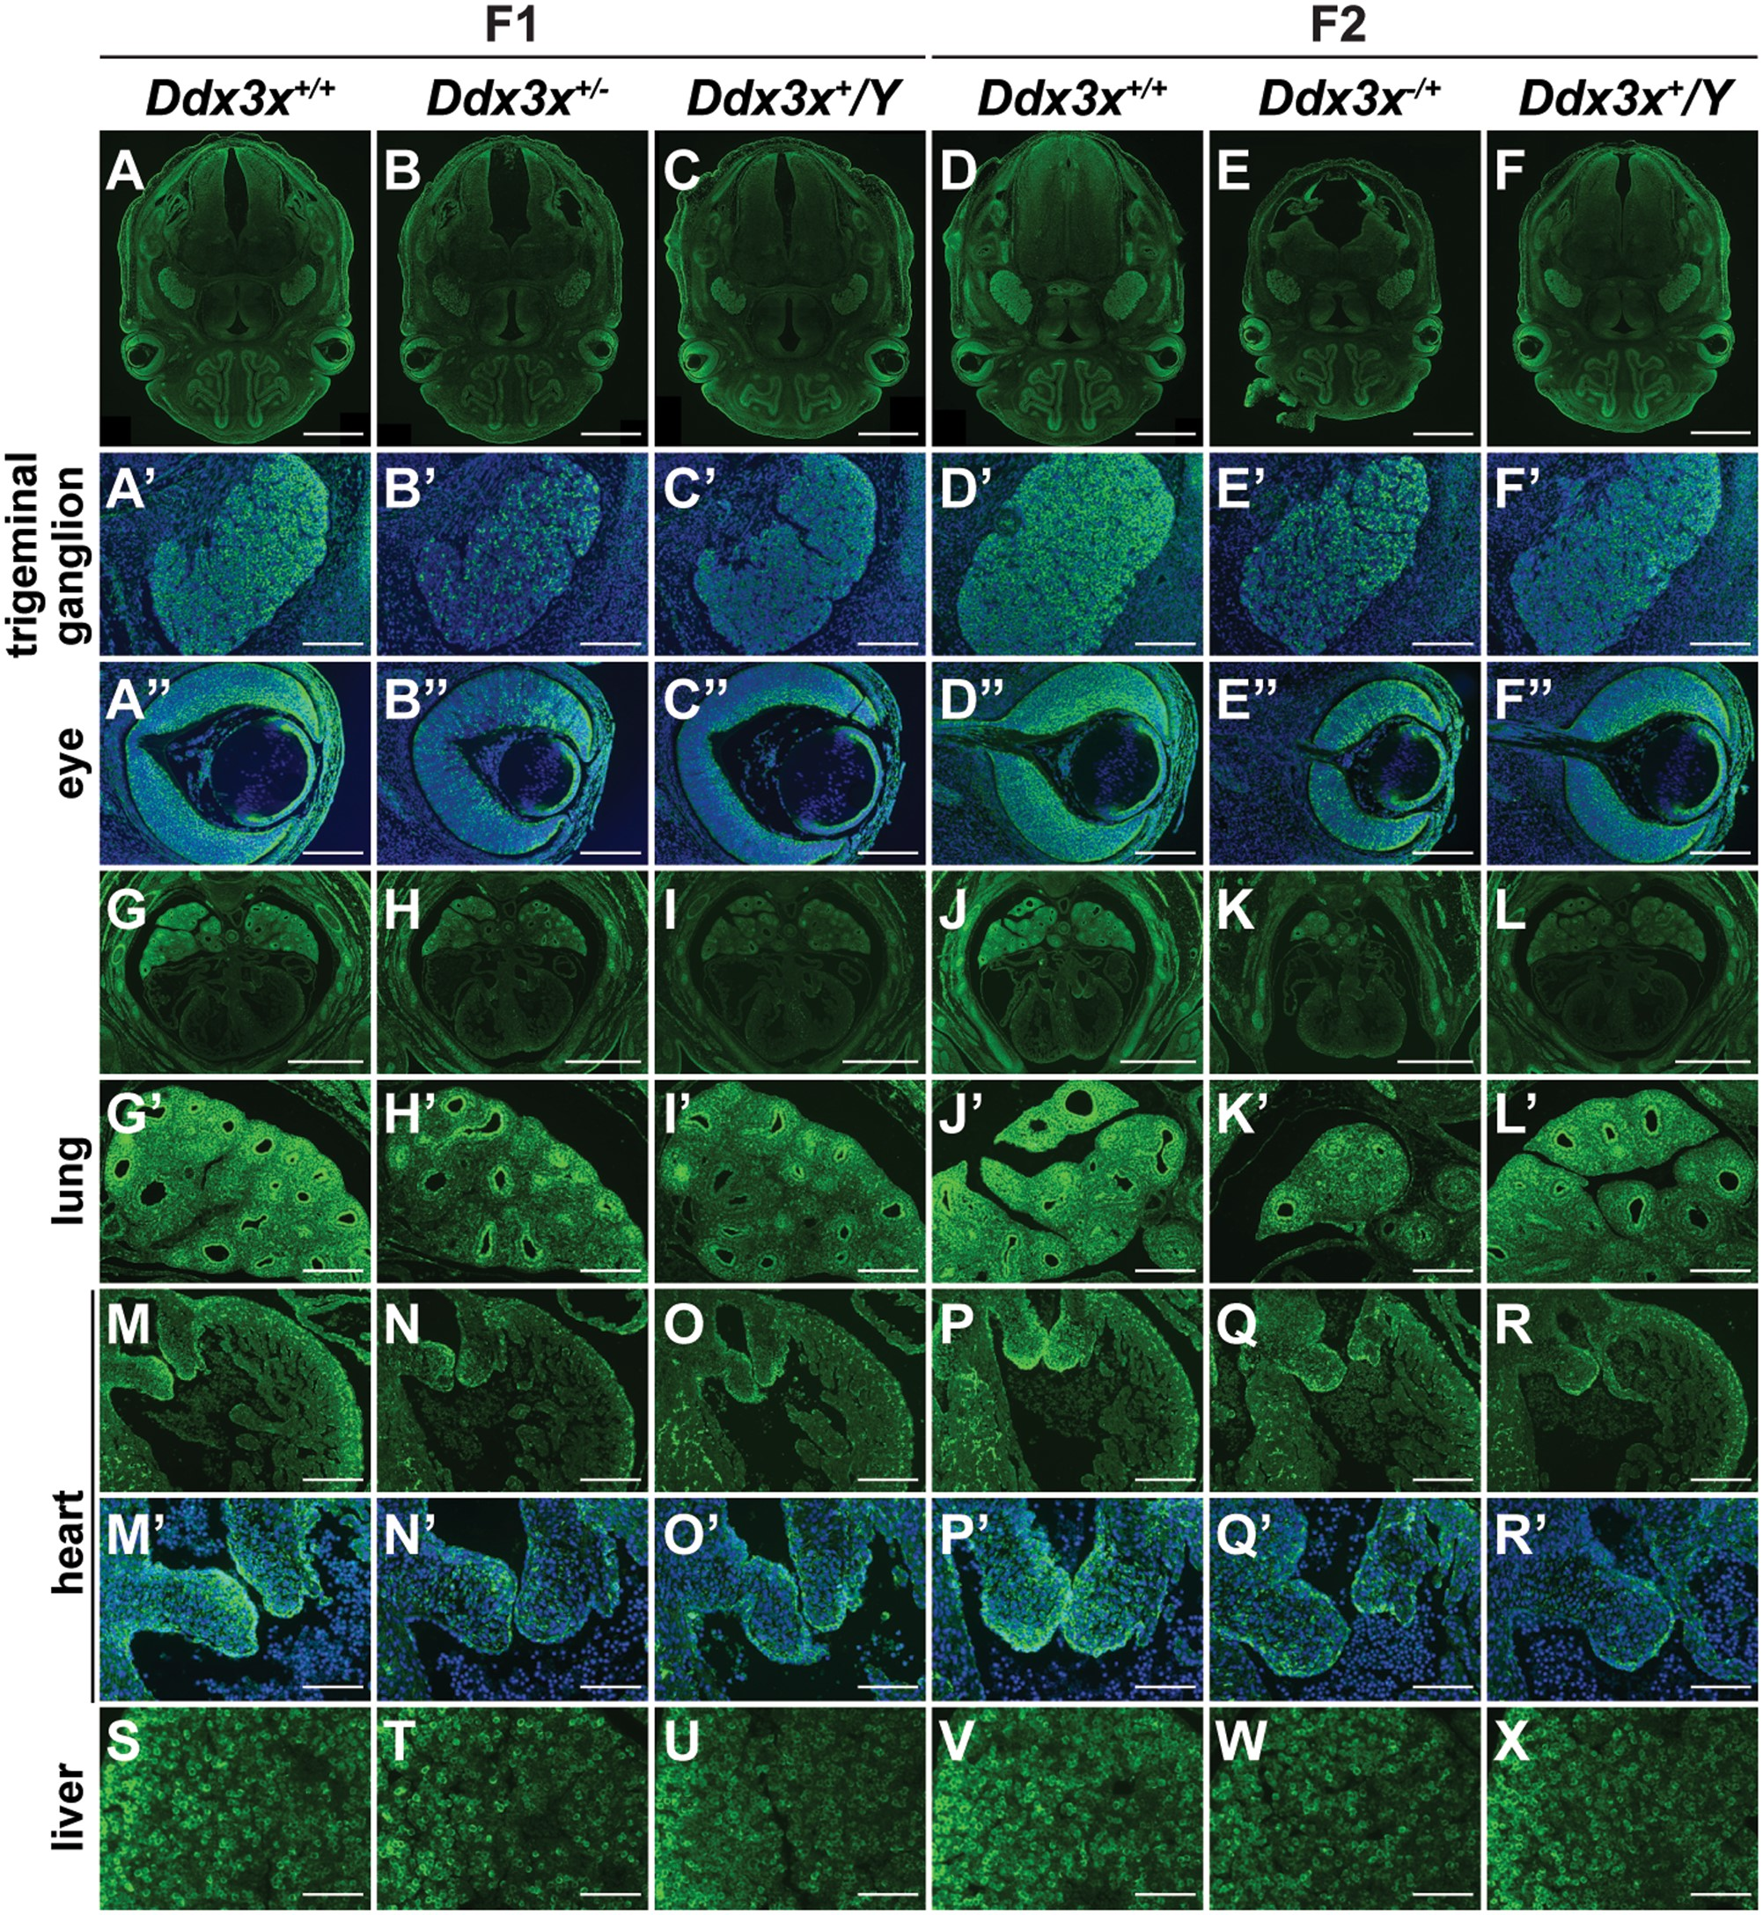
Figure 6. Ddx3x exhibits tissue-specific differences in escape from XCI. Immunohistochemical analysis of E14.5 ...
Notes:
Figure 6. Ddx3x exhibits tissue-specific differences in escape from XCI. Immunohistochemical analysis of E14.5 embryonic tissues from F1 and F2 generations. Ddx3x is ubiquitously expressed in multiple cell types of different tissues and organs, including brain, trigeminal ganglion, eye, nasal cavity, lung, heart and liver, as visualized by anti-Ddx3x immunostaining. Higher Ddx3x expression levels in Ddx3x+/+ females (A, D, G and J) than in Ddx3x+/Y males (C, F, I and L) confirmed that Ddx3x escapes from XCI in females. Ddx3x protein levels in both heterozygous Ddx3x+/−(B and H) and Ddx3x−/+ (E and K) females were lower than their Ddx3x+/+ female littermates. The cells with very low or no detectable Ddx3x signal were randomly distributed in trigeminal ganglions and neural retina of eyes in Ddx3x+/−(B’ and B”) and Ddx3x−/+ (E’ and E”) females. Trigeminal ganglion and eye in A-F are shown at higher magnification in A’−F’ and A”−F”, respectively. Ddx3x was expressed at high level in the lung compared with the heart (G−L). We noted the heterogeneous expression of Ddx3x in the lung. Ddx3x were expressed at high levels mainly in the distal epithelium and mesenchyme (G’−L’). The expression levels and patterns of Ddx3x in Ddx3x+/−(H’) and Ddx3x−/+ (K’) lungs were comparable to those in the Ddx3x+/Y(I’ and L’) males. The relative levels of Ddx3x in the chamber endocardium and the cushion endocardium and mesenchymal cells were higher in the heart (M−R). As shown in mitral valves (M’−R’), the cells with very low Ddx3x signal were randomly distributed in Ddx3x+/−(N’) and Ddx3x−/+ (Q’) females. Lung and heart in G−L are shown at higher magnification in G’−L’ and M−R’, respectively. Mitral valves in M−R are shown at higher magnification in M’−R’. The expression of Ddx3x in the liver was heterogeneous and showed no significant differences in Ddx3x+/−(T) and Ddx3x−/+ (W) females compared with their littermates. The nuclei were counterstained with DAPI (blue). Scale bars, 1 mm (A−F, G−L); 200 μm (A’−F”, G’−R); 100 μm (M’−X).
Unless provided in the caption above, the following copyright applies to the content of this slide: © The Author 2016. Published by Oxford University Press. All rights reserved. For permissions, please e-mail: journals.permissions@oup.com

Slide 6
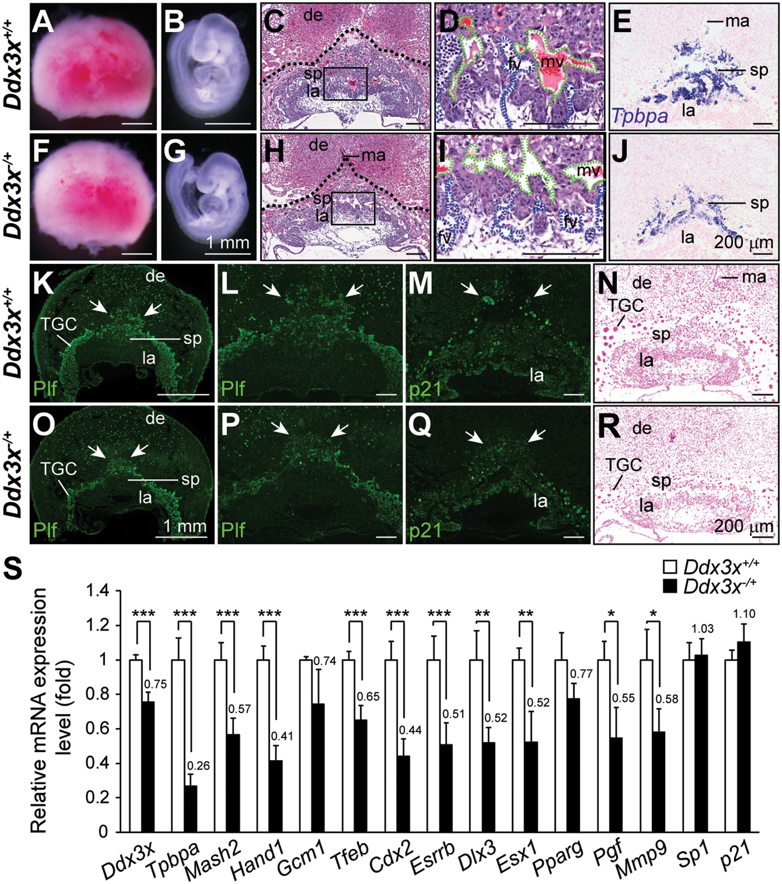
Figure 5. Loss of Ddx3x in Ddx3x^{−/+} extraembryonic tissues leads to abnormal placental development and ...
Notes:
Figure 5. Loss of Ddx3x in Ddx3x−/+ extraembryonic tissues leads to abnormal placental development and marker gene expression. Representative images of placentas and embryos from E9.5 Ddx3x+/+ littermates and Ddx3x−/+ mutants. Placentas from Ddx3x+/+ littermate (A) and Ddx3x−/+ mutant (F) were similar in size, whereas the Ddx3x−/+ embryo (G) was slightly smaller than that of the littermate (B). H&E stained placental sections from E9.5 Ddx3x−/+ mutant (H) showed relatively fewer spongiotrophoblast cells than that in littermate control (C). Dotted lines demarcate the outer placental surface. Boxed areas in C and H are shown at higher magnification in D and I, respectively. Branching morphogenesis of the chorioallantoic interface was apparent in placenta from Ddx3x+/+ control (D). Fetal vessels (filled with nucleated embryonic erythrocytes, blue dashed lines) were juxtaposed with maternal blood vessels (filled with enucleated erythrocytes, green dashed lines). Fetal vessels remained in the chorioallantoic plate region of mutant Ddx3x−/+ placenta (I). Tpbpa-expressing cells localized almost exclusively to the spongiotrophoblast layer of Ddx3x+/+ littermate placenta (E). An apparent reduction in Tpbpa-expressing cells was observed in Ddx3x−/+ placenta (J). Characterization of trophoblast cells in E9.5 placentas. The populations of Plf-positive primary and secondary TGCs (indicated by white arrows) were decreased in Ddx3x−/+ placenta (O) than those in littermate control (K). The distribution of outer TGC layer in Ddx3x−/+ placenta (arrows, P) was less protrusive than those in littermate control (L). The expression of p21 was detected in all three trophoblast layers of Ddx3x+/+ placenta: the outer TGC layer, spongiotrophoblast and labyrinth layer (M). The p21-positive nuclei (arrows) in secondary TGCs surrounding the spongiotrophoblast layer in Ddx3x−/+ placenta were smaller, while the expression of p21 in labyrinth layer was not altered (Q). Feulgen-stained placental sections showed the size of the nuclei and the staining intensities of TGCs were reduced in Ddx3x−/+ placenta (R) compared with the Ddx3x+/+ placenta (N). (S) Quantitative RT-PCR analysis of Ddx3x and marker genes in placentas from E9.5 Ddx3x+/+ and Ddx3x−/+ embryos. n = 7 per group. Error bars indicate SEM; *P < 0.05, **P< 0.01, ***P < 0.005. de, decidua; fv, fetal vessel; la, labyrinth; ma, maternal artery; mv, maternal vessel; sp, spongiotrophoblast; TGC, trophoblast giant cell. Scale bars, 1 mm (A, B, F, G, K, O); 200 μm (C−E, H−J, L−N, P−R).
Unless provided in the caption above, the following copyright applies to the content of this slide: © The Author 2016. Published by Oxford University Press. All rights reserved. For permissions, please e-mail: journals.permissions@oup.com

Slide 7
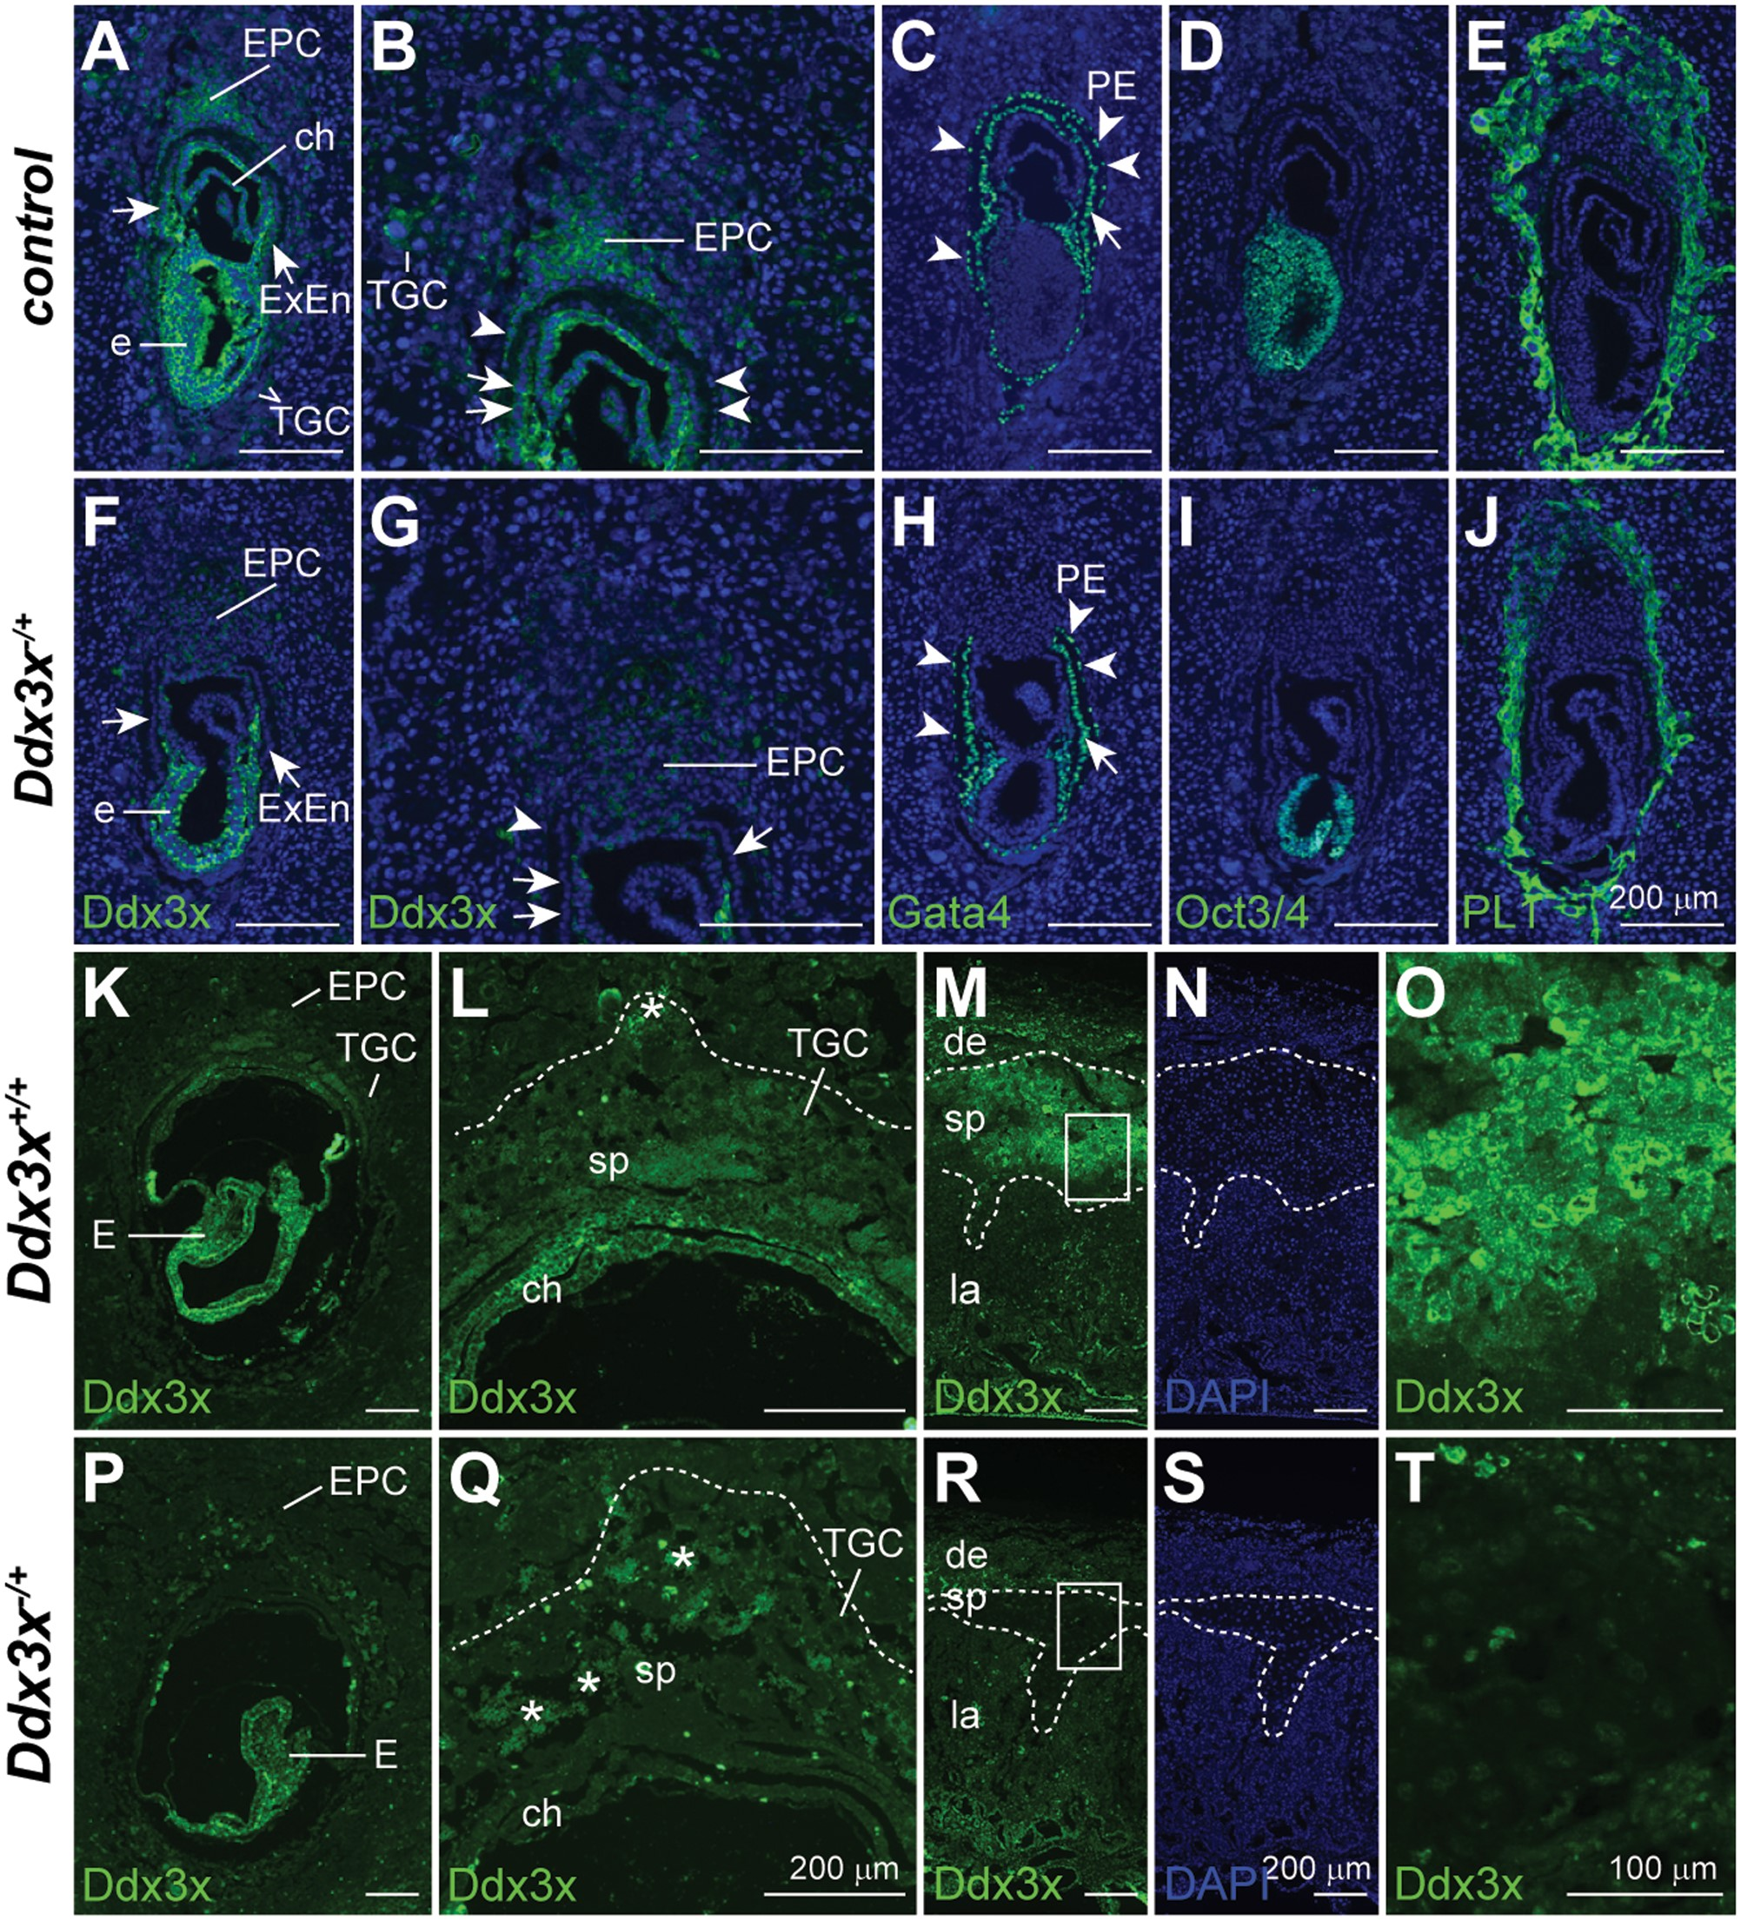
Figure 4. Paternally derived Ddx3x is preferentially inactivated in extraembryonic tissues of Ddx3x<sup>−/+ ...
Notes:
Figure 4. Paternally derived Ddx3x is preferentially inactivated in extraembryonic tissues of Ddx3x−/+ female embryos. Immunofluorescence analyses of Ddx3x, Gata4, Oct3/4, and PL1 expression in serial sections of E7.5 implantation sites. High Ddx3x levels were detected in embryos and extraembryonic tissues (EPC, chorion, extraembryonic endoderm, and parietal endoderm) in controls. Weak Ddx3x expression was observed in TGCs (A). Ddx3x levels were moderately reduced in Ddx3x−/+ embryo proper (F), whereas Ddx3x was significantly reduced in extraembryonic tissues of Ddx3x−/+ embryos compared with those of Ddx3x+/+ littermates (A). Higher magnification of E7.5 EPC areas in A and F are shown in (B) and (G), respectively. Gata4 expression was used to identify the visceral endoderm (arrows) and parietal endoderm (arrowhead) in control (C) and Ddx3x−/+ (H) embryos. Anti-Oct3/4 antibody specifically stained the epiblasts of control (D) and Ddx3x−/+ (I) embryos. PL1-positive trophoblast cells in Ddx3x−/+ implantation site (J) were less protrusive than those in littermate control (E). Nuclei were stained with DAPI (blue). Immunohistochemical analysis of Ddx3x in E8.5 implantation sites (K, L, P and Q) and E16.5 placentas (M−O and R−T) from Ddx3x+/+ and Ddx3x−/+ embryos. The expression of Ddx3x is relative higher in embryo than in the extraembryonic tissues (K). In Ddx3x−/+, the levels of Ddx3x in embryo was slightly lower than the littermate control, however, the protein was uniformly distributed in all embryonic cells (P). Ddx3x is moderately expressed in EPC, while weak expression was observed in TGCs in Ddx3x+/+ implantation site (K). In the Ddx3x−/+ extraembryonic tissues, the expression of Ddx3x was significantly reduced, specifically in EPC (P and Q). Higher magnification of EPC regions in K and P are shown in L and Q, respectively. Dotted lines demarcate the outer border of TGC layer. Asterisks indicate the autofluorescence from blood cells. At E16.5 placenta, Ddx3x expression was highest in spongiotrophoblast layer, albeit not at uniform levels in all cells. Expression levels of Ddx3x were very low, but detectable, in the decidua and labyrinth layer (M). Consistently, the expression of Ddx3x in the spongiotrophoblast layer was significantly reduced in Ddx3x−/+ placenta (R) compared with Ddx3x+/+ littermate (M). Dotted lines demarcate the boundary of spongiotrophoblast layer of the placenta. Boxed areas in M and R are shown at higher magnification in O and T, respectively. The nuclei were counterstained with DAPI (N and S). ch, chorion, de, decidua; E, embryo; EPC, ectoplacental cone; ExEn, extraembryonic endoderm; la, labyrinth; PE, parietal endoderm; sp, spongiotrophoblast; TGC, trophoblast giant cell. Scale bars, 200 μm (A−N, P−S); 100 μm (O, T).
Unless provided in the caption above, the following copyright applies to the content of this slide: © The Author 2016. Published by Oxford University Press. All rights reserved. For permissions, please e-mail: journals.permissions@oup.com

Slide 8
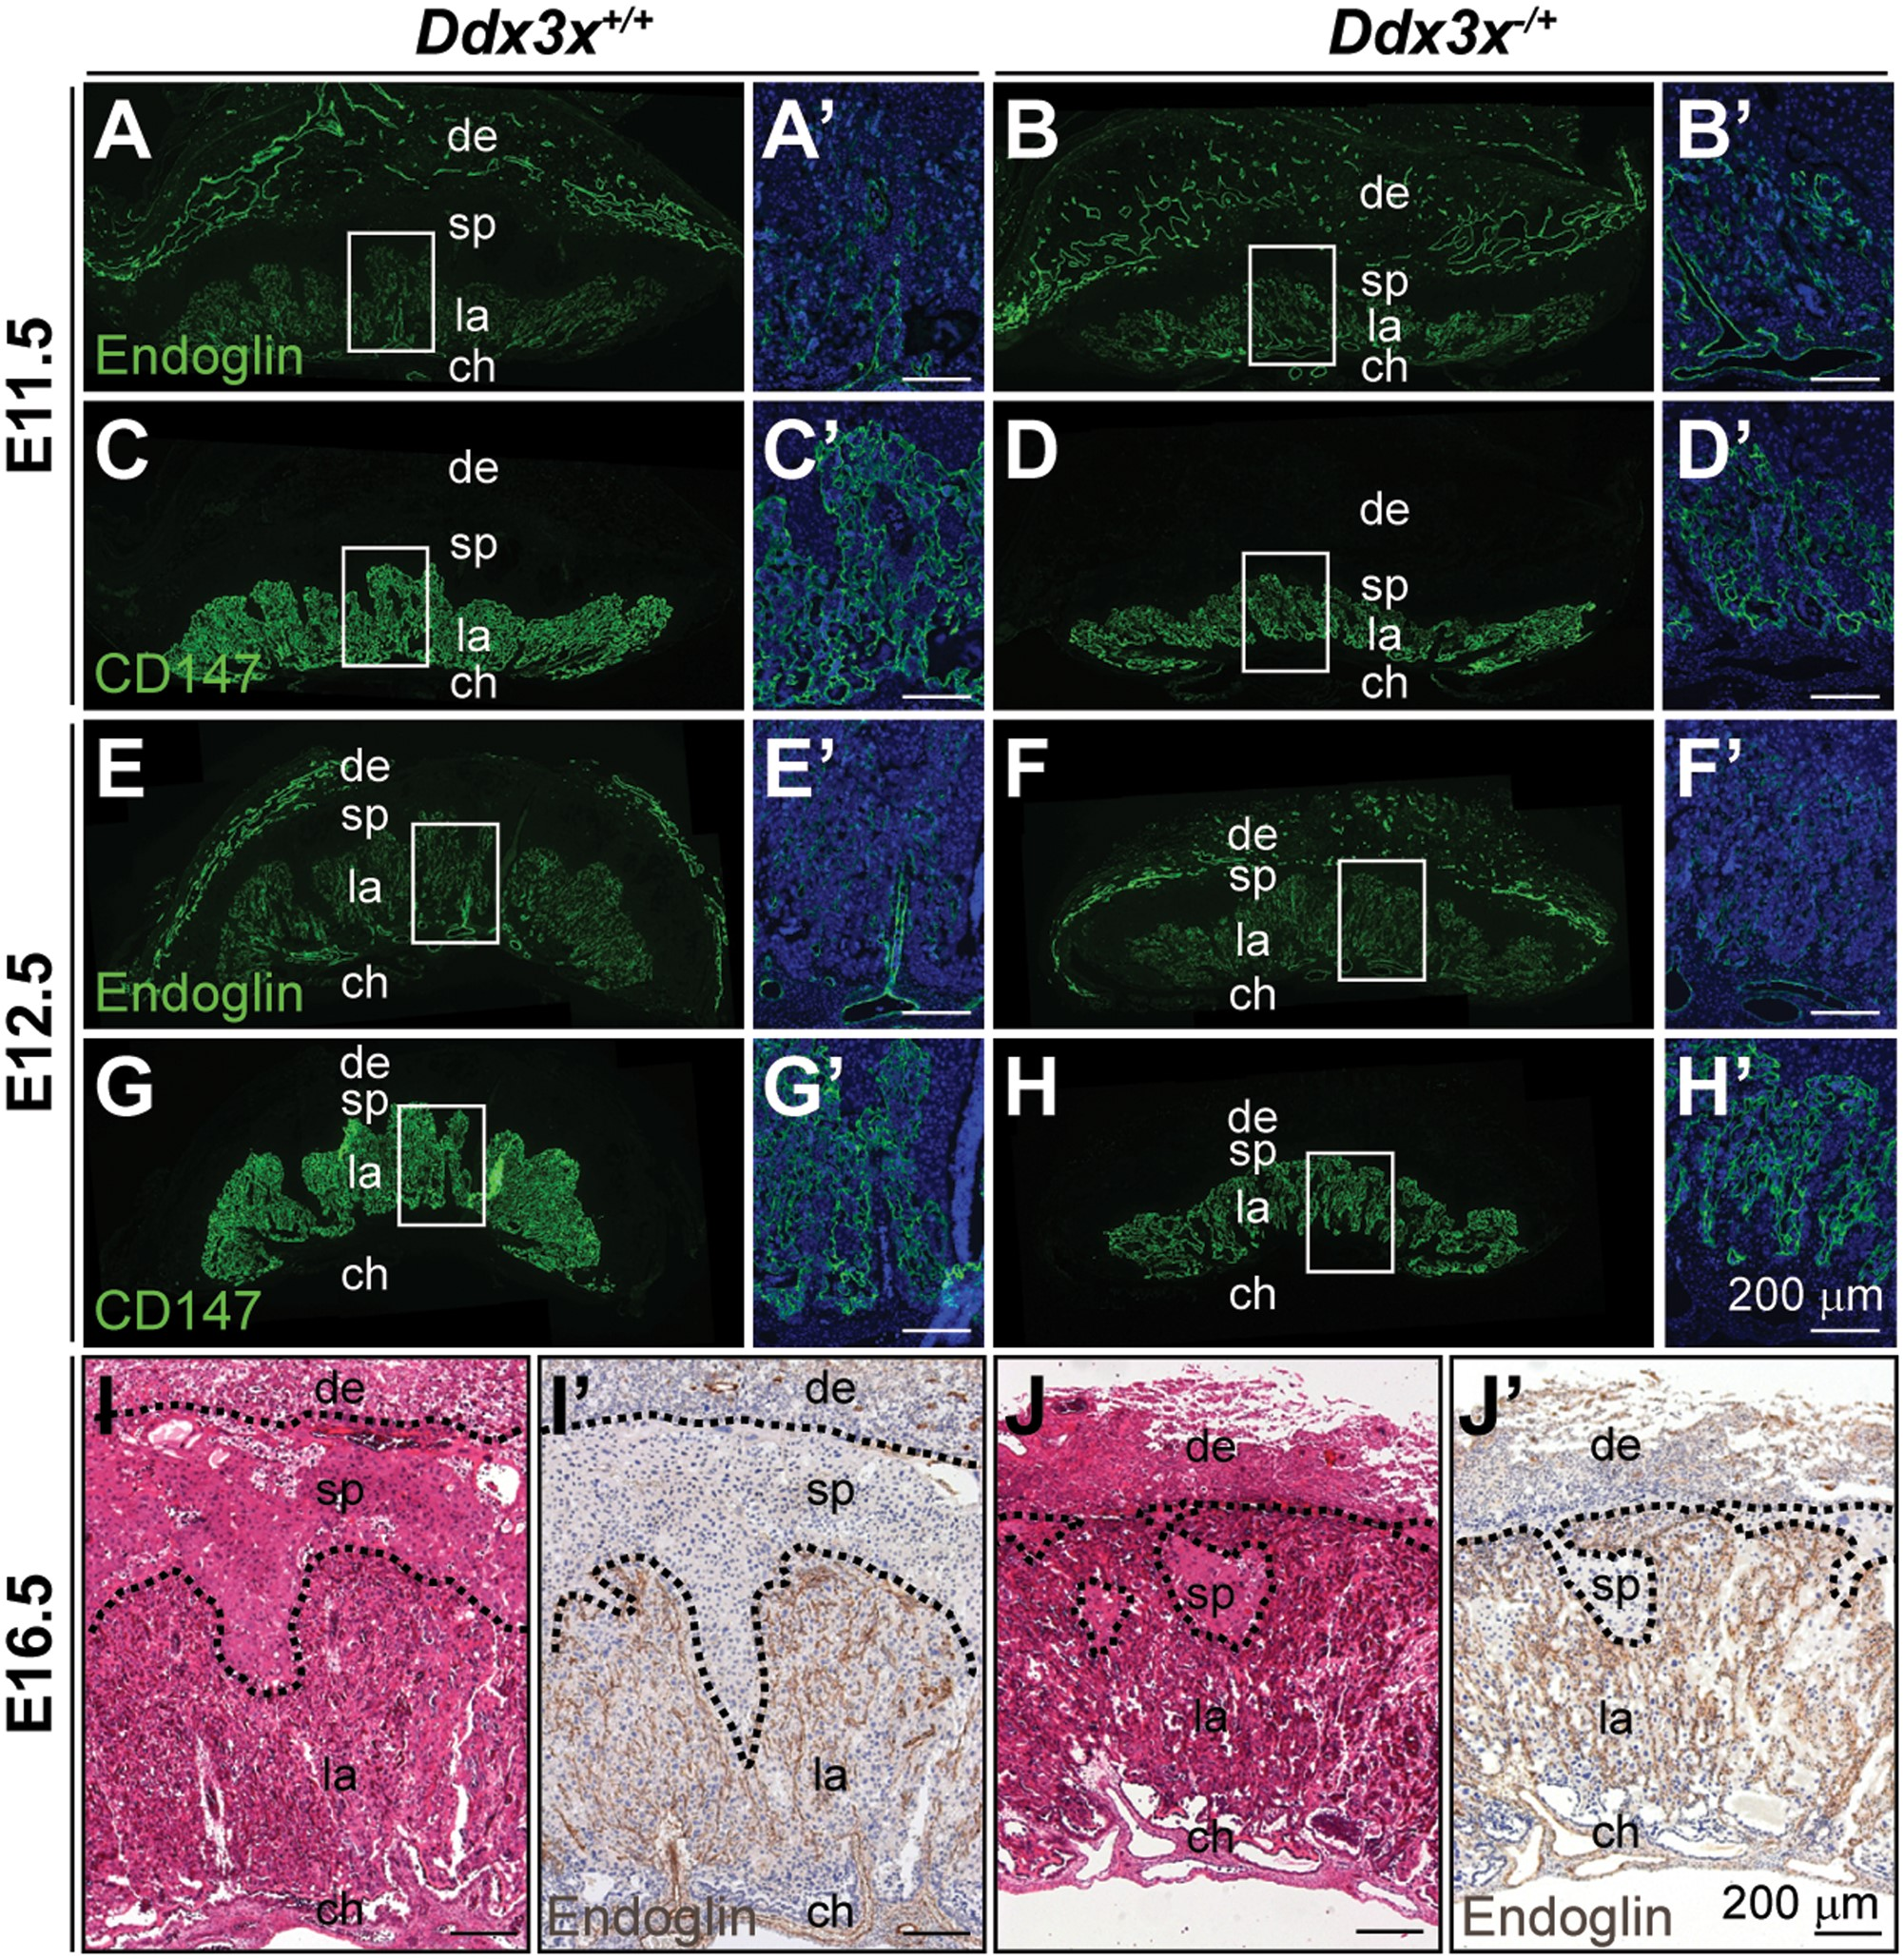
Figure 3. Abnormal labyrinth layer in Ddx3x^{−/+} placenta. Endoglin- (A−B’, E−F’, I’ and J’), CD147- (C−D’ and ...
Notes:
Figure 3. Abnormal labyrinth layer in Ddx3x−/+ placenta. Endoglin- (A−B’, E−F’, I’ and J’), CD147- (C−D’ and G−H’) and H&E- (I and J) stained placental sections from E11.5, E12.5, and E16.5 embryos. In placentas from Ddx3x+/+ controls, the labyrinth layers were well-developed revealed by endoglin-positive endothelial cells (A, E and I’) and CD147-positive trophoblasts (C and G), as gestation progressed. Placentas from Ddx3x−/+ embryos (B, D, F, H and J’) were underdeveloped with thinner and less organized labyrinth layers. Boxed areas in A−H are shown at higher magnification in A’−H’, respectively. The nuclei were counterstained with DAPI. ch, chorion, de, decidua; la, labyrinth; sp, spongiotrophoblast. Scale bar, 200 μm.
Unless provided in the caption above, the following copyright applies to the content of this slide: © The Author 2016. Published by Oxford University Press. All rights reserved. For permissions, please e-mail: journals.permissions@oup.com

Slide 9
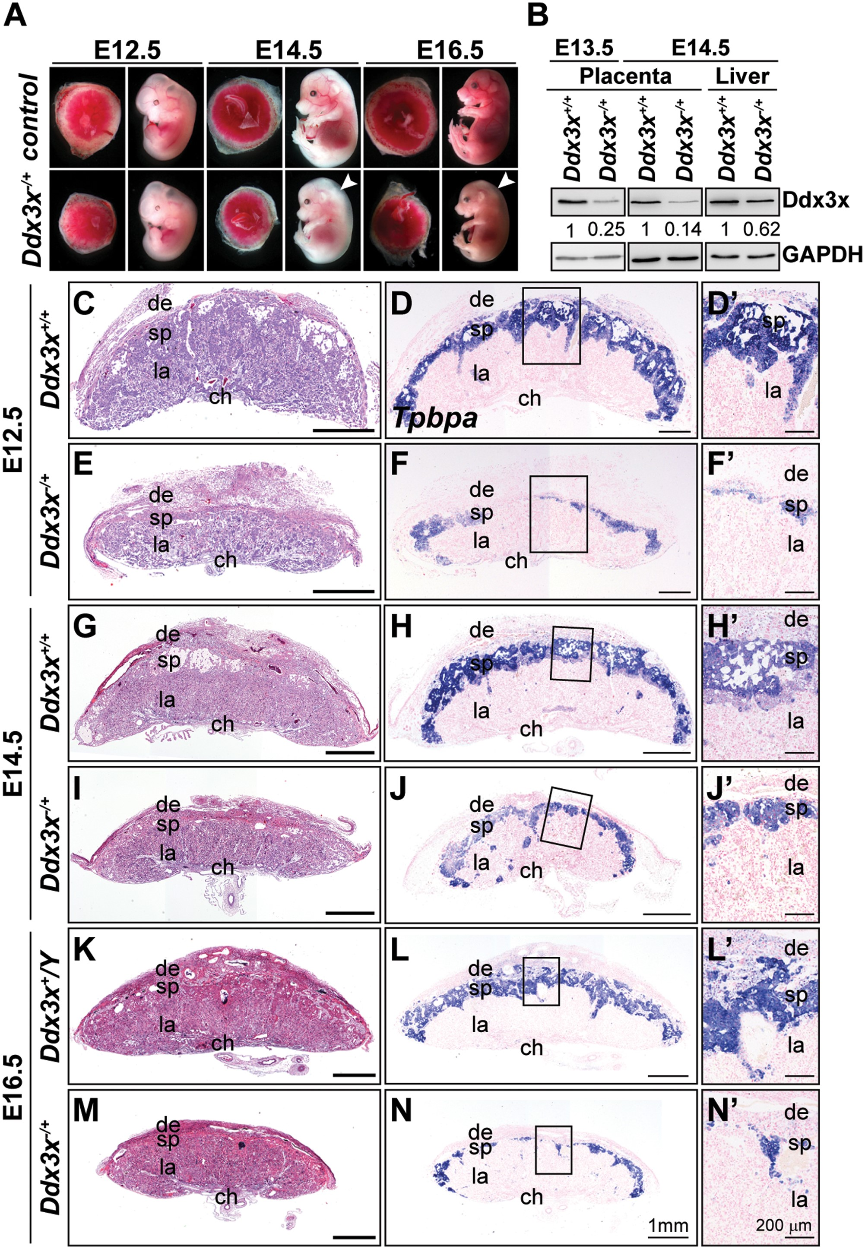
Figure 2. Targeted disruption of maternal Ddx3x allele causes placental defects and prenatal lethality in mice. (A) ...
Notes:
Figure 2. Targeted disruption of maternal Ddx3x allele causes placental defects and prenatal lethality in mice. (A) Whole-mount analysis of F2 Ddx3x−/+ mutant embryos and placentas. Representative images of wild-type littermates (Ddx3x+/+ and/or Ddx3x+/Y) and viable Ddx3x−/+ mutants at E12.5, E14.5, and E16.5. White arrowheads indicate whole body edema in Ddx3x−/+ mutants. (B) Ddx3x expression in placentas and livers from Ddx3x+/+ and Ddx3x−/+ embryos. Tissue extracts prepared from E13.5 and E14.5 Ddx3x+/+ littermates revealed the expected 72 kDa band, whereas Ddx3x expression levels in Ddx3x−/+ placentas were significantly reduced. GAPDH was used as the loading control. Relative Ddx3x protein levels were quantified using ImageJ software. (C−N’) Reduced thickness of spongiotrophoblast layers in mutant Ddx3x−/+ placentas. Hematoxylin and eosin (H&E)-stained midline placental sections from E12.5, E14.5, and E16.5 wild-type (C, G, K) and Ddx3x+/−(E, I, M) embryos. Placental size and spongiotrophoblast layer thickness are drastically reduced in the Ddx3x−/+ mutants compared with those of controls. RNA in situ hybridization analysis of a Tpbpa probe (blue) marks the spongiotrophoblast layer of placentas from wild-type (D, H, L) and Ddx3x−/+ mutants (F, J, N). A significant reduction in Tpbpa-expressing cells occurs in placentas from Ddx3x−/+ embryos. Higher magnification of boxed areas in D, F, H, J, L, and N are shown in D’, F’, H’, J’, L’, and N’, respectively. Nuclei were counterstained with nuclear fast red. ch, chorion; de, decidua; la, labyrinth; sp, spongiotrophoblast. Scale bars, 1 mm (C−N); 200 μm (D’−N’).
Unless provided in the caption above, the following copyright applies to the content of this slide: © The Author 2016. Published by Oxford University Press. All rights reserved. For permissions, please e-mail: journals.permissions@oup.com

