Slide 1
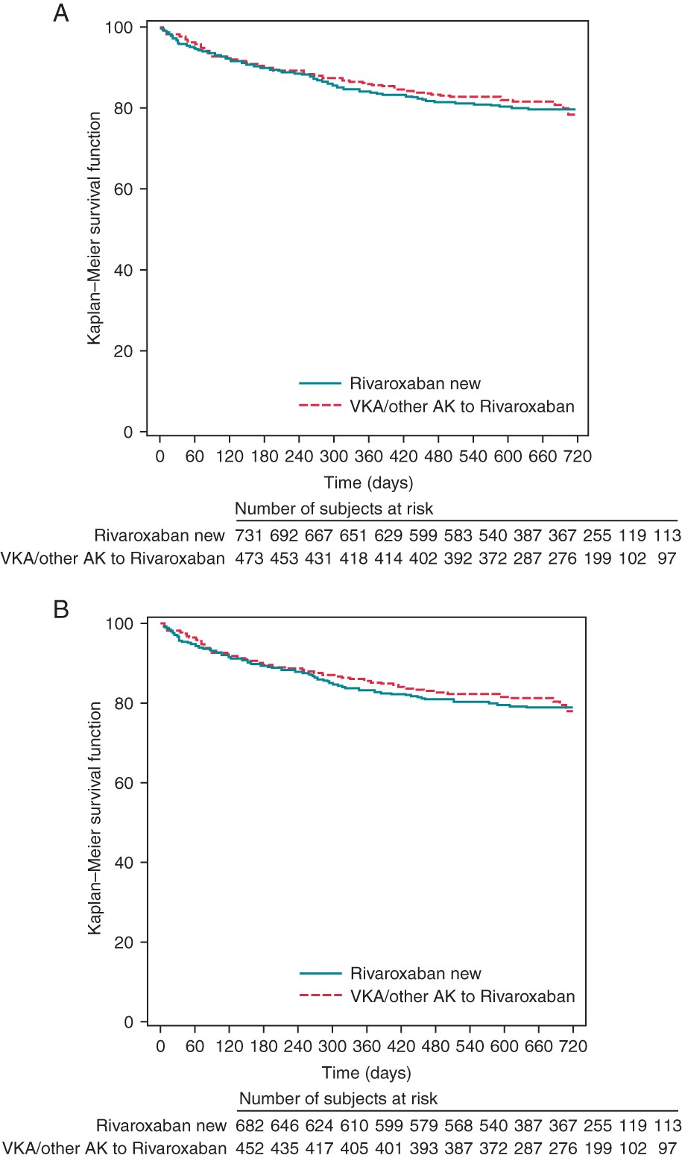
Figure 1 Kaplan–Meier analysis of persistence to rivaroxaban treatment for all patients (A) and for all patients who ...
Notes:
Figure 1 Kaplan–Meier analysis of persistence to rivaroxaban treatment for all patients (A) and for all patients who were observed for at least 12 months (B), according to VKA pre-treatment.
Unless provided in the caption above, the following copyright applies to the content of this slide: Published on behalf of the European Society of Cardiology. All rights reserved. © The Author 2015. For permissions please email: journals.permissions@oup.com

