Slide 1
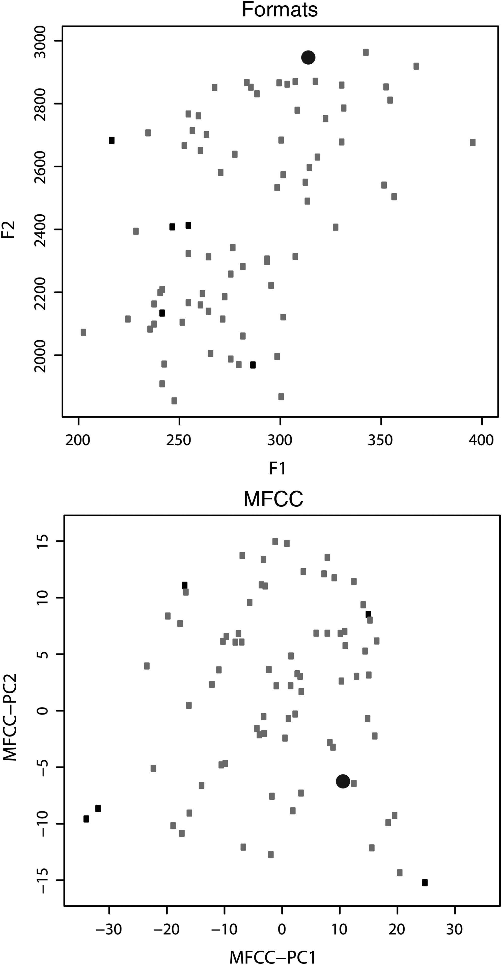
Figure 1. Stimulus selection procedure. Example of segment selection for one given syllable. The upper panel shows the ...
Notes:
Figure 1. Stimulus selection procedure. Example of segment selection for one given syllable. The upper panel shows the configuration of distances obtained by calculating f1 and f2, whereas the lower panel is relative to the distances derived by the principal component of MFCC method (only the first 2 of 15 principal components are plotted), The gray rectangles represent all segments from all speakers for the [di] syllable, the black dot is the starting segment selected for the iterative maximization algorithm, and the black rectangles represent the other segments chosen by the integration of the 2 distance-based methods.
Unless provided in the caption above, the following copyright applies to the content of this slide: © The Author 2013. Published by Oxford University Press. All rights reserved. For Permissions, please e-mail: journals.permissions@oup.com

Slide 2
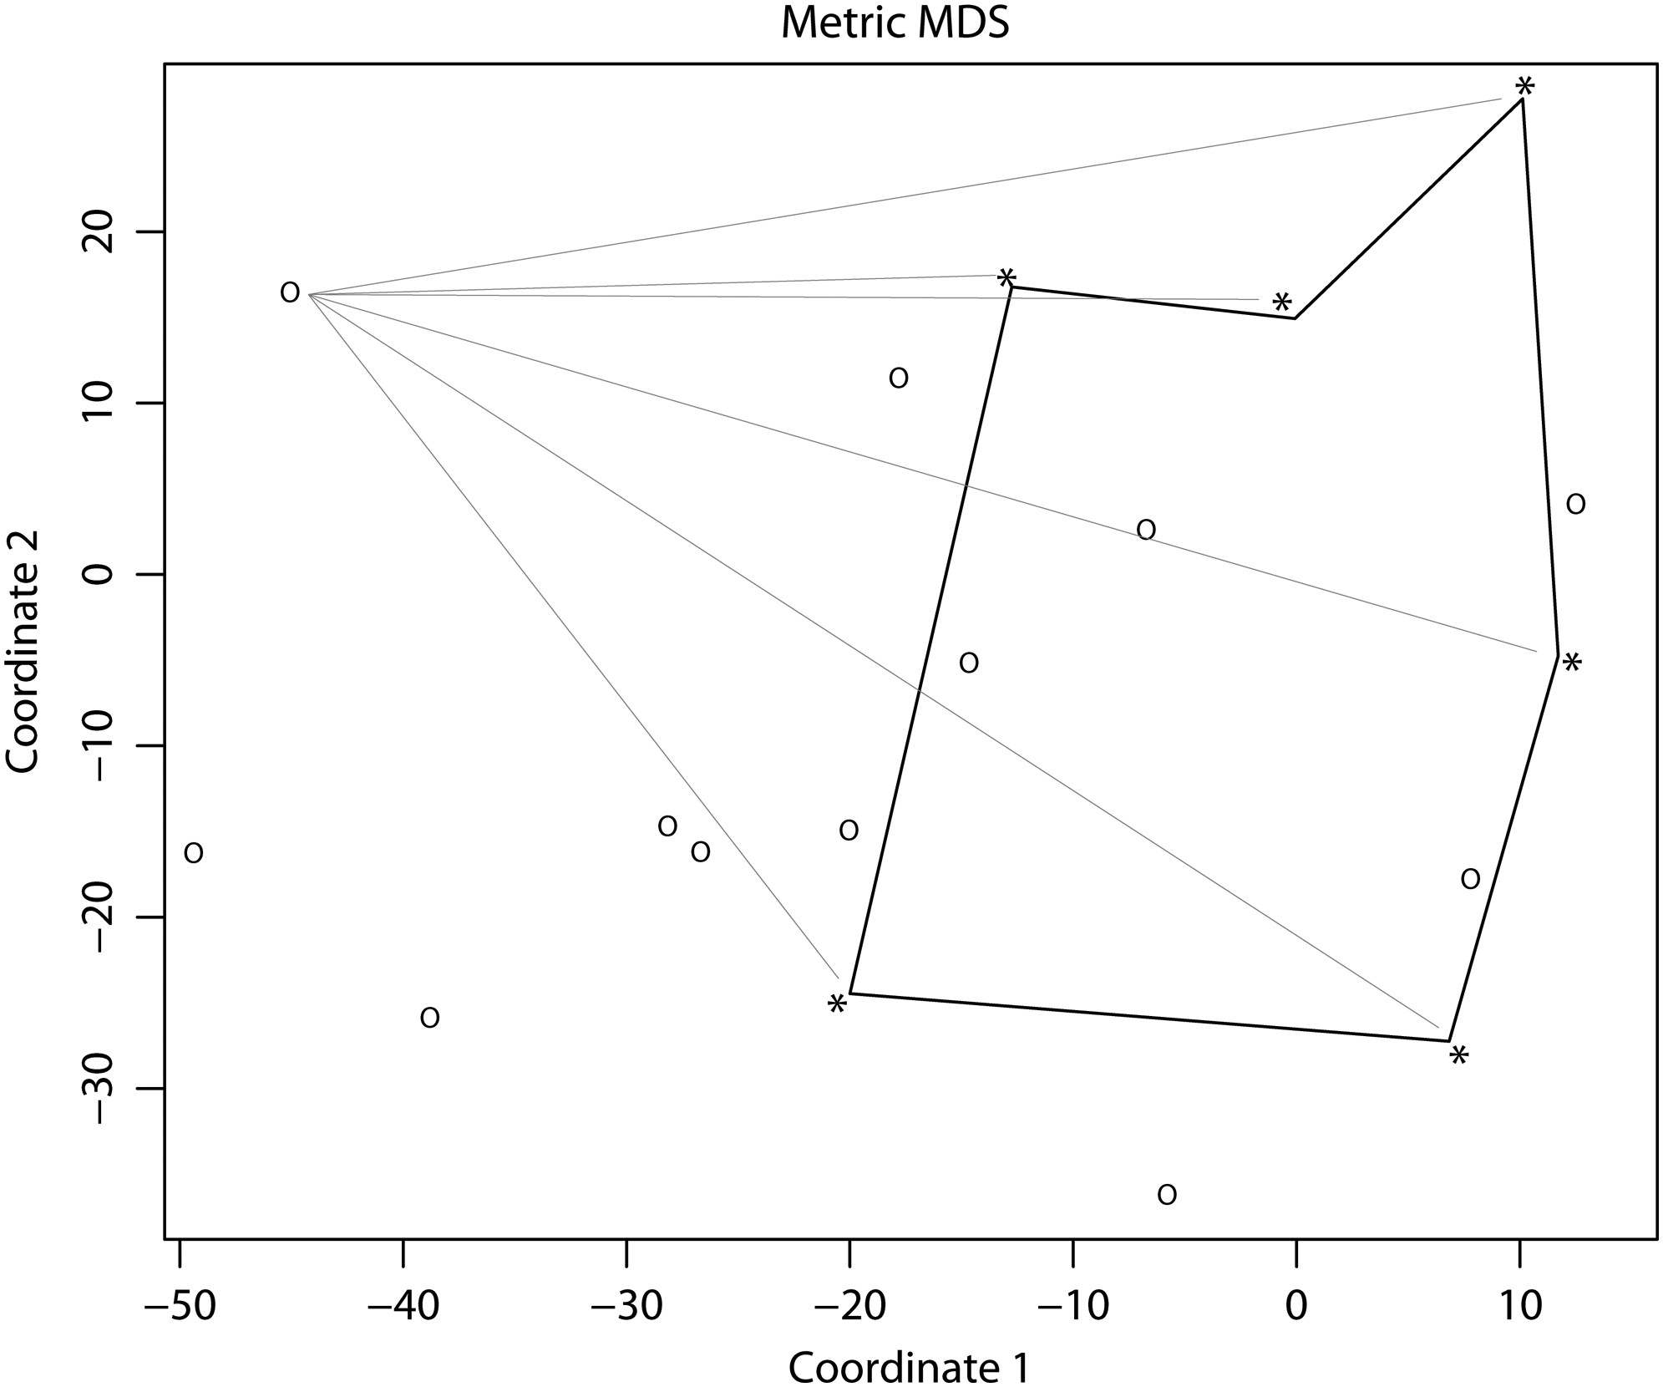
Figure 2. Subjective interspeaker distance calculation. Example of subjective interspeaker distance calculation for one ...
Notes:
Figure 2. Subjective interspeaker distance calculation. Example of subjective interspeaker distance calculation for one given syllable. The MDS procedures enable the projection of subjective distances on an arbitrary 2-dimensional space. Asterisks, bounded by black lines, represent speakers' vocal productions used as stimuli in the TMS study. Circles show the relative positions of TMS subjects' own vocal productions. Gray lines connect one representative subject to each TMS stimulus, thus representing the computation of distances between that subject and stimuli presented in the TMS study.
Unless provided in the caption above, the following copyright applies to the content of this slide: © The Author 2013. Published by Oxford University Press. All rights reserved. For Permissions, please e-mail: journals.permissions@oup.com

Slide 3
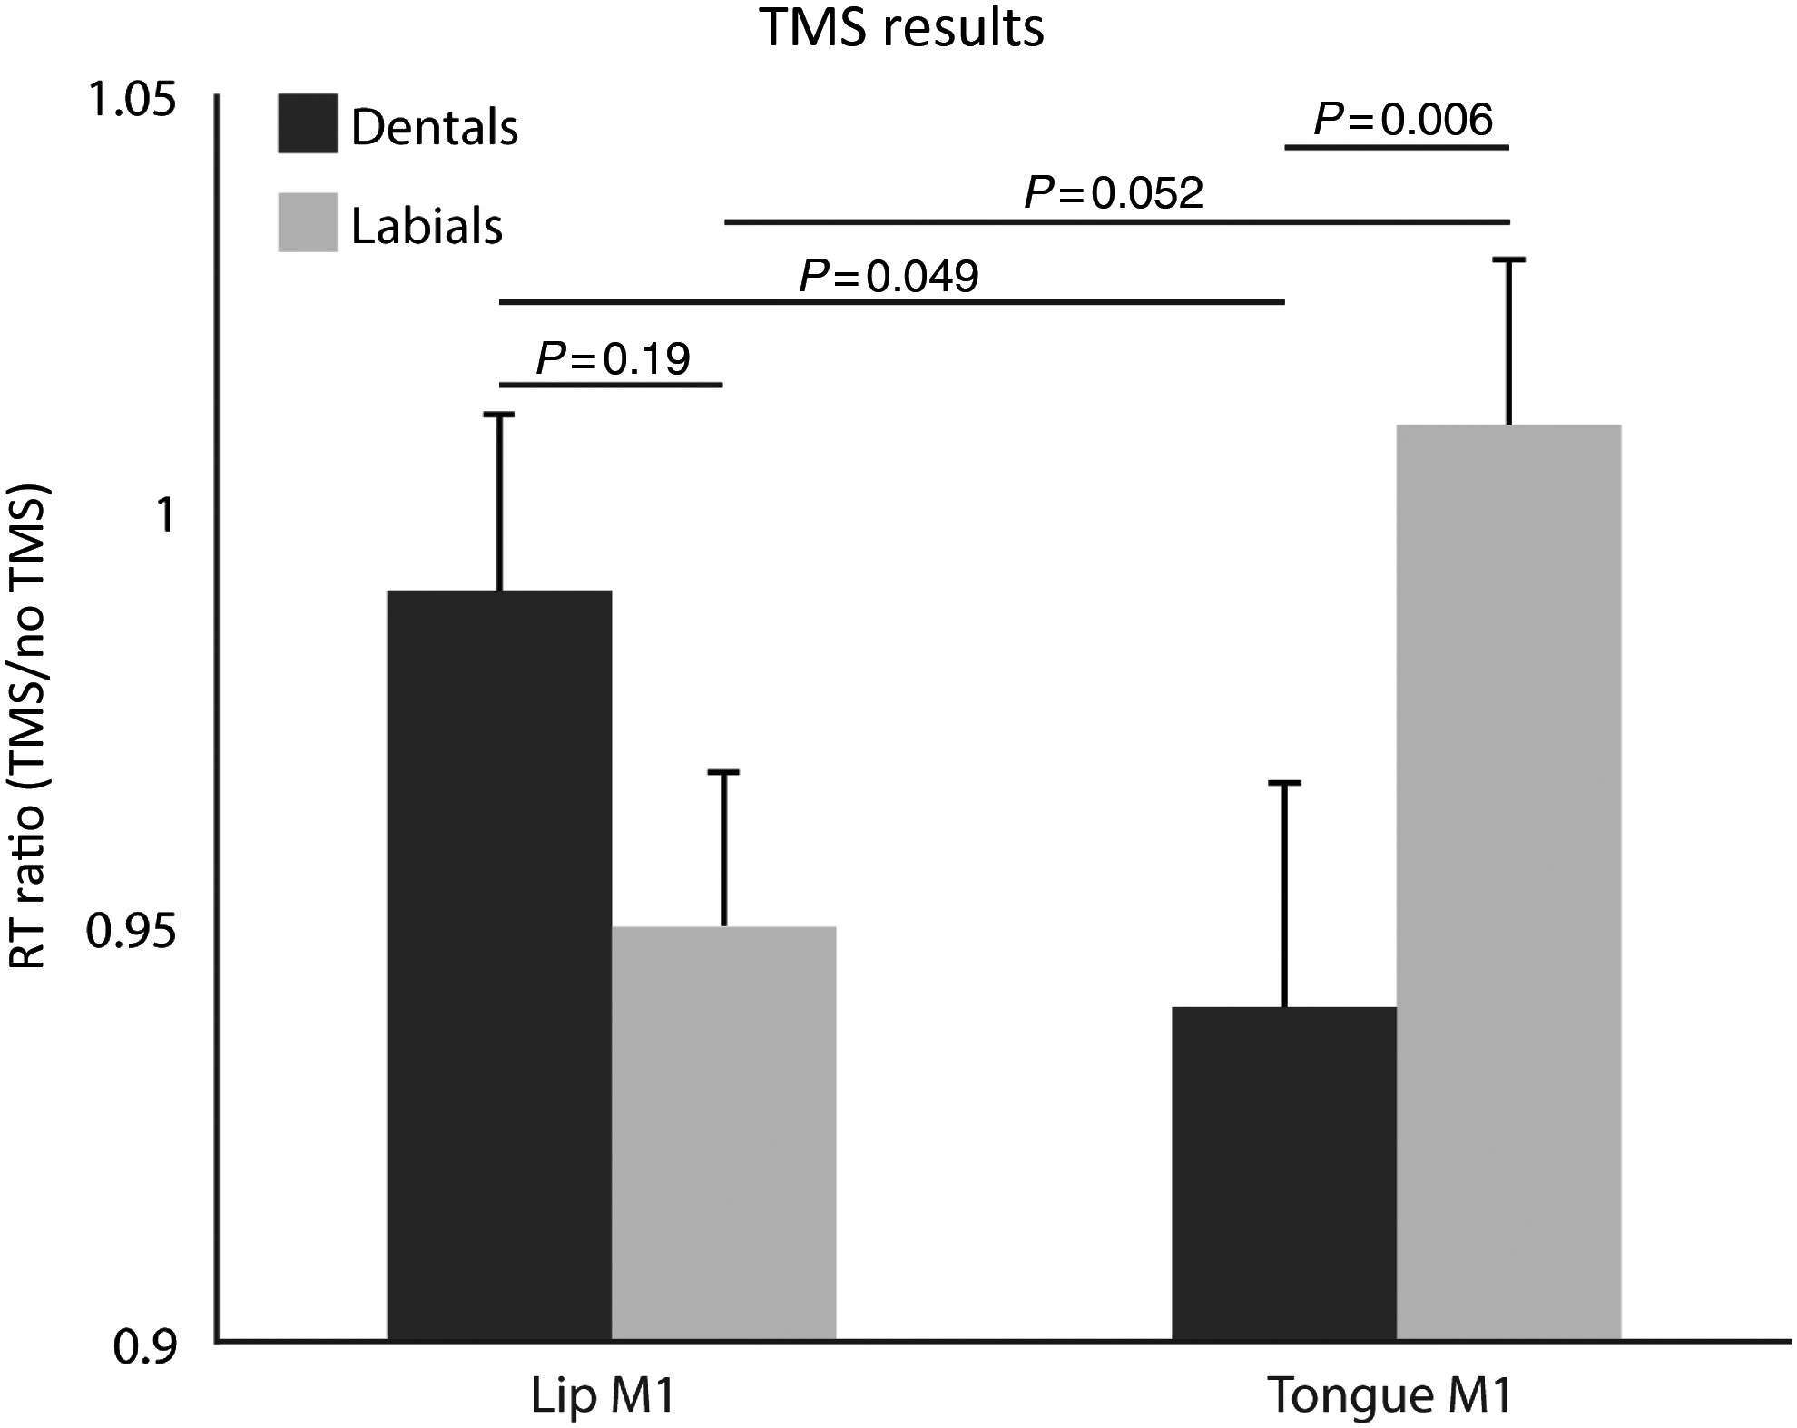
Figure 3. TMS results. Bar plots represent mean RTs (TMS/no-TMS ratio) for the syllable identification task. In the ...
Notes:
Figure 3. TMS results. Bar plots represent mean RTs (TMS/no-TMS ratio) for the syllable identification task. In the abscissa are shown the 2 sites of TMS (Lips M1 and Tongue M1). Dark gray bars represent the dental syllables ([da], [di], [ta], [ti]) and in light gray, the labial syllables ([pa], [pi], [ba], [bi]). Corrected P-values are shown for each post hoc comparison.
Unless provided in the caption above, the following copyright applies to the content of this slide: © The Author 2013. Published by Oxford University Press. All rights reserved. For Permissions, please e-mail: journals.permissions@oup.com

Slide 4
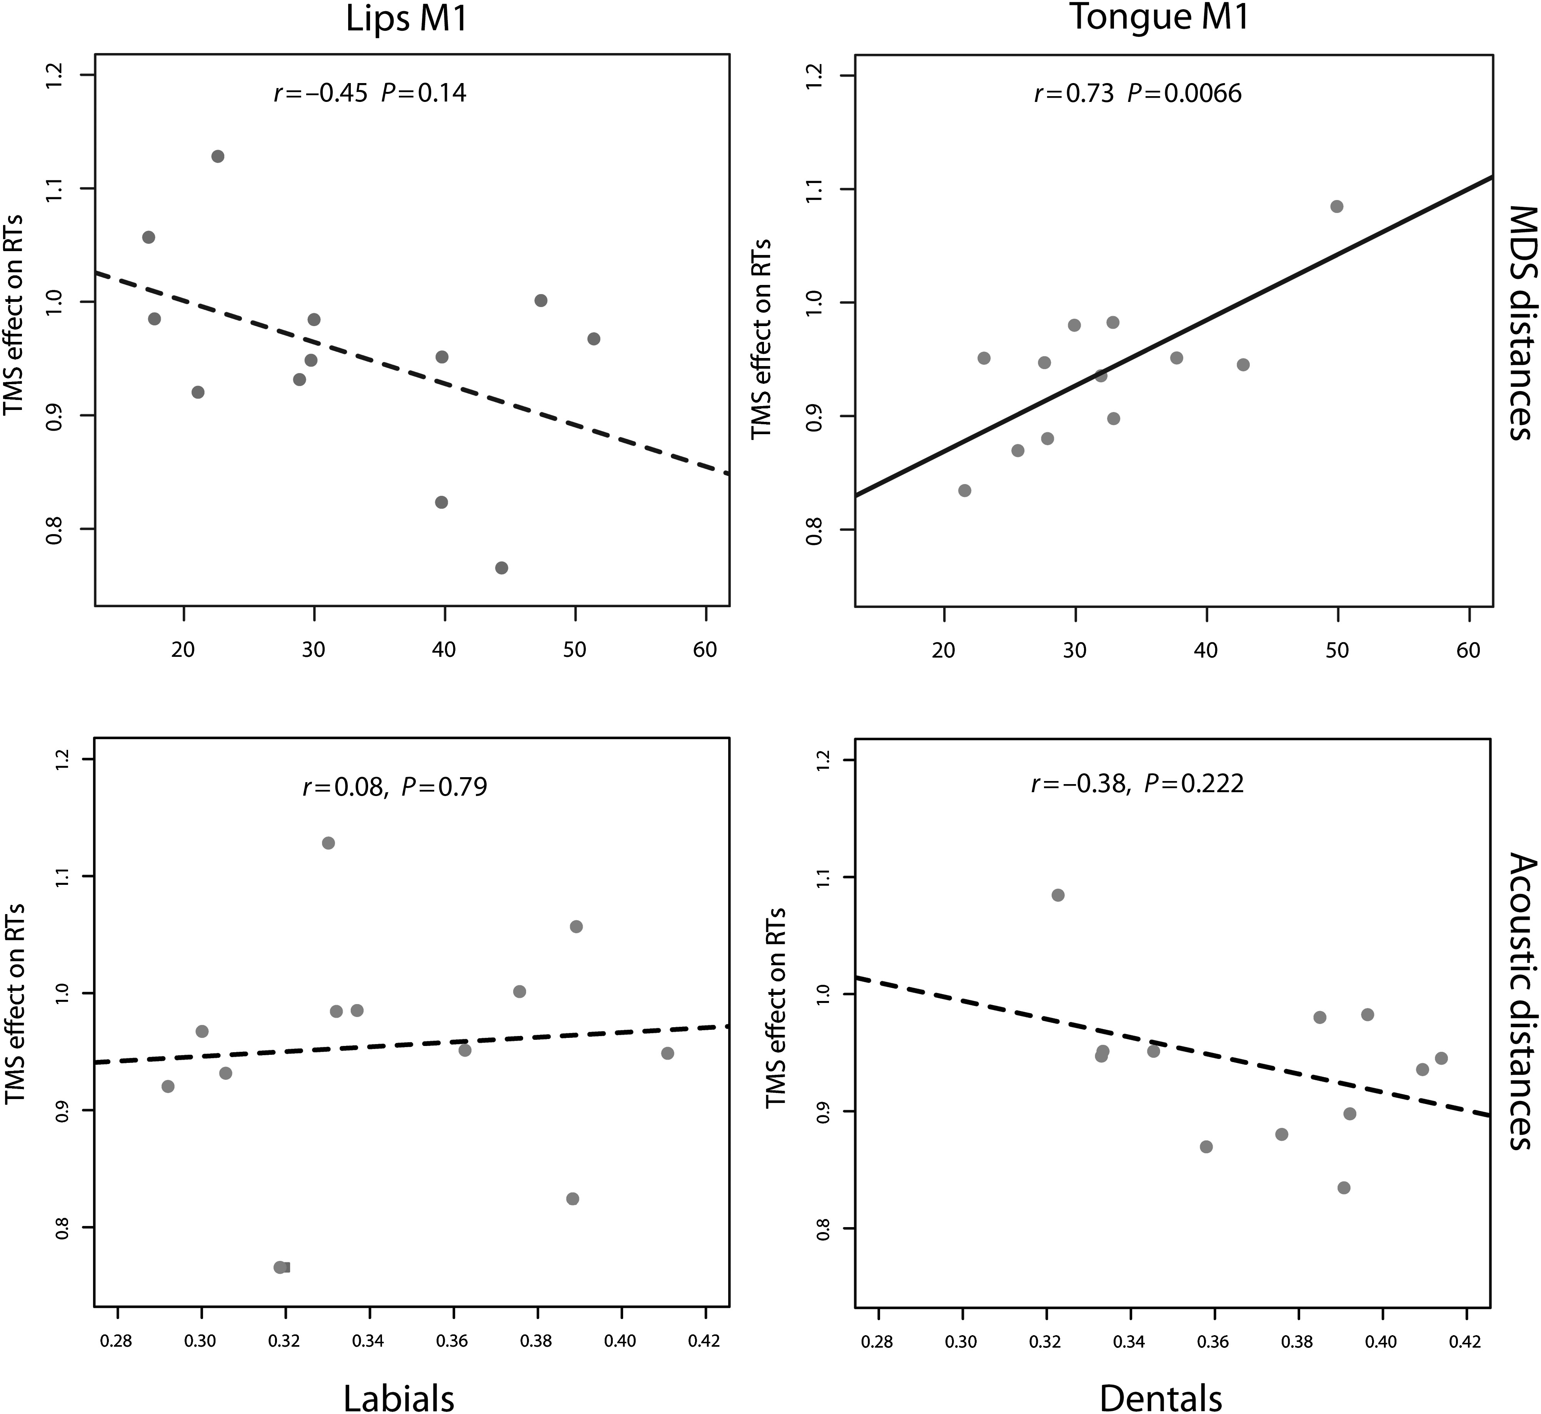
Figure 4. Correlation analyses. Correlation analyses between TMS effect on RTs (ratio between RTs in TMS and no-TMS ...
Notes:
Figure 4. Correlation analyses. Correlation analyses between TMS effect on RTs (ratio between RTs in TMS and no-TMS trials) and the distance measures. Upper panel (A) shows the correlation with the subjective distances (MDS procedure), whereas the lower one (B) shows the correlation with the objective acoustic measures. On the left side of both panels are represented the correlations during the stimulation of the Lips M1 and the labial syllables. On the right side instead are shown the correlations with the stimulation of Tongue M1 and dental stimuli.
Unless provided in the caption above, the following copyright applies to the content of this slide: © The Author 2013. Published by Oxford University Press. All rights reserved. For Permissions, please e-mail: journals.permissions@oup.com

