Slide 1
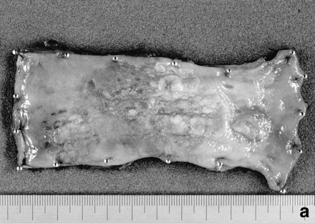
Figure l. Resected specimen of the first esophageal cancer. (a) The tumor was located in the lower esophagus ...
Notes:
Figure l. Resected specimen of the first esophageal cancer. (a) The tumor was located in the lower esophagus and measured 7.1 × 4.3 cm in size. (b) Histopathologically, it was diagnosed as well-differentiated squamous cell carcinoma with submucosal invasion (hematoxylin and eosin).
Unless provided in the caption above, the following copyright applies to the content of this slide:

Slide 2
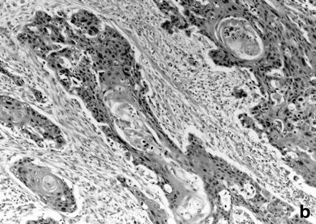
Figure l. Resected specimen of the first esophageal cancer. (a) The tumor was located in the lower esophagus ...
Notes:
Figure l. Resected specimen of the first esophageal cancer. (a) The tumor was located in the lower esophagus and measured 7.1 × 4.3 cm in size. (b) Histopathologically, it was diagnosed as well-differentiated squamous cell carcinoma with submucosal invasion (hematoxylin and eosin).
Unless provided in the caption above, the following copyright applies to the content of this slide:

Slide 3
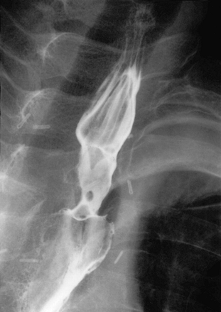
Figure 2. Barium meal demonstrating a round, smooth mass in the upper esophagus.
Notes:
Figure 2. Barium meal demonstrating a round, smooth mass in the upper esophagus.
Unless provided in the caption above, the following copyright applies to the content of this slide:

Slide 4
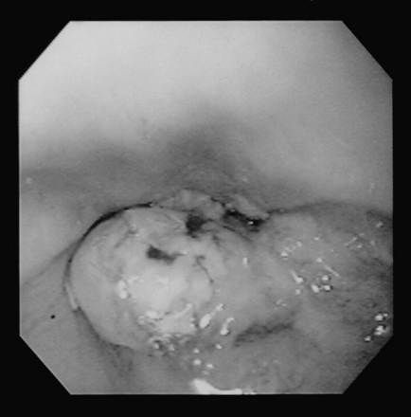
Figure 3. Endoscopy revealed an intraluminal polypoid lesion in the remnant esophagus with ulceration.
Notes:
Figure 3. Endoscopy revealed an intraluminal polypoid lesion in the remnant esophagus with ulceration.
Unless provided in the caption above, the following copyright applies to the content of this slide:

Slide 5
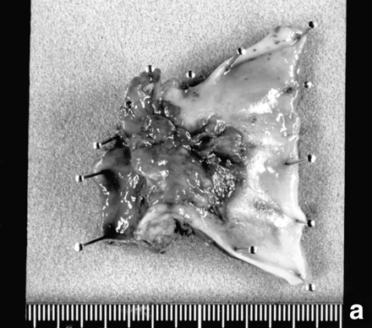
Figure 4. Macroscopic features of the leiomyosarcoma. (a) The resected specimen included a nodular tumor ...
Notes:
Figure 4. Macroscopic features of the leiomyosarcoma. (a) The resected specimen included a nodular tumor measuring 2.4 × 3.0 cm in size in the remnant esophagus. (b) The loupe figure showed the tumor arising from the esophagus, but not from the stomach role.
Unless provided in the caption above, the following copyright applies to the content of this slide:

Slide 6
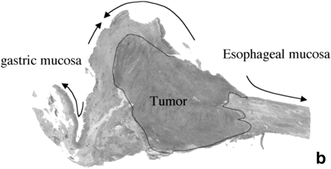
Figure 4. Macroscopic features of the leiomyosarcoma. (a) The resected specimen included a nodular tumor ...
Notes:
Figure 4. Macroscopic features of the leiomyosarcoma. (a) The resected specimen included a nodular tumor measuring 2.4 × 3.0 cm in size in the remnant esophagus. (b) The loupe figure showed the tumor arising from the esophagus, but not from the stomach role.
Unless provided in the caption above, the following copyright applies to the content of this slide:

Slide 7
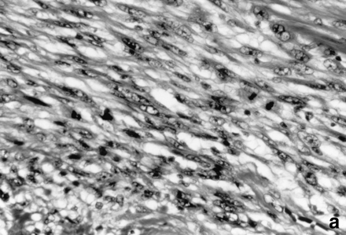
Figure 5. Examination of the tumor. (a) Histopathological examination showing typical interlacing fascicles ...
Notes:
Figure 5. Examination of the tumor. (a) Histopathological examination showing typical interlacing fascicles of pleomorphic spindle-shaped cells with abundant mitotic figures, consistent with the diagnosis of leiomyosarcoma (hematoxylin and eosin). Immunohistochemical staining showed that most tumor cells are positive for smooth muscle actin (b) but negative for cytokeratin (c).
Unless provided in the caption above, the following copyright applies to the content of this slide:

Slide 8
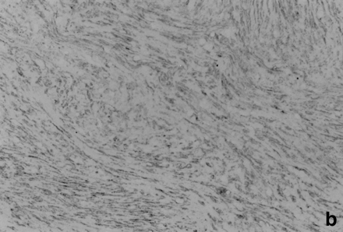
Figure 5. Examination of the tumor. (a) Histopathological examination showing typical interlacing fascicles ...
Notes:
Figure 5. Examination of the tumor. (a) Histopathological examination showing typical interlacing fascicles of pleomorphic spindle-shaped cells with abundant mitotic figures, consistent with the diagnosis of leiomyosarcoma (hematoxylin and eosin). Immunohistochemical staining showed that most tumor cells are positive for smooth muscle actin (b) but negative for cytokeratin (c).
Unless provided in the caption above, the following copyright applies to the content of this slide:

Slide 9
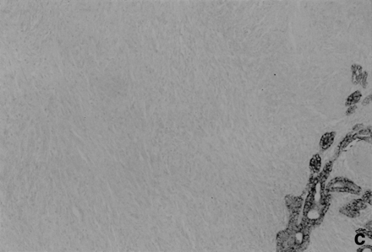
Figure 5. Examination of the tumor. (a) Histopathological examination showing typical interlacing fascicles ...
Notes:
Figure 5. Examination of the tumor. (a) Histopathological examination showing typical interlacing fascicles of pleomorphic spindle-shaped cells with abundant mitotic figures, consistent with the diagnosis of leiomyosarcoma (hematoxylin and eosin). Immunohistochemical staining showed that most tumor cells are positive for smooth muscle actin (b) but negative for cytokeratin (c).
Unless provided in the caption above, the following copyright applies to the content of this slide:

