Slide 1
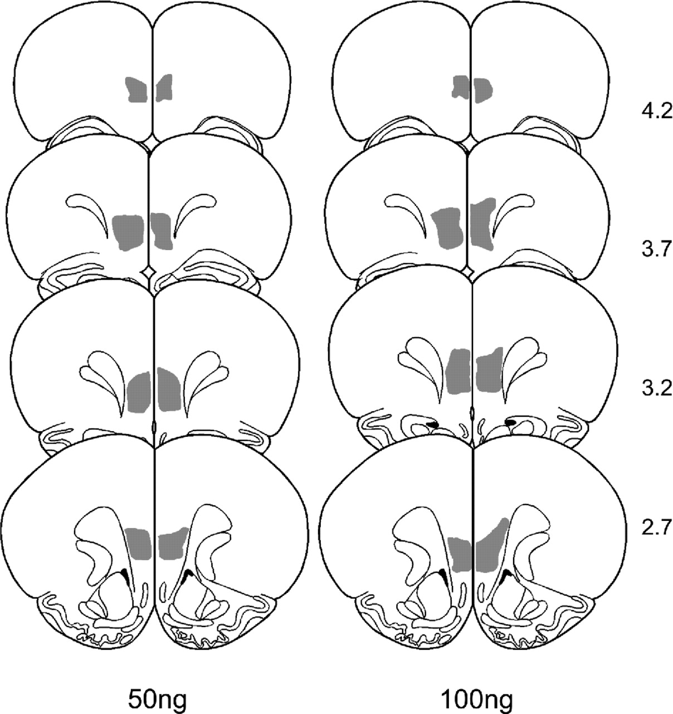
Figure 1. Schematic diagrams of the rat forebrain showing the largest extent of AChE-positive fiber loss ...
Notes:
Figure 1. Schematic diagrams of the rat forebrain showing the largest extent of AChE-positive fiber loss within the medial PFC (adapted from Paxinos and Watson, 1998), following bilateral infusions of 50 ng (left hand diagrams) and 100 ng (right hand diagrams) 192 IgG–saporin. Numbers to the right of each figure refer to the anterior–posterior level forward of bregma (mm).
Unless provided in the caption above, the following copyright applies to the content of this slide:

Slide 2
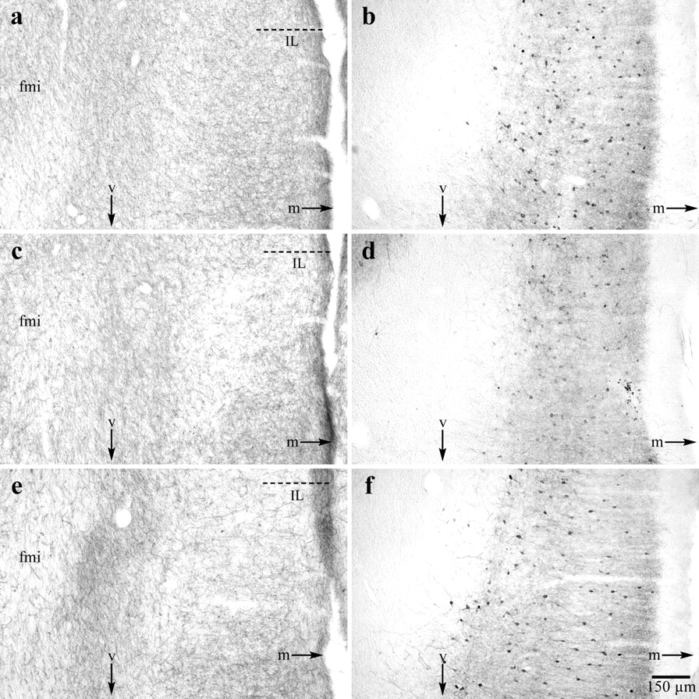
Figure 2. Representative photomicrographs showing AChE-positive fibers (a, c, e) and PARV-immunoreactive ...
Notes:
Figure 2. Representative photomicrographs showing AChE-positive fibers (a, c, e) and PARV-immunoreactive neurons (b, d, f) in the ventromedial PFC of sham (upper panels), 50 ng (middle panels) and 100 ng (lower panels) 192 IgG–saporin lesioned rats. It can be seen in 192 IgG–saporin-lesioned animals that the density of AChE-positive fibers is clearly decreased in the infralimbic cortex (IL) in both lesion groups compared to the sham group. By contrast, PARV-IR neurons are unaffected by immunotoxin infusions in this region. Abbreviations: fmi, forceps minor of the corpus callosum; m, medial; v, ventral; IL, infralimbic cortex.
Unless provided in the caption above, the following copyright applies to the content of this slide:

Slide 3
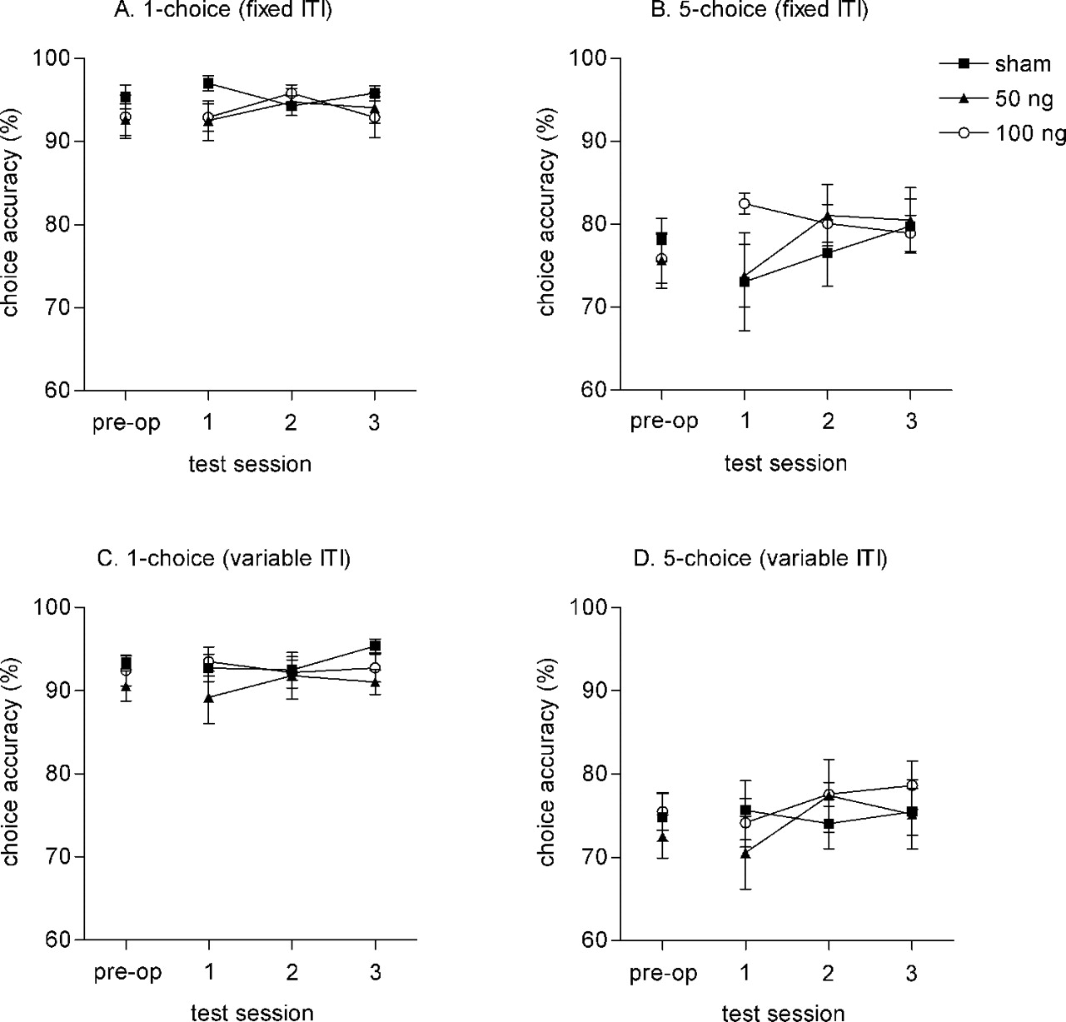
Figure 3. Effect of varying the timing and spatial location of the visual targets on the accuracy of ...
Notes:
Figure 3. Effect of varying the timing and spatial location of the visual targets on the accuracy of performance of sham (n = 9) and 192 IgG–saporin lesioned rats (50 or 100 ng, each n = 9). Pre-operative data were obtained from the final session prior to surgery (mean ± SEM). Subsequent testing was conducted over three challenge sessions, each consisting of four behavioral challenges (‘A’ one-choice, fixed ITI; ‘B’ five-choice, fixed ITI; ‘C’ 1-choice, variable ITI; ‘D’ five-choice, variable ITI) separated by baseline test sessions.
Unless provided in the caption above, the following copyright applies to the content of this slide:

Slide 4
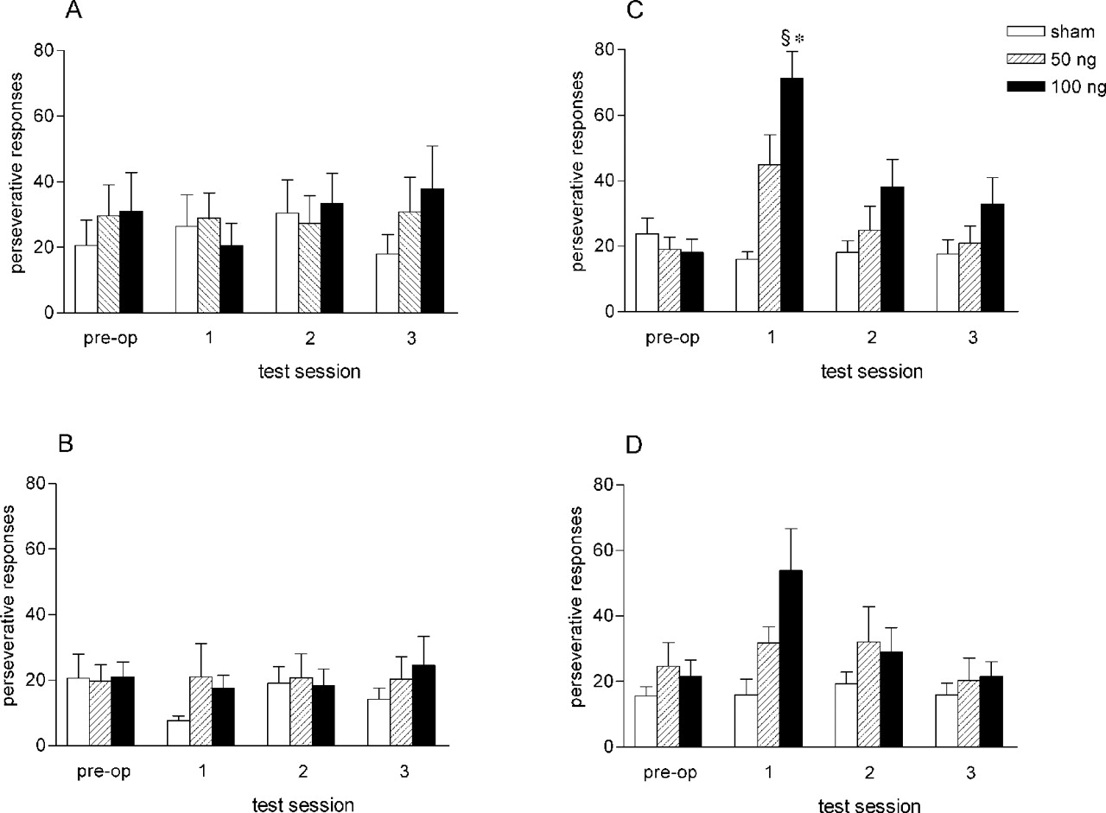
Figure 4. Perseverative responses of sham (n = 9) and 192 IgG–saporin lesioned rats (50 ng or 100 ng, each n ...
Notes:
Figure 4. Perseverative responses of sham (n = 9) and 192 IgG–saporin lesioned rats (50 ng or 100 ng, each n = 9) during sessions consisting of either a fixed location and fixed ITI (‘A’), five locations and a fixed ITI (‘B’), a fixed location and variable ITI (‘C’) or five locations and a variable ITI (‘D’). §P < 0.05 versus pre-operative lesion subjects (100 ng group). *P < 0.05 versus sham subjects.
Unless provided in the caption above, the following copyright applies to the content of this slide:

Slide 5
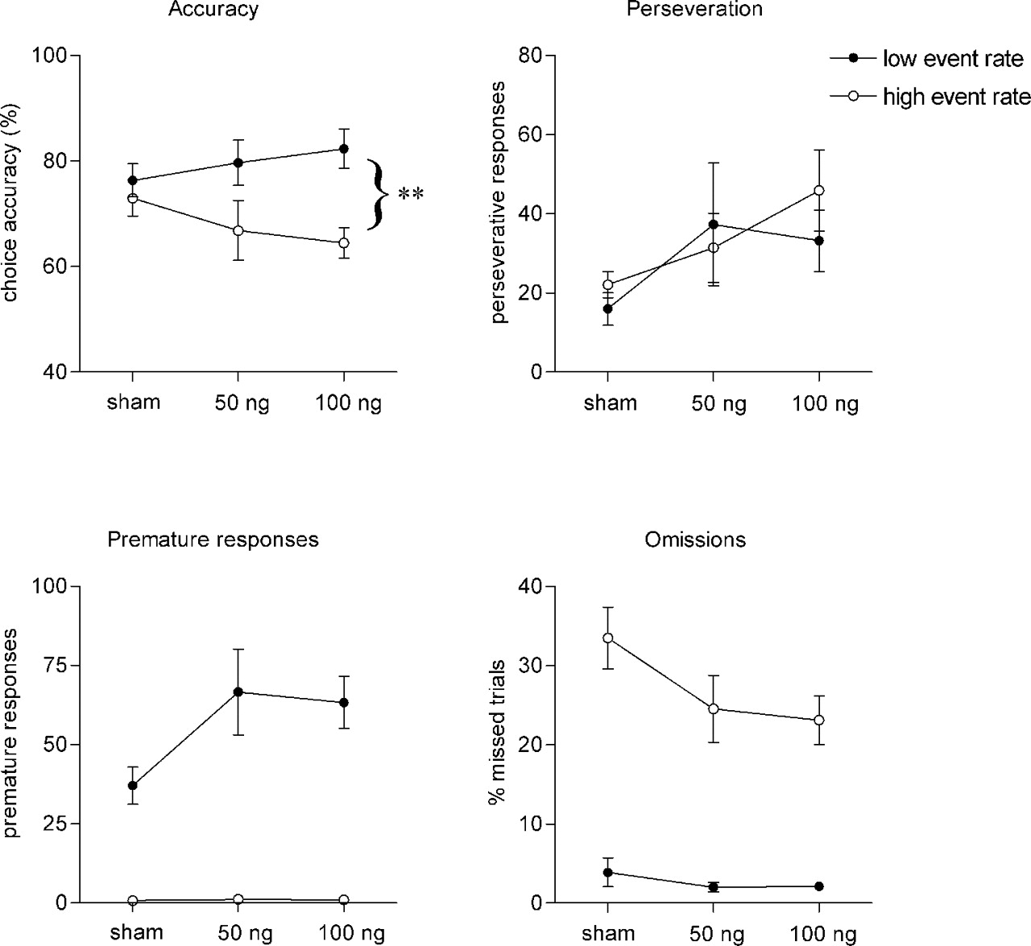
Figure 5. Performance of sham (n = 9) and 192 IgG–saporin-lesioned animals (50 ng or 100 ng, each n = 9) ...
Notes:
Figure 5. Performance of sham (n = 9) and 192 IgG–saporin-lesioned animals (50 ng or 100 ng, each n = 9) under conditions of high and low event rate. Stimuli were presented randomly across all five spatial locations. High and low event rate sessions consisted of 200 trials and inter-trial intervals of 2 and 7 s, respectively. **P < 0.05 high versus low event rate (100 ng group).
Unless provided in the caption above, the following copyright applies to the content of this slide:

Slide 6
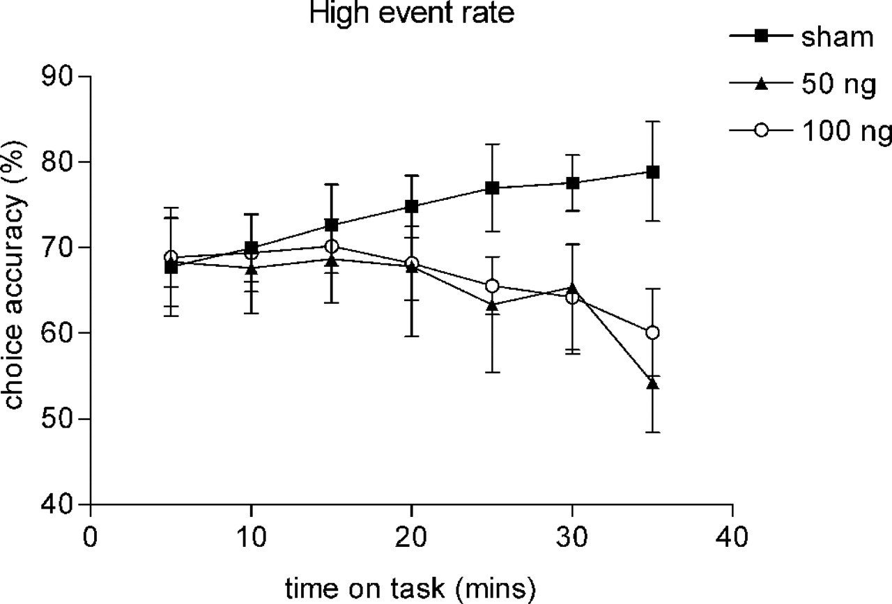
Figure 6. Vigilance decrement in rats with cholinergic lesions of the medial PFC as a function of time on ...
Notes:
Figure 6. Vigilance decrement in rats with cholinergic lesions of the medial PFC as a function of time on task during the high event rate session. Accuracy of target detection was determined over 5 min blocks with stimuli presented randomly across all five spatial locations.
Unless provided in the caption above, the following copyright applies to the content of this slide:

Slide 7
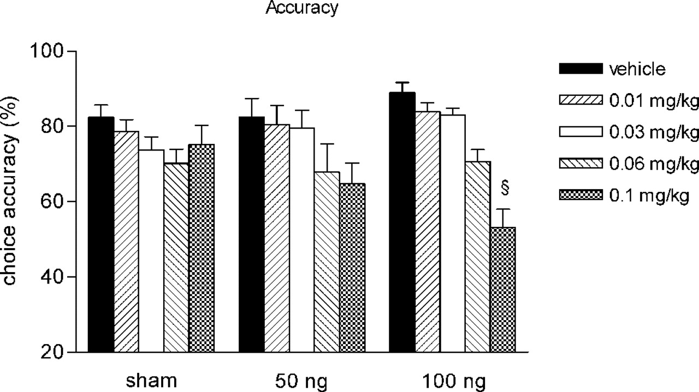
Figure 7. Accuracy of sham (n = 9) and 192 IgG–saporin lesioned animals (50 or 100 ng, each n = 9) on the ...
Notes:
Figure 7. Accuracy of sham (n = 9) and 192 IgG–saporin lesioned animals (50 or 100 ng, each n = 9) on the five-choice task (stimulus duration 0.5 s) following systemic administration of vehicle (normal saline, 1 ml/kg s.c.) or scopolamine hydrochloride (0.01–0.1 mg/kg). ANOVA revealed a significant interaction between lesion and dose [F(8,96) = 2.05; P = 0.049] and a significant main effect of dose for the 100 ng lesion group [F(4,32) = 19.01; P < 0.01]. §P < 0.05 versus sham controls (0.1 mg/kg dose level).
Unless provided in the caption above, the following copyright applies to the content of this slide:

