Slide 1
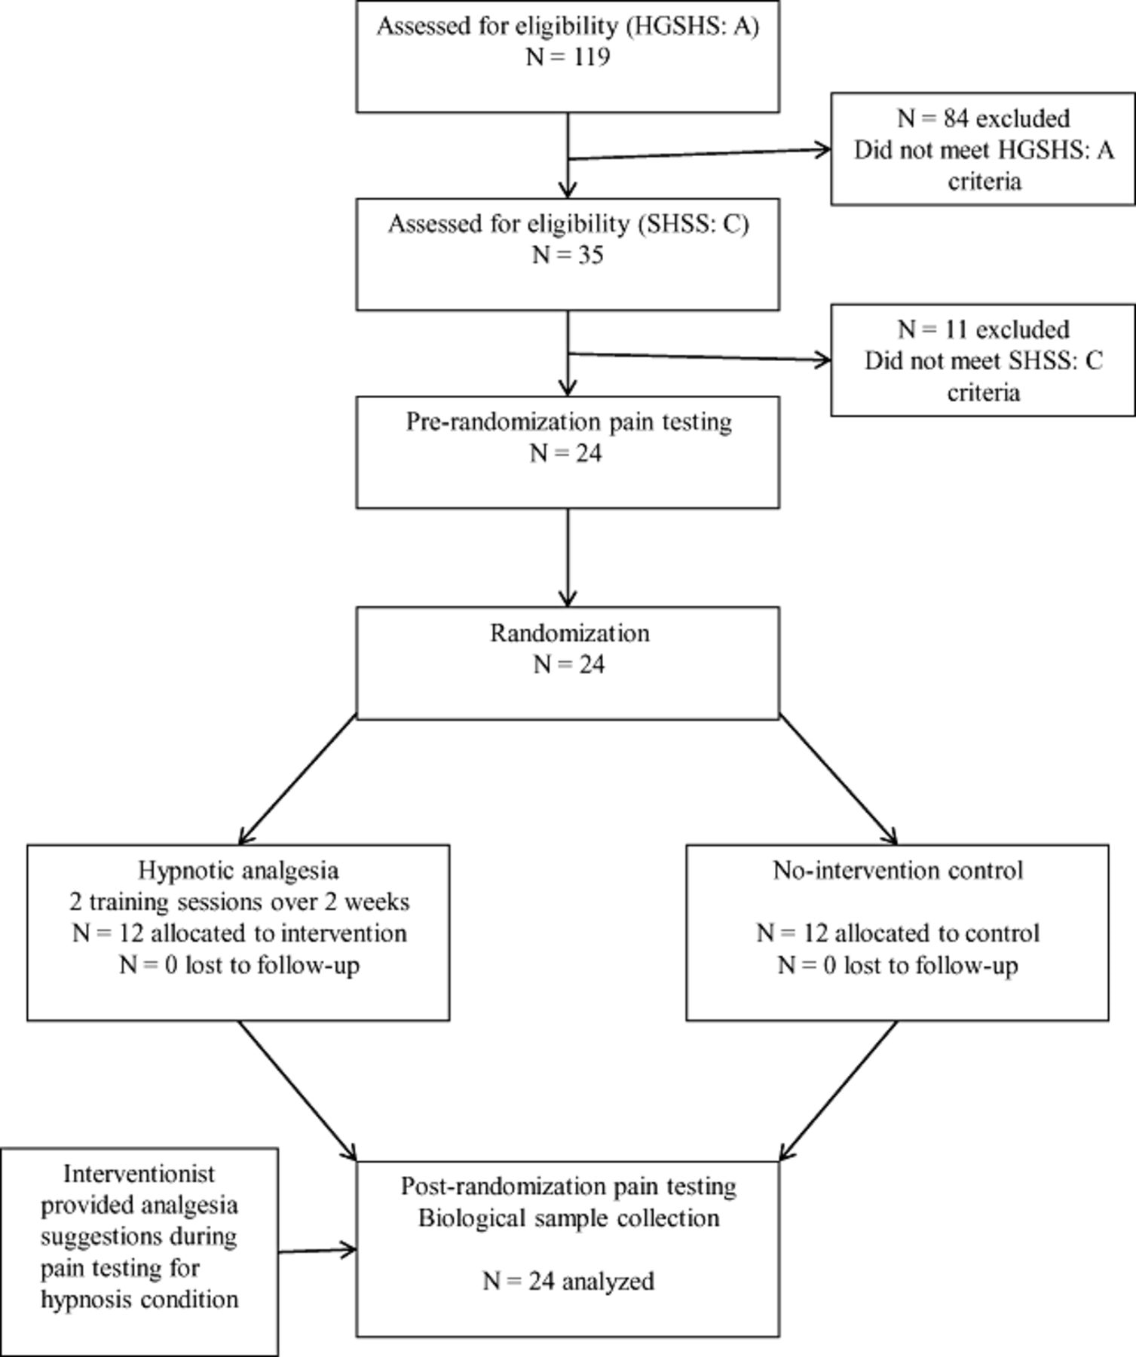
Figure 1 Study flow chart. HGSHS = Harvard Group Scale of Hypnotic Susceptibility; SHSS = Stanford Hypnotic ...
Notes:
Figure 1 Study flow chart. HGSHS = Harvard Group Scale of Hypnotic Susceptibility; SHSS = Stanford Hypnotic Susceptibility Scale.
Unless provided in the caption above, the following copyright applies to the content of this slide: Wiley Periodicals, Inc.

Slide 2
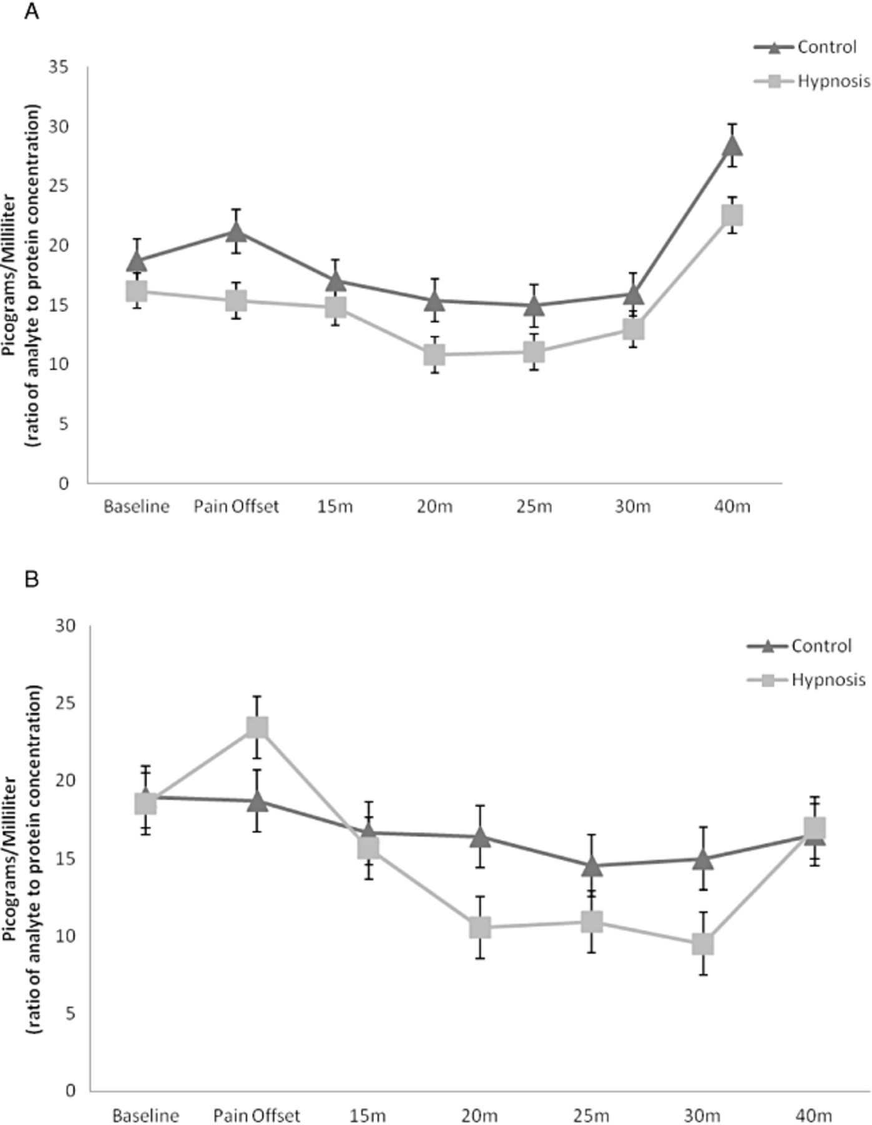
Figure 4 (A) Pre-intervention soluble tumor necrosis factor-α receptor II (sTNFαRII) reactivity; error bars represent ...
Notes:
Figure 4 (A) Pre-intervention soluble tumor necrosis factor-α receptor II (sTNFαRII) reactivity; error bars represent standard error of the mean SEM. (B) Post-intervention sTNFαRII reactivity; error bars represent SEM.
Unless provided in the caption above, the following copyright applies to the content of this slide: Wiley Periodicals, Inc.

Slide 3
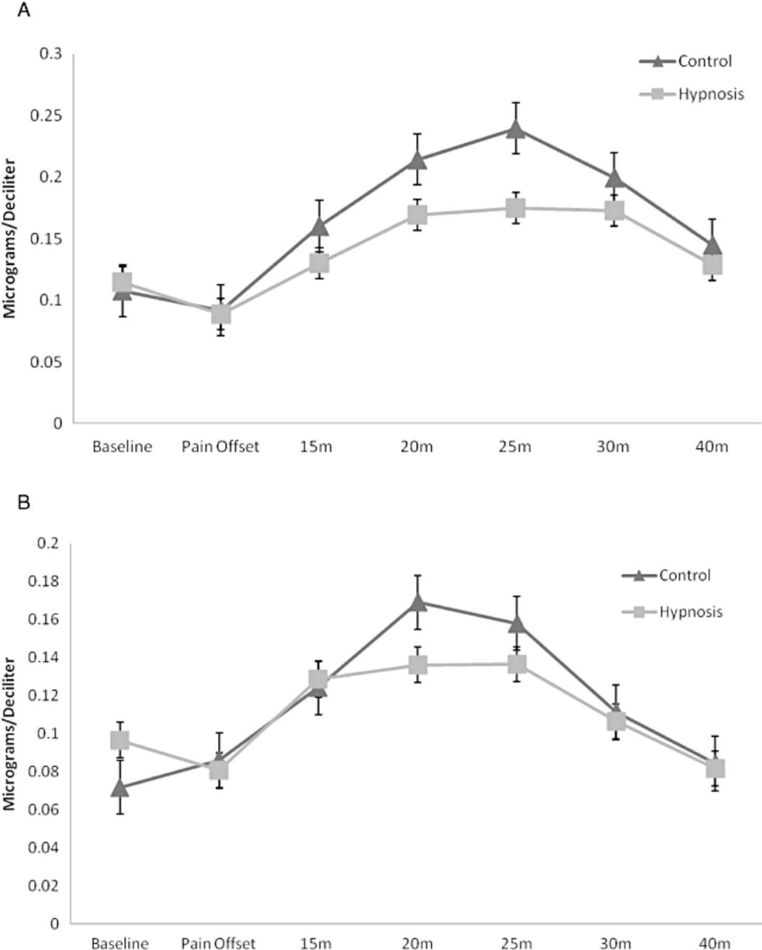
Figure 3 (A) Pre-intervention cortisol reactivity; error bars represent standard error of the mean (SEM). (B) ...
Notes:
Figure 3 (A) Pre-intervention cortisol reactivity; error bars represent standard error of the mean (SEM). (B) Post-intervention cortisol reactivity; error bars represent SEM.
Unless provided in the caption above, the following copyright applies to the content of this slide: Wiley Periodicals, Inc.

Slide 4
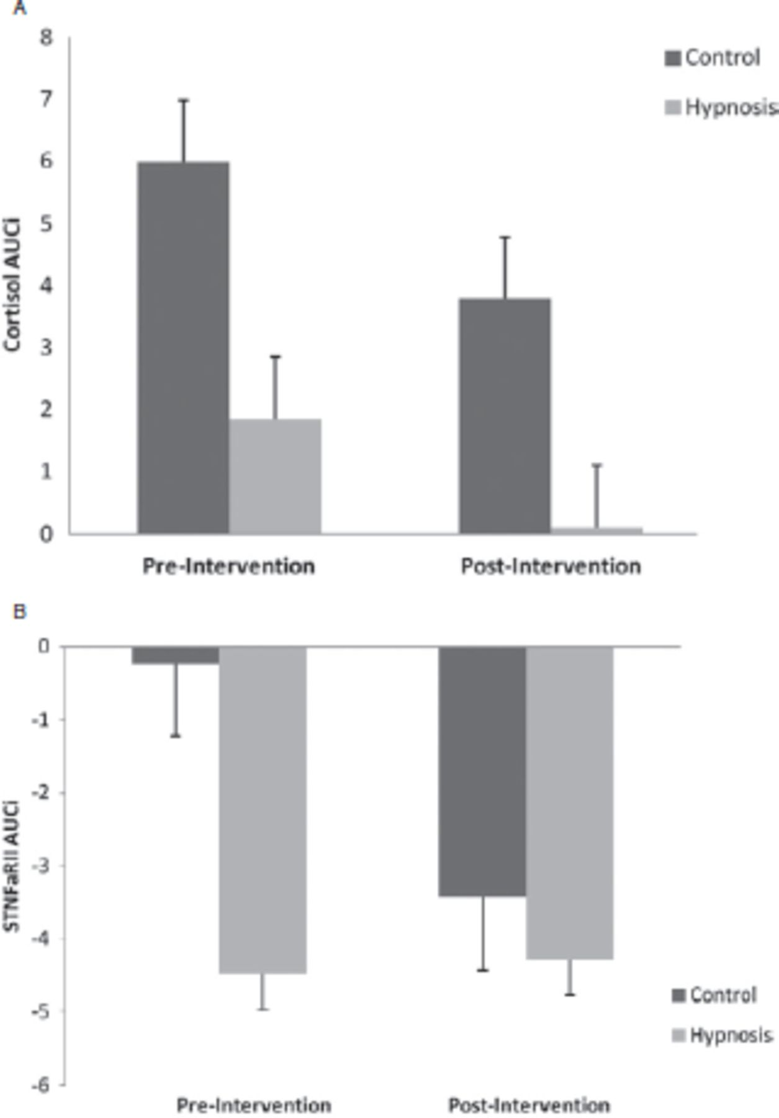
Figure 5 (A) Pre- to post-intervention change in area under the curve with respect to increase (AUC_{I}) ...
Notes:
Figure 5 (A) Pre- to post-intervention change in area under the curve with respect to increase (AUCI) cortisol reactivity. Note that positive numbers represent an increase from baseline. (B) Pre- to post-intervention change in AUCI soluble tumor necrosis factor-α receptor II reactivity. Note that negative numbers represent a decrease from baseline.
Unless provided in the caption above, the following copyright applies to the content of this slide: Wiley Periodicals, Inc.

Slide 5
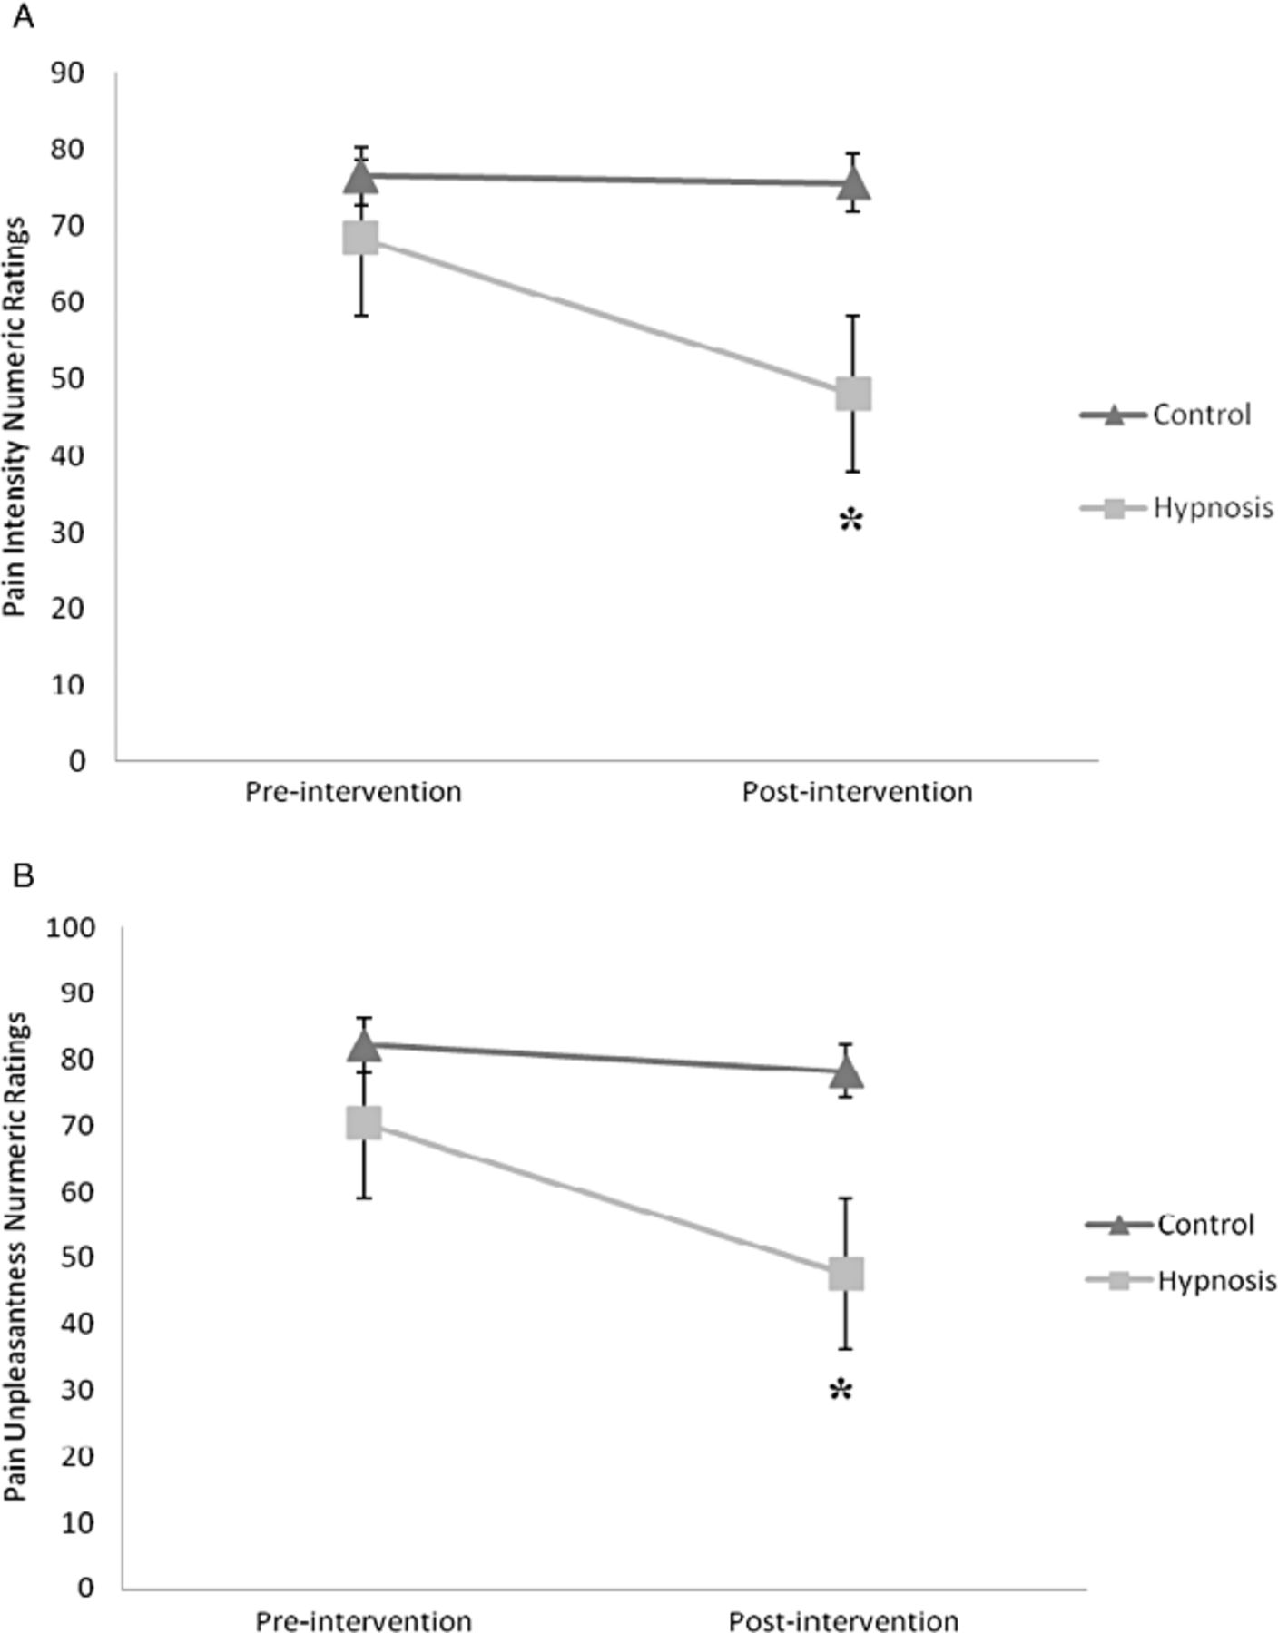
Figure 2 (A) Pre- to post-intervention change in pain intensity. * = significant change for hypnosis. (B) Pre- to ...
Notes:
Figure 2 (A) Pre- to post-intervention change in pain intensity. * = significant change for hypnosis. (B) Pre- to post-intervention change in pain unpleasantness. * = significant change for hypnosis.
Unless provided in the caption above, the following copyright applies to the content of this slide: Wiley Periodicals, Inc.

