Slide 1
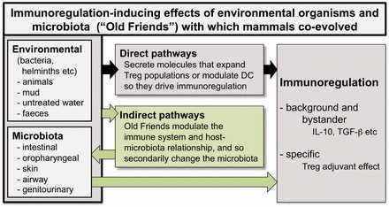
Figure 1. Microbial immunomodulation. Microbes from the environment, and from the various microbiota, modulate the ...
Notes:
Figure 1. Microbial immunomodulation. Microbes from the environment, and from the various microbiota, modulate the immune system. Some of this is due to direct effects of defined microbial products on elements of the immune system. But modulation of the immune system also secondarily alters the host–microbiota relationship and leads to changes in the composition of the microbiota, and so to further changes in immunoregulation (shown as indirect pathways)
Unless provided in the caption above, the following copyright applies to the content of this slide: © The Author(s) 2013. Published by Oxford University Press on behalf of the Foundation for Evolution, Medicine, and Public Health.This is an Open Access article distributed under the terms of the Creative Commons Attribution License (http://creativecommons.org/licenses/by/3.0/), which permits unrestricted reuse, distribution, and reproduction in any medium, provided the original work is properly cited.

Slide 2
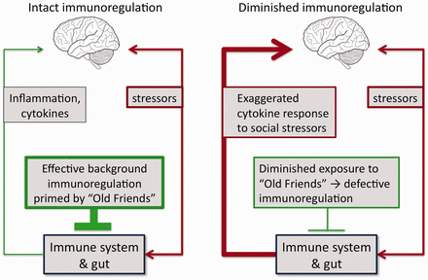
Figure 2. Immunoregulation and the inflammatory response to psychosocial stressors. Stress drives release of ...
Notes:
Figure 2. Immunoregulation and the inflammatory response to psychosocial stressors. Stress drives release of proinflammatory mediators via pathways that involve the immune system and the gut. The inflammatory response to a given level of a stressor is modulated and eventually terminated by immunoregulatory mechanisms. If immunoregulation is defective, as can occur when there has been inadequate exposure to immunoregulation-inducing Old Friends, then a given level of stressor will result in greater and more prolonged inflammatory response
Unless provided in the caption above, the following copyright applies to the content of this slide: © The Author(s) 2013. Published by Oxford University Press on behalf of the Foundation for Evolution, Medicine, and Public Health.This is an Open Access article distributed under the terms of the Creative Commons Attribution License (http://creativecommons.org/licenses/by/3.0/), which permits unrestricted reuse, distribution, and reproduction in any medium, provided the original work is properly cited.

Slide 3
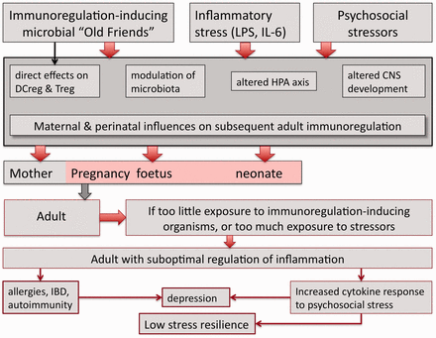
Figure 3. Perinatal influences on adult immunoregulation. Multiple factors in the perinatal period influence the ...
Notes:
Figure 3. Perinatal influences on adult immunoregulation. Multiple factors in the perinatal period influence the developing brain, immune system, microbiota and HPA axis. Withdrawal of immunoregulation-inducing Old Friends and exposure to perinatal psychosocial stressors can result in immunoregulatory defects that are apparent in the adult. Such adults have increased risk of chronic inflammatory disorders, and increased inflammatory responses to psychosocial stressors, resulting in susceptibility to depression and probably to detrimental effects of low SES due to low stress resilience
Unless provided in the caption above, the following copyright applies to the content of this slide: © The Author(s) 2013. Published by Oxford University Press on behalf of the Foundation for Evolution, Medicine, and Public Health.This is an Open Access article distributed under the terms of the Creative Commons Attribution License (http://creativecommons.org/licenses/by/3.0/), which permits unrestricted reuse, distribution, and reproduction in any medium, provided the original work is properly cited.

