Slide 1
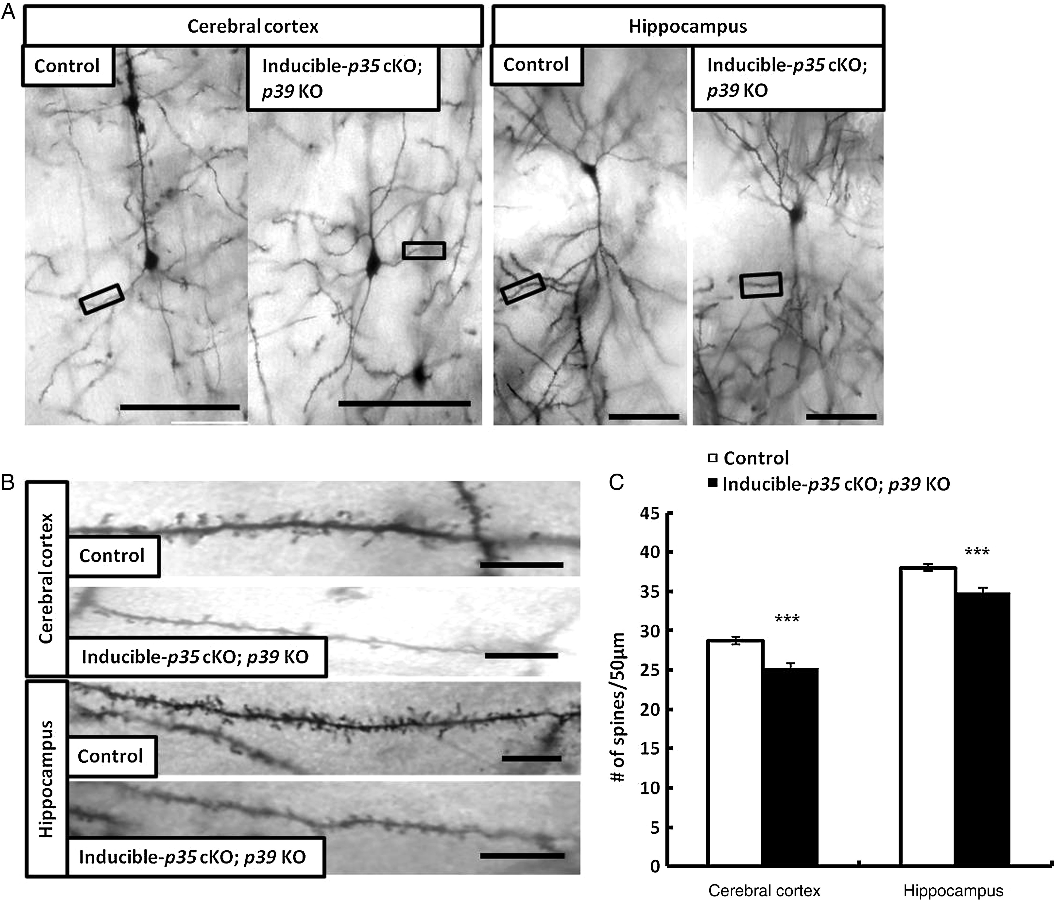
Figure 1. Reduction of dendritic spine density in layer V pyramidal neurons of the cerebral cortex and hippocampal CA1 ...
Notes:
Figure 1. Reduction of dendritic spine density in layer V pyramidal neurons of the cerebral cortex and hippocampal CA1 pyramidal neurons in Inducible-p35 cKO; p39 KO mice. (A) Representative photographs of dendritic segments of layer V pyramidal neurons of the cerebral cortex and hippocampal CA1 pyramidal neurons in p35 flox/flox (control) and Inducible-p35 cKO; p39 KO mice. Scale bar, 50 µm. (B) Magnified images of areas indicated in A. Scale bar, 10 µm. (C) Reduced numbers of spines were observed in layer V pyramidal neurons in cerebral cortex and hippocampal CA1 pyramidal neurons of Inducible-p35 cKO; p39 KO mice compared to those in control mice. *** p < 0.001.
Unless provided in the caption above, the following copyright applies to the content of this slide: © The Author 2014. Published by Oxford University Press. All rights reserved. For Permissions, please e-mail: journals.permissions@oup.com

Slide 2
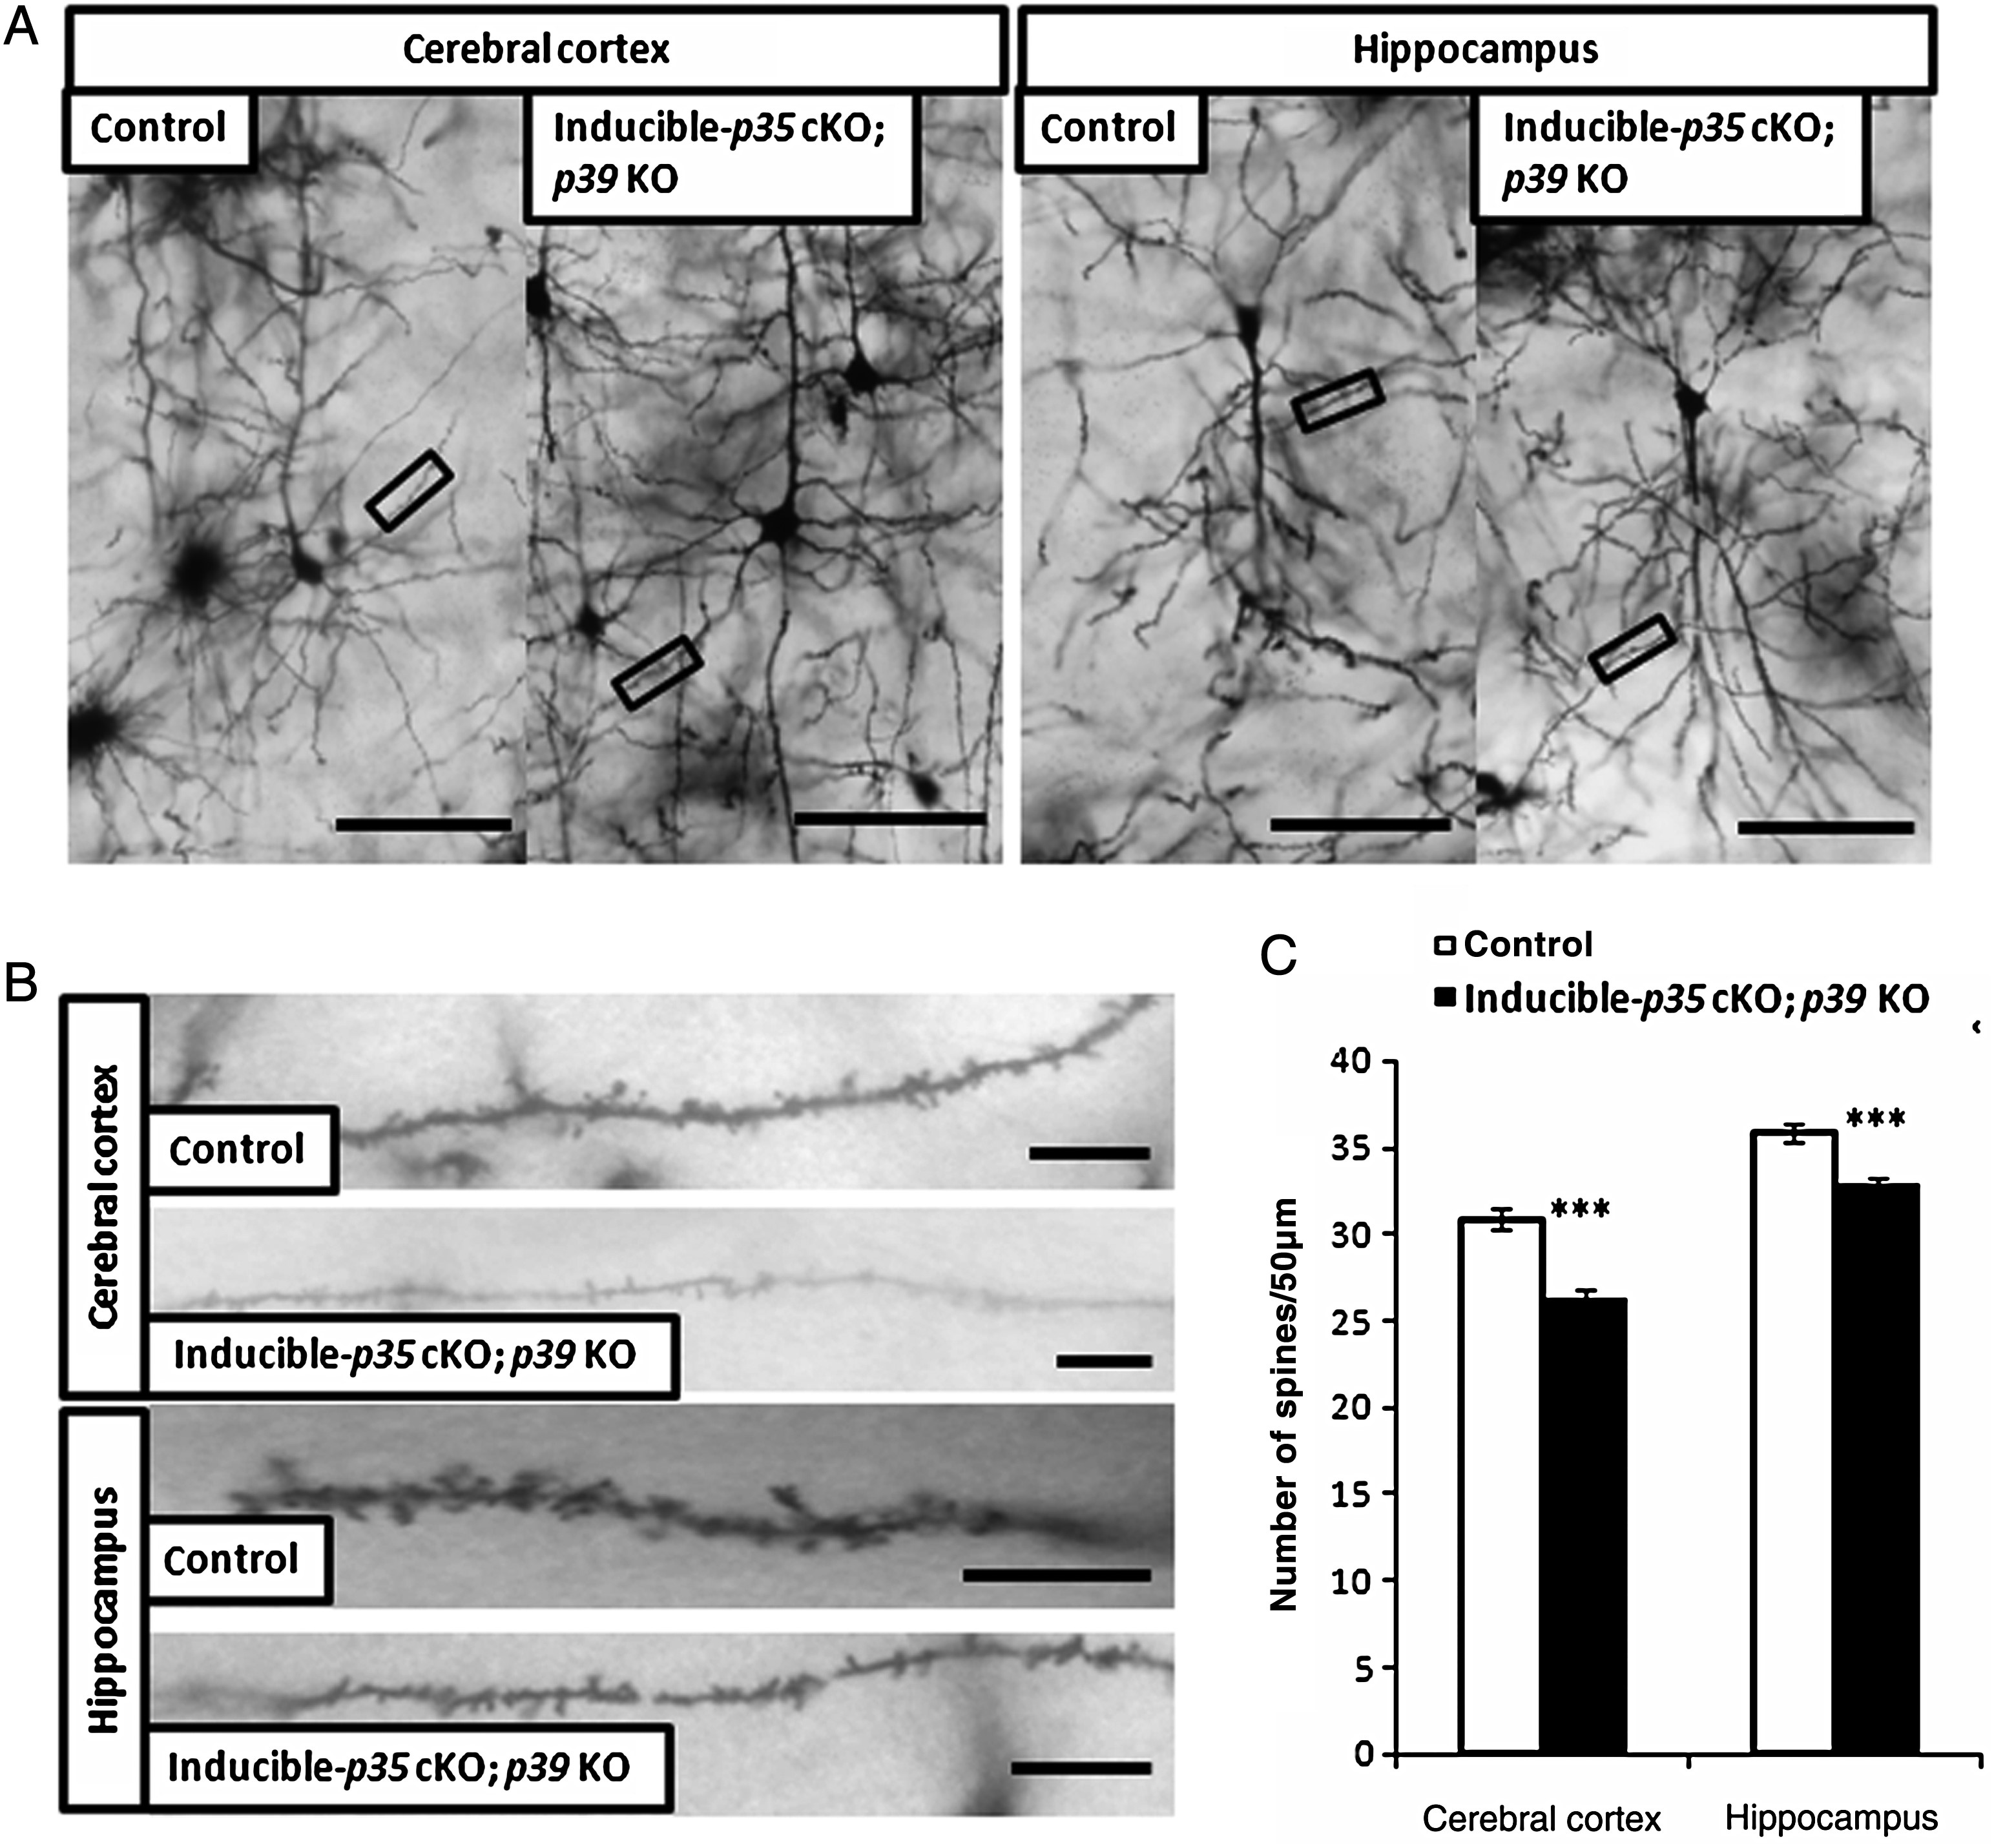
Figure 5. Reduction of dendritic spine density in layer V pyramidal neurons of the cerebral cortex and hippocampal CA1 ...
Notes:
Figure 5. Reduction of dendritic spine density in layer V pyramidal neurons of the cerebral cortex and hippocampal CA1 pyramidal neurons in adult inducible-p35 cKO; p39 KO mice. (A) Representative photographs of dendritic segments of layer V pyramidal neurons of the cerebral cortex and hippocampal CA1 pyramidal neurons in p35 flox/flox (control) and inducible-p35 cKO; p39 KO mice. Scale bar, 50 µm. (B) Magnified images of areas indicated in A. Scale bar, 10 µm. (C) Reduced numbers of spines were observed in layer V pyramidal neurons in the cerebral cortex and hippocampal CA1 pyramidal neurons of adult inducible-p35 cKO; p39 KO mice as compared to those in the control mice. ***p < 0.001.
Unless provided in the caption above, the following copyright applies to the content of this slide: © The Author 2014. Published by Oxford University Press. All rights reserved. For Permissions, please e-mail: journals.permissions@oup.com

Slide 3
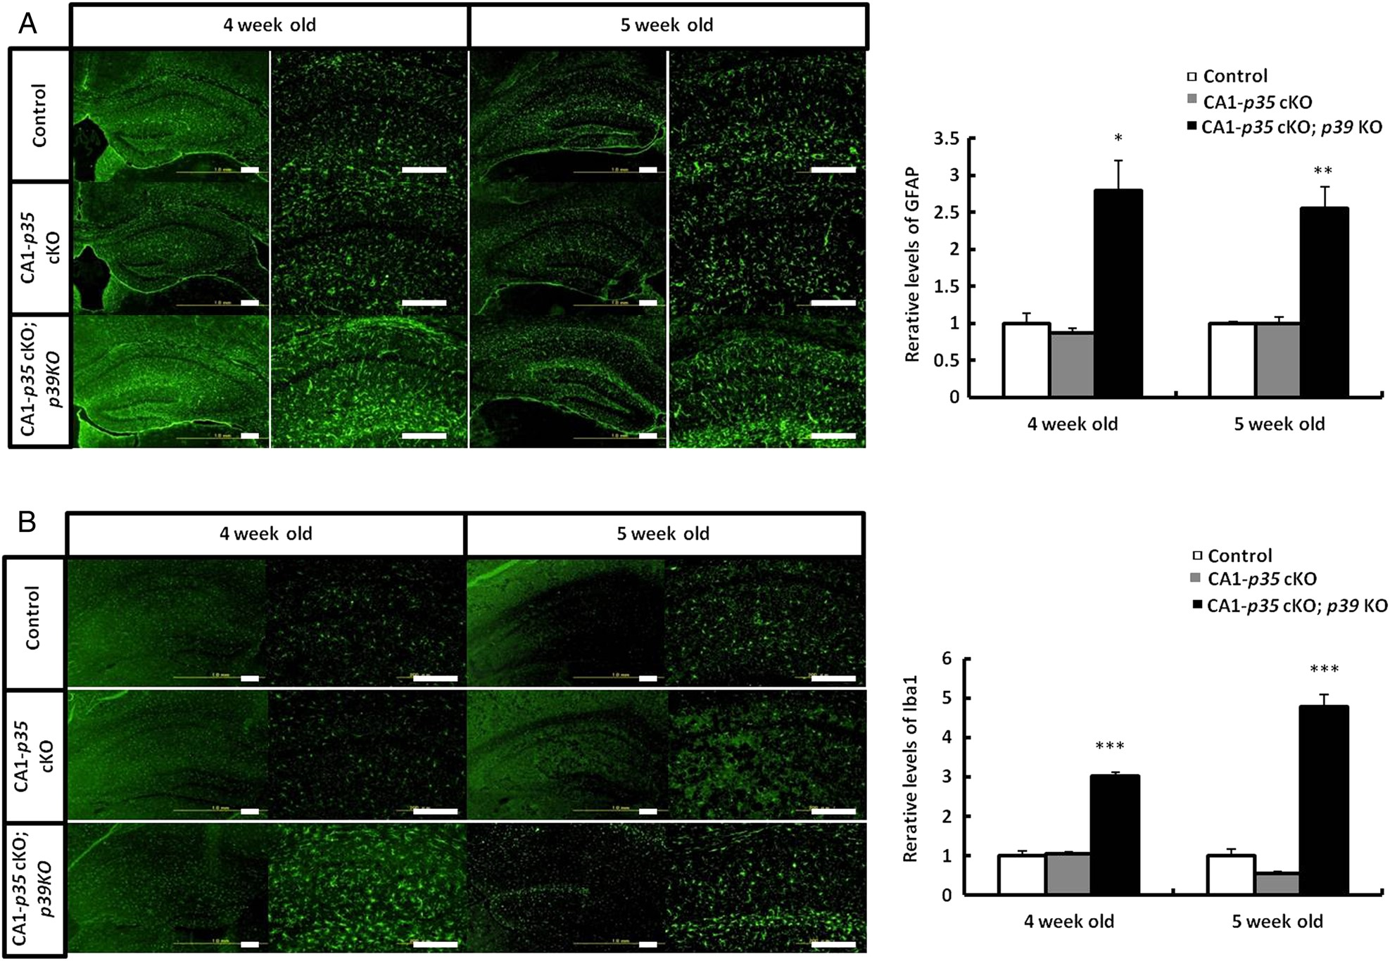
Figure 4. Increase in reactive astrocytes and activated microglia in the hippocampus of CA1-p35 cKO; p39 KO mice. ...
Notes:
Figure 4. Increase in reactive astrocytes and activated microglia in the hippocampus of CA1-p35 cKO; p39 KO mice. Immunostaining for astrocyte (GFAP) (A) and microglia (Iba1) (B) in hippocampal areas in coronal sections from p35 flox/flox (control), CA1-p35 cKO, and CA1-p35 cKO; p39 KO mice. Scale bar, 200 µm. Reactive astrocytes (A) and activated microglia (B) were increased in CA1-p35 cKO; p39 KO mice than in control mice, while no differences were shown between CA1-p35 cKO mice and control mice. *P < 0.05, **P < 0.01, ***P < 0.001.
Unless provided in the caption above, the following copyright applies to the content of this slide: © The Author 2014. Published by Oxford University Press. All rights reserved. For Permissions, please e-mail: journals.permissions@oup.com

Slide 4
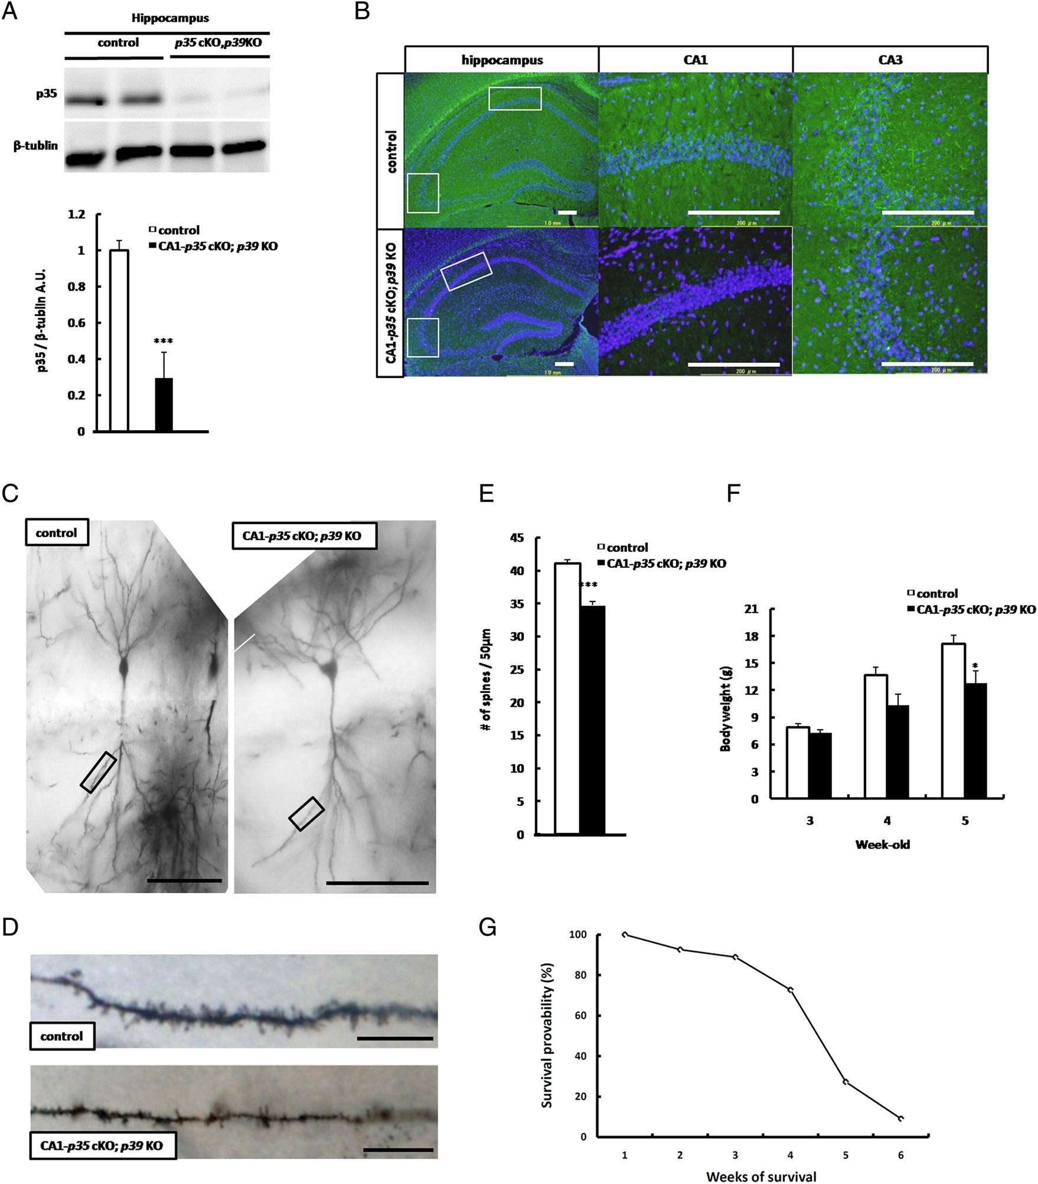
Figure 3. CA1-p35 cKO; p39 KO mice exhibit reduced dendritic spine density in hippocampal CA1 pyramidal neurons, ...
Notes:
Figure 3. CA1-p35 cKO; p39 KO mice exhibit reduced dendritic spine density in hippocampal CA1 pyramidal neurons, reduced body weight, and early lethality. (A) Western blot analysis of hippocampal tissue from p35 flox/flox (control) and CA1-p35 cKO; p39 KO mice for protein levels of p35 and β-tublin, respectively, ***P < 0.001. (B) Immunostaining for pCRMP2 (S522) in coronal sections of hippocampal areas from p35 flox/flox (control) and CA1-p35 cKO; p39 KO mice at age 5 weeks. Scale bar 200 µm. (C) Representative photographs of dendritic segments of hippocampal CA1 pyramidal neurons at age 5 weeks. Scale bar, 100 μm. (D) Magnified images of the areas indicated in A. Scale bar, 10 μm. (E) Reduced dendritic spine density in hippocampal CA1 pyramidal neurons spine density was observed in hippocampal CA1 pyramidal neurons of CA1-p35 cKO; p39 KO mice compared with those of control mice, ***P < 0.001. (F) Loss of body weight in CA1-p35 cKO; p39 KO mice was observed at age 4 weeks. *P < 0.05. (G) Early lethality was observed at 4 weeks of age. Approximately 80% CA1-p35 cKO; p39 KO mice were dead at age 5 weeks.
Unless provided in the caption above, the following copyright applies to the content of this slide: © The Author 2014. Published by Oxford University Press. All rights reserved. For Permissions, please e-mail: journals.permissions@oup.com

Slide 5
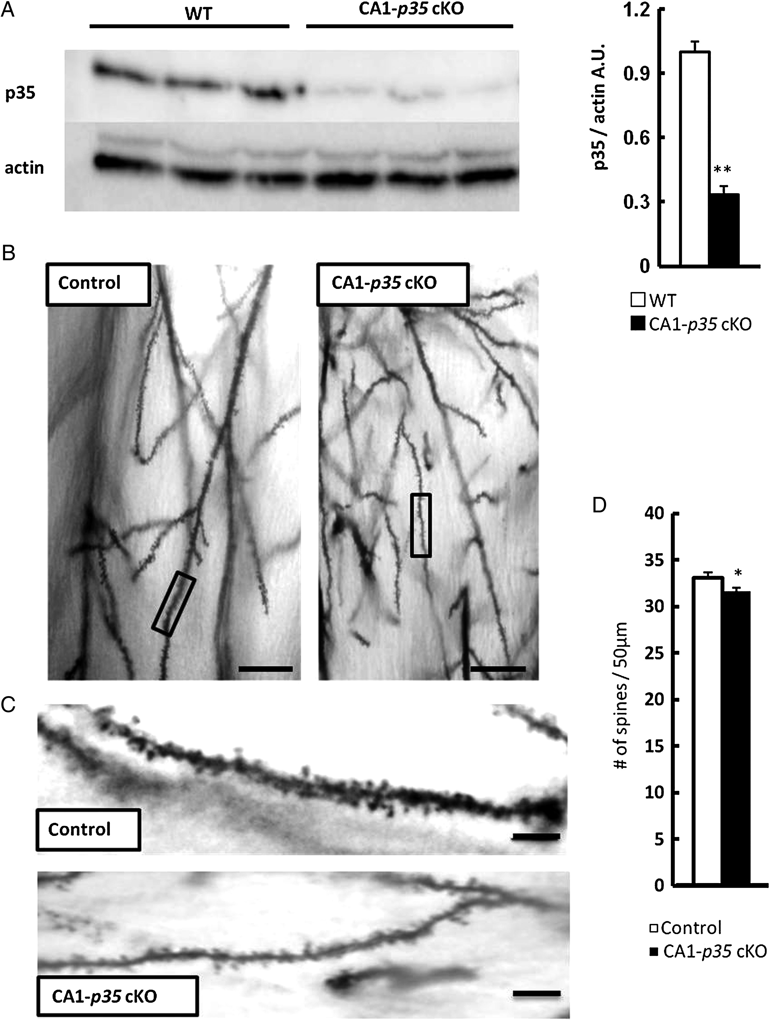
Figure 2. Reduction of dendritic spine density in hippocampal CA1 pyramidal neurons of CA1-p35 cKO mice. (A) Western ...
Notes:
Figure 2. Reduction of dendritic spine density in hippocampal CA1 pyramidal neurons of CA1-p35 cKO mice. (A) Western blot analysis of hippocampal tissue from WT and CA1-p35 cKO mice for protein levels of p35 and actin. Reduced levels of p35 protein were observed in the hippocampus of CA1-p35 cKO compared with those in 4-week-old WT mice (n = 6, **P < 0.01). (B) Representative photographs of dendritic segments of hippocampal CA1 pyramidal neurons of p35 flox/flox (control) and CA1-p35 cKO mice. Scale bar, 50 μm. (C) Magnified images of areas indicated in B. Scale bar, 10 μm. (D) Reduced numbers of spines were observed in the CA1 pyramidal neurons of CA1-p35 cKO mice compared with those in control mice. *P < 0.05.
Unless provided in the caption above, the following copyright applies to the content of this slide: © The Author 2014. Published by Oxford University Press. All rights reserved. For Permissions, please e-mail: journals.permissions@oup.com

