Slide 1
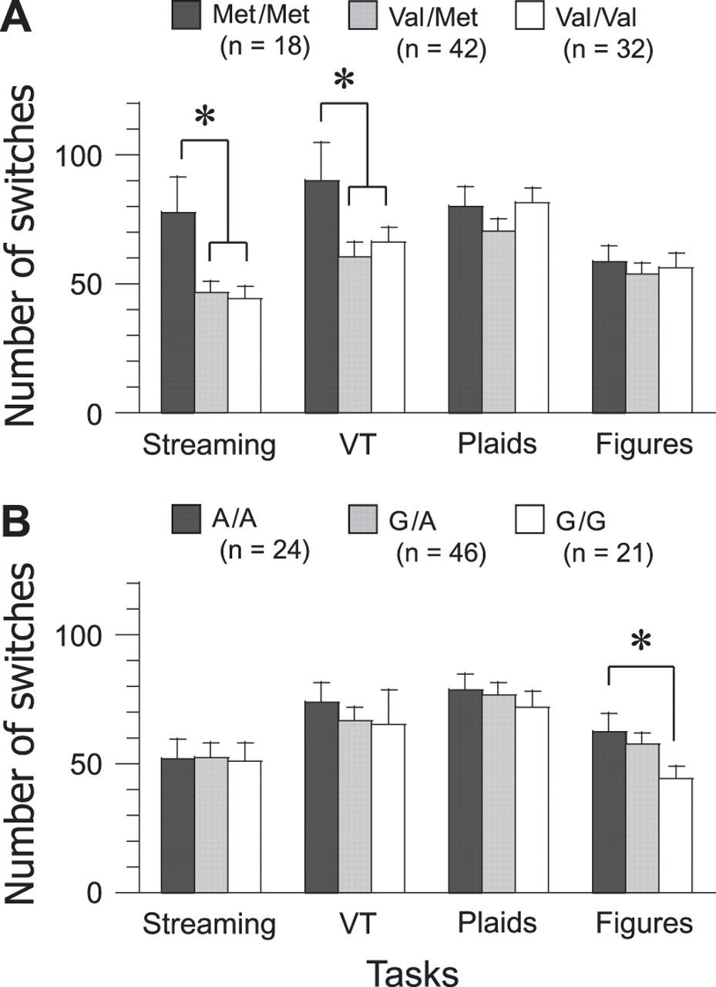
Figure 4. Number of perceptual switches for genotype groups. (A) COMT genotype group comparison. The number of ...
Notes:
Figure 4. Number of perceptual switches for genotype groups. (A) COMT genotype group comparison. The number of perceptual switches was greater for the Met/Met group than for the Val/Met and Val/Val groups in the auditory streaming and verbal transformation tasks. Error bars represent the standard error of mean. (B) HTR2A genotype group comparison. The number of perceptual switches was greater for the A/A group than for the G/G group in the reversible figure task. *P < 0.05.
Unless provided in the caption above, the following copyright applies to the content of this slide: © The Author 2011. Published by Oxford University Press. All rights reserved. For permissions, please e-mail: journals.permissions@oup.com

Slide 2
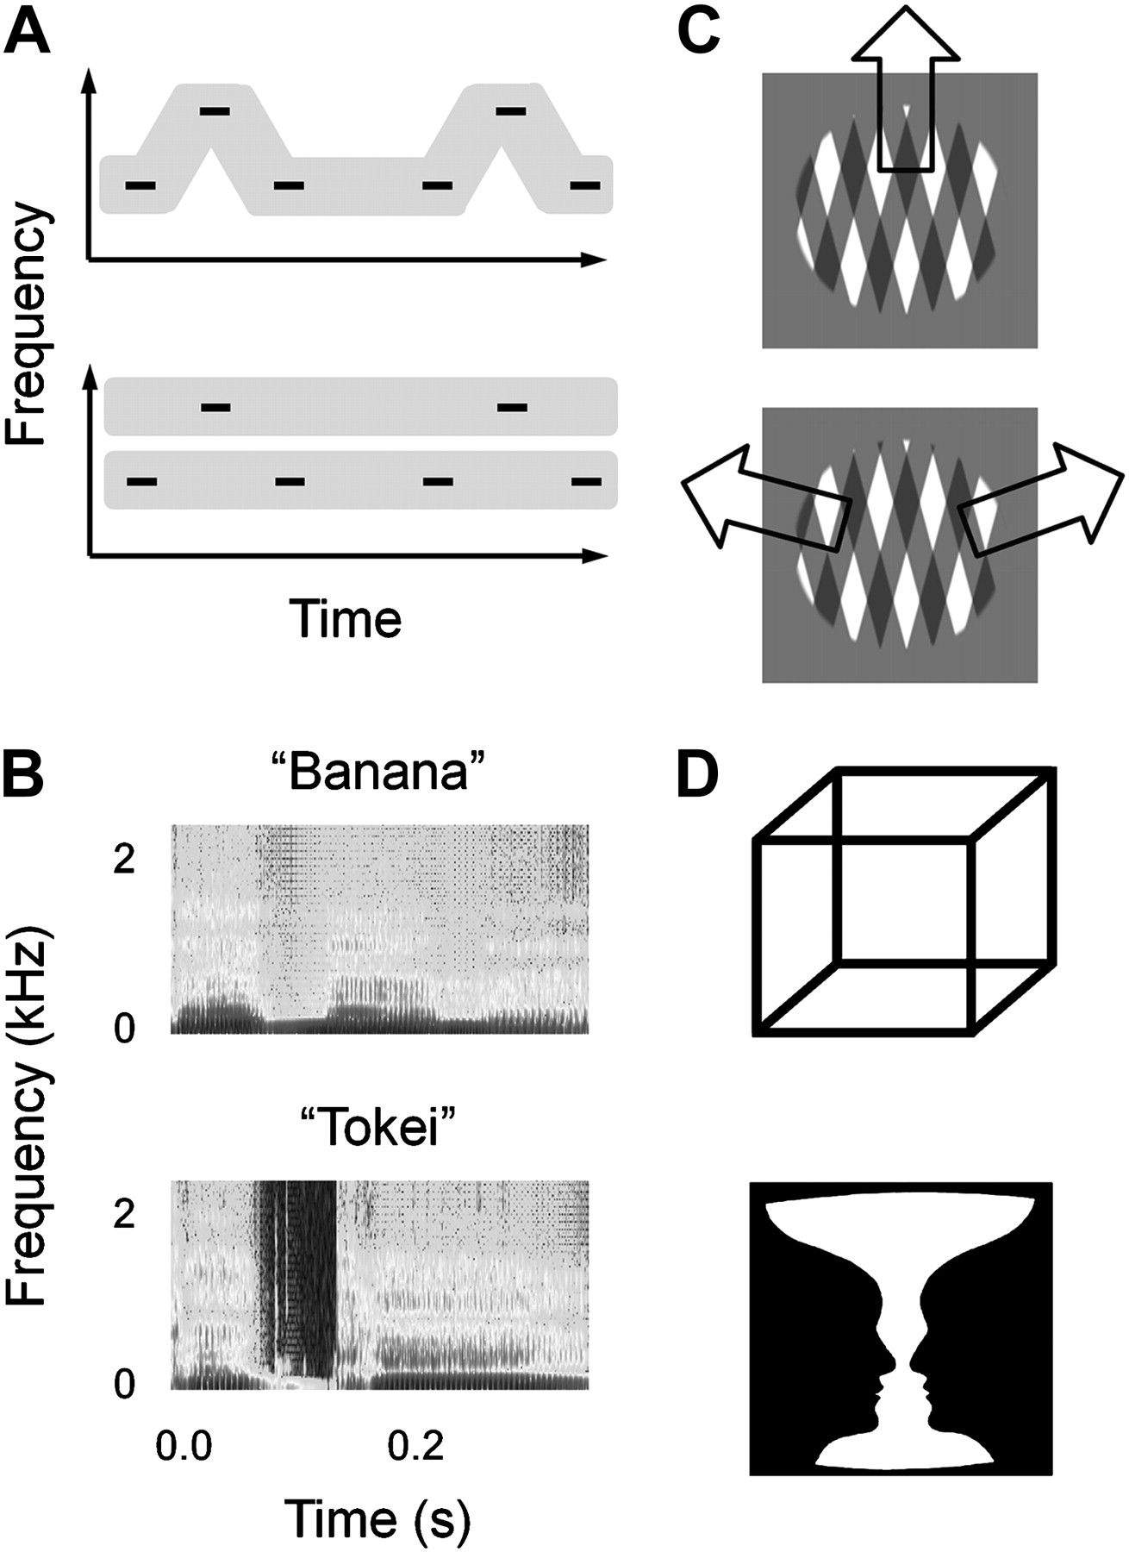
Figure 1. Schematic representation of auditory and visual stimuli. (A) A sound sequence of a triplet tone was presented ...
Notes:
Figure 1. Schematic representation of auditory and visual stimuli. (A) A sound sequence of a triplet tone was presented in the auditory streaming task. The auditory stimulus produces perceptual switches between one stream with a galloping rhythm and 2 streams with isochronous rhythms. (B) The spectrograms indicate the time–frequency distribution of energy in the stimuli of the verbal transformation task. The constant stimulation of a stimulus word changes in the verbal form (e.g., “banana”) to another form (e.g., “nappa”). (C) Two rectangular gratings were moving in the visual plaid task. The visual stimulus induces perceptual switches between upward grouped and sideward split motion. (D) The Necker cube and Rubin vase were used in the reversible figure task. The Necker cube can be interpreted as having the lower left or upper right faces in front. Perceptual interpretation flips between black faces and a white vase in the Rubin vase.
Unless provided in the caption above, the following copyright applies to the content of this slide: © The Author 2011. Published by Oxford University Press. All rights reserved. For permissions, please e-mail: journals.permissions@oup.com

Slide 3
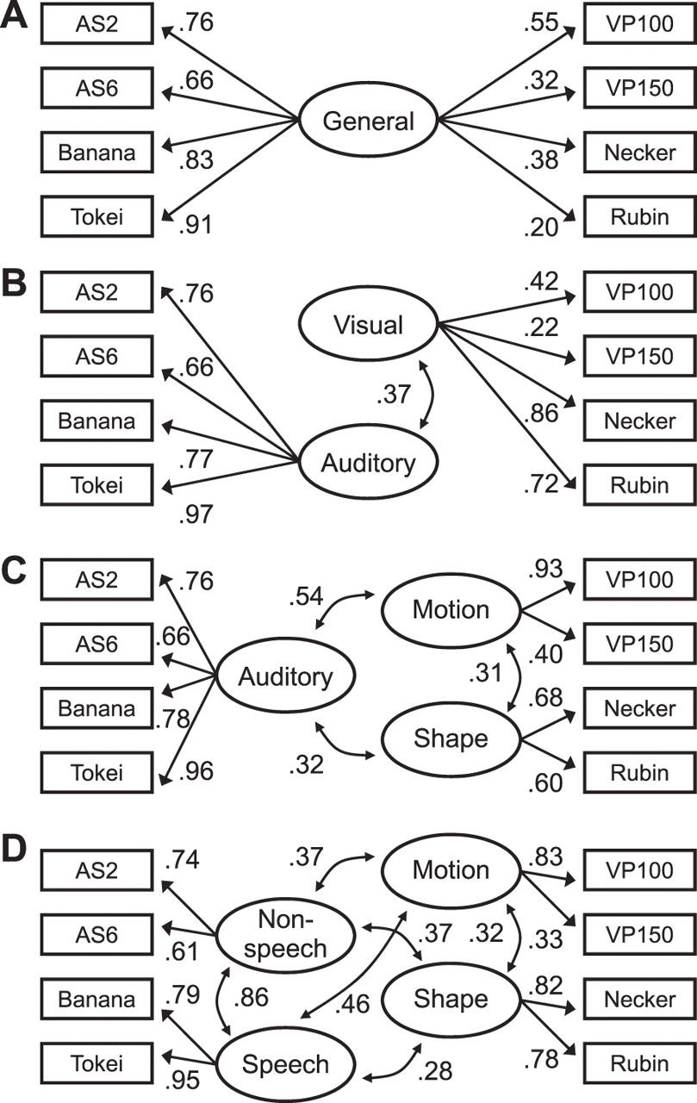
Figure 3. Results of confirmatory factor analysis. (A–D) One-, 2-, 3-, and 4-factor models. The 3-factor model is ...
Notes:
Figure 3. Results of confirmatory factor analysis. (A–D) One-, 2-, 3-, and 4-factor models. The 3-factor model is endorsed in terms of fit indices (see Table 3). The squares and ellipses represent observed and latent variables, respectively. The single-headed arrows have standardized regression coefficients that are equivalent to factor loadings, whereas the double-headed arrows indicate correlations between the latent variables. All of the coefficients are significant (P < 0.05).
Unless provided in the caption above, the following copyright applies to the content of this slide: © The Author 2011. Published by Oxford University Press. All rights reserved. For permissions, please e-mail: journals.permissions@oup.com

Slide 4
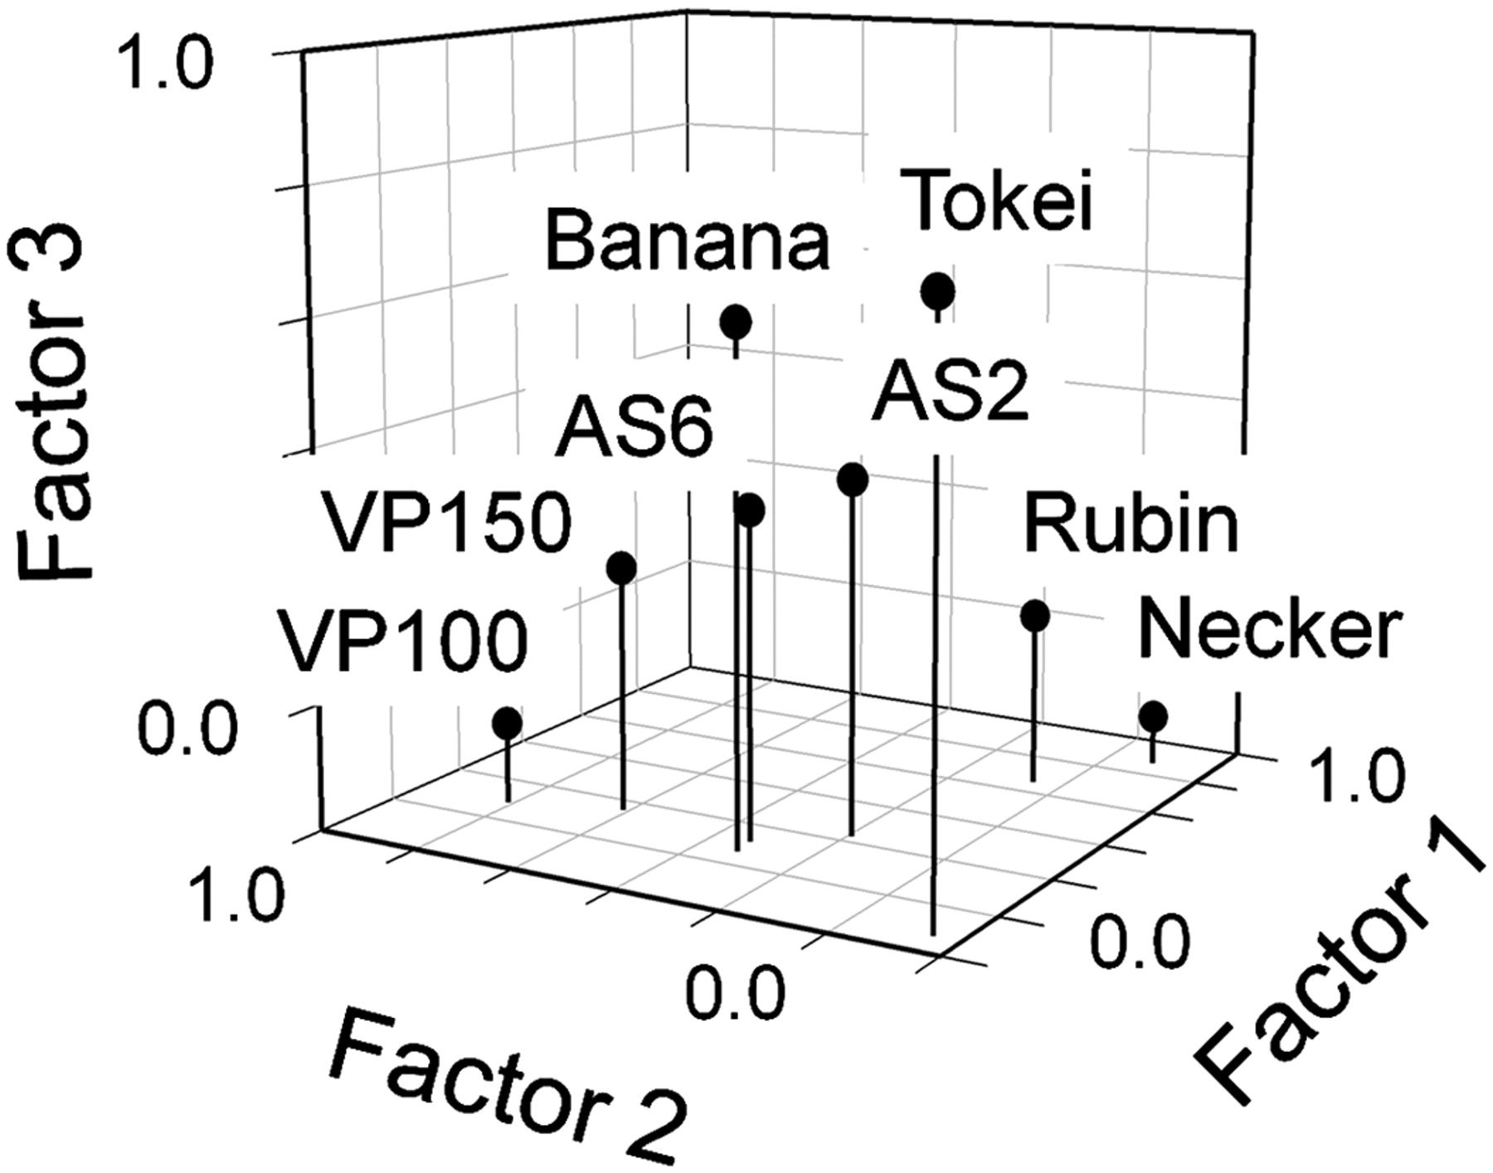
Figure 2. Results of exploratory factor analysis. The number of perceptual switches for each individual (N = 92) is ...
Notes:
Figure 2. Results of exploratory factor analysis. The number of perceptual switches for each individual (N = 92) is used as an observed variable. The factors were extracted by using the maximum likelihood method and then subjected to an oblique Promax rotation, in which it is postulated that the factors behind the observed variables are not completely independent of one another. The circles are plotted on the basis of factor loadings for each of the 8 conditions. Factors 1, 2, and 3 can be considered the “shape,” “motion,” and “auditory” factors, respectively. AS2 and AS6, auditory streaming at Δf = 2 and 6 semitones; VP100 and VP150, visual plaids at Δd = 100° and 150°.
Unless provided in the caption above, the following copyright applies to the content of this slide: © The Author 2011. Published by Oxford University Press. All rights reserved. For permissions, please e-mail: journals.permissions@oup.com

