Slide 1
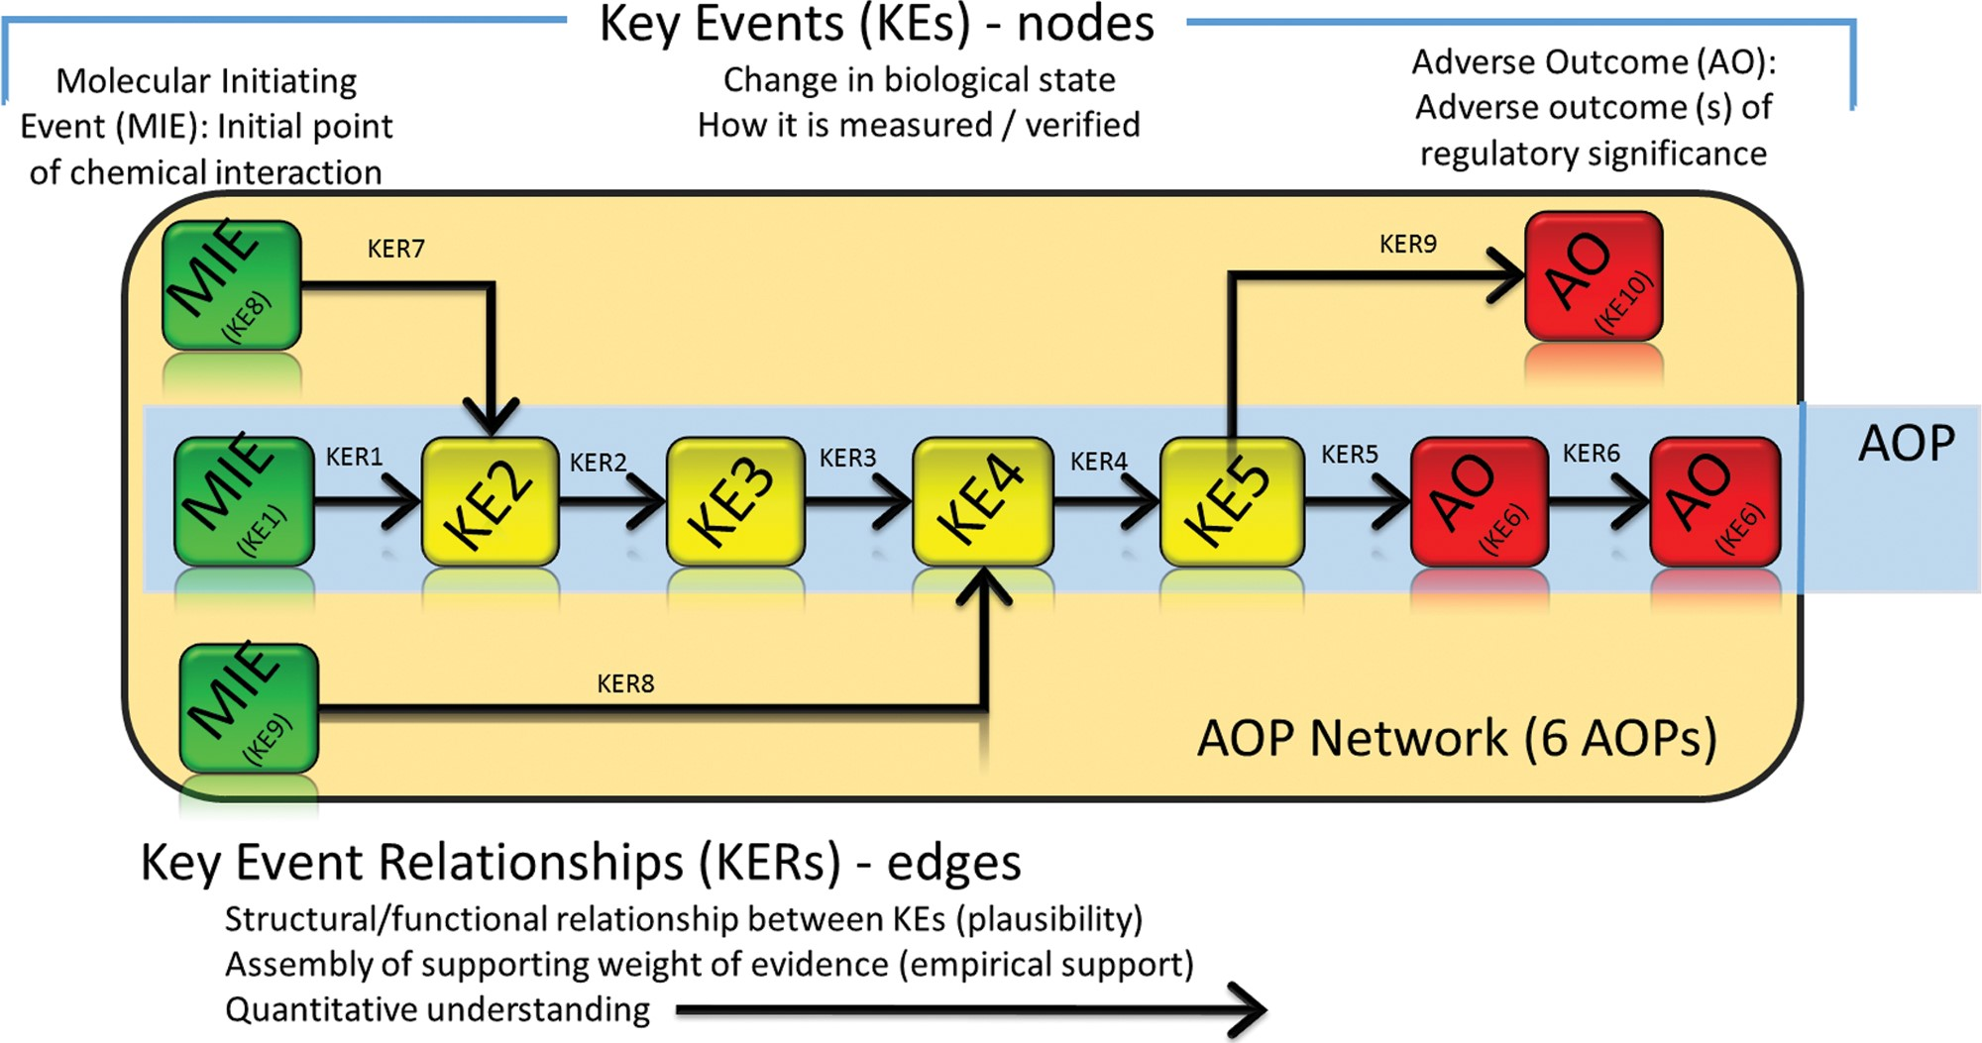
FIG. 1 Conceptual representation of the adverse outcome pathway (AOP) framework including modular representation as ...
Notes:
FIG. 1 Conceptual representation of the adverse outcome pathway (AOP) framework including modular representation as Key Events (KEs) and Key Event Relationships (KERs), 2 specialized types of KEs, molecular initiating events (MIEs) and adverse outcomes (AOs), that serve as upstream and downstream anchors in an AOP, and assembly of multiple AOPs sharing common KEs and/or KERs into an AOP network.
Unless provided in the caption above, the following copyright applies to the content of this slide: © The Author 2016. Published by Oxford University Press on behalf of the Society of Toxicology.This is an Open Access article distributed under the terms of the Creative Commons Attribution Non-Commercial License (http://creativecommons.org/licenses/by-nc/4.0/), which permits non-commercial re-use, distribution, and reproduction in any medium, provided the original work is properly cited. For commercial re-use, please contact journals.permissions@oup.com

Slide 2
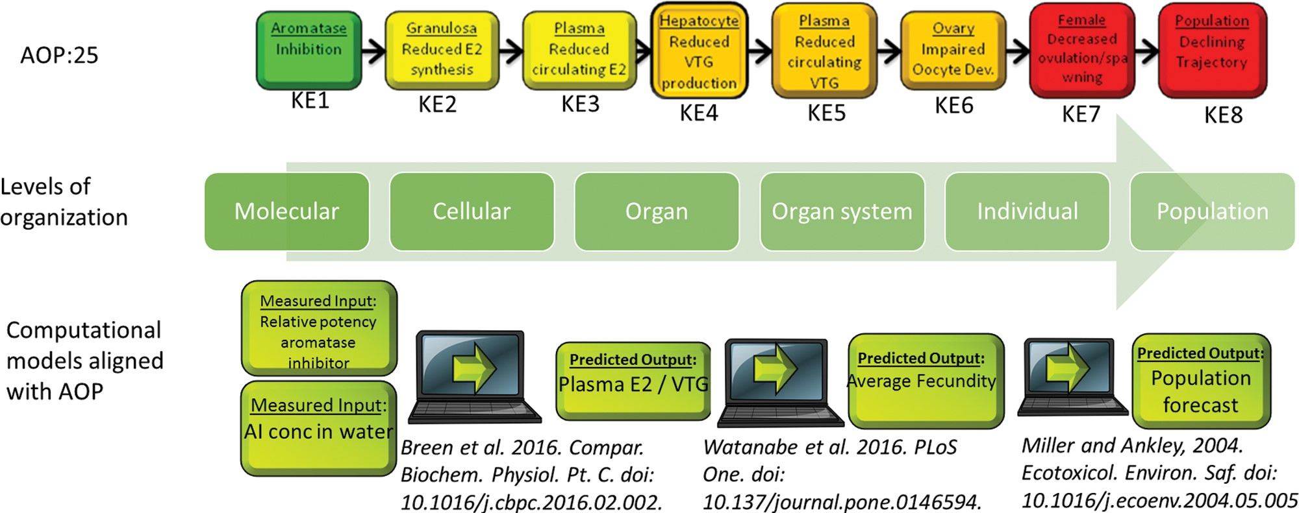
FIG. 2 Illustration of the alignment between multiple computational models and an adverse outcome pathway linking ...
Notes:
FIG. 2 Illustration of the alignment between multiple computational models and an adverse outcome pathway linking aromatase inhibition to reproductive dysfunction and declining population trajectory in fish. Model constructs allow for quantitative extrapolation across key events at multiple levels of biological organization ranging from molecular scale interactions to population-level effects.
Unless provided in the caption above, the following copyright applies to the content of this slide: © The Author 2016. Published by Oxford University Press on behalf of the Society of Toxicology.This is an Open Access article distributed under the terms of the Creative Commons Attribution Non-Commercial License (http://creativecommons.org/licenses/by-nc/4.0/), which permits non-commercial re-use, distribution, and reproduction in any medium, provided the original work is properly cited. For commercial re-use, please contact journals.permissions@oup.com

