Slide 1
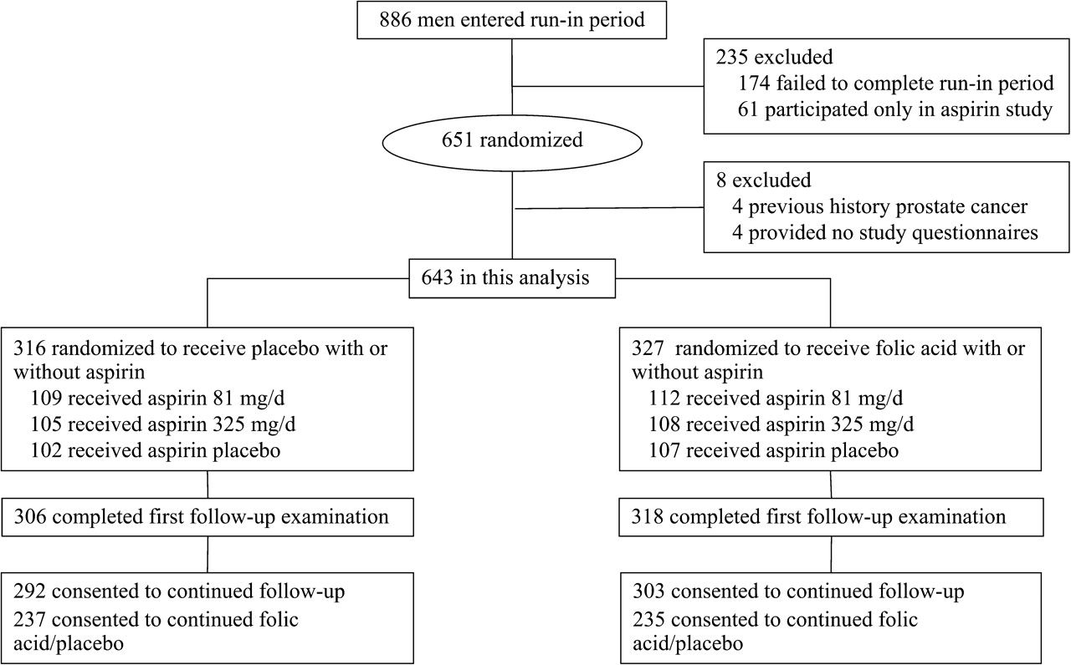
Figure 1 Design of the trial and flow of participants.
Notes:
Figure 1 Design of the trial and flow of participants.
Unless provided in the caption above, the following copyright applies to the content of this slide: © The Author 2009. Published by Oxford University Press.

Slide 2
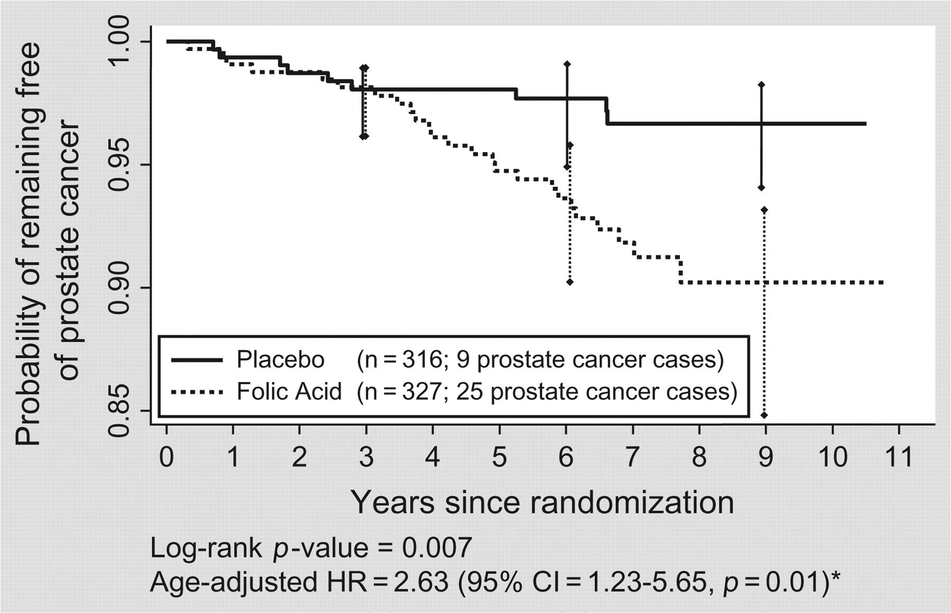
Figure 2 Kaplan–Meier plot of the prostate cancer–free status over time among the 643 men randomized to placebo and ...
Notes:
Figure 2 Kaplan–Meier plot of the prostate cancer–free status over time among the 643 men randomized to placebo and folic acid treatment in this study. The 95% confidence intervals (CIs) for probability of remaining free of cancer are shown at 3, 6, and 9 years for both treatment groups. The numbers of patients at risk for prostate cancer at 3, 6, and 9 years were 284, 274, and 10, respectively, in the placebo group and 300, 233, and 10 in the folic acid group. *Cox proportional hazard models were used to obtain hazard ratios (HRs) and 95% confidence intervals and Wald tests to obtain P values. In the figure, hazard ratio is age adjusted. The multiadjusted hazard ratio (with adjustment for aspirin treatment group, alcohol use, baseline multivitamin use and plasma levels of vitamins B 2 , B 6 , and B 12 ) was 2.58 (95% CI = 1.14–5.86, P = 0.02).
Unless provided in the caption above, the following copyright applies to the content of this slide: © The Author 2009. Published by Oxford University Press.

