Slide 1
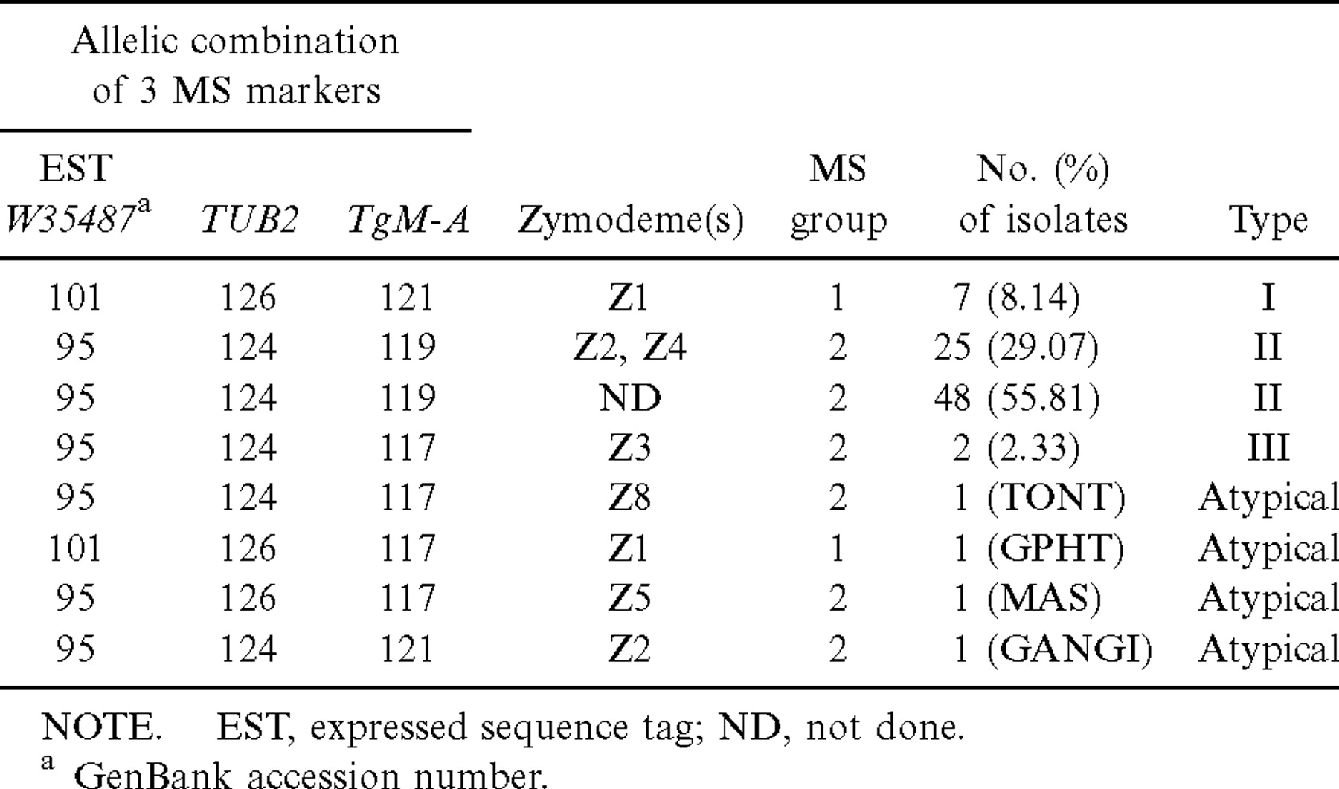
Table 3 Allelic combinations of 3 less-polymorphic microsatellite (MS) markers associated with isoenzyme markers, and ...
Notes:
Table 3 Allelic combinations of 3 less-polymorphic microsatellite (MS) markers associated with isoenzyme markers, and correspondence with types I, II, III, and atypical types, for a population of 86 isolates from human congenital toxoplasmoses
Unless provided in the caption above, the following copyright applies to the content of this slide: © 2002 by the Infectious Diseases Society of America

Slide 2
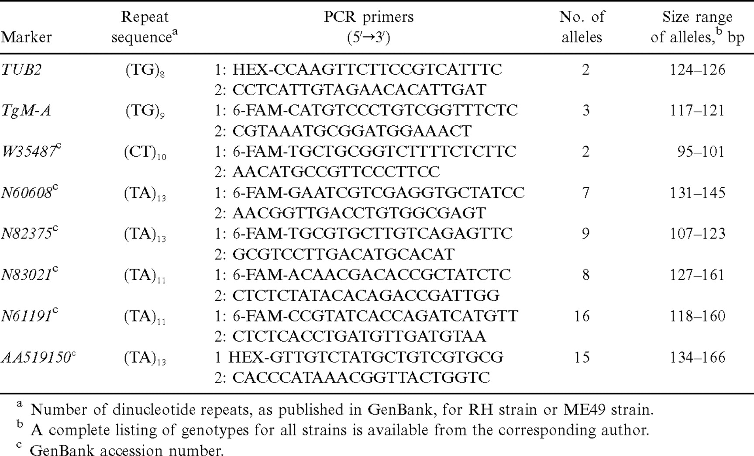
Table 2 Microsatellite markers, polymerase chain reaction (PCR) primers, and allelic polymorphism in 86 isolates ...
Notes:
Table 2 Microsatellite markers, polymerase chain reaction (PCR) primers, and allelic polymorphism in 86 isolates originating from human congenital toxoplasmosis
Unless provided in the caption above, the following copyright applies to the content of this slide: © 2002 by the Infectious Diseases Society of America

Slide 3
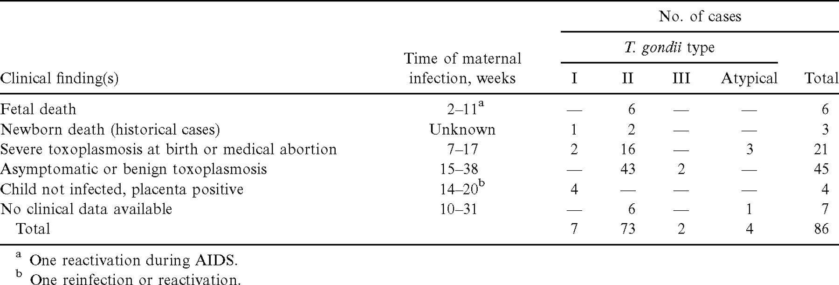
Table 1 Clinical characteristics of patients with Toxoplasma gondii infection, and relationships with the main ...
Notes:
Table 1 Clinical characteristics of patients with Toxoplasma gondii infection, and relationships with the main genotypes of T. gondii
Unless provided in the caption above, the following copyright applies to the content of this slide: © 2002 by the Infectious Diseases Society of America

