Slide 1
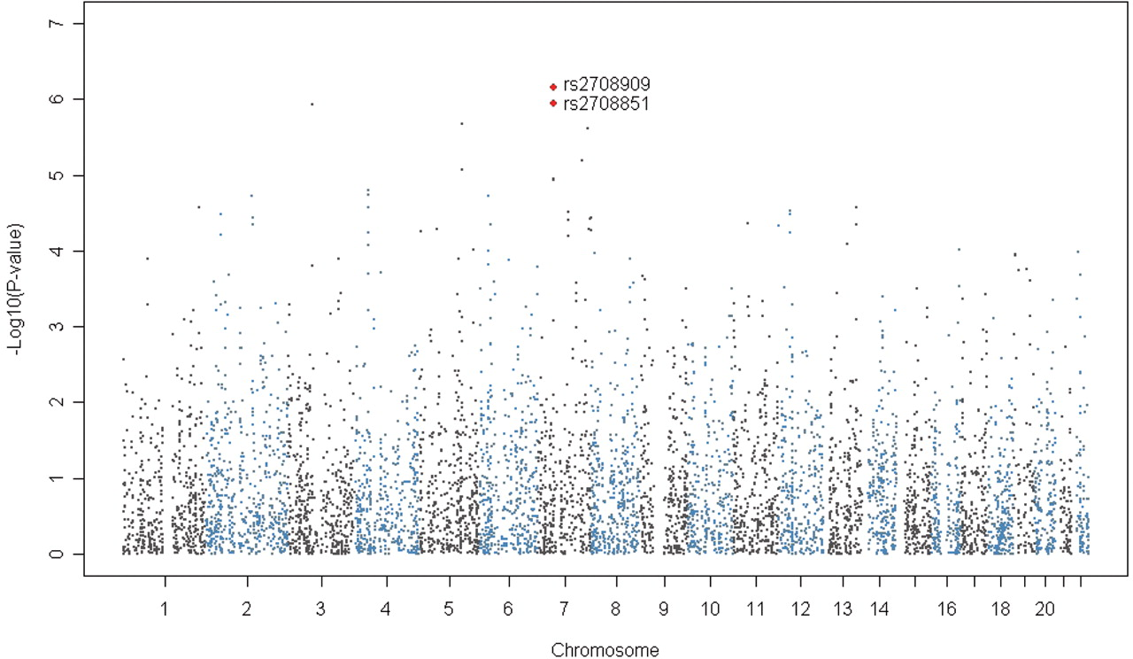
Figure 1. Association analysis of combined joints analysis in two-stage GWAS of ALS (n = 2289 ALS cases and 4532 ...
Notes:
Figure 1. Association analysis of combined joints analysis in two-stage GWAS of ALS (n = 2289 ALS cases and 4532 controls) based on the logistic regression model correcting for age, gender and population. SNPs listed in Table 1 are represented by red dots.
Unless provided in the caption above, the following copyright applies to the content of this slide: © The Author 2009. Published by Oxford University Press. All rights reserved. For Permissions, please email: journals.permissions@oxfordjournals.org

Slide 2
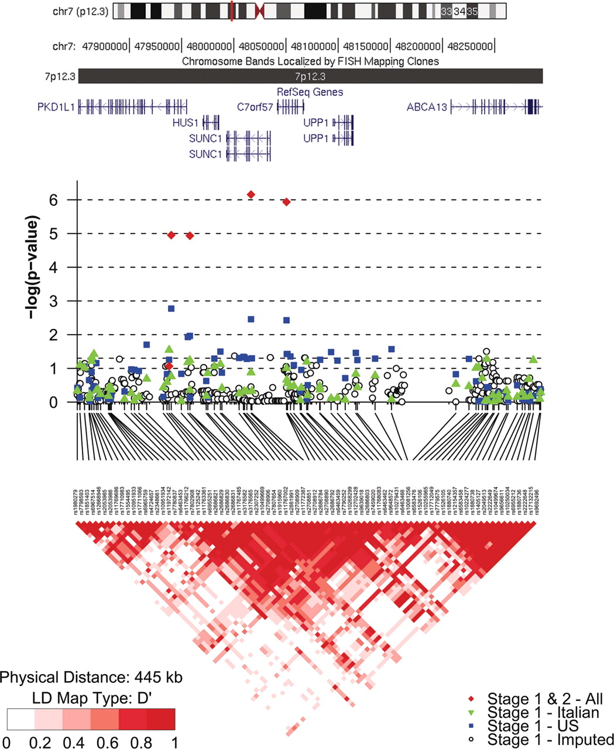
Figure 2. Location of the association signal and pairwise linkage disequilibrium (LD) surrounding the most associated ...
Notes:
Figure 2. Location of the association signal and pairwise linkage disequilibrium (LD) surrounding the most associated SNPs on chromosome 7p12.3. LD pattern is depicted using stage 1 US data. Association signals are shown for all SNPs genotyped in (A) stage 1 US samples (blue squares, n = 1065); (B) stage 1 Italian samples (green triangles, n = 1456); (C) stage 2 all populations (orange circles, n = 4300), and the combined dataset (red diamonds, n = 6821). The most associated SNPs, rs2708909 and rs2708851, lie in or near gene SUNC1, and are in almost complete LD (D′ = 0.981, r2 = 0.959 based on stage 1 US data). Plots were produced using the snp.plotter package within R version 2.6.1.
Unless provided in the caption above, the following copyright applies to the content of this slide: © The Author 2009. Published by Oxford University Press. All rights reserved. For Permissions, please email: journals.permissions@oxfordjournals.org

Slide 3
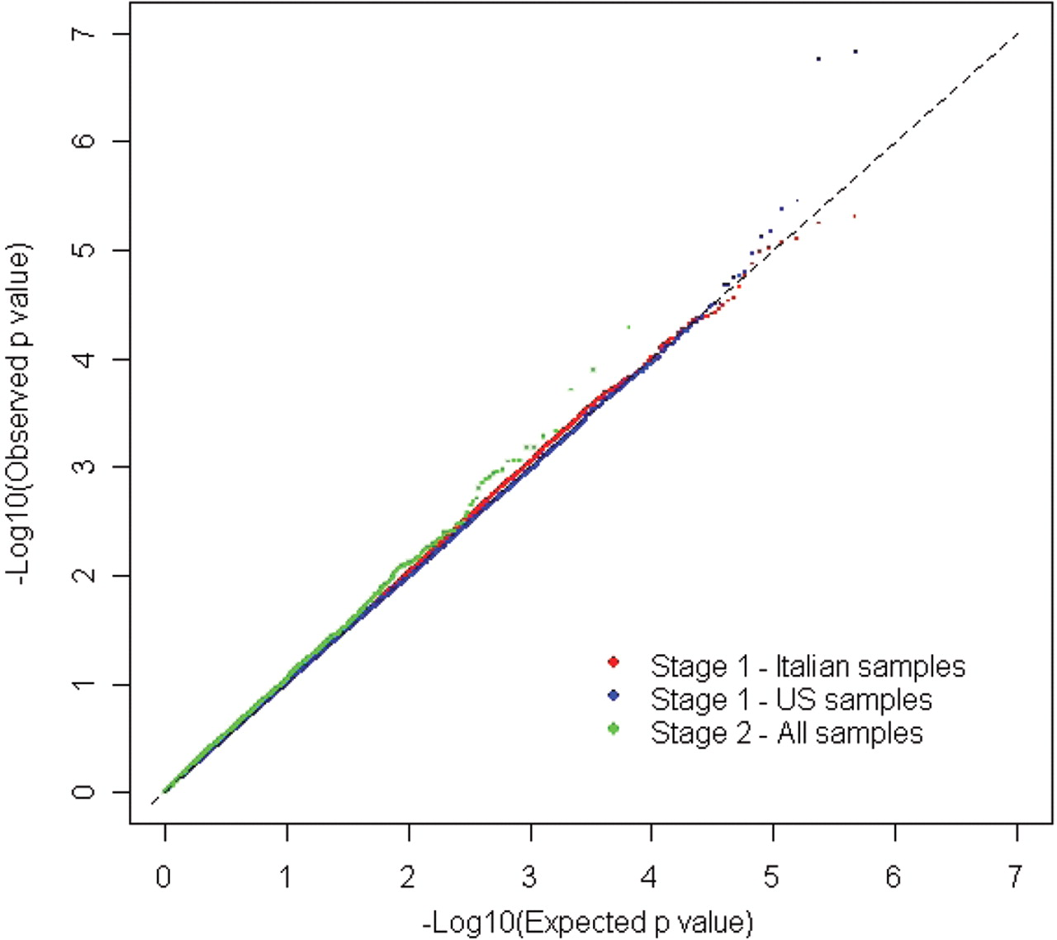
Figure 3. Q-Q plot based on (A) genomic-controlled Cochran-Armitage Trend test P-values for 474 554 SNPs analyzed in ...
Notes:
Figure 3. Q-Q plot based on (A) genomic-controlled Cochran-Armitage Trend test P-values for 474 554 SNPs analyzed in the stage 1 271 North American ALS cases and 794 North American controls (genomic inflation factor λ = 1.002); (B) genomic-controlled Cochran-Armitage Trend test P-values for 466 131 SNPs analyzed in the stage 1 266 Italian ALS cases and 1190 Italian controls (genomic inflation factor λ = 1.147) and (C) logistic regression P-values for 6758 SNPs analyzed in the stage 2 1752 ALS cases and 2548 controls.
Unless provided in the caption above, the following copyright applies to the content of this slide: © The Author 2009. Published by Oxford University Press. All rights reserved. For Permissions, please email: journals.permissions@oxfordjournals.org

