Slide 1
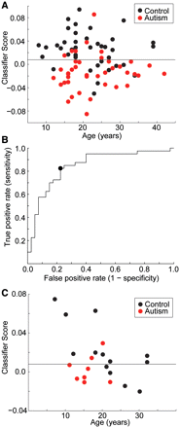
Figure 1 Accuracy of the leave-one-out classifier in the training dataset and replication in an independent sample of ...
Notes:
Figure 1 Accuracy of the leave-one-out classifier in the training dataset and replication in an independent sample of families. (A) Scatter plot showing classification scores for leave-one-out classifier in the training dataset for connections selected by P < 0.001. (B) Receiver operating characteristic (ROC) curve showing the optimal compromise between the true positive rate and false positive rate that was the basis for the discriminant threshold. (C) Scatter plot showing classification in the replication sample.
Unless provided in the caption above, the following copyright applies to the content of this slide: © The Author (2011). Published by Oxford University Press on behalf of the Guarantors of Brain. All rights reserved. For Permissions, please email: journals.permissions@oup.com

Slide 2
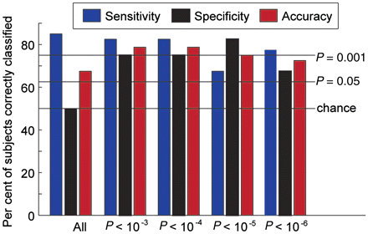
Figure 2 Dependence of classification accuracy on the subset of connections used. Sensitivity, specificity and total ...
Notes:
Figure 2 Dependence of classification accuracy on the subset of connections used. Sensitivity, specificity and total accuracy for the classifier is shown for all connections and for the subset of connections selected by a two-tailed t-test with P-values 0.001, 0.0001, 0.00 001 and 0.000 001. Horizontal lines show what per cent of subjects out of 40 would need to be classified correctly to achieve the specified P-value, and apply to sensitivity and specificity bars only.
Unless provided in the caption above, the following copyright applies to the content of this slide: © The Author (2011). Published by Oxford University Press on behalf of the Guarantors of Brain. All rights reserved. For Permissions, please email: journals.permissions@oup.com

Slide 3
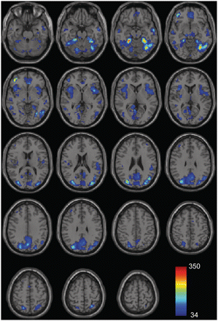
Figure 3 Brain regions most informative for classification. Shaded regions represent regions of interest ...
Notes:
Figure 3 Brain regions most informative for classification. Shaded regions represent regions of interest disproportionately represented among informative connections, with colour scale representing the number of occurrences of the region of interest among the 58 908 most informative connections. Permutation testing demonstrated that if connections were randomly selected from the regions of interest, no region would be represented >33 times in 95% of simulations.
Unless provided in the caption above, the following copyright applies to the content of this slide: © The Author (2011). Published by Oxford University Press on behalf of the Guarantors of Brain. All rights reserved. For Permissions, please email: journals.permissions@oup.com

Slide 4
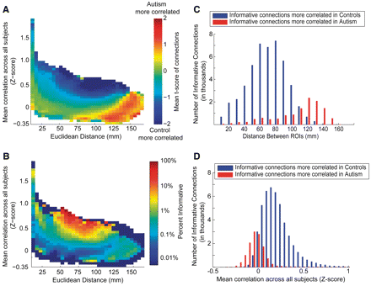
Figure 4 Connectivity differences in autism related to distance between brain regions and strength of correlation. (A) ...
Notes:
Figure 4 Connectivity differences in autism related to distance between brain regions and strength of correlation. (A) All connections were grouped into bins based on the distance in millimetre between the regions of interest (ROIs) versus the mean Fisher-transformed correlation across all 80 subjects. Within each bin, the two-tailed, two-sample t-score comparing autism and control subjects was averaged across the connections in the bin. Negative correlations were higher in subjects with autism (less anticorrelated), particularly between more distant regions. Strong positive correlations between brain regions were higher in control subjects. (B) Per cent of connections within each bin that were among the 58 908 most informative. (C) Distribution of informative connections with a positive versus negative t-score as a function of mean Fisher-transformed correlation across all subjects. (D) Distribution of informative connections with a positive versus negative t-score as a function of Euclidean distance.
Unless provided in the caption above, the following copyright applies to the content of this slide: © The Author (2011). Published by Oxford University Press on behalf of the Guarantors of Brain. All rights reserved. For Permissions, please email: journals.permissions@oup.com

Slide 5
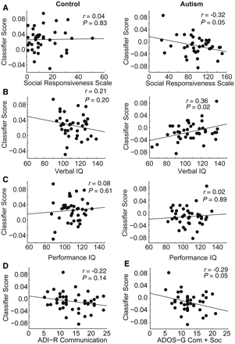
Figure 5 Relationship between functional connectivity classification score and clinical covariates. Scatter plots and ...
Notes:
Figure 5 Relationship between functional connectivity classification score and clinical covariates. Scatter plots and best linear fit are shown for functional connectivity MRI classification score as a function of (A) Social Responsiveness Scale, (B) verbal IQ, (C) performance IQ, (D) ADI-R, (E) ADOS-G (social + communication) in autism and control samples. Significant relationships are annotated by correlation values and P-values above the plots.
Unless provided in the caption above, the following copyright applies to the content of this slide: © The Author (2011). Published by Oxford University Press on behalf of the Guarantors of Brain. All rights reserved. For Permissions, please email: journals.permissions@oup.com

