Slide 1
Figure 1. Biotinylated-MAR^{ab} or MTD^{ab} were injected into the cerebral ventricles of E14 embryonic ...
Notes:
Figure 1. Biotinylated-MARab or MTDab were injected into the cerebral ventricles of E14 embryonic mice. (A,B) Coronal sections run in parallel for biotin amplification showed biotin-MARab-labeled cells in the VZ and SVZ (A), whereas biotin-MTDab did not label cells (B). Note: erythrocytes produced nonspecific labeling in MARab and MTDab. (C–G) RG neural stem cells were positive for biotin-MARab. Arrowheads indicate RG pial fibers; arrows indicate RG ventricular process. (H,I) biotin-MARab+ cells (green) co-localized with the RG cell marker vimentin (red). Scale bars: (A,B) 100 µm; (C–H) 10 µm.
Unless provided in the caption above, the following copyright applies to the content of this slide: © The Author 2014. Published by Oxford University Press. All rights reserved. For Permissions, please e-mail: journals.permissions@oup.com

Slide 2
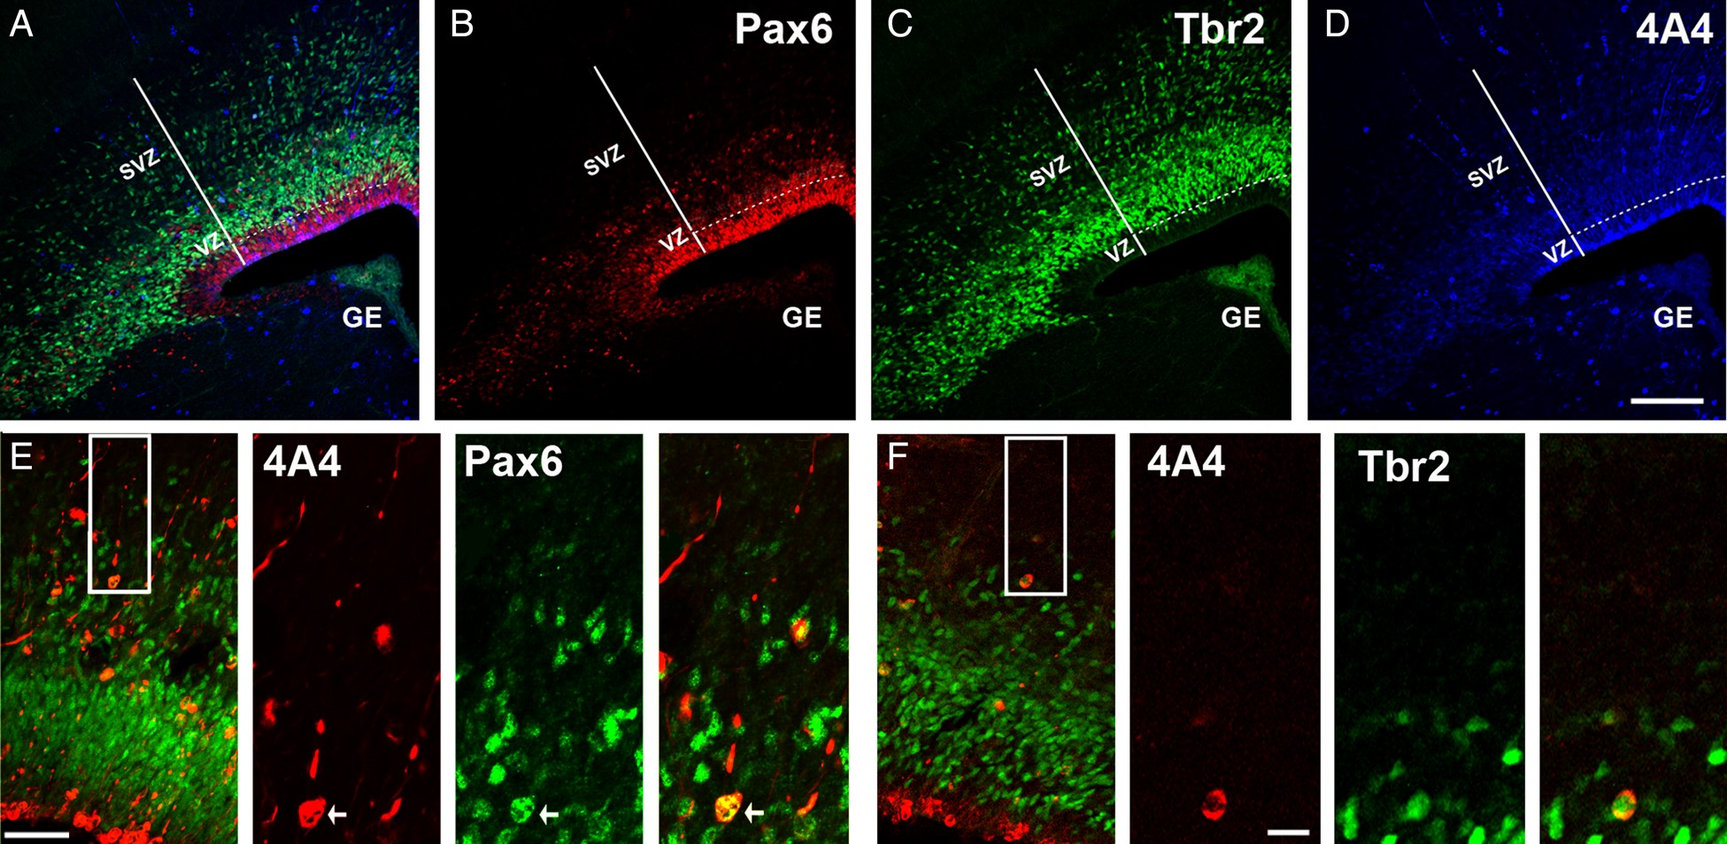
Figure 2. Analysis of precursor cell number. Maternal MAU^{ab} and MTD^{ab} IgGs were injected in utero ...
Notes:
Figure 2. Analysis of precursor cell number. Maternal MAUab and MTDab IgGs were injected in utero in E14 mice, and precursor cell number in the cerebral cortex was quantified 2 days later at E16. (A) Triple immunostaining for Pax6 (red, B), Tbr2 (green, C), and 4A4 (blue, D). (E) Proliferative precursor cell types located in the SVZ of the E16 developing cortex. Inset indicates region of higher power images to the right. Mitotic translocating RG cells were identified by expression of the mitotic cell marker 4A4 (red), presence of a pial directed fiber, and expression of Pax6 (green). (F) Proliferative precursor cell types in the E16 developing cortex. Inset indicates region of higher power images to the right. Mitotic intermediate progenitor cells were identified by expression of the mitotic cell marker 4A4 (red), and expression of Tbr2 located in the SVZ (green). Calibration bar: (A–D) 250 µm; (E,F) 100 µm and 25 µm, respectively.
Unless provided in the caption above, the following copyright applies to the content of this slide: © The Author 2014. Published by Oxford University Press. All rights reserved. For Permissions, please e-mail: journals.permissions@oup.com

Slide 3
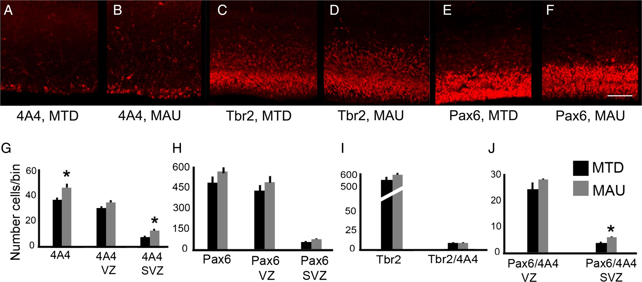
Figure 3. Prenatal exposure to MAU^{ab} increases the number of proliferative Pax6+ precursor cells in the SVZ. ...
Notes:
Figure 3. Prenatal exposure to MAUab increases the number of proliferative Pax6+ precursor cells in the SVZ. Maternal MAUab and MTDab IgGs were injected in utero in E14 mice, and precursor cell number in the cerebral cortex was quantified 2 days later at E16. (A,B,G) MAUab treatment increased the number of 4A4+ mitotic precursor cells in the SVZ (P = 0.02), but not in the VZ of the developing neocortex. (C–F, H,I) The total number of Tbr2+ and Pax6+ precursor cells did not differ in mice exposed to MAUab compared with mice exposed to MTDab. (J) The number of mitotic Tbr2+ precursor cells (Tbr2+/4A4+) was not differentness in mice exposed to MAUab versus MTDab. However, the number of mitotic Pax6+ precursor cells (Pax6+/4A4+) was significantly increased in the SVZ (P = 0.01), but not in the VZ of the developing neocortex of mice exposed to MAUab versus MTDab. Calibration bar: 50 µm.
Unless provided in the caption above, the following copyright applies to the content of this slide: © The Author 2014. Published by Oxford University Press. All rights reserved. For Permissions, please e-mail: journals.permissions@oup.com

Slide 4
Figure 4. MAU^{ab} treatment significantly increased the number of mitotic precursor cells in the SVZ of the ...
Notes:
Figure 4. MAUab treatment significantly increased the number of mitotic precursor cells in the SVZ of the ganglionic eminence. (A,B) E16 murine ganglionic eminence (GE) 2 days after injection with either MAUab and MTDab IgGs at E14. (C) The number of 4A4+ mitotic precursor cells was significantly increased in the SVZ (P = 0.03), but not in the VZ of the developing GE after exposure to MAUab compared with MTDab exposure. Calibration bar: 100 µm.
Unless provided in the caption above, the following copyright applies to the content of this slide: © The Author 2014. Published by Oxford University Press. All rights reserved. For Permissions, please e-mail: journals.permissions@oup.com

Slide 5
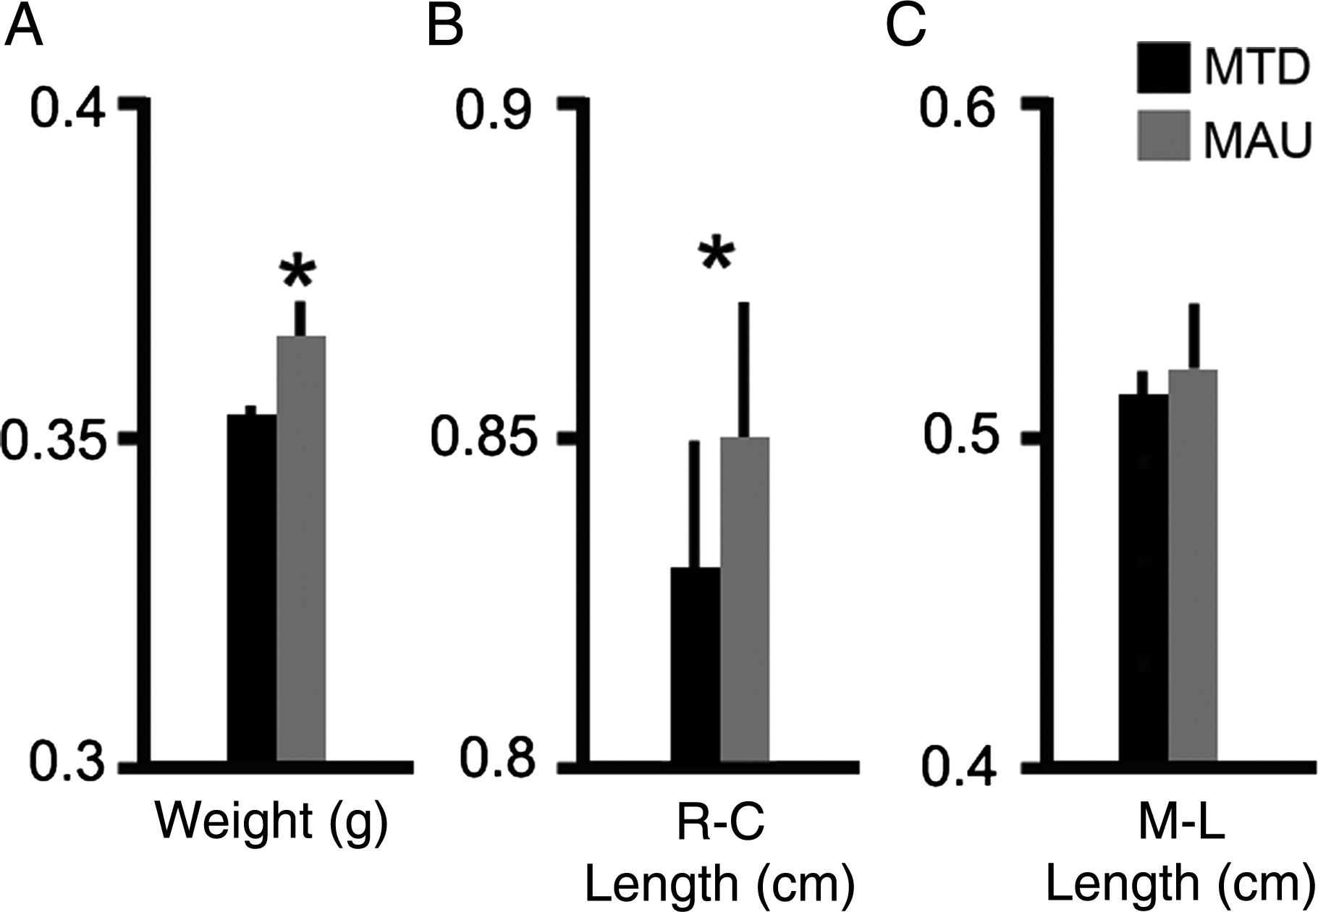
Figure 5. Prenatal MAU^{ab} exposure increased brain size and weight. (A) Brains of adult animals prenatally ...
Notes:
Figure 5. Prenatal MAUab exposure increased brain size and weight. (A) Brains of adult animals prenatally exposed to MAUab weighed more than those exposed to MTDab (MAUab: 365.26 ± 5.06 mg; MTDab: 352.73 ± 2.41 mg; P = 0.002). (B,C) Rostro-caudal length (R-C) was increased in brains from animals exposed to MAUab compared with those exposed to MTDab. Medio-lateral length (M-L) was increased but the difference was not a significant.
Unless provided in the caption above, the following copyright applies to the content of this slide: © The Author 2014. Published by Oxford University Press. All rights reserved. For Permissions, please e-mail: journals.permissions@oup.com

Slide 6
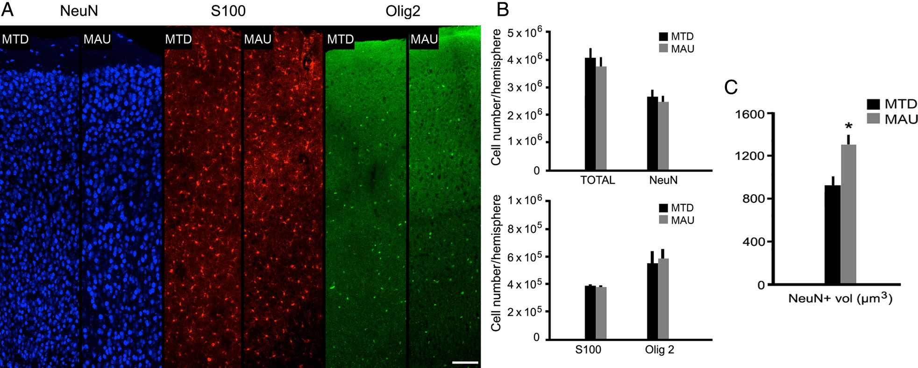
Figure 6. Stereological analysis of cortical cell number and somal size in the adult cerebral cortex of animals that ...
Notes:
Figure 6. Stereological analysis of cortical cell number and somal size in the adult cerebral cortex of animals that were prenatally exposed to MAUab or MTDab at E14. (A,B) The number of Neu+ cells (neurons), S100+ cells (astrocytes), and Olig2+ cells (oligodendrocytes) did not differ between MAUab and MTDab mice. (C) However, the size of the NeuN+ cells was increased in the MAUab-exposed animals compared with those exposed to MTDab (P = 0.01). Calibration bar: (A–D). 100 µm.
Unless provided in the caption above, the following copyright applies to the content of this slide: © The Author 2014. Published by Oxford University Press. All rights reserved. For Permissions, please e-mail: journals.permissions@oup.com

Slide 7
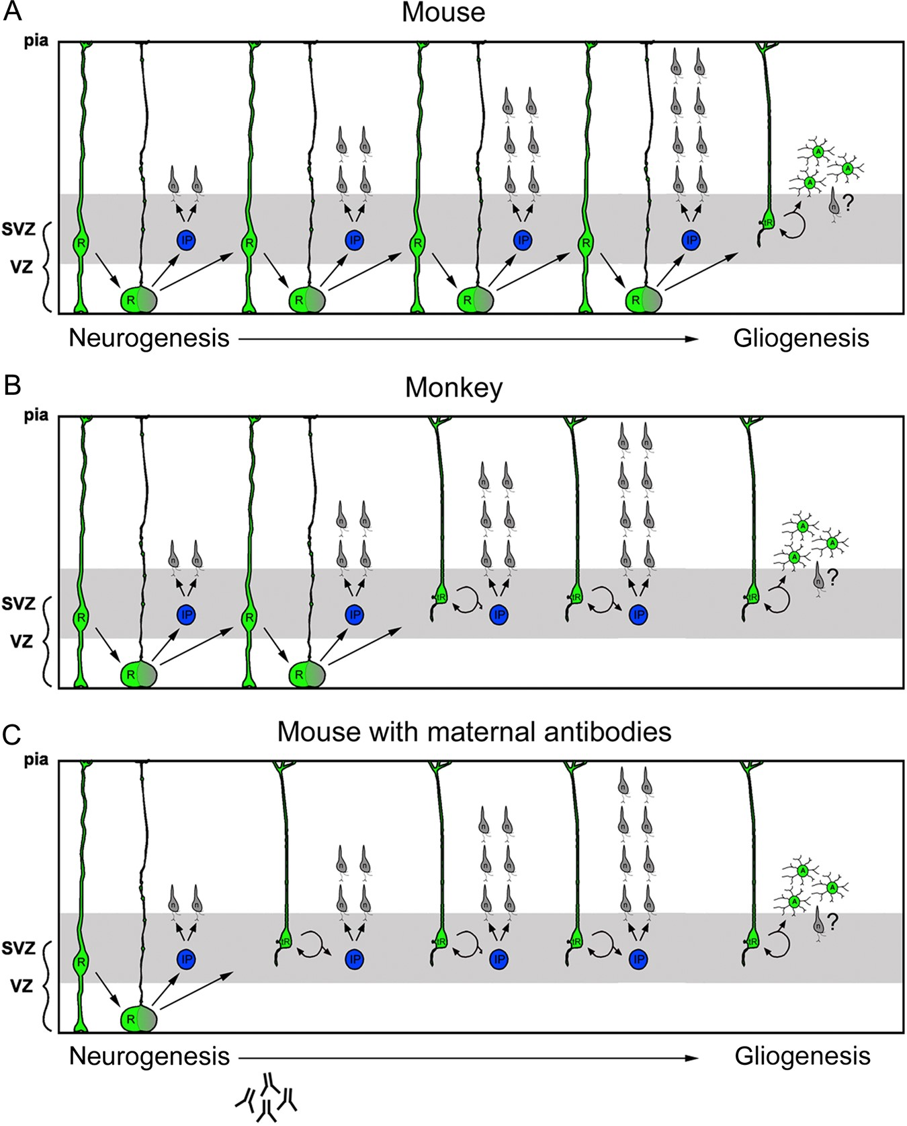
Figure 7. Scheme depicting how prenatal MAU^{ab} impacts precursor cell function during development of the ...
Notes:
Figure 7. Scheme depicting how prenatal MAUab impacts precursor cell function during development of the cerebral cortex. RG cells detach from the ventricle and translocate their soma from the VZ into the overlying SVZ. However, the stage of development at which RG cells translocate into the SVZ is tightly regulated and varies by species. (A) In mouse, Pax6+ RG cells begin translocating from the VZ during later stages of neurogenesis. (B) In macaque, RG cells begin translocating into the SVZ soon after the start of neurogenesis. (C) In the prenatal mouse neocortex that has been exposed to MAUab, RG cells precociously detach from the ventricle and translocate away from the VZ into the SVZ much earlier than normal. Prenatal treatment with MAUab produces RG translocation in the mouse at nearly the same stage of cortical development as occurs in the macaque, changing the normal pattern and timing of the neurogenic process.
Unless provided in the caption above, the following copyright applies to the content of this slide: © The Author 2014. Published by Oxford University Press. All rights reserved. For Permissions, please e-mail: journals.permissions@oup.com

